Slide 1
Welcome to T-level Education and Early Years
Tasks to prepare for starting in September!
Note: If you attended a taster day, you may have already completed some of these tasks.

Slide 2
About the course...
The last week of August and first week of September will be for induction and enrolment. You must be available from the end of August. Timetables will not be available until this point.
Please ensure that on your first day you bring the following:
1. Confirmation of your GCSE results – we cannot enrol you without a copy of results so this is essential.
2. A pen, paper & file.
3. Your completed Summer work.

Slide 3

If GCSE’s don’t go your way…
Don’t fret – get in touch with the college – you will be invited to a YES day where we will sit and find a course that is right for you!

Slide 4
Costs associated with the T level course
£55 one off fee to be paid at enrolement– this will pay for your textbook and three important early years documents printed in colour. This is a digital payment – not cash.
Uniform is mandatory at placement – a Chichester college sweatshirt/fleece and t-shirt with black trousers. These are approximately £13.20 per t-shirt and £19.80 per fleece. We recommend you buy two t-shirts and one fleece. We have preloved uniform in college that you can purchase for £5 per t-shirt and £10 per fleece. If you are in receipt of student finance, this can also help you with purchases.
Trip costs – we will be letting you know about our exciting trips soon! Where possible, we will ask for as little as possible towards these trips – always less than £25 (and sometimes as little as £5) to help towards costs.

Slide 5
DBS CHECK
We use an online company called Carecheck to apply for your DBS. This is faster and simpler than paper applications!
Please email your full legal name and email address to
sackmana@chichester.ac.uk
I will get your application email sent before you leave today. Look out for emails from Carecheck and complete your registration and application by the end of August. Please get in touch with me if you are struggling.
You will need to prepare 3 documents to support your application (passport, provisional driver’s licence, recent bank statement, HMRC letter, birth certificate and others).

Slide 6
References
We also require two references – these must be from a teacher or employer (volunteer is fine).
You need to contact your references and ask them to email you a reference that you forward to AMY. We require their name, how they know you and an email address please.
One of these should be from a childcare placement undertaken over the Summer (more details to follow).

Slide 7
Summer tasks
Task one:
You must complete a minimum of 2 days in a childcare placement before enrolment.
One of your references should come from this most recent experience.
You can volunteer at a nursery, childminders, holiday club or any other setting where you can complete around 4 – 6 hours a day.

Slide 8
Summer tasks
The Resource project is a mandatory piece of work for acceptance onto the course. It should be fun for you to do and you should consider it an opportunity to show off your strengths – you can present it in a format you choose ie. Poster, ppt, blog, podcast, song, mind map, leaflet and so on.
Your work must contain information about caring for under-5s under these headings:
Food and drink
Nappies and toileting
Keeping clean
Supporting imagination in children
Messy play
Books and stories, music and rhymes

Slide 9
Summary – to dos…
Contact college with GCSE results and bring these to enrolment.
Complete 2 days in a childcare placement.
Organise 2 references (including one from the above placement).
Complete a resource project in a style of your choosing – email it to Amy or bring in on day one.
Email AMY with your name and email address and complete the CARECHECK DBS application.
Prepare your documents to support your DBS application.

Slide 10
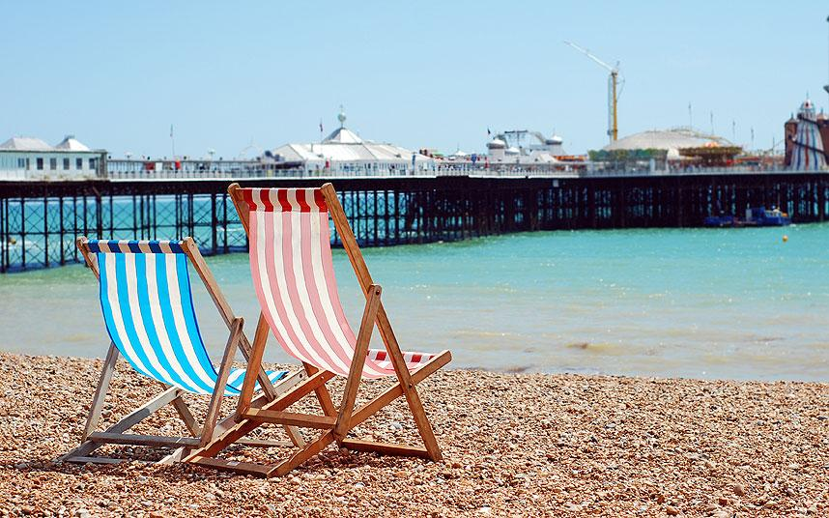
Any questions or worries?
AMY (your course lead) is on holiday with her children for much of August but will still be checking emails periodically.
Please email me and I will get back to you within a week.
sackmana@chichester.ac.uk
Have a lovely Summer and see you
very soon!

