Slide 1
WELCOME
follow
our guys
about
our mission
working with us
our identity
TO ASHCROFT CARE SERVICES
WOULD YOU LIKE TO FIND OUT MORE ABOUT US?

Slide 2
ABOUT US
follow
our identity
about
our guys
our mission
working with us
ASHCROFT IS AN AWARD WINNING SPECIALIST PROVIDER OF LEARNING DISABILITY SERVICES
We advocate passionately for people with learning disabilities. We will never accept that a disability should restrict, constrain, prevent or block. We want to see disabled people live life to the full. We encourage people to reach for the stars, to take a chance, to give it a go. We challenge assumptions and question the status quo. We never accept ‘no’ for an answer. We are Ashcroft and we encourage awesomeness!
LIFE IS FOR LIVING. NO LIMITS.

Slide 3
We
really care
No egos at Ashcroft
We
are committed
We have strong moral and ethical codes and are honest and fair at all times.
We all take responsibility and respond well when we make mistakes – we say sorry and put it right.
To the people we support, their families, and the people we work with. We give 100%.
follow
about
our guys
our identity
our mission
working with us

Slide 4
TO SUPPORT PEOPLE TO LIVE THE LIFE THEY CHOOSE
For many, this means building a happy, high quality life of real value, in which potential is fulfilled and ambitions are achieved.
We enable this by employing the best people to deliver outstanding, person-led support, focusing on the development of the skills and attributes people require to live as independently as possible.
Our approach is brave and passionate, and we work as a team with unity of purpose and total commitment.
AT ASHCROFT THERE ARE NO LIMITS.
follow
our guys
about
our mission
working with us
our identity

Slide 5
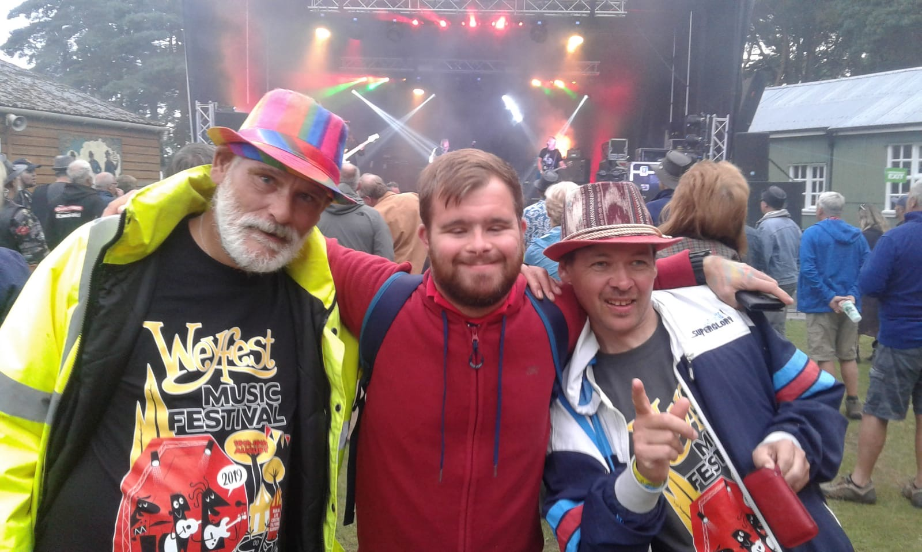
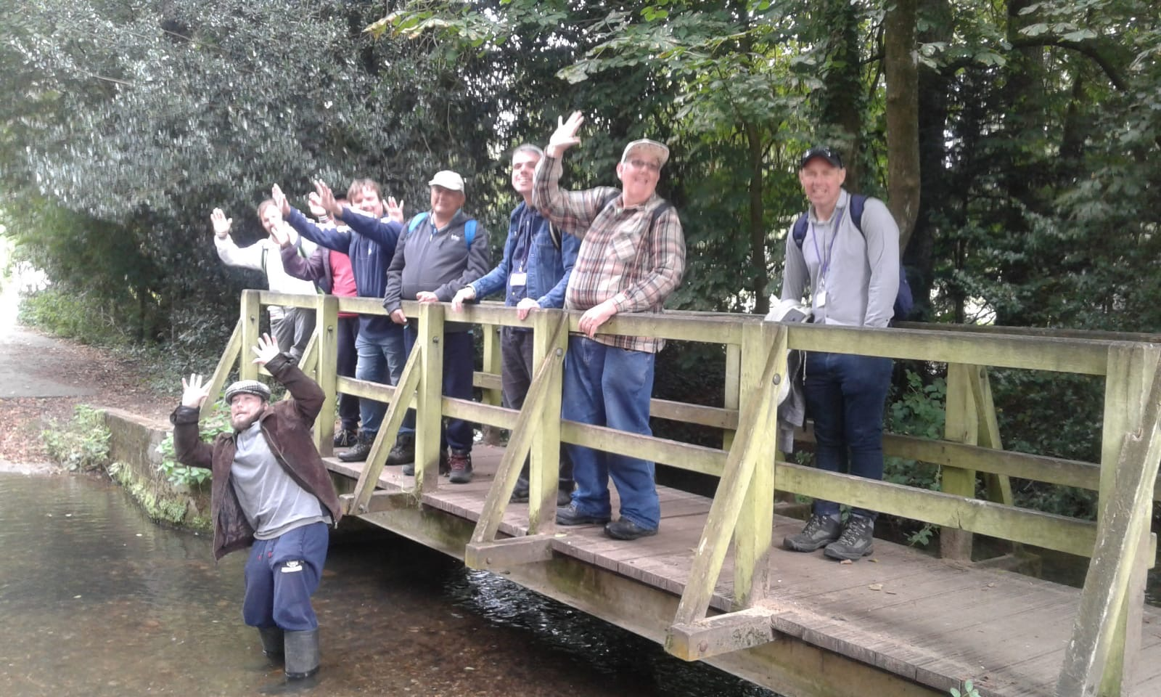
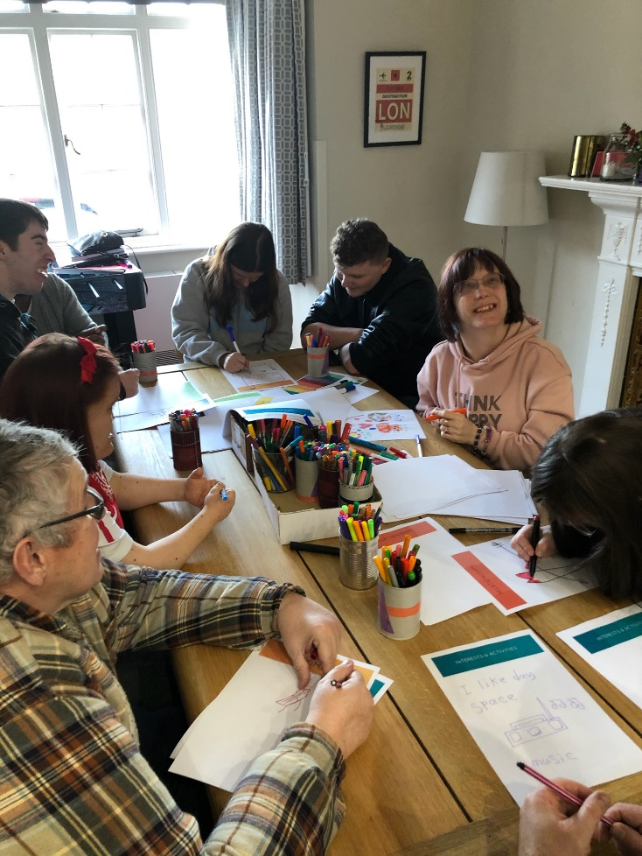
follow
our guys
about
our identity
working with us
our mission
We support 160 people in 23 different locations with various learning disabilities. Some of our guys are supported in the community and others live in small, residential homes across Surrey and Sussex. We believe in the importance of environment and our homes are maintained to high standards.

Slide 6
Working with adults with learning disabilities isn’t for everyone…..
You need to have
ethics,
empathy
energy
But if you have those things then this can be a fabulous career with:
on-the-job training
career progression
flexible working days
follow
our identity
our guys
about
our mission
working with us

Slide 7
@Ashcroftsupport
@AshcroftCare
our guys
about
our mission
working with us
our identity
www.ashcroftsupport.com
Would you like to know more about job opportunities at Ashcroft?
Call Sam on 01293 826200
or email jobs@ashcroftsupport.com

