Slide 1
Good Morning

Slide 2
Getting to know Teams
Kim Folgate
April 2020

Slide 3
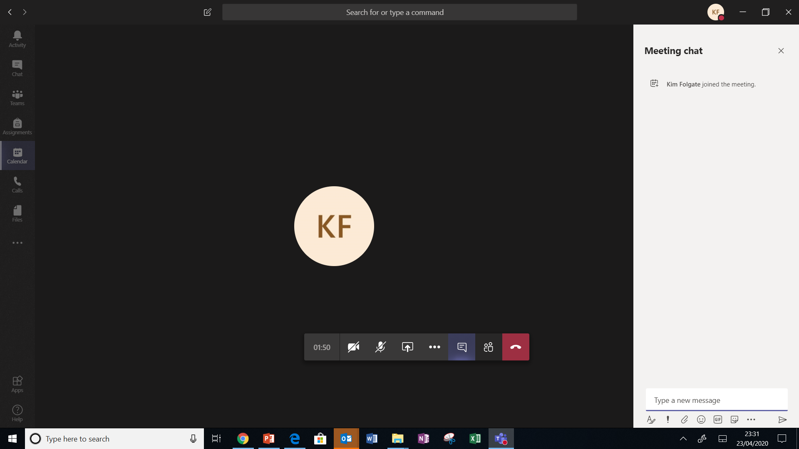
Getting to know Teams – Main control icons
… More Actions eg. Full Screen mode, blur background & meeting notes
Microphone Mute/Unmute
Chat Button
Show/Hide
Camera
On/Off
Show Participants
Share Button
Leave Session
Notes:
Screenshots Microsoft Teams

Slide 4
Getting to know Teams - Chat
Notes:
Screenshots Microsoft Teams

Slide 5
Getting to know Teams - Chat
Chat thread is saved in Teams so can be viewed again
Notes:
Screenshots Microsoft Teams

Slide 6
Getting to know Teams – Chat Icons
Notes:
Screenshots Microsoft Teams

Slide 7
Getting to know Teams – Chat Icons
Attach a file from OneDrive or Computer
… Messaging Extensions
(other apps)
eg. Stream, YouTube,
Praise Stickers
Emoji
Full range of FORMAT tools
Most are on/off buttons
Send
Message Delivery Options eg mark urgent
Stickers & Memes
Giphy
Animated Stickers
Notes:
Screenshots Microsoft Teams

Slide 8
Getting to know Teams - Activities
You can open in Teams /or download and open in word
I will attach activities via Chat
Notes:
Screenshots Microsoft Teams

Slide 9
Your Turn! Have a play to get to know controls

Slide 10
Before we start….
Please now mute your microphone
During the presentation type any questions, or your answers to my questions in chat
Opportunity at end of each section to ‘ask’ questions
Notes:
Icon’s Microsoft Teams

Slide 11
This session will be recorded, and be available in Teams to replay

