Slide 1
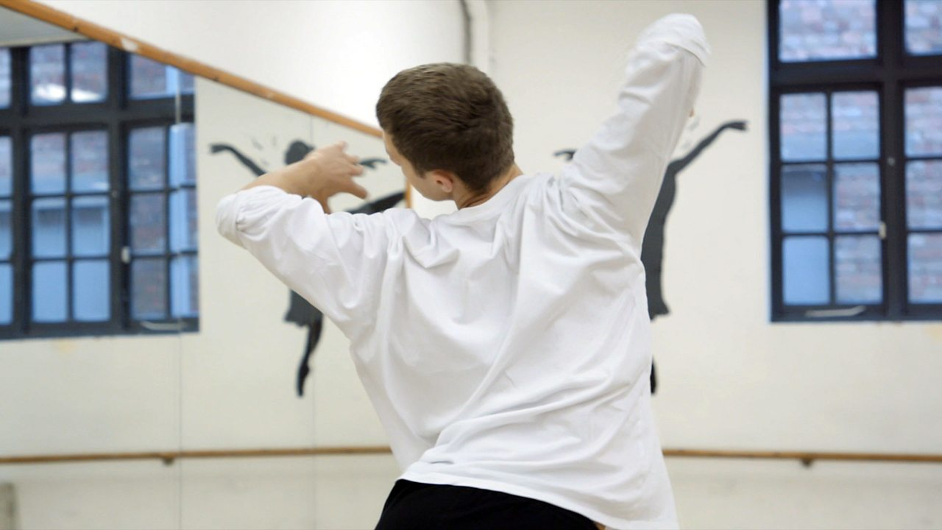
Careers in Performing Arts

Slide 2
Popular pathways
Pathway | Profile | Entry routes, skills, salary
Lighting technician
Dancer / choreographer
Actor
Sound engineer
Stage manager
Singer / songwriter

Slide 3
Considered the apprenticeship route?
Hosanna is a technical theatre apprentice at the Royal Opera House in London

Slide 4
Some jobs you might not have thought of
Drama therapist
Wardrobe technician
Arts administrator
Community arts worker
Audio engineer
Further education teacher!

Slide 5
Have you organised your work experience yet?
All year 12 students must complete a work placement
Students are expected to arrange their own placements
Larger BTECs / CamTechs will have calendared week
All other students choose timing of their placement
During the academic year; or
In Work Experience Week

Slide 6
PROGRESSION PLUS CENTRE
In the LRC on the 1st Floor
Support with
Work experience
University applications
Apprenticeships
Job applications
Interview skills
And much more

