Slide 1
Careers in Business, Finance and Economics

Slide 3
Popular pathways
Pathway | Profile | Entry routes, skills, salary
Human resources manager
Finance manager
General manager
Marketing manager
Economist (public sector)
Accountant

Slide 4
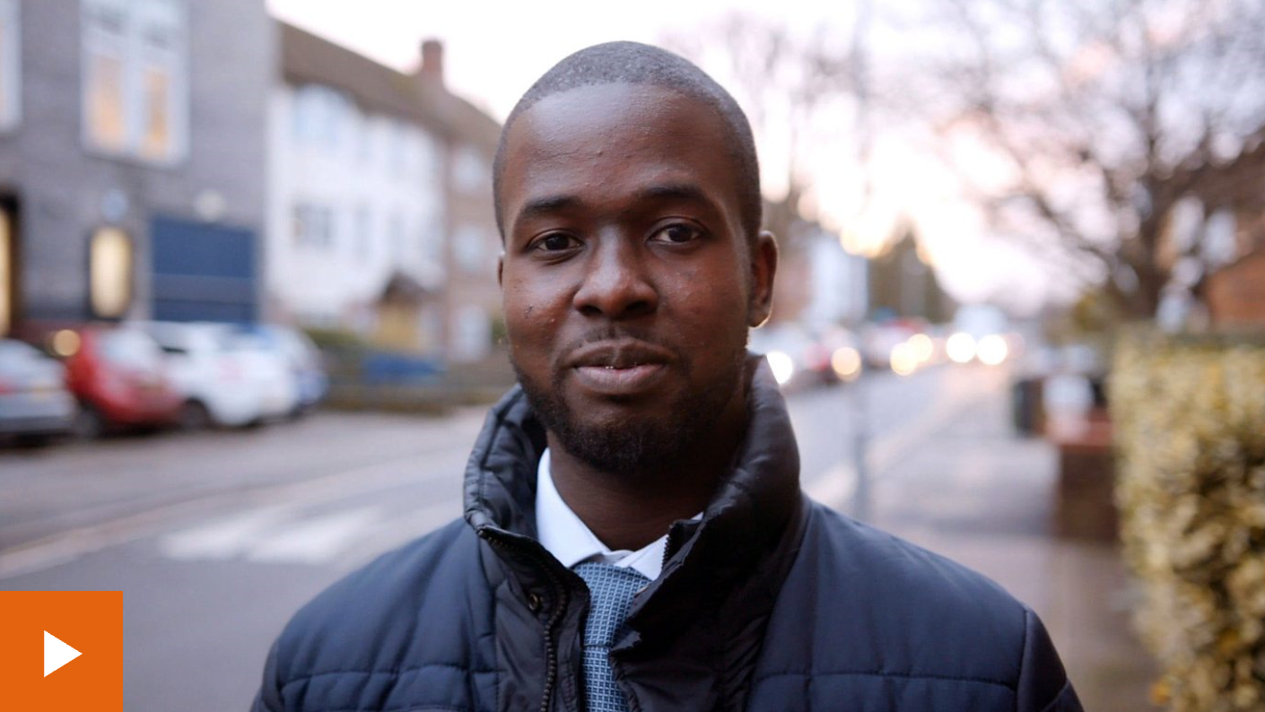
Considered the apprenticeship route?
Damilare is an apprentice accountancy technician
Omar is doing a degree apprenticeship in chartered management

Slide 5
Some jobs you may not have considered
Business analyst
Accounts assistant
Audit manager
Sales executive
Merchandiser

Slide 6
Labour Market Information
Rank these careers in order of most jobs currently advertised.
*According to National Careers Service ‘Find a job’ website
 | No. jobs advertised*
Human resources
Finance manager
General manager
Marketing manager
Accountant

Slide 7
Labour Market Information
Rank these careers in order of most jobs currently advertised.
*According to the government’s ‘Find a job’ website
 | No. jobs advertised*
Human resources | 50
Finance manager | 150
General manager | 150
Marketing manager | 95
Accountant | 405

Slide 8
PROGRESSION PLUS CENTRE
In the LRC on the 1st Floor
Support with
Work experience
University applications
Apprenticeships
Job applications
Interview skills
And much more

