Slide 1
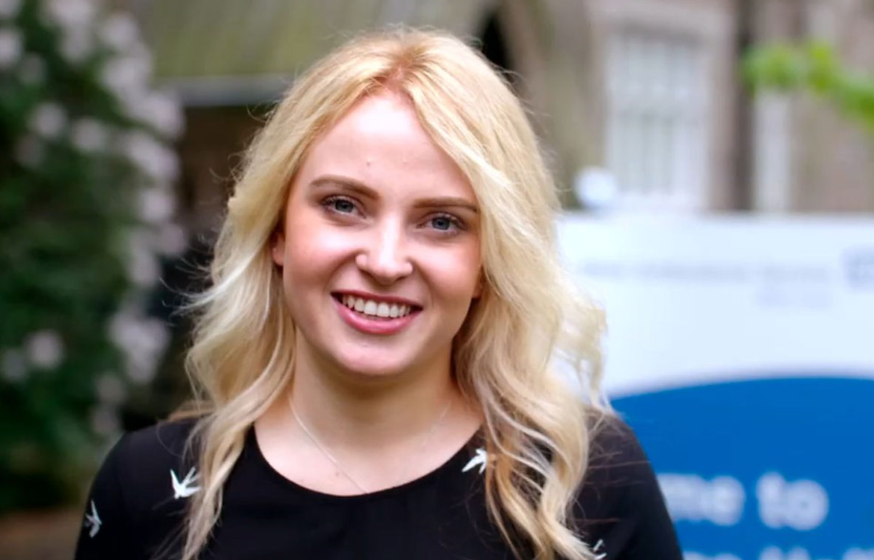
Careers related to History and Politics

Slide 4
Popular pathways
Pathway | Profile | Entry routes, skills, salary
Policy adviser
Journalist
Local government
Museum curator
Politician

Slide 5
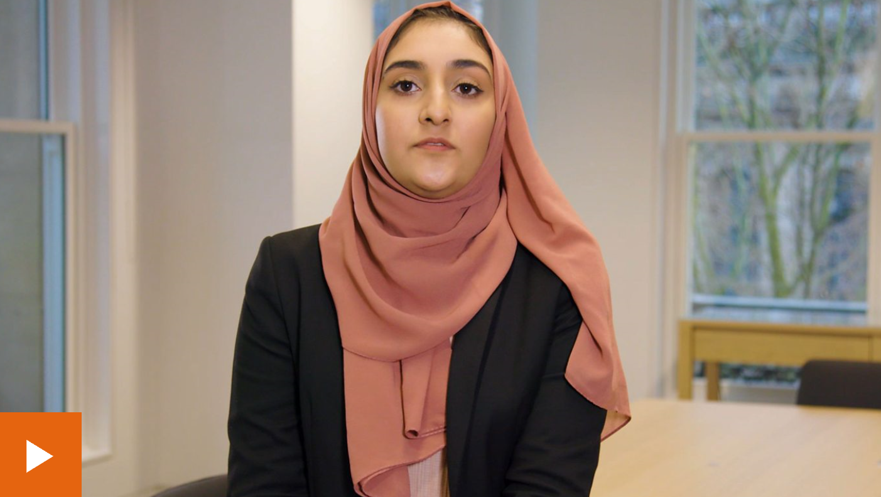
Considered the apprenticeship route?
Halimah is an apprentice paralegal

Slide 6
Some jobs you may not have considered
Press officer
Policy researcher
Solicitor
Public relations officer
Teaching

Slide 7
Labour Market Information
Rank these careers in order of most jobs currently advertised.
*According to National Careers Service ‘Find a job’ website
 | No. jobs advertised*
Journalist
Policy adviser
Solicitor
Press officer
Museum curator

Slide 8
Labour Market Information
Rank these careers in order of most jobs currently advertised.
*According to the government’s ‘Find a job’ website
 | No. jobs advertised*
Journalist | 33
Policy adviser | 17
Solicitor | 118
Press officer | 53
Museum curator | 7

Slide 9
Have you organised your work experience yet?
All year 12 students must complete a work placement
Students are expected to arrange their own placements
Larger BTECs / CamTechs will have calendared week
All other students choose timing of their placement
During the academic year; or
In Work Experience Week

Slide 10
PROGRESSION PLUS CENTRE
In the LRC on the 1st Floor
Support with
Work experience
University applications
Apprenticeships
Job applications
Interview skills
And much more

