Slide 1
Careers in Biology

Slide 3
Popular Biology pathways
Pathway | Profile | Entry routes, skills, salary
Physiotherapist
Nurse
Pharmacist
Paramedic
Marine Biologist
Research Scientist
Veterinary Nurse

Slide 4
Considered the apprenticeship route?
Georgia is a science apprentice for MedImmune. She helps develop medicines.

Slide 5
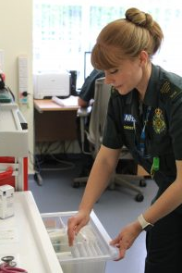
Some jobs you might not have thought of
Conservation officer
Urgent care desk paramedic
Mental health nurse
Food technologist
Microbiologist
Biomedical scientist
Radiograper

Slide 6
Labour Market Information
Rank these careers in order of most jobs currently advertised.
*According to National Careers Service ‘Find a job’ website
 | No. jobs advertised*
Physiotherapist
Nurse
Pharmacist
Paramedic
Marine Biologist
Microbiologist

Slide 7
Labour Market Information
Rank these careers in order of most jobs currently advertised.
*According to National Careers Service ‘Find a job’ website
 | No. jobs advertised*
Physiotherapist | 776
Nurse | 9543
Pharmacist | 991
Paramedic | 166
Marine Biologist | 1
Microbiologist | 20

Slide 8
Have you organised your work experience yet?
All year 12 students must complete a work placement
Students are expected to arrange their own placements
Larger BTECs / CamTechs will have calendared week
All other students choose timing of their placement
During the academic year; or
In Work Experience Week

Slide 9
PROGRESSION PLUS CENTRE
In the LRC on the 1st Floor
Support with
Work experience
University applications
Apprenticeships
Job applications
Interview skills
And much more

