Slide 1
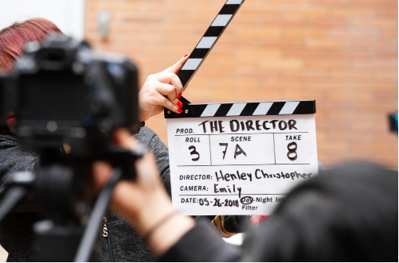
Careers in Film and Media

Slide 3
Popular film and media pathways
Pathway | Profile | Entry routes, skills, salary
Games designer
Digital content producer
Music video director
Camera operator
Journalist
Production assistant
Video editor

Slide 4
Considered the apprenticeship route?
Marissa is a photography apprentice

Slide 5
Some jobs you might not have thought of
Commissioning and development manager
Streaming manager
Stage manager
Press officer
Media planner

Slide 6
Have you organised your work experience yet?
All year 12 students must complete a work placement
Students are expected to arrange their own placements
Larger BTECs / CamTechs will have calendared week
All other students choose timing of their placement
During the academic year; or
In Work Experience Week

Slide 7
PROGRESSION PLUS CENTRE
In the LRC on the 1st Floor
Support with
Work experience
University applications
Apprenticeships
Job applications
Interview skills
And much more

