Slide 1


Careers in Engineering, Physics and Electronics

Slide 2
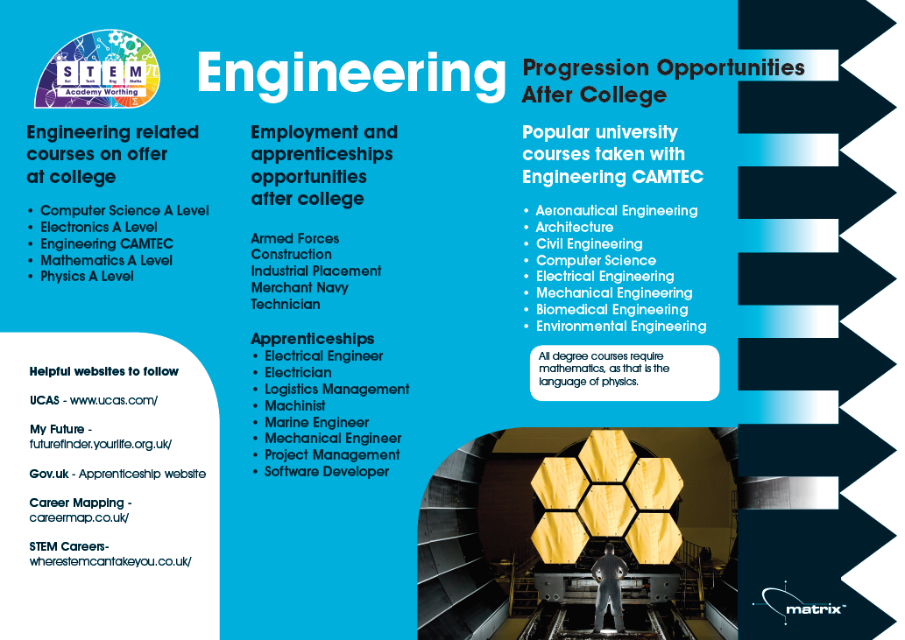

Slide 3
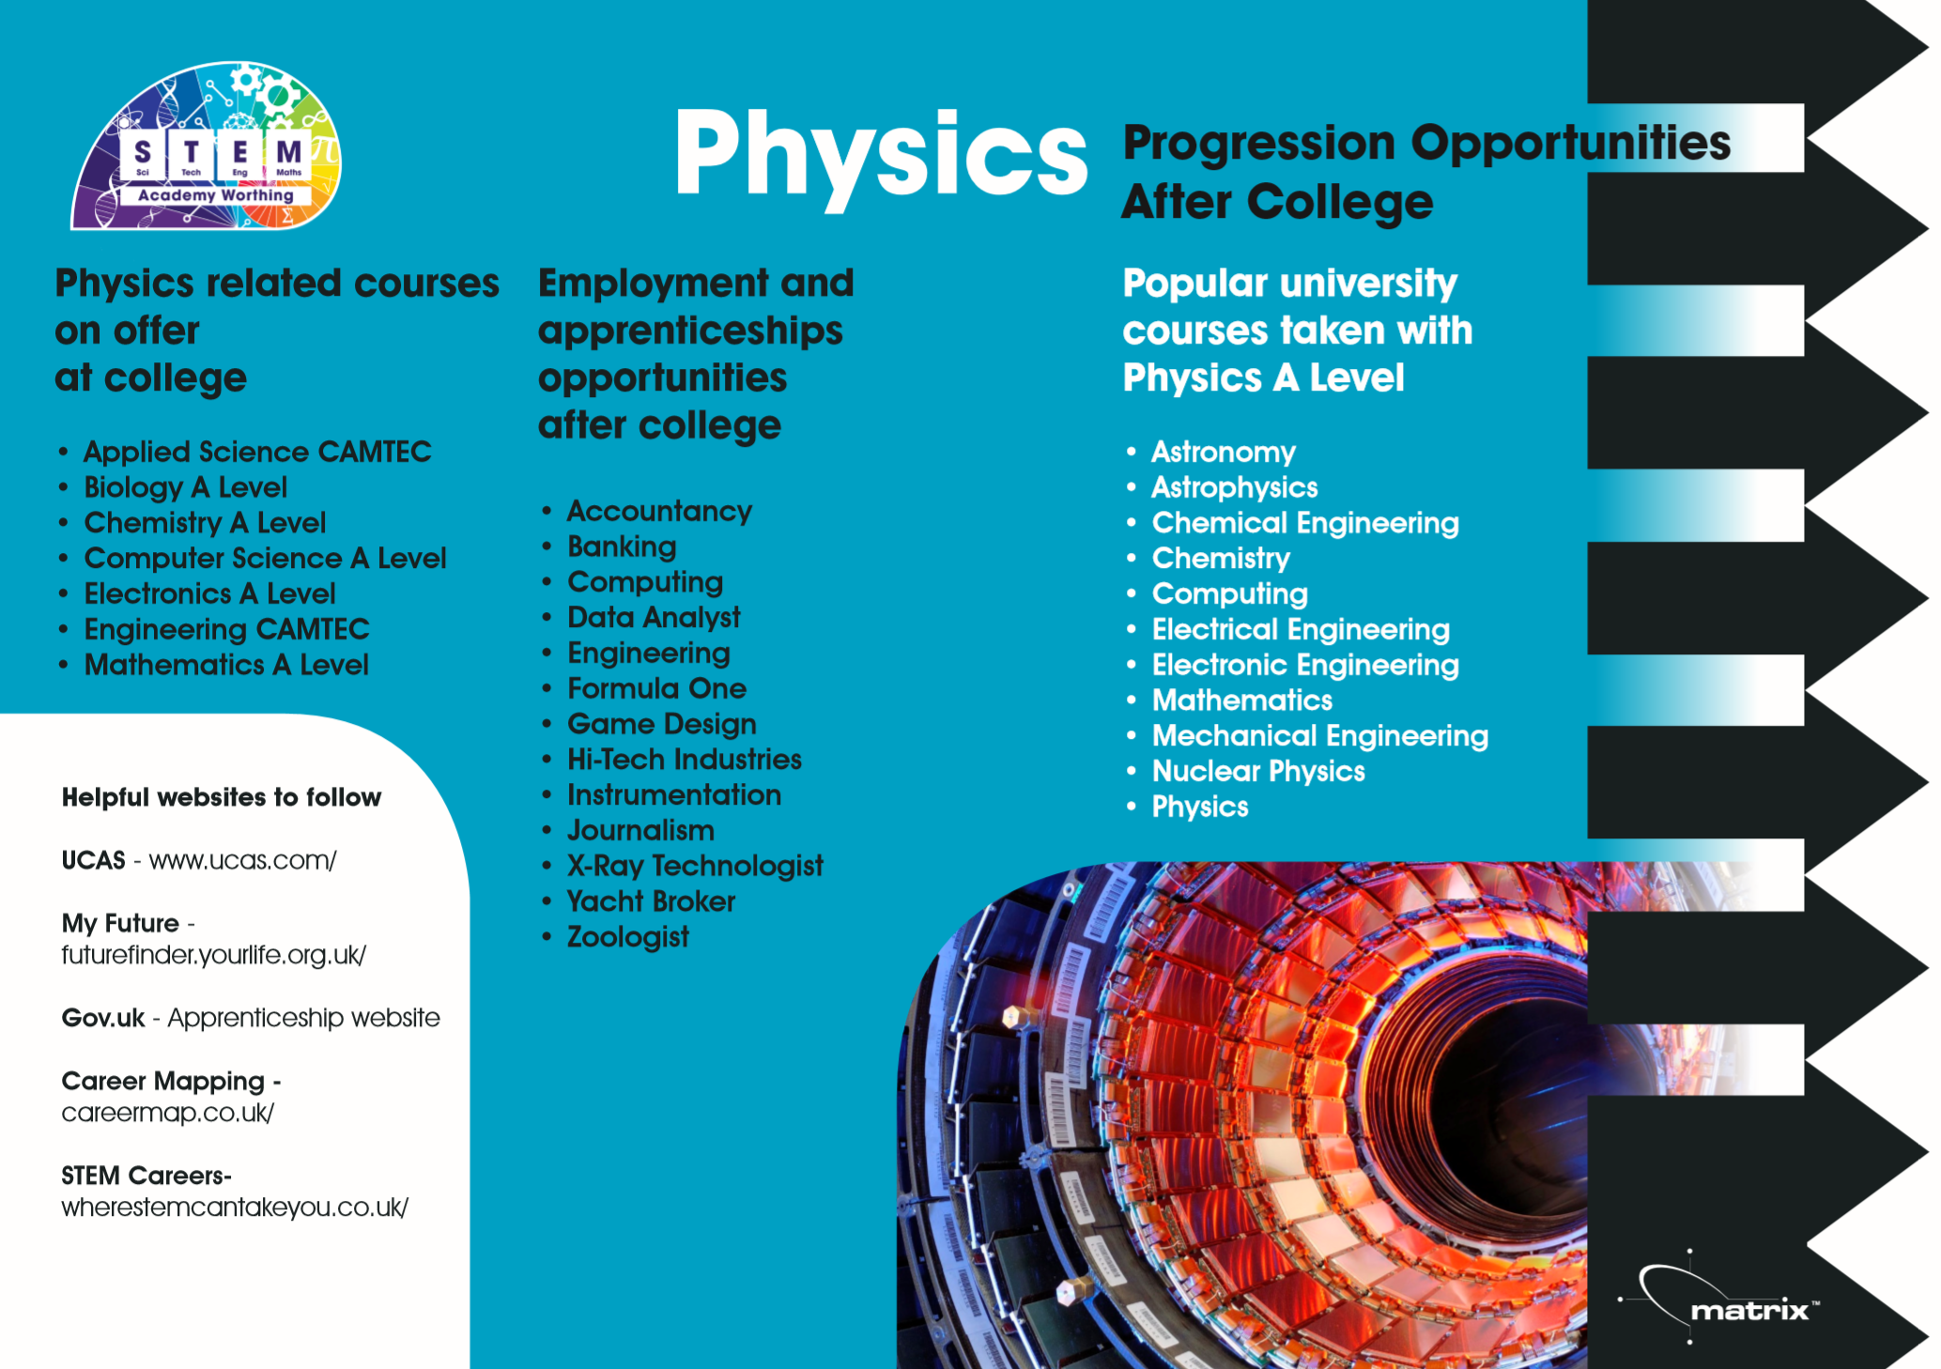

Slide 4


Popular pathways
Pathway | Profile | Entry routes, skills, salary
Construction manager
Automotive engineer
Civil engineer
Electrical engineer
Project engineer

Slide 5
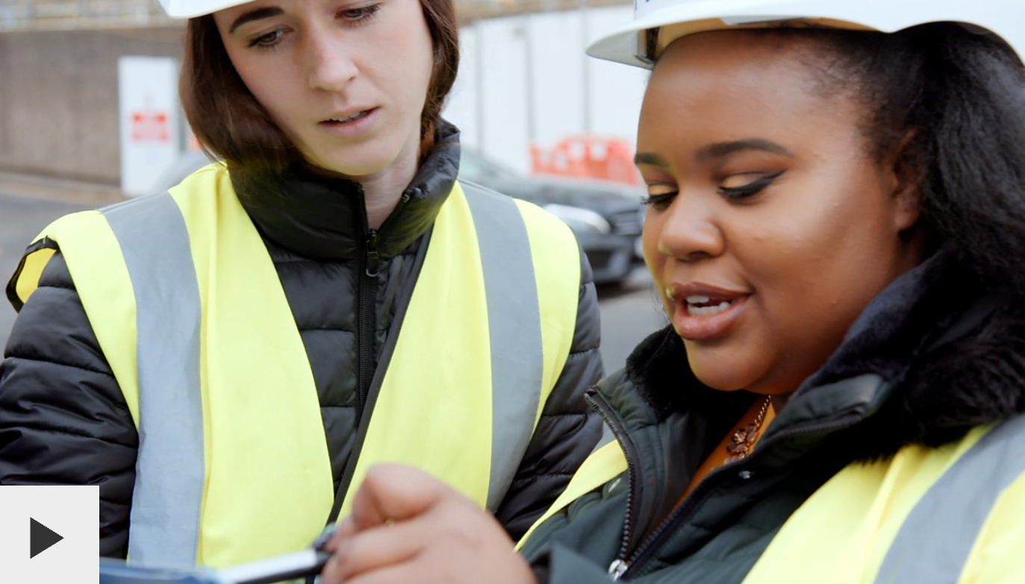
Considered the apprenticeship route?
Jasmine is an apprentice engineer on the HS2 rail link

Slide 6
Labour Market Information
Rank these careers in order of most jobs currently advertised.
*According to National Careers Service ‘Find a job’ website
 | No. jobs advertised*
Construction engineer
Automotive engineer
Civil engineer
Electrical engineer
Mechanical engineer

Slide 7
Labour Market Information
Rank these careers in order of most jobs currently advertised.
*According to National Careers Service ‘Find a job’ website
 | No. jobs advertised*
Construction engineer | 87
Automotive engineer | 68
Civil engineer | 103
Electrical engineer | 255
Mechanical engineer | 215

Slide 8
Some jobs you might not have thought of
CAD technician
Manufacturing manager
Water engineer
Nuclear medicine technologist
Air traffic controller

Slide 9

Have you organised your work experience yet?
All year 12 students must complete a work placement
Students are expected to arrange their own placements
Larger BTECs / CamTechs will have calendared week
All other students choose timing of their placement
  During the academic year; or
  In Work Experience Week

Slide 10

PROGRESSION PLUS CENTRE
In the LRC on the 1st Floor
Support with
  Work experience
  University applications
  Apprenticeships
  Job applications
  Interview skills
  And much more

