Slide 1
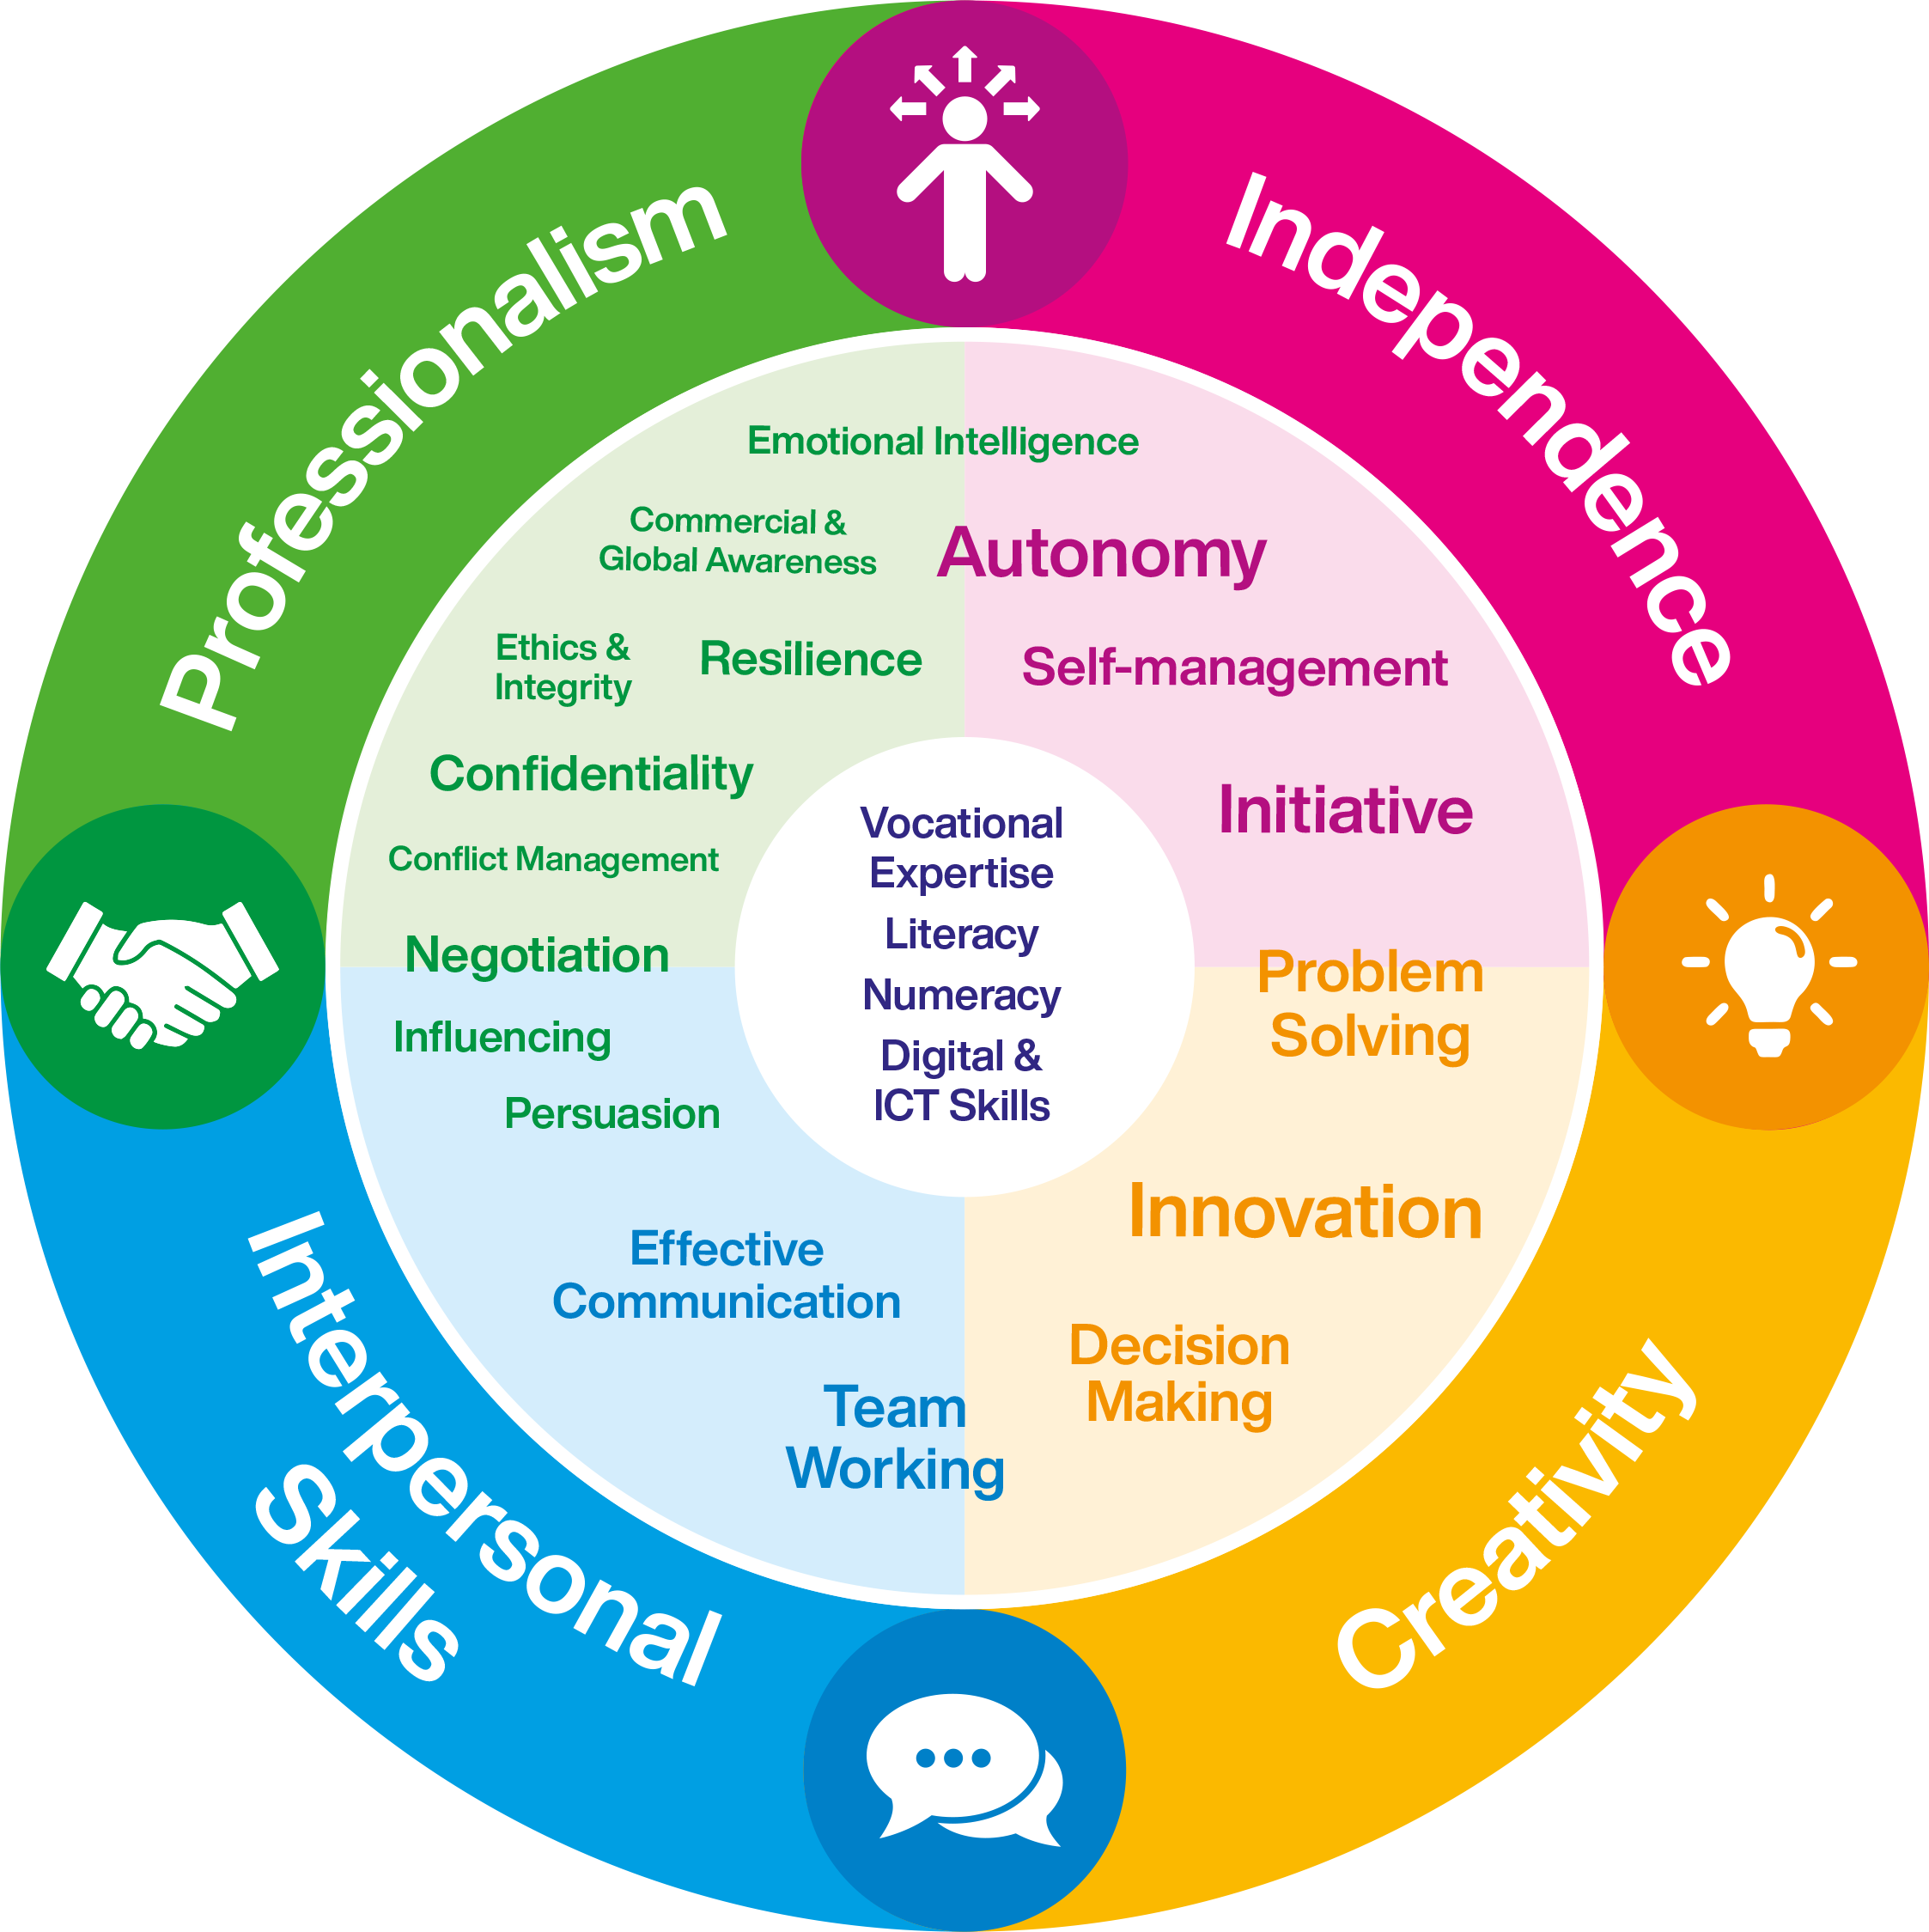
Graduate
Attributes

Slide 2
Graduate
Attributes
Notetaking Tools and techniques for effective notetaking

Slide 3
I cnduo't bvleiee taht I culod aulaclty uesdtannrd waht I was rdnaieg. Unisg the icndeblire pweor of the hmuan mnid, aocdcrnig to rseecrah at Cmabrigde Uinervtisy, it dseno't mttaer in waht oderr the lterets in a wrod are, the olny irpoamtnt tihng is taht the frsit and lsat ltteer be in the rhgit pclae. The rset can be a taotl mses and you can sitll raed it whoutit a pboerlm. Tihs is bucseae the huamn mnid deos not raed ervey ltteer by istlef, but the wrod as a wlohe. Aaznmig, huh? Yaeh and I awlyas tghhuot slelinpg was ipmorantt! See if yuor fdreins can raed tihs too.

Slide 4
Reading for assignments
Step 1 – What do you
need?
Step 2 – Assess
Take a close and critical look at your assignment. What do you need to find out?
Create a list of the kinds of sources, information, examples, ideas etc. that you will be looking for in your reading.
Do you have a reading list?
Does the title sound like what I am looking for?
Is the author a well know authority?
Does the blurb or abstract confirm that it is relevant?
Look at the list of contents. Does it cover the topic areas you need?
Look at the index. Does it make specific reference to what you need?
Notes:
Example books in class

Slide 5
Reading for assignments
Step 3 – Saturation point
You should aim to reach the saturation point, the point at which no new ideas emerge.
If you are making notes from a source for an assignment, include page numbers and basic bibliographical information. You will never regret it!!

Slide 6
Skim Reading
Look at
Title
Contents - Are your topics mentioned?
Abstract or summary (If available)
Author - Is the name recommended or familiar from other works
Index -Try looking for your keywords
Images - Diagrams, tables etc.

Slide 7
Mind Tools - Video on Speed Reading
Notes:
https://www.youtube.com/watch?v=AcYQ_71vtFQ

Slide 8
Why take notes?
Why?
Record of information
Helps understanding
Helps Memory
Helps your writing
Revision

Slide 9
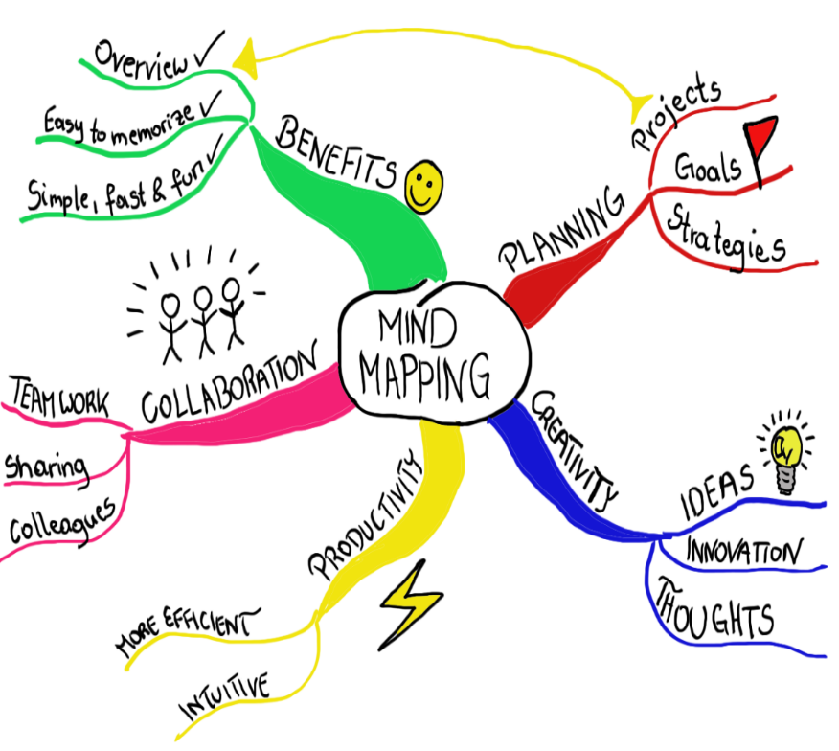
Techniques What do you do?
The Cornell Method
Outline or Linear Notes
Mind Maps
Four Quarter
Grid Notes
Write on the slide
Doodle, Sketch or Flow Charts
Matrix/Grid Method

Slide 10
Note Taking - Top tips!
Be concise:
Keep it to the point, use abbreviations when appropriate
Use bullet points rather than full sentences to act as prompts
Try to minimise irrelevant and unimportant information – to avoid confusion later!
Keep it readable
Will it be readable later today? Tomorrow? Next week?
Think about your handwriting
Space material out on the page
Be organised
Don’t copy whole paragraphs - try to paraphrase
Include references cited/suggested by your lecturers
Make sure the structure is easy to follow
Type up your notes as soon as possible

Slide 11
Summary
Critical selection of resources
Skim & speed reading
Speed increases if you are looking for particular words in the text. Make sure you know your keywords!
Read slowly and actively. Take notes, highlight, label or photocopy relevant items
Challenge the ideas – do you agree with the author?
Keep and USE your notes
Notes:
Skim/speed reading used in daily life – emails/texts/social media.

