Slide 1
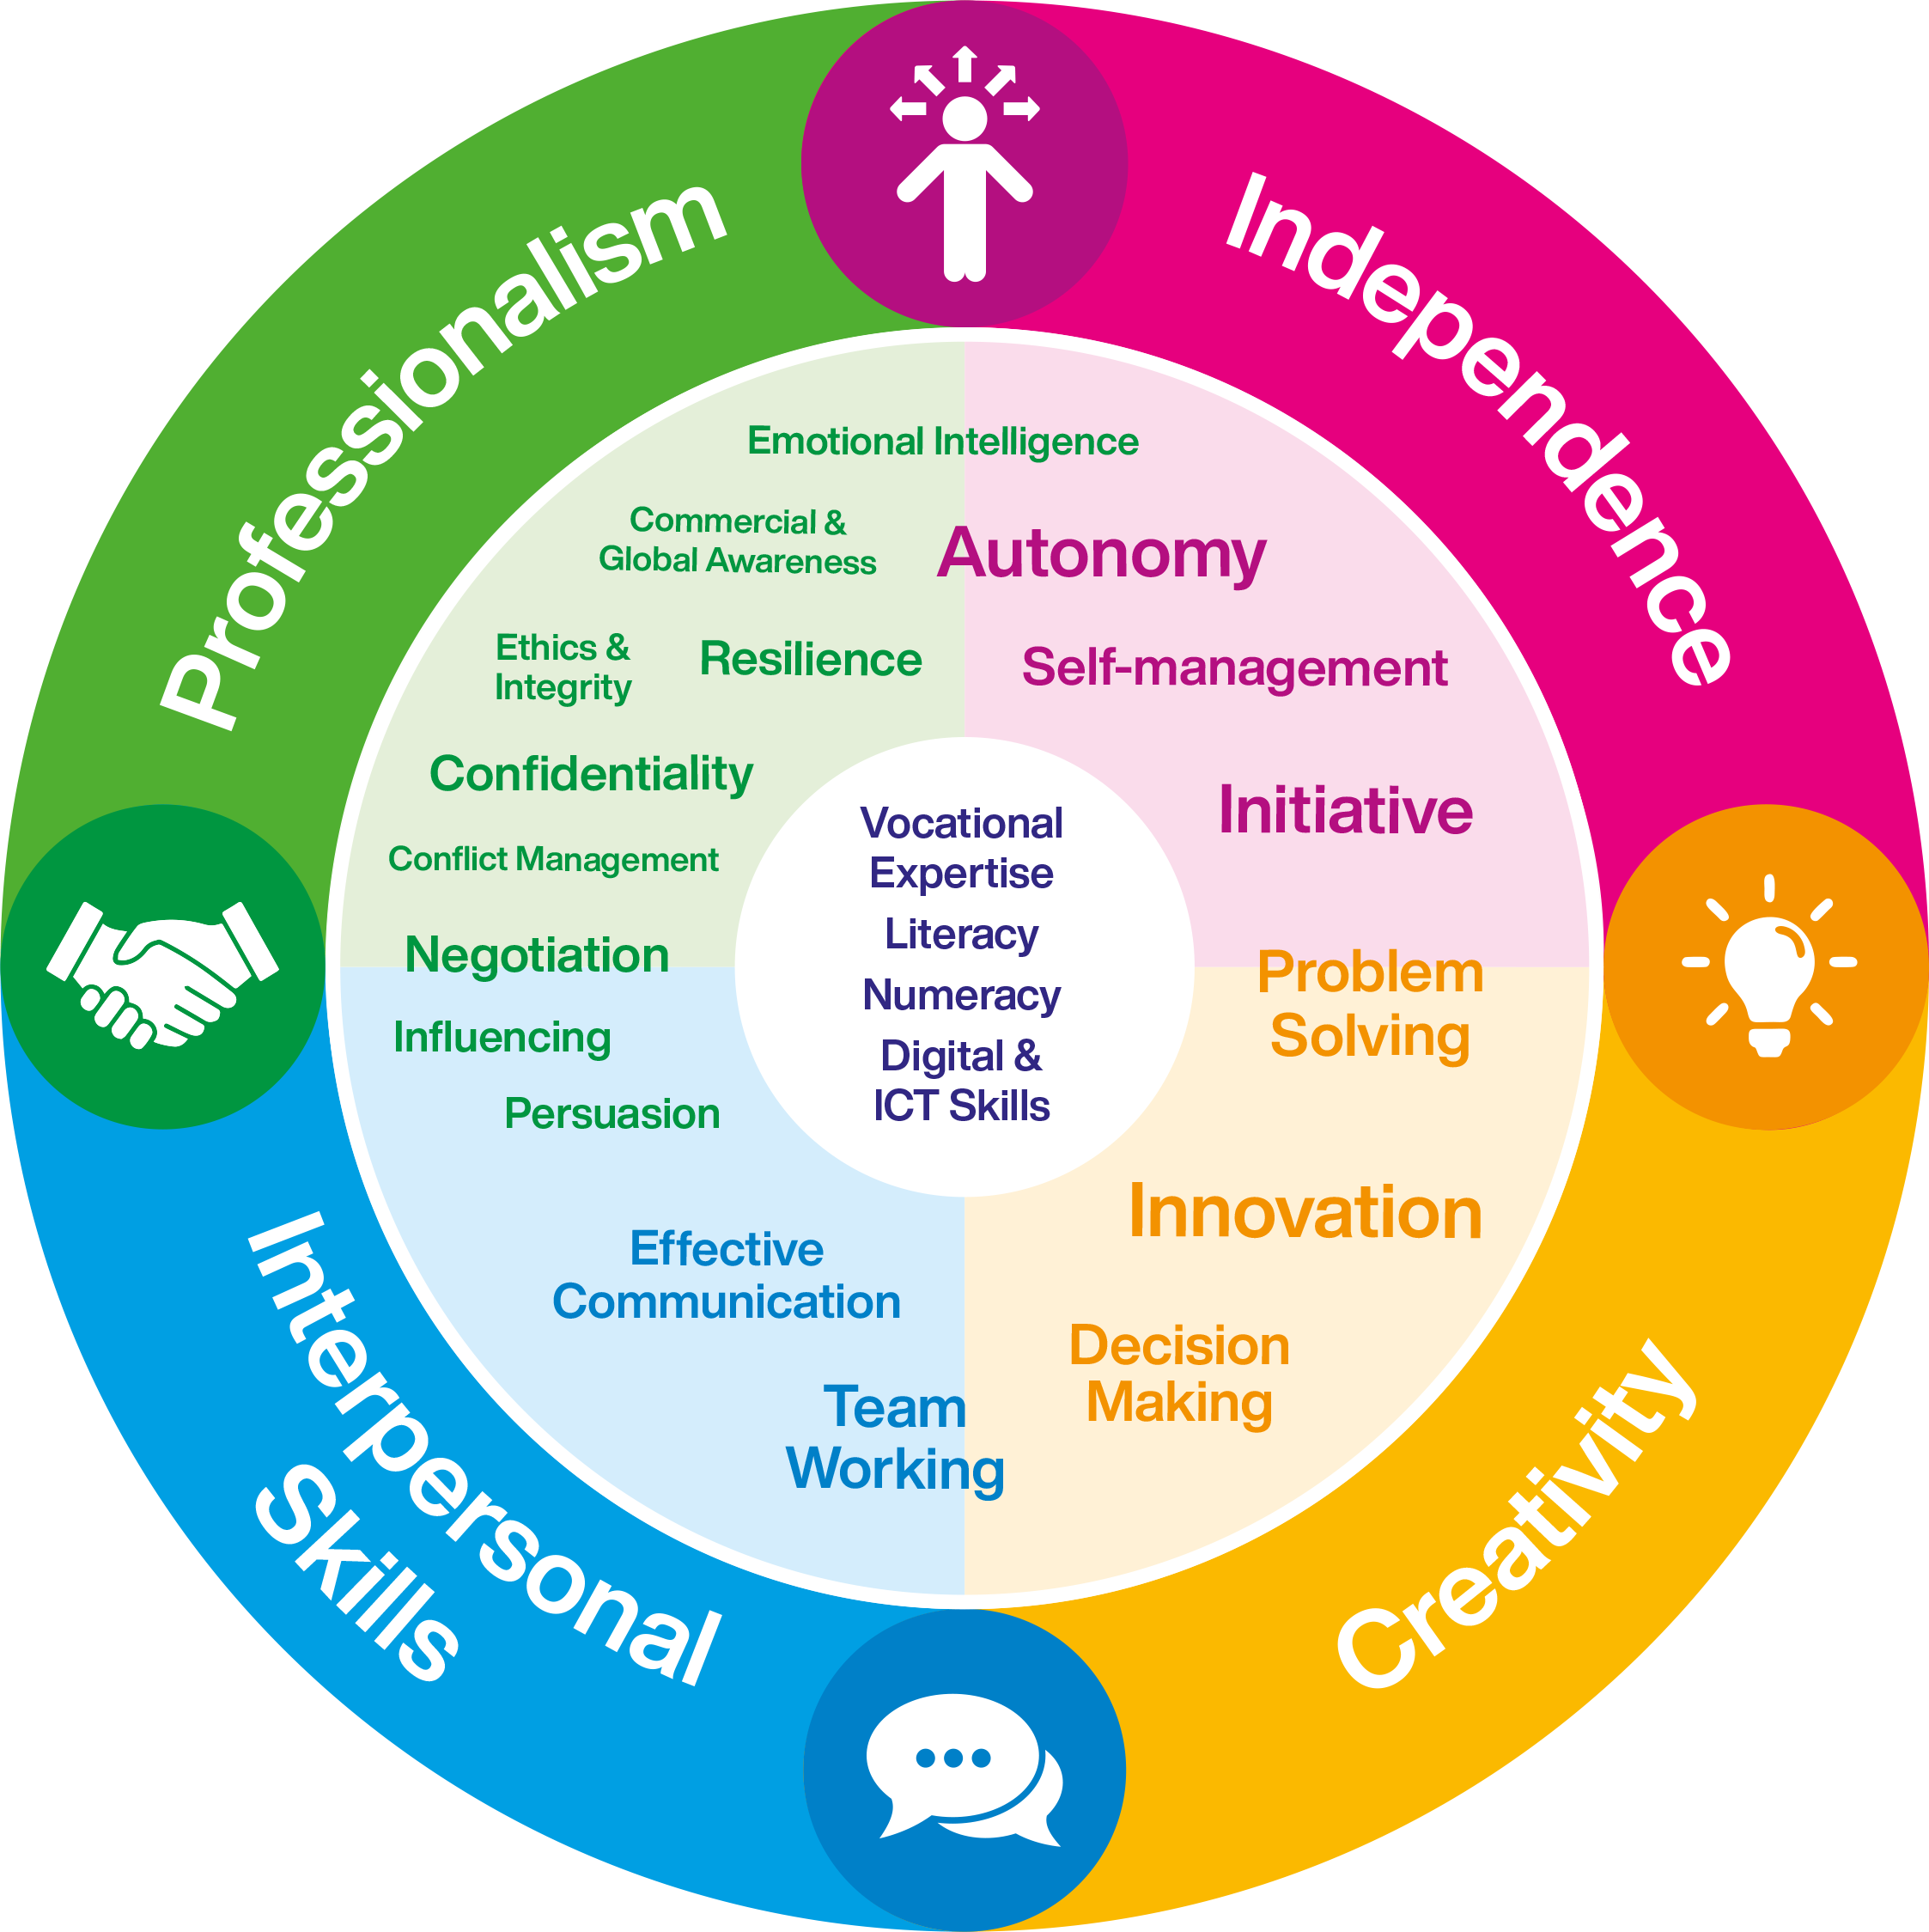
Graduate
Attributes

Slide 2
Graduate
Attributes
Referencing
Developing effective referencing and citation skills
APA 6th edition
Notes:
In this session you will learn
Why you need to reference
What is plagiarism?
How to cite from a book, webpage & journal article
How to write a reference list
Secondary references

Slide 3
What is referencing?
Referencing is a system used at colleges and universities to let anyone reading your assignments know exactly where you found your information

Slide 4
Why do we need to reference?
To show where we have found our information
To acknowledge or credit other people’s writing or ideas
To allow anyone reading our work to find and check the information
To avoid being accused of plagiarism
Notes:
To show evidence of your research
To show you can critically evaluate other people’s ideas and use them to support your arguments
Stress importance of good record keeping/note taking

Slide 5
What is plagiarism and collusion?
Plagiarism
Collusion
Copying or paraphrasing other people’s work or ideas without full acknowledgement.
Where a student works in a fraudulent manner with another (or others) being assessed independently (either wholly or in part) in the same module.
You will be guilty of collusion if you knowingly allow any of your academic work to be acquired by another person for presentation as if it were that person’s own work.

Slide 6
Is it plagiarism?
1. Copy and paste a paragraph of text from a web site without enclosing it in quotation marks and referencing the source?
Yes
2. Use the ideas of another author without providing a reference even if you write them in your own words?
Yes
3. Claim work produced by another student as your own?
Yes
4. Copy a diagram or data table from a web site, providing a reference for the source underneath?
No

Slide 7
Is it plagiarism?
5. Submit all or part of one essay for two separate assignments?
Yes
6. Copy words from a book into your own work, but place quotation marks around them and provide a citation?
No
7. Include a fact or saying in your assignment which is generally known without referencing the original source?
No
8. Incorporate text from another source, changing one or two words and providing a citation?
Yes
Cardiff University (2006)

Slide 8
APA referencing
In the main part of your essay you need to detail clearly the name of the author you are quoting from and the year their work was published (add a page number if appropriate) – citation
The reader should then be able to cross-reference this to a more detailed list at the end - reference list
Notes:
So, how do we actually go about referencing.
When you are writing your report/essay, if you want to quote from someone's work, you should place the surname of the Author and the year that the work was published along with a page number in the main text of your work. This is known as a CITATION.
At the end of your essay, you will have a detailed list of all the sources. This is called the REFERENCE LIST.
It is really important that both the citations and the reference list are consistent, uniform and really easy to understand!
This is the suggested system for use in Chichester College. There are others! Check with your teacher that this is what they require.

Slide 9
Direct quotes
Use the exact words from the book or web page
Keep them brief, just a few words or a couple of sentences
Put quotation marks around the quote
Add a citation and reference to show where you found the information
Notes:
In English studies you might use a longer direct quote of a piece of poetry or prose if you are then going to follow the quote with an extended analysis of it.

Slide 10
Indirect quotes
It is better to rewrite the information you find in your own words
You can summarise or paraphrase the information
You still need to provide a citation and reference as you didn’t create the original information yourself

Slide 11
Summarising
To summarise you need to give a brief overview of the information
Include the main idea and key points in your own words
It should be much shorter than the original writing

Slide 12
Paraphrasing
To paraphrase you need to completely rewrite the information in your own words
It shows what you know and understand about the subject
It should be about the same length as the original information

Slide 13
How to avoid plagiarising and last minute panics
Good record keeping and note taking are essential to this process
Do not copy and paste from the internet into your notes
Read the article, make your own notes and use these for your assignment
Make sure you collect the information you need to reference the webpage
Have a system to keep track of your sources of information
Write a reference for every source you think you might use
You can collect these by using a spreadsheet, document, sheets of paper or cards

Slide 14
How do we reference?
To reference your assignment correctly you will need to do two things
Give a citation in your assignment
Create a reference list at the end of the assignment

Slide 15
What is a citation?
A citation is a piece of writing in your assignment that shows who wrote or is responsible for the idea, words or image you are using
Each citation ‘cites’, or points to, a reference in your reference list

Slide 16
Example citations - Books
Direct quotation
Peck and Coyle (2012) state that “writing is not the
same as thinking out loud” (p. 52).
“Writing is not the same as thinking out loud” (Peck
& Coyle, 2012, p. 52).
Indirect quotation
Peck and Coyle (2012, p. 52) emphasize that in
written work you have the opportunity to improve
your presentation by re-evaluating and rewriting
your first thoughts.
Notes:
Name, Year, Page number)
Indirect: even if you don’t use a quote, but mention something which is an idea or information from something else, or putting it into your own words, still cite it.

Slide 17
Example citations - Websites
Direct quotation
“… being aware of fake news does not mean we can always spot it” (Burns, 2017).
Direct quotation with no date
“Time management is about making things happen, rather than having them happen to you. You need to get control!” (Greenhow, n.d.).
Indirect quotation with no author
A study for Alcohol Concern ("Call to stop", 2015) proposes various policies to reduce children's drinking …
Notes:
Webpage citations are basically the same as books – (author, year)
If no author use the title of the document in quotation marks

Slide 18
Book citations
Which of these direct quotations from Bram Stoker’s book Dracula is correctly cited
“As the Count leaned over me and his hands touched me, I could not repress a shudder” Dracula.
“If ever a face meant death – if looks could kill – we saw it at that moment” (Stoker, 2014, p. 254).
“There in one of the great boxes, of which there were fifty in all, on a pile of newly dug earth, lay the Count!” Stoker, Dracula (2014, p. 63).
When she was in bed he came and himself fixed the wreath of garlic round her neck (Stoker, 2014, p. 160).

Slide 19
References
The reference you write in your reference list will give all the details of the source where you read the original quotation
The reference list should be one alphabetical list and include references to all types of resource used
Begin each reference with the surname of the author/editor or the organisation name which you used to begin the citation

Slide 20
APA referencing - books
Write the reference using this format
Author, Initials. (year). Title of book (Edition, if later than first e.g. 3rd ed.). Place of publication: Publisher.
Notes:
Author - Surname, initial(s) or first name(s), year of publication (in brackets), title (in italics or underlined), edition, Place of Publication, Publisher

Slide 21
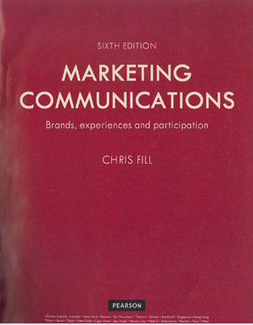
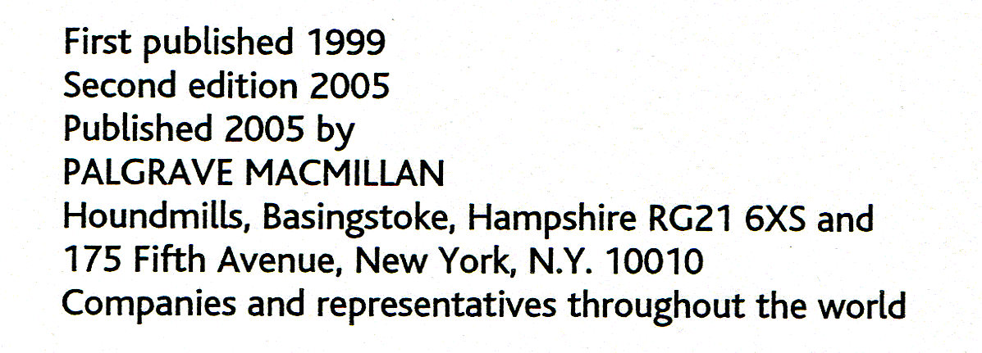
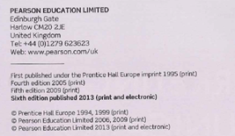
Title 2nd ed.
Title
Marketing communications: brands, experiences and participation
Author
Fill, C.
Edition
6th ed.
Publisher
Pearson Education Limited
Place
Harlow
Year
2013
P
Reference in your reference list
Notes:
Place is town or city not county

Slide 22
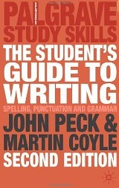
Reference
Fill, C. (2013). Marketing communications:
brands, experiences and participation (6th ed.).
Harlow: Pearson Education Limited.

Slide 23
Exercise 1
Using the formats for creating an APA reference and the photocopy provided write
A citation from the photocopied pages of the book
Write a full reference for this book to go in your reference list

Slide 24
Exercise 1 - Answer

Slide 25
Exercise 2
Use this format for a book from a print source with two authors write
Citation
(Author1 surname & Author2 surname, year of publication, p. number)
Reference
Author1 surname, Initials., & Author2 surname, Initials. (year). Title of book (Edition if later than first e.g. 3rd ed.). Place of publication: Publisher.

Slide 26
Exercise 2 – Answer
1. Citation
(Price & Maier, 2007, p. 156)
2. Reference
Price, G., & Maier, P. (2007). Effective study skills. Harlow: Pearson Education Limited.

Slide 27
Secondary Referencing
Much of your research at college will be done using textbooks and journal articles
The authors will often quote or discuss ideas from the key writers on the topic they are presenting
You may wish to use one of these quotes/ideas in your work

Slide 28
Secondary referencing
What if I haven’t read the original source?
If you haven’t read the original source you
don’t need to give the details of the original in
your reference list
You should reference the source you actually read
You need to cite both sources, the original author
and date and the source where you found it

Slide 29
Secondary Referencing Example
“Mental illness is [a] . . . topic that is presented quite problematically, particularly on television. Images of the mentally ill are stigmatized and sinister”
This is a quote from Nancy Signorielli found on page 105 of a media textbook by Stephen Harper published in 2009
It is cited by the authors of the book as coming from an original source published in 1993

Slide 30
Secondary citation and reference – Example
Citation for both sources
“Mental illness is [a] . . . topic that is presented quite problematically, particularly on television. Images of the mentally ill are stigmatized and sinister” (Signorielli, 1993, cited by Harper, 2009, p. 105).
Reference for the book you actually read
Harper, S. (2009). Madness, power and the media: class, gender and race in popular representations of mental distress. Basingstoke: Palgrave Macmillan.

Slide 31
Articles – printed sources
Weekly magazine article Barrett, L. (2016, August 23). Daewoo’s drive to survive in the UK. Marketing Week, 22-23.
Journal article McQueen, H., & Webber, J. (2019). What is very important to learning? Journal of Further and Higher Education, 33(3), 241-253.
Notes:
For your citation you use the same details as when citing from a book – author surname, year of publication and a page number.
In your reference the name of the magazine or journal is in italics.
You also give the page numbers of the entire article.
For journals after the title put the volume no if there is one in italics and issue number in brackets.
In the reference the name of the magazine or journal is in italics.
Your also give the page number of the entire article in the reference
Journals – after the title put the volume no if there is one in italics and issue number in brackets

Slide 32
Exercise 3
1. A citation from the photocopied pages of the journal article
(Author surname 1, Author surname 2, & Author surname 3, year of publication, p. number)
2. Write a full reference for this journal article to go in your reference list
Author 1, Initials., Author 2, Initials., & Author 3, Initials. (year). Title of article. Title of Journal, Volume number if any (part/issue number), start page number-end page number of article.
Notes:
With 3 – 5 authors list them all in your first citation. For any further citations list the first author and then et. al. Always list all the authors in your reference.

Slide 33
Exercise 3 – Answer
Citation
“People want to know where they stand, and performance evaluations offer transparency” (Goler, Gale, & Grant, 2016, p. 93).
Goler, Gale and Grant, (2016, p. 93) explain that . . .
With three to five authors, name all authors the first time, then use et al. (and others). For example: the first time it would be (Goler, Gale, & Grant, 2016, p. 93) and subsequent citing of the same publication would use (Goler et al., 2016, p. 93).
Reference
Goler, L., Gale, J., & Grant, A. (2016). Let’s not kill performance evaluations yet. Harvard Business Review, 94(11), 90-94.

Slide 34
APA references - webpages
Author surname, Initials. (year, when site was produced or document published). Title of web page. Retrieved from URL web address
Burns, J. (2017). Fake news: universities offer tips on how to spot it. Retrieved from https://www.bbc.co.uk/news/education-41902914
Notes:
Title of webpage is in italics
Sometimes not all the information will be available.

Slide 35
Webpage information
If no year is given write n.d.
You can use an organisation as an author if you cannot see the name of a person
If no author is given begin with the title of the document
You must include the words Retrieved from before the web address
Notes:
Sometimes not all the information is available.
If no author or organisation begin with the title of the document.

Slide 36
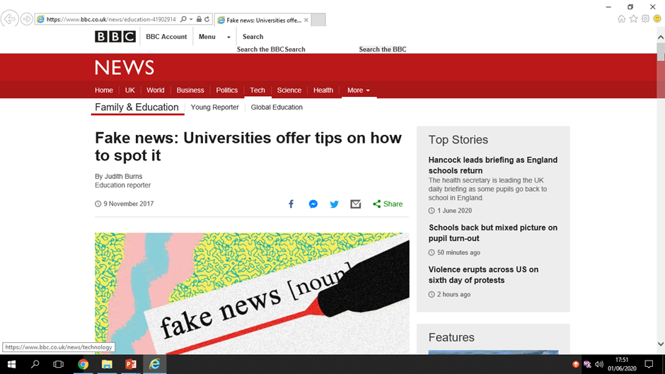
Author
Burns, J.
Retrieved from
https://www.bbc.co.uk/news/education-41902914
Title
Fake news: universities offer tips on how to spot it.
Year
2017
Burns, J. (2017). Fake news: universities offer tips on how to spot it. Retrieved from https://www.bbc.co.uk/news/education-41902914

Slide 37
Exercise 4
Use this format for a webpage from an electronic source
Citation
(Author surname, year of publication)
Reference
Author surname, Initials. (year). Title. Retrieved from URL of webpage

Slide 38
Exercise 4 - Answer
Citation in Text
“We work with our suppliers to ensure safe and fair working conditions throughout our supply chain”
(Aldi, n.d.).
Reference
Aldi. (n.d.). Ethical working conditions. Retrieved from https://www.aldi.co.uk/about-aldi/corporate-responsibility/supply-chain-information

Slide 39
Example Reference List
Cardwell, M., Clark, L., & Meldrum, C. (2004). Psychology (3rd ed.). London: Harper Collins.
Greenhow, M. (n.d.). Study skills online. Retrieved from http://people.brunel.ac.uk/~mastmmg/ssguide/sshome.htm
Ki-Moon, B. (2016). For permanent peace. Harvard International Review, 28(2), 24-25. Retrieved from http://search.ebscohost.com/login.aspx?direct=true&db=bth&AN=21684953&site=eds-live
McQueen, H., & Webber, J. (2019). What is very important to learning? Journal of Further and Higher Education, 33(3), 241-253.
National Health Service. (2018). Check your symptoms. Retrieved from http://www.nhsdirect.nhs.uk/check your symptoms
Notes:
One alphabetical sequence showing books, DVD and website and journal articles
For DVDs use the name of the primary contributor eg the director or presenter.
After [DVD] in square brackets put place of origin where DVD was primarily made and released.
If DVD was downloaded from webpage after DVD you put retrieved from and the web address..

