Slide 1
Careers in Visual Arts

Slide 2
Popular pathways
Pathway | Profile | Entry routes, skills, salary
Graphic designer
Textile designer
Illustrator
Photographer
Concept artist

Slide 3
Considered the apprenticeship route?
Amy Keegan is a creative and design apprentice

Slide 4
Labour Market Information
Rank these careers in order of most jobs currently advertised.
*According to National Careers Service ‘Find a job’ website
 | No. jobs advertised*
Graphic designer
Textile designer
Photographer
Games designer

Slide 5
Labour Market Information
Rank these careers in order of most jobs currently advertised.
*According to National Careers Service ‘Find a job’ website
 | No. jobs advertised*
Graphic designer | 98
Textile designer | 39
Photographer | 319
Games designer | 28

Slide 6
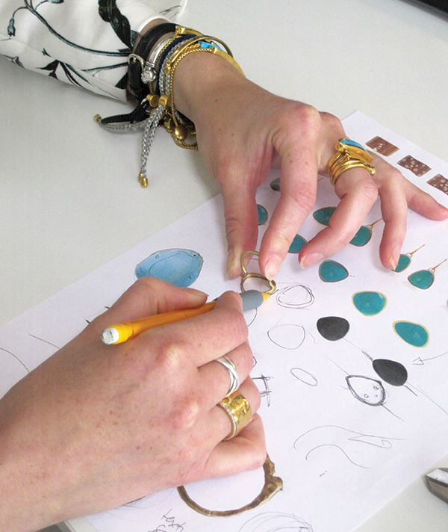
Some jobs you might not have thought of
Games design – environmental artist
UX designer (User Experience designer)
Art therapy
Community arts worker
Jewellery designer
Clinical photographer

Slide 7
Have you organised your work experience yet?
All year 12 students must complete a work placement
Students are expected to arrange their own placements
Larger BTECs / CamTechs will have calendared week
All other students choose timing of their placement
During the academic year; or
In Work Experience Week

Slide 8
PROGRESSION PLUS CENTRE
In the LRC on the 1st Floor
Support with
Work experience
University applications
Apprenticeships
Job applications
Interview skills
And much more

