Slide 1





INTERVIEW TECHNIQUES
‘GET THAT JOB!’
Notes:
Introduce the workshop and explain it would be helpful to have the STAR technique handout as part of the session.

Slide 2

LEARNING OUTCOMES
By the end of this session you will have:
Learned about what interviews are and the purpose of them
Identified different types of interviews and assessments that can be part of applying for a job
Explored the behaviours that can help you to succeed in an interview
Learned about a technique (‘STAR’) which can help you provide well-structured examples of your skills and competencies
Notes:
Outline the learning outcomes of the session.

Slide 3

WHAT ARE INTERVIEWS?
?
What are interviews?
In an interview, employers can meet you and ask you questions about your:
Experiences
Knowledge
Qualities
Skills
?
What are the purpose of interviews?
Interviews are used by employers to help them decide who they would like to hire for a job.
An interview gives you the opportunity to sell yourself and persuade an employer to choose you over the other candidates they are considering.
Notes:
Outline what interviews are and their purpose

Slide 4






POSSIBLE RECRUITMENT STAGES
GROUP
TELEPHONE
CENTRES
INTERVIEWS
ASSESSMENTS
FACE-TO-FACE
INDIVIDUAL
GROUP
Notes:
Ask attendees to name as many types of interviews that they can. Explain to attendees that, as part of applying for a job, they may have to undertake assessments that test their knowledge, skills, qualities etc. alongside attend an interview. [CLICK] to reveal these and discuss each one.
Individual: e.g. a psychometric (personality) test online that identifies whether you align with the company’s values and objectives
Group: e.g. a role-play exercise where you have to work together to solve a problem
Centres: e.g. a written test and an in-tray exercise in the morning following by a presentation in the afternoon

Slide 5

TELEPHONE INTERVIEWS
May be used on its own or to help decide who to invite to a face-to-face interview.
KEY FEATURES:
Normally fairly short (e.g. no more than 30 mins)
Timings agreed in advance
There may be more than one person on the phone
TIPS:
  Make sure you are in a quiet place where you will not be disturbed
  Know the name and position of who you will be speaking to
  Prepare in the same way that you would for a full interview (see face-to-face interview)
  Have your CV or application form to hand
  First impressions count, so practice answering the phone professionally
  Try to build rapport (do not just answer ‘yes’ or ‘no’)
Notes:
Explain key features and tips of an assessment centre style interview.

Slide 6

FACE-TO-FACE INTERVIEWS
Are there any training opportunities in this role?
How much are you going to pay me?
What is it to like to work for this company?
How many hours am I going to work?
…
Used to meet you in person and
decide if you are right for the job.
KEY FEATURES:
    You will be asked questions by one person or a panel of people
    The person who will line manage you could be there
    You may have to attend more than one face-to-face interview
    TIPS:
  Research the company in advance, e.g.:
      What they do and where they do it
      Their vision and values
      Any recent news about the company
  Prepare examples of how your skills and
  competencies match the role requirements
  Think of some questions to ask at the end of the interview
Notes:
Explain key features and tips of face to face style interview.
Ask attendees why questions at the end of an interview are important (ANSWER: to show an interest in the role and working for the company)
[0.5] Ask attendees to tell you whether the following questions are examples of ‘good questions’ or ‘bad questions’:
[CLICK] “How much are you going to pay me?” (BAD: this could suggest you are most interested in the money as opposed to the job itself)
[CLICK] “How many hours am I going to work?” (BAD: this is usually listed on the job advert/description and could suggest you have not read it fully)
[CLICK] “What it is like to work for this company?” (GOOD: shows an interest in working for the employer)
[CLICK] “Are there any training opportunities in this role?”(GOOD: shows you are someone the company could invest in and that you are keen to learn on the job)

Slide 7
INDIVIDUAL ASSESSMENTS
Used to test whether candidates have the required skills and competencies.
KEY FEATURES:
  You could be asked to do these before or after an interview
  Might be completed online
  Often multiple choice
  Could be timed
  May be that you have to pass the assessment to move on to the next stage of the recruitment process
  TYPES:
  Numeracy, literacy and logical reasoning tests
  Personality questionnaire: identifies your key character traits and see if you ‘fit’ the organisation and role
  In-tray exercise: checks how you would approach a task that you might do in the role
TIPS:
  Have a look online to see if there are any example tests that you can practice
  in advance
  Stay calm
  Listen/read the instructions and questions carefully
  Do not rush but be aware of the time
  For personality questionnaires, answer honestly (there is no right or wrong answer)
  If possible, check your answers at the end
Notes:
Explain key features and tips of individual assessment style interviews.

Slide 8

GROUP ASSESSMENTS
Used to find out how candidates work and communicate in a team.
KEY FEATURES:
  Involve several candidates who may be competing for the same job
  Can involve more than one activity, such as:
      Group interview: answering questions in turn
      Group task: working together to complete a task
      Role plays: acting out a given situation
  TIPS:
  Listen carefully to what you are expected to do
  Be polite and listen to the contributions of others
  Make sure that you contribute (you can only be assessed on what you say and do)
Notes:
Explain key features and tips of an group assessment style interview.

Slide 9

ASSESSMENT CENTRES
Used to decide whether a number of candidates are suitable for the job at the same time.
KEY FEATURES:
  May last a full day
  Attended by a large group of candidates
  Tend to include both individual and group assessments
TIPS:
  Make sure that you understand what activities you will be undertaking
  Follow the relevant tips provided in the previous slides
Notes:
Explain key features and tips of an assessment centre style interview.

Slide 10
CASE STUDY: JADE
JADE’S JOB INTERVIEW
?
What positive actions did Jade
Soon to finish her childcare course at college, Jade wanted to find a job working with young children. She applied for a job at a nursery and was excited when she was selected for a telephone interview.
Jade was nervous about talking on the phone, so she practiced greeting the interviewer with a friend the day before. She also thought about how to answer some of the questions she might be asked.
On the day of the telephone interview, Jade was at college. She found a quiet spot in the café, but it became noisy when people came in for lunch. She sometimes found it difficult to hear the interviewer.
During the call, Jade was asked about the placement she had completed as part of her course. She managed to give some good examples of what she had learnt during her placement, but could not remember exactly what she had included on her CV.
A few days later, Jade was delighted to receive an email invite for a face-to-face interview. After getting over her excitement, she started to prepare.
take to prepare for her
telephone interview?
Practiced greeting the interviewer
Thought about how to answer questions she might be asked
?
What could Jade have done
differently during her telephone
interview?
Found a place that would be quiet for the duration of the interview
Had her CV at hand to refer to
?
What can Jade do to prepare for
the face-to-face interview?
Research the nursery
Select a professional outfit
Identify examples that show that she has the required skills
Practice positive body language
Notes:
Read the case study of Jade’s job interview.
Ask attendees to consider the following questions:
What positive actions did Jade take to prepare for her telephone interview?
1) Practiced greeting the interviewer. 2) Thought about how to answer questions she might be asked.
What could Jade have done differently during her telephone interview?
1) Found a place that would be quiet for the duration of the interview. 2) Had her CV at hand to refer to
What can Jade do to prepare for the face-to-face interview?
1) Research the nursery. 2) Select a professional outfit. 3) Identify examples that show that she has the required skills. 4) Practice positive body language.

Slide 11






INTERVIEW BEHAVIOUR
Alongside what you say, in a face-to-face interview it is also important to consider how you behave and present yourself.
Approximately 55% of communication is made via body language!*
Thoughtful goodbye
Handshake
“Nice to meet you”
“Thank you for inviting me here today”
Eye contact
Actively engaged and listening
Sitting up straight
Smiling
Leaning in slightly
Handshake
“Thank you for your time”
“I hope to hear from you soon”
Professional introduction
Positive body language
* Mehrabian and Wiener (1967) and Mehrabian and Ferris (1967)
Notes:
Explain that, alongside what you say, in a face-to-face interview it is also important to consider how you behave and present yourself. Outline the information in the 3 boxes professional introduction, positive body language, thoughtful goodbye.

Slide 12
‘STAR’ TECHNIQUE
SITUATION
Describe what was happening and when
1
RESULT
TASK
Reveal the outcome and
what you achieved
4
2
Explain what you
were doing
3
ACTION(S)
Discuss the action(s) you took and the skills you used
Notes:
Refer to the STAR technique handout and explain students can use this to practice answering interview questions in a good level of detail. Explain this will provide prompts to help them in an interview situation if they have a mind blank they can think of STAR to help them get their answers started!

Slide 13
SUMMARY
Today we have:
Learned about what interviews are and the purpose of them
Identified different types of interviews and assessments that can be part of applying for a job
Explored the behaviours that can help you to succeed in an interview
Learned about a technique (‘STAR’) which can help you provide well-structured examples of your skills and competencies
Notes:
Outline what has been covered in the session today

Slide 14


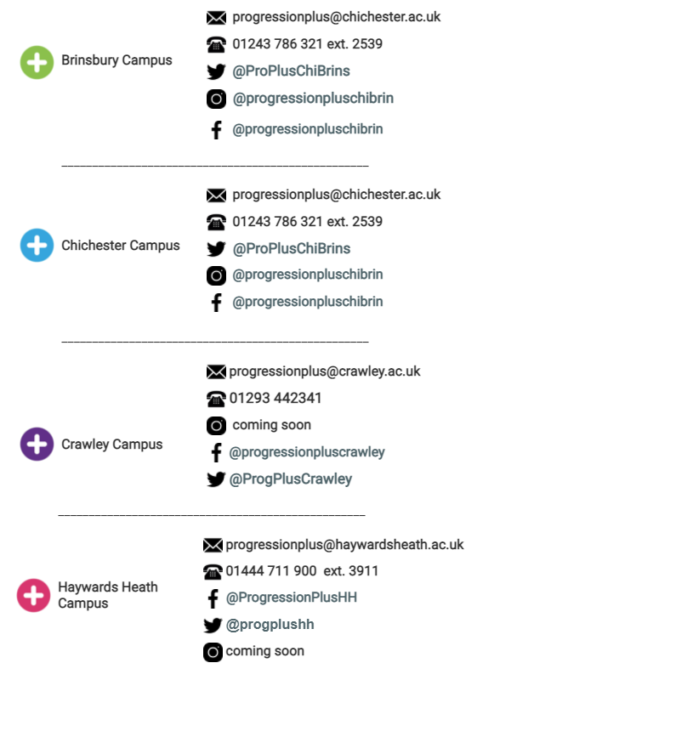
ANY QUESTIONS?
CONTACT US
Notes:
TOTAL SLIDE TIME: 2 minutes
RESOURCES: none
CONTENT AND/OR ACTIVITY(S):
[2] Answer any questions that students have

