Slide 1
Functional Skills Maths Booklet 1
Level 2 Intensive – 2019 Reform

Slide 2
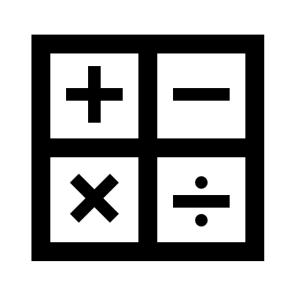
1. Number (Manual and Calculator)
Course Contents Covered in
Booklet 1
Booklet 2
Booklet 3
Booklet 4
Booklet 5
2. Checking & Formula
3. Working with Measure
4. Shape
5. Data
Exams:
There are 2 parts to the exam:
1 Non-Calculator part (30 minutes)
1 Calculator part (1hr and 30 minutes)
These are sat together, with a short break between sections.
Within this booklet (as well as the others) you may see these symbols next to questions. Red means it was designed to be completed without a calculator, while green means it’s fine to use your calculator! If both are there, it means this could be on either paper!

Slide 3
Number: Addition, Subtraction, Division, Multiplication. Percent/Fraction/Ratio
How confident are you on the following topics?
We will be covering all of these subjects withing our sessions.
TOPIC | Confident | OK | Need More Practice
Addition
Subtraction
Multiplication
Division
Percentages
Fractions
Ratio

Slide 4
Number: Addition, Subtraction, Division, Multiplication. Percent/Fraction/Ratio
Number will take us through the basics of Functional Skills maths. The next few pages are about operations.
Addition = combining numbers into a greater amount.
i.e. 10 + 12 = 22
Subtraction = Taking apart numbers from the greater amount.
i.e. 22 – 12 = 10
Multiplication = How many groups of a number we have.
i.e. 3 groups of 5 total 15 (3 x 5 = 15)
Division = How many times a number fits inside another number.
i.e. 5 fits inside 15 3 times (15 ÷ 5 = 3)

Slide 5
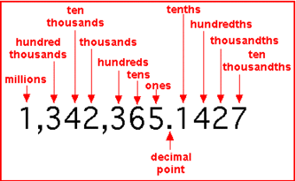
Addition and Subtraction
Adding and subtracting are relatively straight forward, as long as you remember the following:
Place Value
The value of a digit depending on its place in a number.
In the decimal system, each place is 10x bigger than the place to its right (so each place to the left is 10x smaller!)
So when we have 10 ones, we actually have 1 ten, and no ones. Again, once we have 10 tens, we actually have 1 hundred, no tens and no ones, etc.
Remember, when answering questions, start with the units (or decimals if there are any) for:
Addition
Subtraction
Multiplication
However, for Division, start with the largest unit!

Slide 6
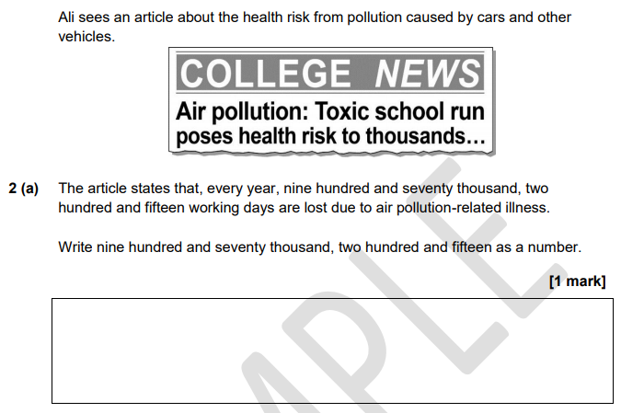
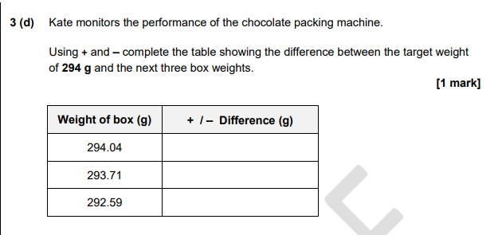
Exam Question

Slide 7
Methods of Multiplication and Division (non-calculator)
For the calculator paper, you can use your calculator throughout.
However, the non calculator section may cause more problems.
Multiplication:
There are several techniques for manual multiplication. One is repeated adding.
3 x 5 = 15
If 3 x 5 means the same as ‘3 groups of 5’, we can add 3 five times
3 + 3 + 3 + 3 + 3 = 15
3 6 9 12 15
HOWEVER! This method will be quite a pain with larger numbers, so we need a second method…

Slide 8
Multiplication (cont)
Another method is the following
Tens
Units
×
Tens
Tens
Tens
Units
Units
Tens
Tens
Units
Units
Units
With this method, we can multiply numbers greater than ten together.
We do this by laying our sum around the box, so that one number is over each column.
We then work through the sums as normal.
4 2
×
The final step is to add the columns diagonally
2
2
1
6
9
4
2
8
3
1
6
8
9
8

Slide 9
4 2
×
6
9
Step 1: Lay out our sum around the edges of our grid.
4 2
×
Step 2: We will now work on the 1 by 1 sums:
2 x 6 = 12
4 x 6 = 24
(Remember! Tens go in the top half of the grid, units in the bottom)
2
1
6
9
4
2
4 2
×
2
1
6
9
Step 2: We will now work on the second line of 1 by 1 sums:
2 x 9 = 18
4 x 9 = 36
4
2
3
1
6
8
4 2
×
Step 3: We add all the answers diagonally:
8 on its own is 8
1+1+6 = 9
1+4+3 = 8
2 on it’s own is 2
SO, our answer to 42 x 69 is 2,898!
2
2
1
6
9
4
2
8
3
1
6
8
9
8

Slide 10
Practice!
83 x 45 =
8 3
×
4
5
27 x 76 =
2 7
×
7
6
716 x 38 =
This one is the same method, but with an extra column! Have a go!
7 1 6
×
3
8

Slide 11
Multiplication - Decimals
With this, we actually just do the same thing as before, but add in our decimals (we are even going to use the same numbers as before!)
Units
Tenths
×
Tens
Tens
Units
Units
Units
Tens
Tens
Units
Units
Tenths
Notice that while the numbers we put in our now units and tenths, within the box we keep the same tens and units. This is because we do exactly the same thing, with one extra step! So let’s look at 4.2 x 6.9:
4 2
×
The decimal points travel on the straight lines. When they meet, they go diagonal!
2
2
1
6
9
4
2
8
3
1
6
8
9
8
So, 4.2 x 6.9 = 28.98!

Slide 12
Practice!
37 x 54 =
3 7
×
5
4
22 x 83 =
2 2
×
8
3
71 x 38 =
7 1
×
3
8

Slide 13
Division
To divide manually, there are many methods that can be used.
We’re going to look at two different methods:
Repeated adding.
In the same way that we can use repeated adding to multiply, we can actually use it to divide!
If I have the sum 21÷3, I am trying to find out how many 3’s go into 21; or how many groups of 3 make 21!!
3 6 9 12 15 18 21
3 3 3 3 3 3 3
So, it takes 7 groups of 3 to make 21. This means that 21÷3 = 7
AGAIN, This method will be a pain with larger numbers, so we need another method…

Slide 14
Division
Bus Stop Method:
For larger numbers, we use the bus stop method. You might remember this from school.
3
This is the number we are dividing
4 2 6
This is the number we are dividing by
Let’s see how we do this one together!

Slide 15
Division
Step 1 – Put the number you want to divide in the bus stop, and the number you want to divide by next to the stop
3
4 2 6
1
Step 2 – starting from the left, see how many times the 3 will go into the 4; there will be one 3 and 1 left over. Write how many 3’s there are in 4 above the bus stop.
3
4 2 6
3 1
1 4
Step 3 – we continue the process with the next number. REMEMBER, the 1 from step two is added to the ‘2’ in ‘426’, but it represents a 10, so we are looking for how many 3’s are in 12.
3
4 2 6
3 1
1 4 2
Step 4 – Finally, how many 3’s are in 6.
3
4 2 6
3 1

Slide 16
Practice!
1) 99 ÷ 3
2) 128 ÷ 4
3) 335 ÷ 5
4) 160 ÷ 10

Slide 17
Practice!
5) 64 ÷ 8
6) 800 ÷ 4
7) 154 ÷ 7
8) 237 ÷ 9

Slide 18
Rounding
One last thing we need to look at is rounding.
Rounding is used to eliminate any not whole numbers we have after sums (numbers after the decimal point).
The Rule to Rounding!
Rounding works based on what number you are working with. If the number after the decimal point is 1 – 4, then we just get rid of the number and move on. If the number is 5 – 9, then we get rid of it, and move the number left up by 1!
Example:
A question asks me to find the area of a room in m², rounded to two decimal places.
After working through my question, I come to the answer 34.6817. This is the exact measurement in m², but that means I have two many numbers after the decimal point!
As normal, we start with the number furthest right (the smallest unit).
34.6817
Because the 7 falls into the 5 – 9 category, we remove it and add one to the next column.
34.682
Because the 2 falls into the 1 – 4 category, we simply remove it.
34.68
Now my answer is acceptable for the final answer
34.68 m²

Slide 19
Rounding (cont.)
The Exception #1
We don’t ALWAYS have to round. Examples where we don’t round include:
Money questions with the answer in pounds requires two numbers after the decimal point (i.e. £3.45); this is because these numbers show the pence. However, if we were working with a question and we had more than two numbers after the decimal point, we would have to round until we only had two!
Other answers to X number of decimal points.
Exact measurements on drawings, for area, etc.
Sometimes we do round, but no matter what we round up! Examples of this include:
When finding the exact number of tiles you need to cover a wall ends in a decimal, you will need to round up matter what, as you always need the extra in this sort of situation!
In other circumstances, you will be asked to estimate exact numbers, and then make a comment based on this estimation.
In this situation, always apply the same technique to all numbers you are estimating, i.e. always round up OR down, never both. This is because you can easily comment on your estimation being an over or under estimation
The Exception #2
The Exception #3

Slide 20
Percentages
How do you find a percentage of a number?
There are several different ways
Remember that you can use a calculator, but the calculator on the on-line exam does NOT have a % button.
Find 47% of £340
47 ÷ 100 x 340 =
340 ÷ 100 x 47 =
0.47 x 340 =
Which method do you prefer?
How could we do this without a calculator?
Find 10%! – 10% of any number will always be the same individual numbers, just with the decimal place moved over one spot to the left!
SO, 10% of £340.00 is £34.00 (remember, money only ever shows two digits after the decimal point – these are the pence!)
Find 1%! – 1% is similar, but the decimal moves TWO spots!
SO, 1% of £340 is £3.40
With the ability to find 10% and 1%, we can work out any percentage question we could be asked – without a calculator!!

Slide 21
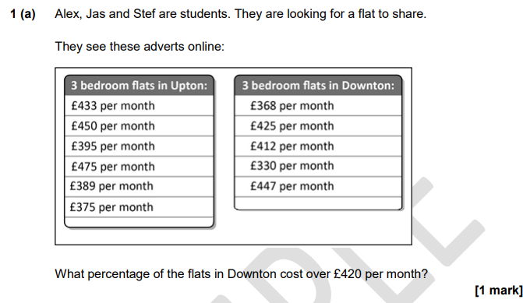
Exam Question

Slide 22
Percentages
Percentage Change – Profit/Loss
Percentage change allows us to see how much profit we have made, or (sadly) how much we may have lost, as a percentage. The formula is below.
So: If I buy 5 clocks for a total of £50, and sell them for a total of £60 what is the percentage change?
First, let’s work out the change between the two values:
60 – 50 = 10
So the change (or the difference) is 10
Next, lets divide the change by the original price:
10 ÷ 50 = 0.2
Finally, lets take this answer and multiply by 100:
0.2 x 100 = 20
So the percentage change is 20%
And, because the money I receive is more than the money I spent, I have a percentage change of 20% profit!! Phew!

Slide 23
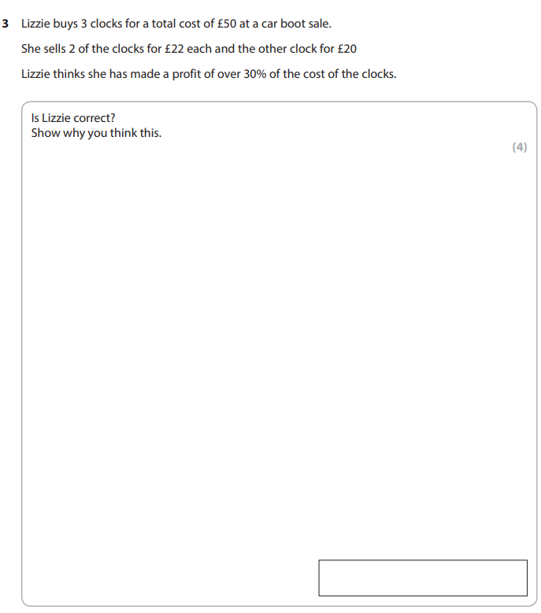
Exam Question
Percentage Change – Profit/Loss

Slide 24
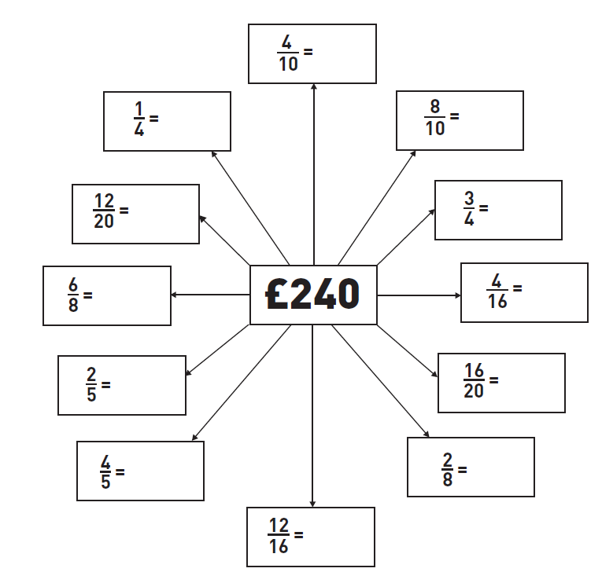
Fractions
How do you calculate a fraction of a number?
Divide by the bottom number (denominator) and multiply by the top number (numerator).
e.g. to find 2/3 of 360
360 ÷ 3 x 2 = 240 (360 ÷ 3 = 120 and then 120 x 2 = 240)
What can you notice about the answers? Why is this?

Slide 25
Fractions
Simplifying Fractions
On the last page you may have noticed that different fractions of the same number came to the same answer…
This is because, when working with fractions, we can make the numbers smaller, as long as there is a times table that BOTH numbers (the numerator AND the denominator) are a part of.
Example:
Both 6 and 9 are in the 3 times table
6
9
Because both the numerator and denominator are in the 3 times table, we can divide both by 3:
6 ÷ 3 = 2
9 ÷ 3 = 3
TIP: If you can’t find a times table that works with both the numerator and denominator, try dividing by 2! If you can’t do that (because the numbers are odd and don’t share a times table), then you are at your simplest point!
6
9
3 =
3 =
2
3
÷
÷

Slide 26
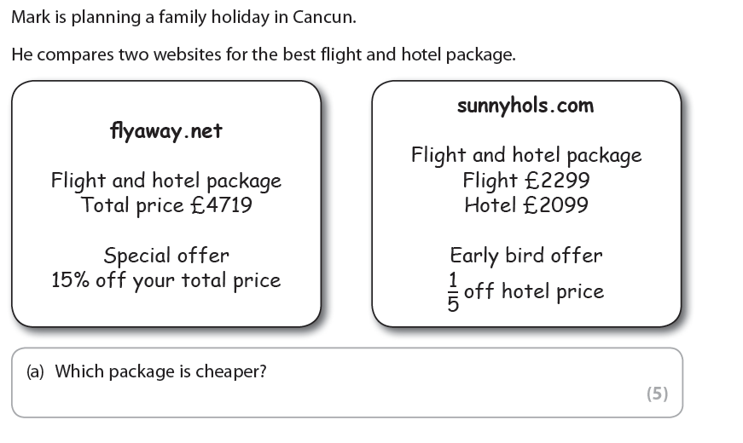
Exam Question
When given options you must clearly show how you work out how much each option costs and indicate your choice.

Slide 27
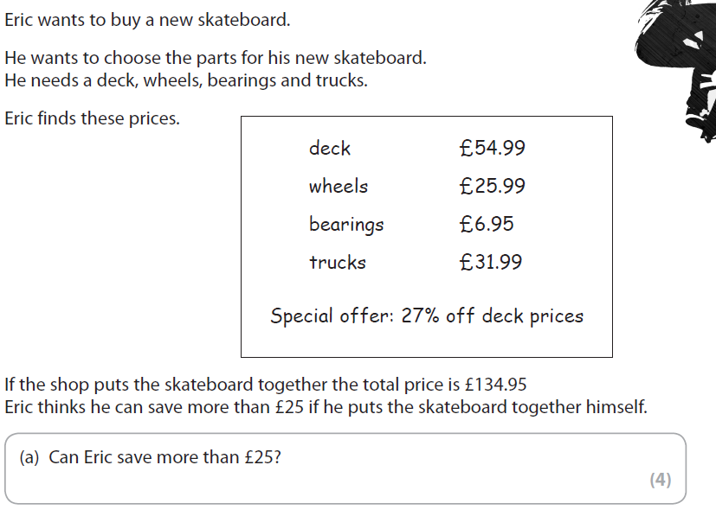
Exam Question

Slide 28
Advanced Fractions!
Sometimes you might need to add fractions. When they are the same kind, this is simple:
2 + 2 = 4
5 + 5 = 5
But when they have different bottom numbers, this is much harder. We need to cross multiply!
When we add fractions, we only really care about the top number. The bottom number is the total, so stays the same!
Cross Multiplying
2 + 3 = ?
6 + 5 = ?
2 + 3 = ?
6 + 5 = ?
2 + 3 = ?
6 + 5 = ?
10 + 18 = ??
30 + 30 = 30
First, we multiply the denominators together. This will be one of the common multiples, and out NEW denominator (6 X 5 = 30)
Next, we multiply the first numerator with the old second denominator. This will be our NEW first numerator (2 X 5 = 10)
Next, we multiply the second numerator with the old first denominator together. This will be our NEW second numerator (3 X 6 = 18)
Now we solve our NEW version of the sum: we add the fractions together. Now they have the same denominator, it’s the same as before!
Once you have your answer, there still might be one more step: Remember to check and see if the question asks for the answer in the simplest form! If it does, follow the steps we went over earlier!

Slide 29
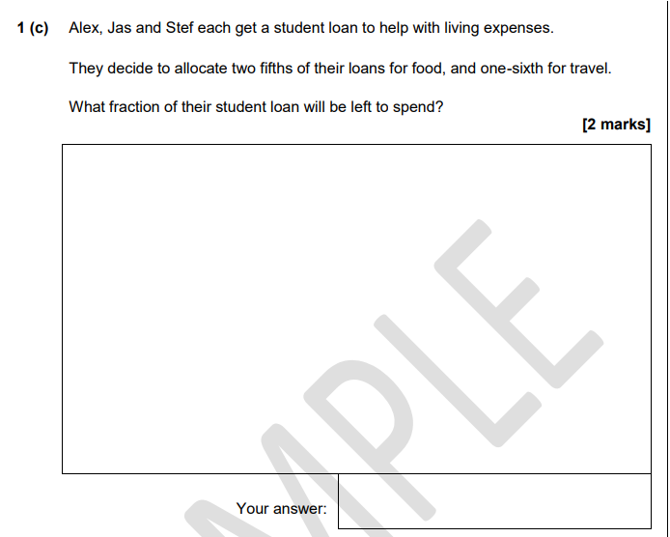
Exam Question
Remember: read the question carefully!
You don’t want to over complicate it for yourself!
Never do more than you need to!

Slide 30
Ratio
3 types of questions
You may need to share a quantity in a given ratio
You might be given a value for one quantity and need to work out the other(s) or the total amount e.g. to dilute squash, mix a cocktail or make concrete
You might be asked to write and simplify a ratio from given quantities.
A. Sharing in a given ratio
First work out how many parts there are altogether.
Divide the total by the number of parts
Multiply to find each part
Example
Share £480 between Jack, Fiona and Luke in the ratio 3:4:5
3+4+5 = 12
480 ÷ 12 = 40
3 x 40 = 120 (Jack’s part)
4 x 40 = 160 (Fiona’s part)
5 x 40 = 200 (Luke’s part)
£120 : £160 : £200
Ratio Top Tip #1
The numbers in a ratio are in the same order as the names given in a question

Slide 31
Ratio (Cont.)
B. Finding one quantity or the whole amount
Matt and Jane share some money in the ratio 3:5
If Matt gets £210
What is Jane’s share?
How much money did they share?
With this question we will work backwards from Matt’s share.
Matt has £210. This is equal to 3 parts. SO let’s divide 210 by 3!
210 ÷ 3 =
Now we know what one part is worth, we can multiply up to find Jane’s share, as well as the total amount!
Jane’s Share = £
Totally amount = £

Slide 32
C. Writing and Simplifying Ratios
Simplifying ratios is very similar to what we covered with simplifying fractions.
You are looking for a time table that includes all parts of the ratio. Then it is the same method as before!
350:280:140
With the ratio 350:280:140, it might be quite hard to work out if there is a connection between these values as they are very large.
We can start by removing the zero from each value – what we are actually doing is dividing all parts by 10, as all the numbers are in the ten times table!
35:28:14 – This is much easier to find a common multiple. Let’s try…. 7!
When we divide each part by 7, we end up with 5:4:2! That looks a LOT simpler than where we started!
5:4:2

Slide 33
Practice Questions

Slide 34
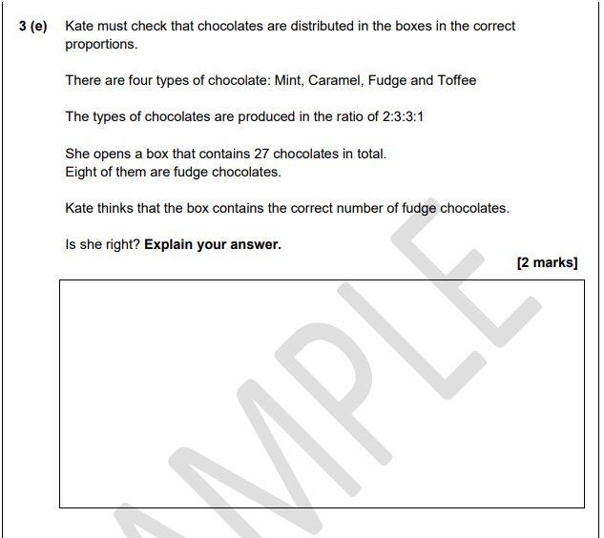
Practice Questions

Slide 35
Number: Addition, Subtraction, Division, Multiplication. Percent/Fraction/Ratio
How do you feel now that we have worked through each of these subjects a little?
TOPIC | Confident | OK | Need More Practice
Addition
Subtraction
Multiplication
Division
Percentages
Fractions
Ratio

