Slide 1
Functional Skills Maths Booklet 2
Level 2 Intensive – 2019 Reform

Slide 2
Formula: The Check, BIDMAS, Formula, Exam Practice
How confident are you on the following topics?
We will be covering all of these subjects withing our sessions.
TOPIC | Confident | OK | Need More Practice
Formula
BIDMAS
Within this booklet (as well as the others) you may see these symbols next to questions. Red means it was designed to be completed without a calculator, while green means it’s fine to use your calculator! If both are there, it means this could be on either paper!

Slide 3
The Check
Formula: The Check, BIDMAS, Formula, Exam Practice
What does this mean?
There are 3 ways you can check your calculation
Reverse (or inverse) calculation
Estimation
Alternative calculation
With the new specification, you will likely be told which check to use. If you aren’t given a specific type of check to do, but are still asked to do a check, pick the one that makes the most sense for the question!!
Method 1: Reverse calculations
Choose one or two of your calculations and ‘undo’ them or do them backwards
+ is the opposite of –
X is the opposite of ÷
Forwards Reverse
3 + 4 = 7 7 – 4 = 3
£4.50 x 6 = 27 27 ÷ 6 = 4.5

Slide 4
Check
Method 2 - Estimation
In some situations it may be more appropriate to estimate an answer to check if your answer is the right size.
E.g. Calculate the cost of lunch
Sandwich £2.95
Crisps 78p
Drink £1.09
£2.95 + £0.78 + £1.09 = £4.82
Solution:
Round each price to the nearest pound to estimate how much lunch will cost and check your answer
£3 + £1 + £1 = £5
Method 3 – an alternative calculation
You may be able to think of another way to approach the calculation to check if you still come to the same result.
THINK ABOUT:
The different ways we’ve looked at to work with percentages, fractions and ratios; these are all alternative methods to the one you originally chose!!

Slide 5
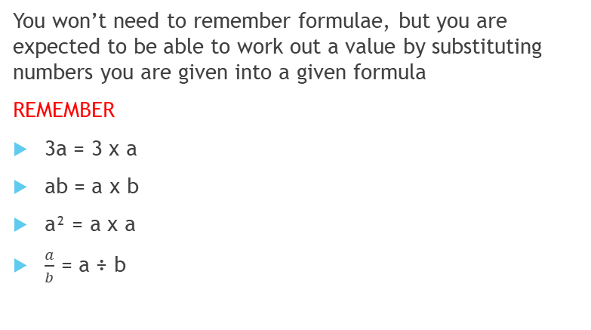
Formula (Algebra) and Substitution
You won’t need to remember formulae, but you are expected to be able to work out a value by substituting numbers you are given into a given formula
REMEMBER
3a = 3 x a
ab = a x b
a² = a x a
$\frac{a}{b}$ = a ÷ b
BIDMAS
Make sure you do the operations in the right order. To do this we follow B.I.D.M.A.S.
Brackets
Indices (Powers)
Division
Multiplication
Addition
Subtraction
These can be done at the same time
These can be done at the same time

Slide 6
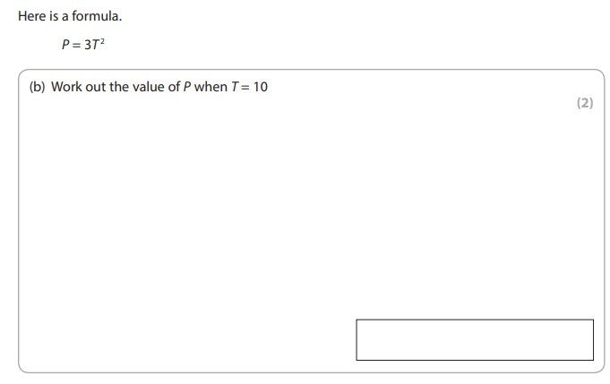
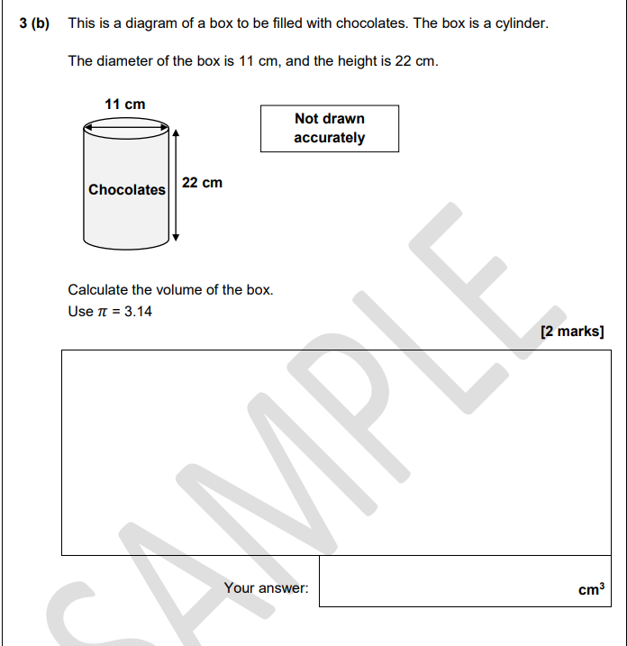
Exam Question
Don’t worry about not having the formula with this question: we will go over it in the next booklet!
Right now, know that you need:
3.14 x 5.5 x 5.5 x 22 =
Follow up question:
Why did I use 5.5 in my sum?
Clue: It is related to the 11cm!

Slide 7
Common Formula Speed, Distance and Time
REMEMBER:
Cover the value you want to find. What’s left?
Two values next to each other? Multiply.
Above and below? Divide!
D
S
T
D=
S=
T=
If a train travels 300 miles over 2 hours, how fast was it going?
If a bus travels for 2 hours at a speed of 50 mph, how far did it go?
A cyclist rides 5 miles at a speed of 2 miles an hour. How long did it take?

Slide 8

BIDMAS Practice
3 + 4 x 6 =
4(24 – 17) =
Using the formula A = $lw$ find A when $l=4m and w=3m$
Using the formula $V= πr²h$
Find V when r= 5, h = 25 and π = 3
More Formula!!
5cm
12cm
Lindsay works 22 hours a week, at a rate of £33.58. He works all four weeks of February. For his hard work he gets a bonus of £500. How much does he earn in total?
Lindsay decides to go on holiday to France in March. He plans to change one third of his salary from February into Euros to take with him. How many Euros does he take with him?

Slide 9
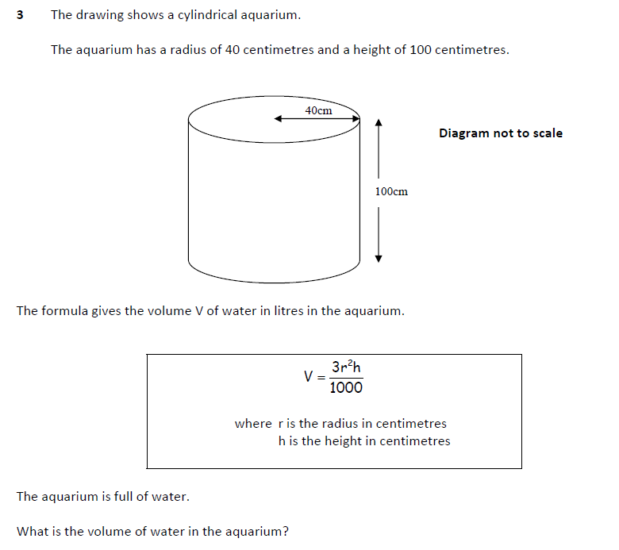
EXAM STYLE PRACTICE
You don’t need to remember the formula or understand how or why it works, but you do need to know how to use it.
What does 3r²h mean?
3 x r x r x h ÷ 1000

Slide 10
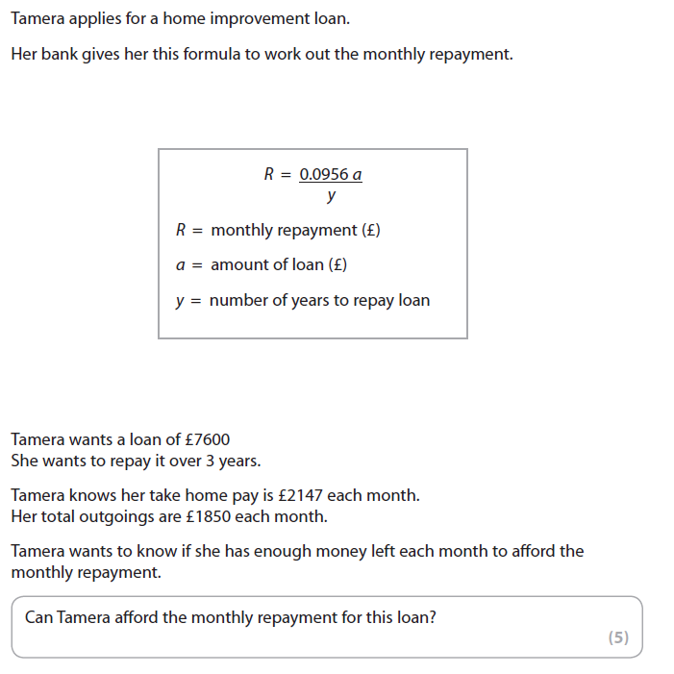
Exam Style Question

Slide 11
Formula: The Check, BIDMAS, Formula, Exam Practice
How do you feel now that we have worked through each of these subjects a little?
TOPIC | Confident | OK | Need More Practice
Formula
BIDMAS

