Slide 1
Functional Skills Maths Booklet 3
Level 2 Intensive – 2019 Reform

Slide 2
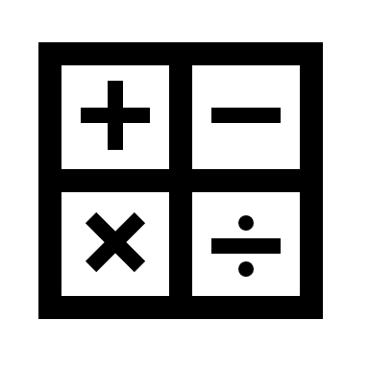
Guide:
Remember, no matter what we are doing in Functional Skills maths, we are doing with an understanding of both maths and problem solving.
You may need to buy more than you need.
Read the question: if they haven’t told you to do or not do something explicitly, and you can use a method to find an answer, then use it!
Within this booklet (as well as the others) you may see these symbols next to questions. Red means it was designed to be completed without a calculator, while green means it’s fine to use your calculator! If both are there, it means this could be on either paper!

Slide 3
Working with Measure: Metric Measure, Conversion, Time, Area & Volume
How confident are you on the following topics?
We will be covering all of these subjects withing our sessions.
TOPIC | Confident | OK | Need More Practice
Metric System
Conversion
Time
Perimeter, Area & Volume
Area & other shapes
Circumference and Area (Circles)

Slide 4
Working with Measure: Metric Measure, Conversion, Time, Area & Volume
What you need to be able to do with measure at level 2:
Convert between metric units for length, weight and capacity
Convert between metric and imperial units
Calculate with time
Calculate perimeter, area and volume (using given formulae where needed)
Metric Units
There is a code for the metric units! See below… are there any other words you associate with these words?
milli = $\frac{1}{1000}$
Milli – Millennium, millipede… all to do with 1000!
Centi – Century, centipede, cents in a dollar, percent… all to do with 100!
centi = $\frac{1}{100}$
Kilo = x 1000

Slide 5
Metric Conversion
÷ 10
÷ 100
÷ 1000
mm
cm
m
km
x 10
x 100
x 1000
÷ 10
÷ 100
ml
cl
l
x 10
x 100
÷ 10
÷ 100
÷ 1000
÷ 1000
mg
cg
g
kg
Tonne
x 10
x 100
x 1000
x 1000

Slide 6
Metric Conversion with Area & Volume
REMEMBER!
When working with square and cube numbers, how many smaller units make up a bigger unit is different to normal! We will only ever be working with metres for area and volume, as grams and litres won’t work here!
So, 100cm = 1m
BUT
10,000 cm = 1m²
1,000,000 cm = 1m³
Why is this?
Why is it important to remember with conversion questions?

Slide 7
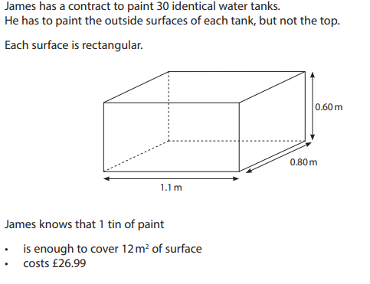
Example Question
It might be tempting to convert these decimal metres into centimetres…
BUT, this may cause you an issue later in the question when you need the answer in m²
You’ll need to remember to device your answer in cm² to m², so ÷ by 10,000! (because 100 cm² is = 10,000 cm)
We will look at this question in more detail later!

Slide 8
Converting Between Metric and Imperial Units
You are quite likely to get a question that needs you to convert between metric and imperial units.
You may also need to convert between different currencies
You will be given the conversion factor
You need to decide whether to multiply or divide.
Using Conversion Factors!
In questions where you are expected to convert using a factor, you will see something like this:
£1 = $1.25
How do we use this?
(with this example we are using money, but this could be any metric unit to imperial unit)

Slide 9
Converting Between Metric and Imperial Units
In questions where you are expected to convert using a factor, you will see something like this:
£1 = $1.25
How do we use this?
Rule 1 – You can’t do anything with the left side of the conversion factor: if you divide or multiply anything by 1, you will always get the same answer. So we HAVE TO USE the right side of the conversion factor.
Rule 2 – We’re using the right side of the conversion factor, but how do we know what to do with it?
Carl is going on holiday to America. He has £325. How many dollars will he have?
Carl has pounds in the question. Because the unit of currency (or measurement) is the same as the left side of the Conversion factor, we will multiply. So, 325 x 1.25 is what we need to do
325 x 1.25 =
Carl is coming back from holiday in America. He has $225. How many pounds will he have?
Carl has Dollars in the question. Because the unit of currency (or measurement) is the same as the right side of the Conversion factor, we will divide. So, 225 ÷ 1.25 is what we need to do
225 ÷ 1.25 =
REMEMBER: If the unit you are using in your question is the same as the LEFT side of the conversion factor, Multiply
If the unit you are using in your question is the same as the RIGHT side of the conversion factor, Divide

Slide 10
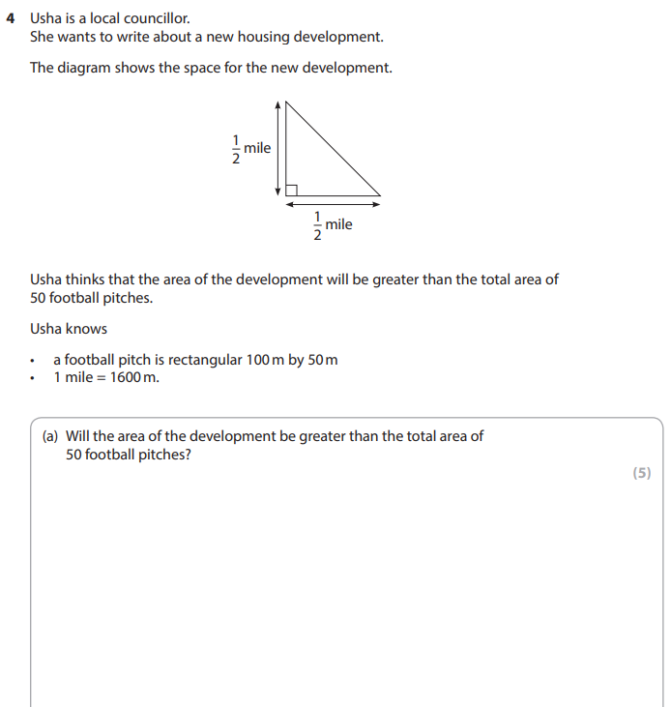
Exam Question

Slide 11
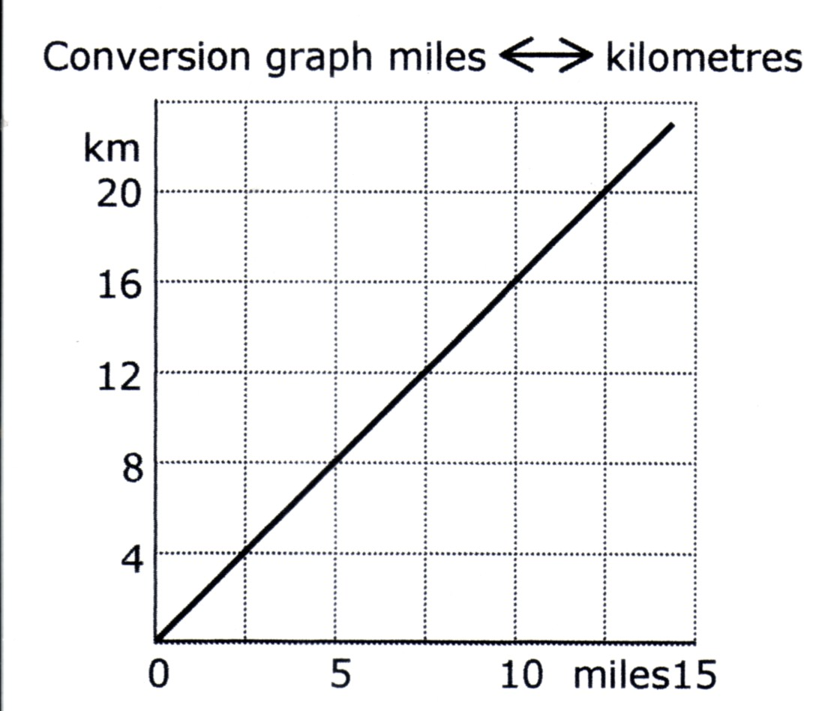
Converting Between Metric and Imperial Units
You may also need to use a conversion graph. It will look like this:
How might we use this?

Slide 12
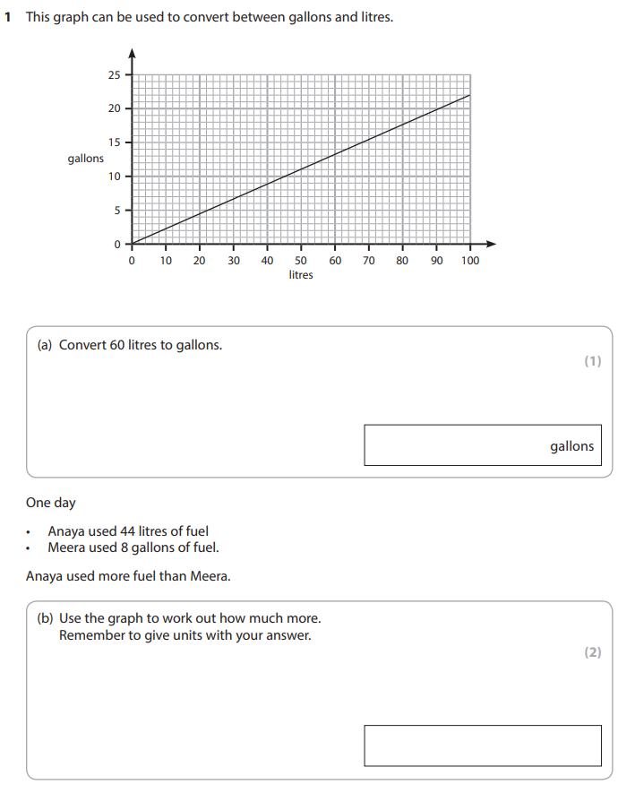
Exam Question

Slide 13
Time
There are times when you may need to convert time from standard to decimal. This is a little complicated, as decimals work in 10’s and time works in 6’s… SO WE NEED TO CONVERT!
When calculating with time take special care when using a calculator.
REMEMBER 2 hours 30 minutes is 2.5 hours, 3.25 hours is 3 hours 15 minutes
How would you convert 3.35 hours into hours and minutes?
0.35 x 60 = 21
3 hours and 21 minutes
How would you convert 1 hour 24 minutes into a decimal?
24 ÷ 60 = 0.4
1.4 hours

Slide 14
Time (Practice)
Convert these into hours and minutes
1.6 hours
4.2 hours
3.9 hours
Convert these into hours
3 hours and 42 minutes
2 hours and 12 minutes
1 hour and 48 minutes

Slide 15
Exam Practice

Slide 16
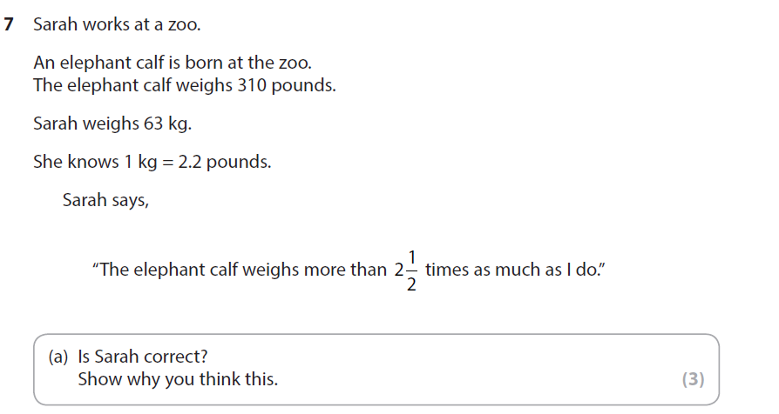
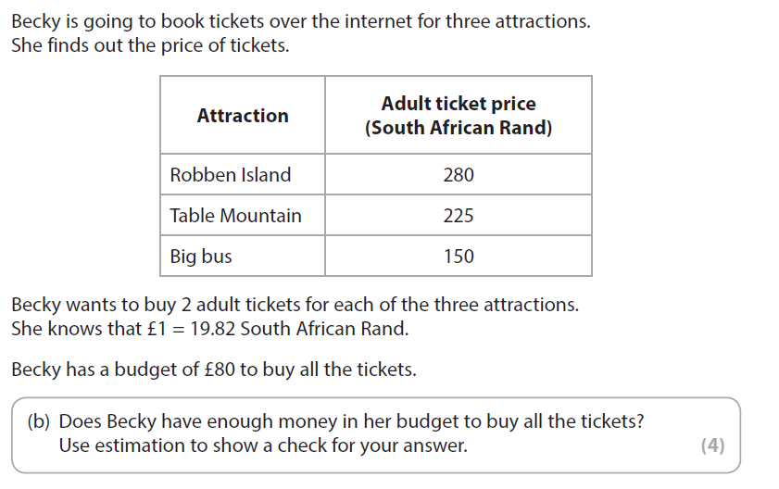
Exam Practice

Slide 17
Perimeter, Area & Volume
The perimeter of a shape is the total length of its sides
length
width
width
length
Perimeter of a rectangle
= length + width + length + width
5 m
lawn
3 m
Perimeter of this lawn
= 5 + 3 + 5 + 3
= 16
m

Slide 18
Perimeter, Area & Volume
Area is how much it takes to cover a 2D surface.
5 metres long
3 metres wide
Area of a rectangle
= length × width
The area is
square metres
= m²
Pretty straight forward so far, but now we’re going to look at odd shaped rooms…

Slide 19
Perimeter, Area & Volume
There are a few ways we can deal with shapes like this:
3 m
Method 1: Find out the area for the whole square (4.5 x 5.2), and then subtract the area of the missing square (1.5 x 2.2)
1.5 m
4.5 m
2.2 m
3 m
5.2 m
3 m
Method 2: Split the shape in two, and work out the area for each. Then, add them back together. You can split the shape horizontally or vertically.
1.5 m
4.5 m
2.2 m
3 m
5.2 m

Slide 20
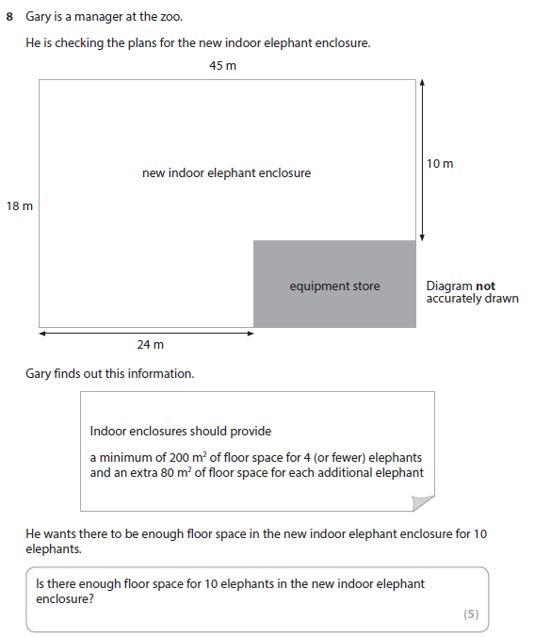
Exam Question

Slide 21
Exam Question

Slide 22
Perimeter, Area & Volume
Area of a triangle
The area of a triangle is calculated by:
Half base x height ( $\frac{1}{2}$ bxh)
OR
Base x Height ÷ 2

Slide 23
Perimeter, Area & Volume
4 m
12 m
8 m
12 m
How could find the area of this hall?
Well, look at the whole shape, and think about if it can be cut up into other shapes we do know! (A bit like the L-shaped rooms from earlier!)
Once we have done that, we can work out the missing measurements from the ones we have!

Slide 24
Perimeter, Area & Volume
4 m
A
B
A
12 m
C
8 m
12 m
So, we can look at this shape as two triangles, a square and a rectangle.
You will need to work out the green lengths to complete the sums.
A) = Base x Height ÷ 2 X = ÷ 2 =
B) = Length x Width X 4m =
C) = Length x Width 8m X 12m =
The total area of this shape is the added total, so A + A + B + C = m² (why did I add 8 twice?)

Slide 25
Exam Question
You could this in two ways: As described on the previous page, or using the formula given here. Try both!

Slide 26
Perimeter, Area and Volume
Perimeter and Area of Circles
D = Diameter
R = Radius (half the Diameter)
r
d
For circles, you will need to use Pi (π). Pi has a value of 3.14 (normally… they will tell you if it’s different!)
Formula for Circumference (Perimeter):
π x D
Find the circumference of the circle when d = 10cm
Formula for Area:
π x R x R OR π x R²
Find the area of the circle when r = 5cm

Slide 27
Perimeter, Area & Volume
Volume = length × width × depth
OR
Volume = area x depth
Volume is measuring how much it takes to FILL a 3D shape.
3 cm
2 cm
4 cm

Slide 28
Perimeter, Area & Volume
Here is an example of a volume type question:
Example
60 cm
50 cm
120 cm
Volume of the fish tank
cm³ is actually the same as capacity in ml!! This is why we divide by 1000… to find the litres!
Volume = 120 × 50 × 60
= 120 ×
=
cm³
Capacity in litres
= ÷ 1000
(1 litre = 1000 cm³)
= litres

Slide 29
Perimeter, Area & Volume
Solving problems with perimeter, area and volume in real-life contexts
The key to answering questions in FS it to remember:
Questions are often based on building something, tiling or packing boxes
Questions might be linked with scale drawings
You might also have to work out the cost
Think about the context of the problem
If tiling you need to cut tiles and throw the off-cuts away so round up
If cutting something out of a sheet of plywood you may need to round down as you have to throw away any left over pieces.
Check the question – can pieces be joined?

Slide 30
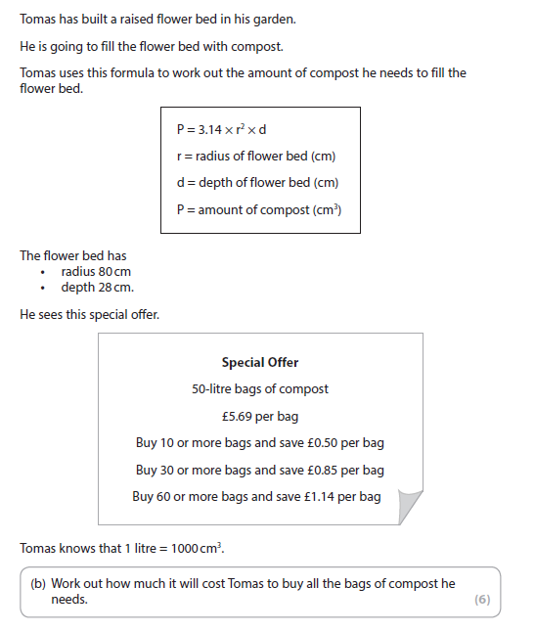
Exam Question

Slide 31
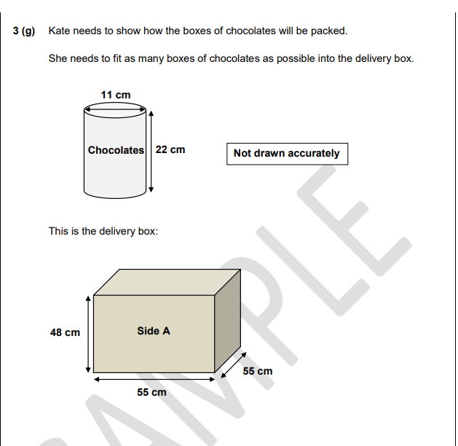
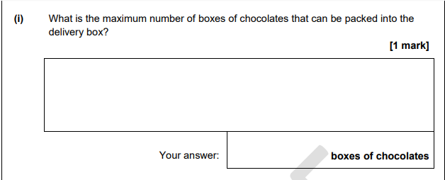
Exam Question

Slide 32
Working with Measure: Metric Measure, Conversion, Time, Area & Volume
How do you feel now that we have worked through each of these subjects a little?
TOPIC | Confident | OK | Need More Practice
Metric System
Conversion
Time
Perimeter, Area & Volume
Area & other shapes
Circumference and Area (Circles)

