Slide 1
Functional Skills Maths Booklet 4
Level 2 Intensive – 2019 Reform

Slide 2
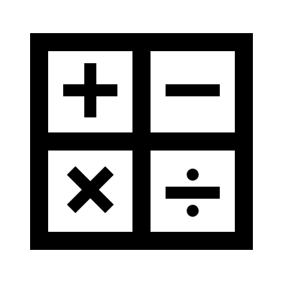
Guide:
Remember, no matter what we are doing in Functional Skills maths, we are doing with an understanding of both maths and problem solving.
You may need to buy more than you need.
Read the question: if they haven’t told you to do or not do something explicitly, and you can use a method to find an answer, then use it!
Within this booklet (as well as the others) you may see these symbols next to questions. Red means it was designed to be completed without a calculator, while green means it’s fine to use your calculator! If both are there, it means this could be on either paper!

Slide 3
Shape: Scale, Reflective and Rotational Symmetry, Angles, Identifying Shapes, Nets, Plans & Elevations
How confident are you on the following topics?
We will be covering all of these subjects withing our sessions.
TOPIC | Confident | OK | Need More Practice
Scale
Shape Knowledge
Symmetry
Angles
Nets, Plans & Elevations

Slide 4
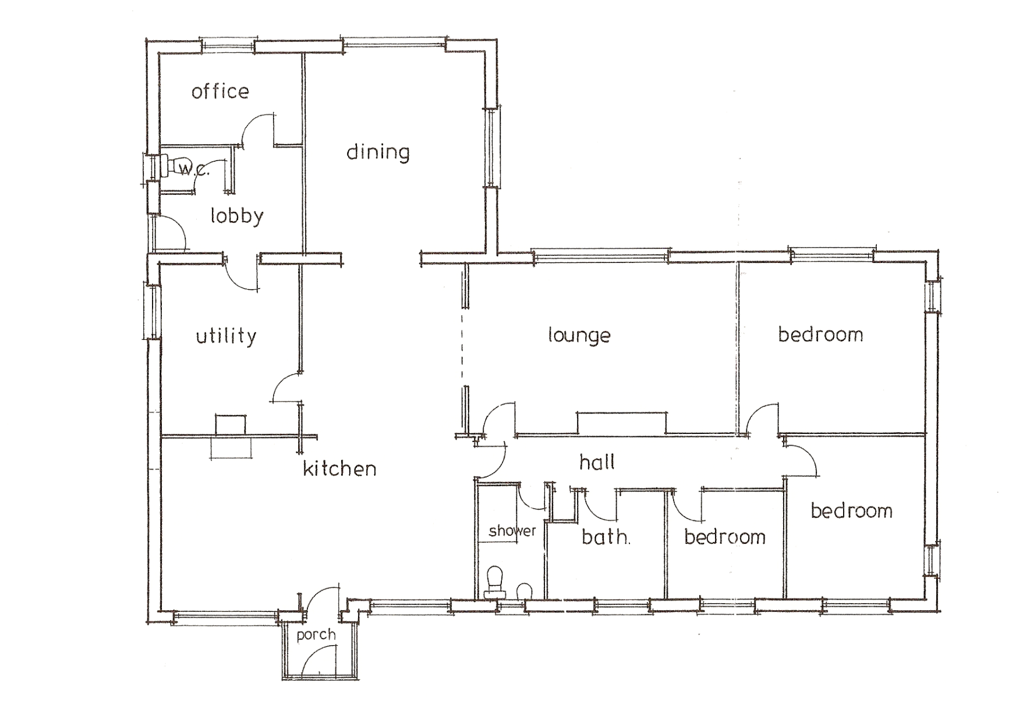
Scale
Scale is how we represent the real world in a small space.
Take a look below:
Plan by Andy Guard Associates
• Who uses a plan like this? Why?
• What information can you get from a scale diagram like this one?
• The scale is 1 : 100. What does this mean?

Slide 5
Scale
Using Scale
Scale is usually written as a ratio
e.g. 1:50
To work out the actual size you multiply the size on the plan by the scale factor
e.g. a length of 5cm on the plan would represent a real measurement of 5 x 50 = 250cm (using scale 1:50)
To draw an object to scale you divide the real size by the scale factor
e.g. a real object measuring 4m would be 400÷50 = 8cm on the plan (why did I use 400?)
Does this remind you of anything we have already looked at?
Does this remind you of anything we have already looked at?

Slide 6
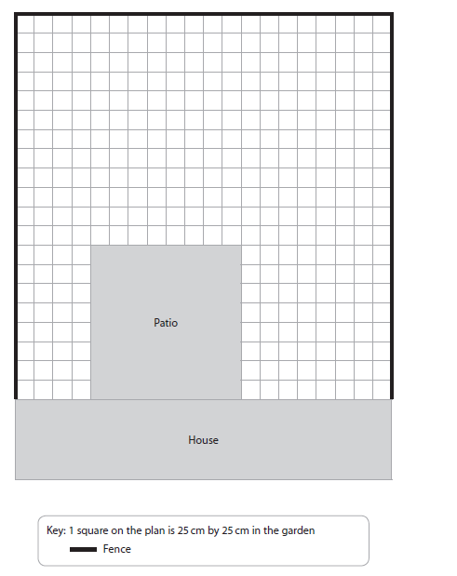
Exam Question

Slide 7
Identifying Shapes
For Functional Skills you need to be able to identify shapes. For most this won’t be too much of a problem. Here are some examples below:
Square: Four even length sides
Rectangle: Two sides are longer than the other two
Triangle: Three even sides (is this our only option?)
Circle: Perfectly round shape, with no sides.
Pentagon: A five sided shape.

Slide 8
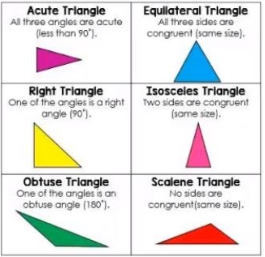
Identifying Shapes
There are more shapes though!! They can still come up in FS, so we need to go over them:
Triangles
These are the different types of triangle you could encounter… Don’t worry though! The formula for area is the same, no matter what!
Other shapes!!
6 sided = Hexagon
7 sided = Heptagon
8 sided = Octagon
9 sided = Nonagon
10 sided = Decagon
Try matching the shapes to the types!
Which one is missing?

Slide 9
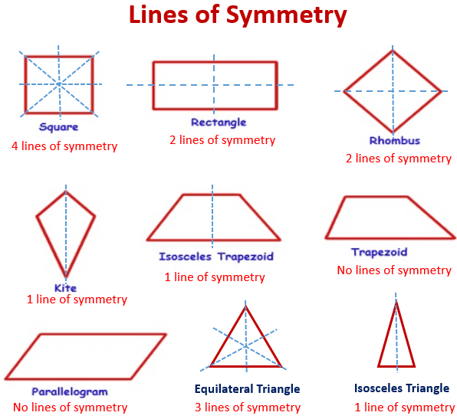
Reflective & Rotational Symmetry
There are 2 types of symmetry
1. Mirror or reflective symmetry
The shape or pattern is reflected in a mirror line
2. Rotational symmetry
The shape or pattern is rotated. This is equal to the number of points in a shape.

Slide 10
Reflective & Rotational Symmetry
How many different types of symmetry can you identify in the shapes below:

Slide 11
Angles
All shapes have angles; but what are they?
Angles are how we measure the space between two points (in a curve)
Angles are measured in the following ways:
Acute Angle
An angle less than 90°
Obtuse Angle
An angle between 90° and 180°
Reflex Angle
An angle greater than 180° and less than 360°
Right Angle
An angle exactly 90°
Straight Angle
An angle exactly 180°
Full Rotation
An angle of 360°

Slide 12
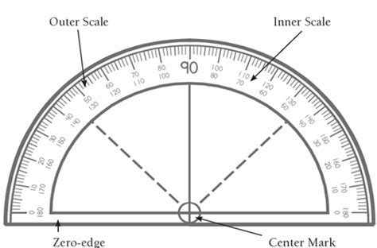
Angles
How do we measure angles?? Well we use this handy device!!
What you need to do, is line up the Centre Mark with the corner of your angle (where the lines meet).
Next, line up the zero edge with the starting edge.
Depending on which way you are measuring, you will need to use either the inner or the outer scale!
Try measuring the angles on the previous page!
Acute Angle = °
Obtuse Angle = °
Reflex Angle = °
Right Angle = °
Straight Angle = °
Full Rotation = °

Slide 13
Angles & Shapes
You may be asked to find the value of missing angles in shapes. You could measure all the angles, but this takes a lot of time. Instead, remember the following and it will help you!
Circles and Triangles:
Circles always have 360°
A triangle will always have 180°
The rest…
For all other shapes, you can follow this rule:
(Number of sides – 2) × 180 = total degrees in a shape
Lets try a square!
4 (the number of sides) – 2 = 2
2 × 180 = 360
There are 360° in a square
Try these shapes out for yourself!
°
°
°

Slide 14
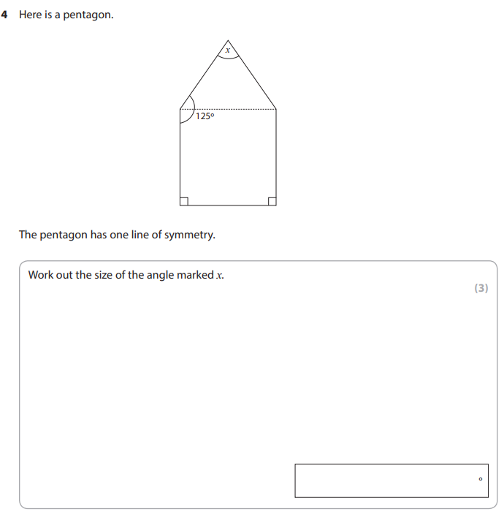
Exam Question
Tip: The question mentions that this shapes has one line of symmetry. This might make the question a lot easier if you can find it!

Slide 15
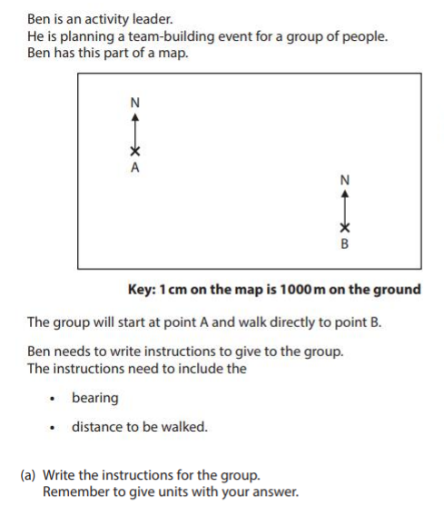
Angles & Bearings
You may also need to use angles to give bearings in directions. Below is an example of this style of question.

Slide 16
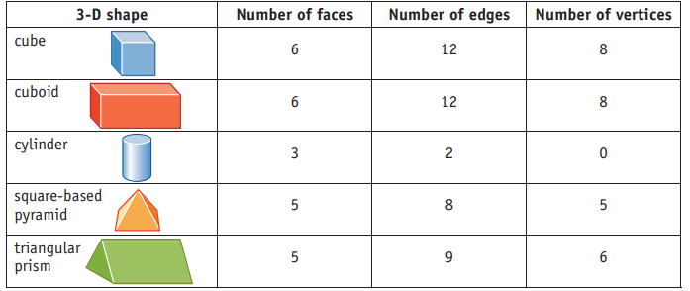
Nets, Plans & Elevations
A net is the 2D shape that you would need to cut out and fold to create a 3D shape
Faces are the flat surfaces of a shape. Edges are where these connect. Vertices are straight ‘bones’ of the shape.
Below is a table showing a 3D object, along with information on it’s faces, edges and vertices. Beneath that are four of the 3D shapes linked with their net. What might the fifth one look like?

Slide 17
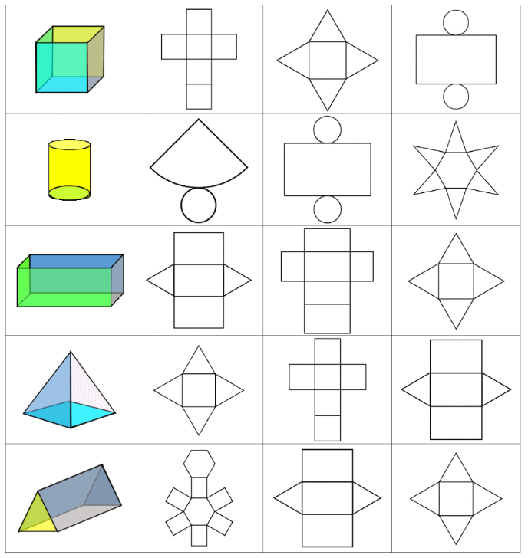
Nets, Plans & Elevations
Can you work out which nets go with these 3D shapes?

Slide 18
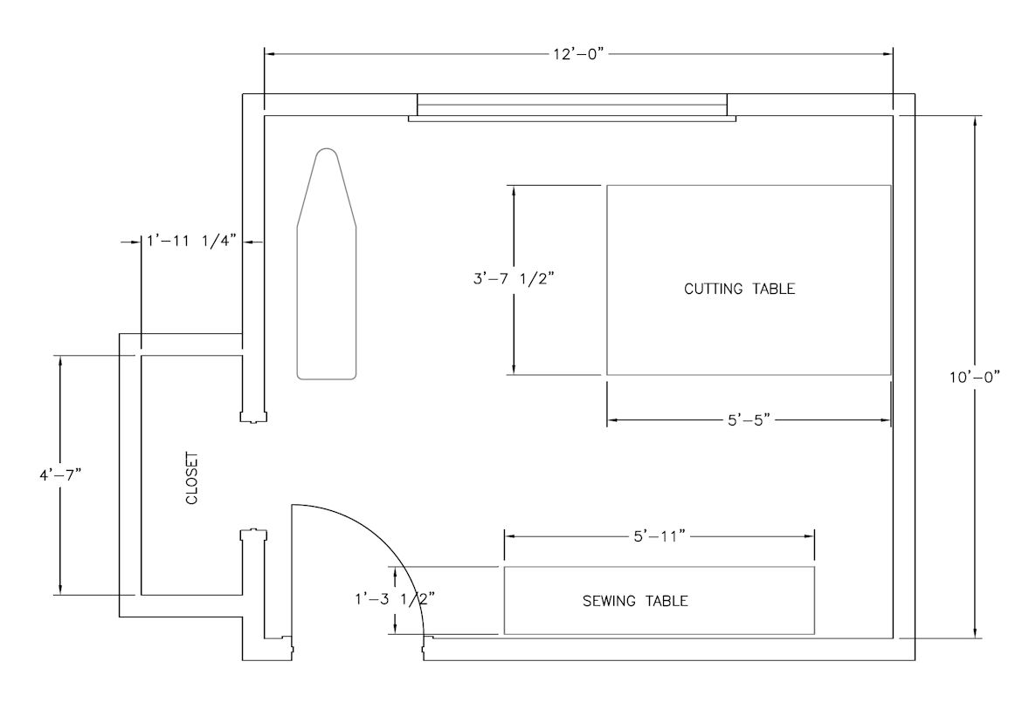
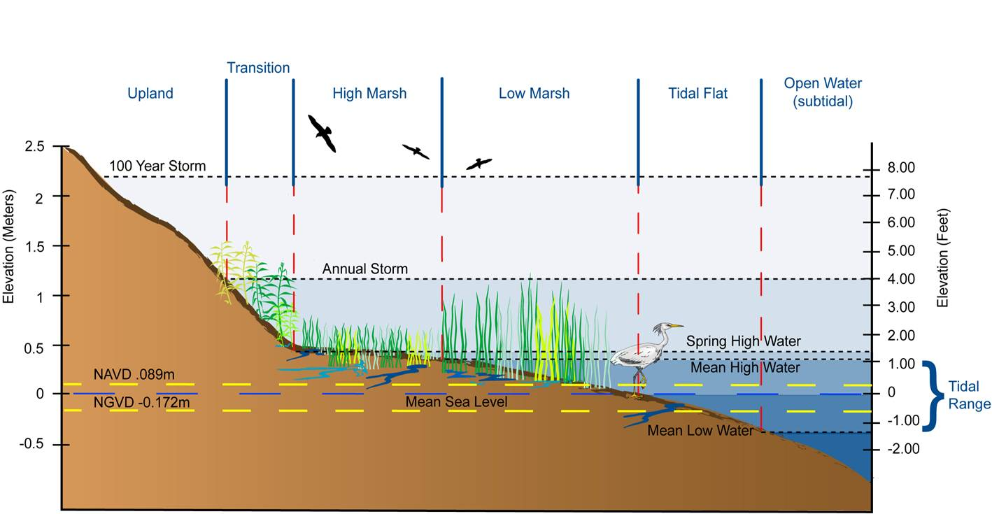
Nets, Plans & Elevations
A plan is the view of a 3D object from above. We use this for most of the questions on scale we looked at earlier
An elevation is the view from the side, front or rear of a 3D object

Slide 19
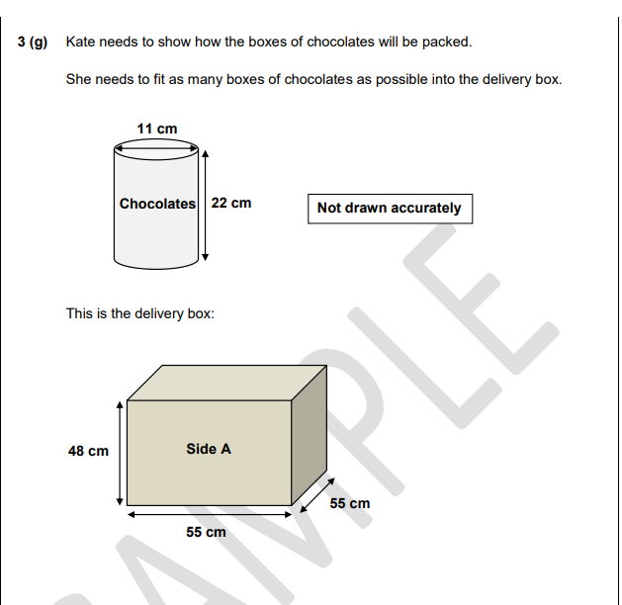
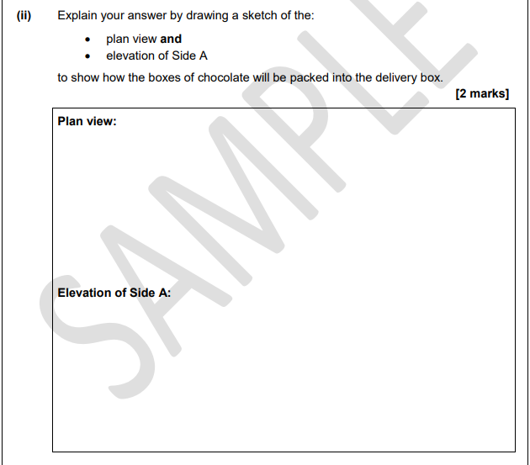
Exam Question
Remember to look at the number of points being given and the vocabulary used in the question: sketch indicates it does not need to be accurate in scale!

Slide 20
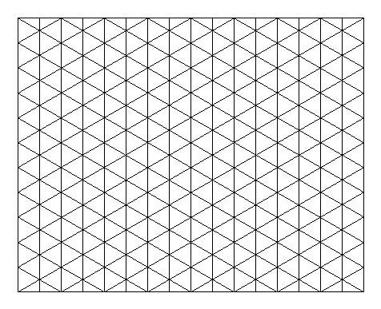
Isometric Drawing
Isometric drawings don’t come up very often in FS, but it’s important for us to know it and be able to understand.
You might need to re-create a 3D image. Below is an example how you should do this
You may be asked to draw a 3D shape on an isometric grid
An isometric grid is made up of triangles or dots in a triangular formation
Always start drawing your shape from a corner

Slide 21
Shape: Scale, Reflective and Rotational Symmetry, Angles, Identifying Shapes, Nets, Plans & Elevations
How confident do you feel with the following topics now that we have covered them?
TOPIC | Confident | OK | Need More Practice
Scale
Shape Knowledge
Symmetry
Angles
Nets, Plans & Elevations

