Slide 1
Functional Skills Maths Booklet 5
Level 2 Intensive – 2019 Reform

Slide 2
Guide:
Remember, no matter what we are doing in Functional Skills maths, we are doing with an understanding of both maths and problem solving.
You may need to buy more than you need.
Read the question: if they haven’t told you to do or not do something explicitly, and you can use a method to find an answer, then use it!
Within this booklet (as well as the others) you may see these symbols next to questions. Red means it was designed to be completed without a calculator, while green means it’s fine to use your calculator! If both are there, it means this could be on either paper!

Slide 3
Data: Averages (Mean, Median and Mode), Range, Correlation, Comparison of Data, Probability
How confident are you on the following topics?
We will be covering all of these subjects withing our sessions.
TOPIC | Confident | OK | Need More Practice
Averages & Range
Graphs
Correlation
Data Collection
Probability

Slide 4
3 types of average
We use different types of averages and data. What do these terms mean?
Mean -
Mode -
Median -
There’s another term we use!
Range is not an average, but it helps us to interpret the other averages by giving us a little more information about the spread of the data.
Most exam questions are about mean rather than the other averages as it is the one used most in everyday life

Slide 5
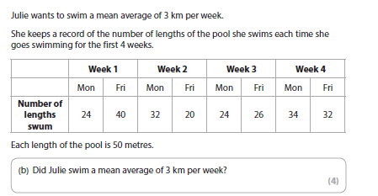
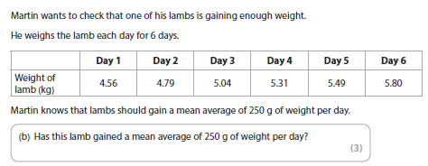
Extra Average Questions

Slide 6
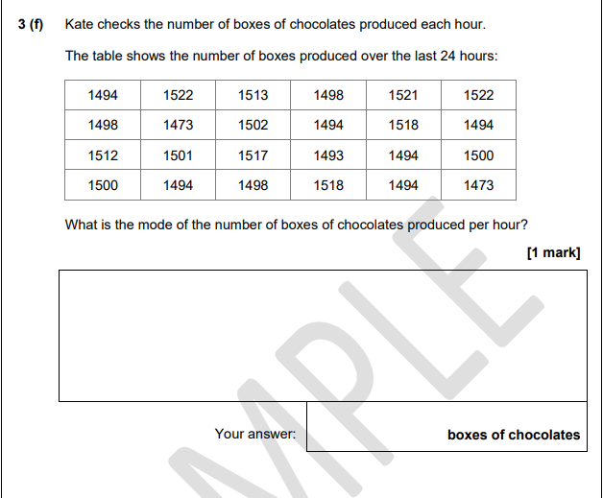
Exam Question

Slide 7
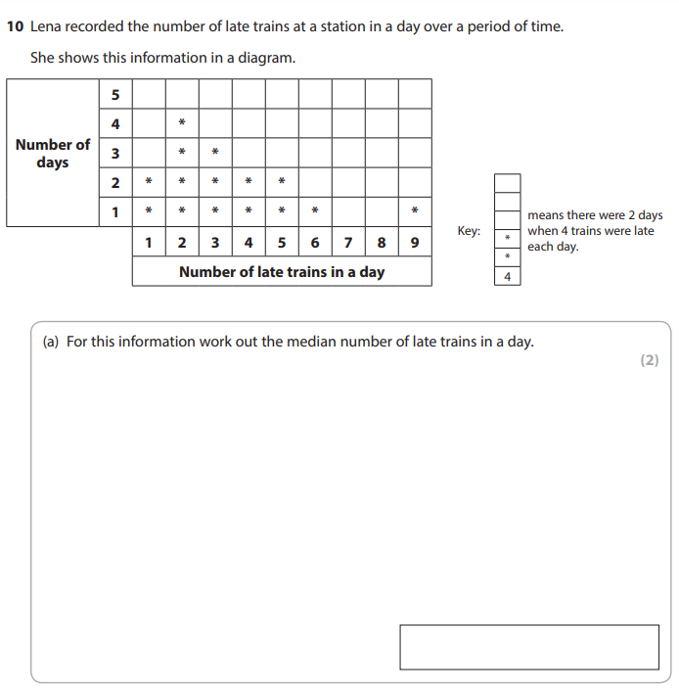
Exam Question

Slide 8
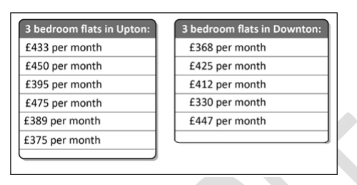
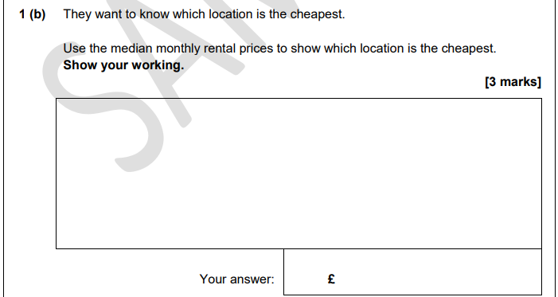
Exam Question

Slide 9
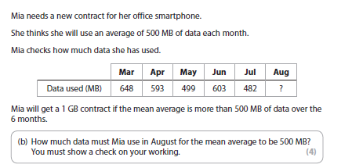
Using the mean to find missing values
At level 2 instead of just working out the mean from a set of data they may expect you to use your skills to work out a missing value from the data.
You need to use what you know about mean, but do it backwards
REMEMBER!
We know that
Total ÷ n = mean (n is the number of values)
In these questions you are given the mean and n
How can you work out the TOTAL?
Mean x n = total

Slide 10
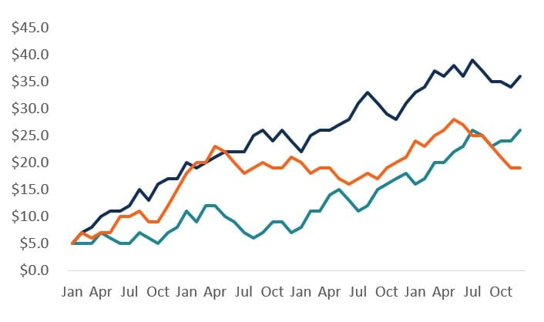
Graphs and Charts
In functional skills you will be expected to be able to read and interpret graphs (we did a little of this with conversion!), as well as generate your own from data.
You usually get 3 marks for drawing a graph or chart.
Labelling the axes – don’t forget to include units such as £ or cm
A linear scale – the numbers must go up evenly
Accurate plotting – use the scale you have chosen carefully
Types of Graph
Line Graph
The most common type of chart graph is the line graph. This is the perfect solution for showing multiple series of closely related series of data and progression over time.

Slide 11
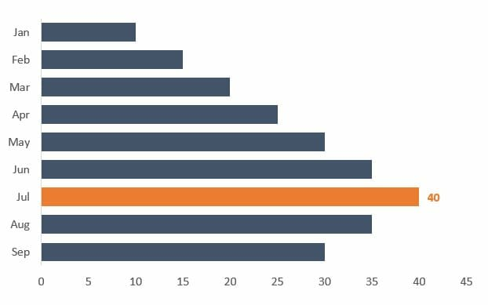
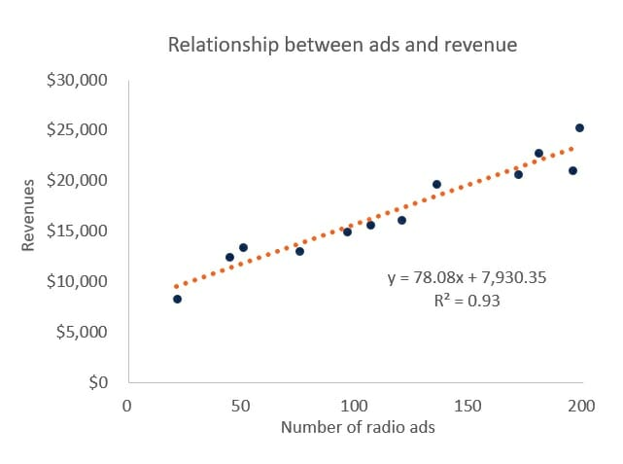
Types of Graph
Bar Chart
Bar charts are the best types of graphs for presenting a single data series. Bar charts have a much heavier weight to them than line graphs do, so they really emphasize a point and stand out on the page
You might be more used to seeing this graph going up rather than along – Don’t worry! Both are fine
Scatter Graph/Line of Best Fit
The scatterplot shows the relationship between two data series and determines correlation. A line of best fit shows us the average by passing through the most plotted points.

Slide 12
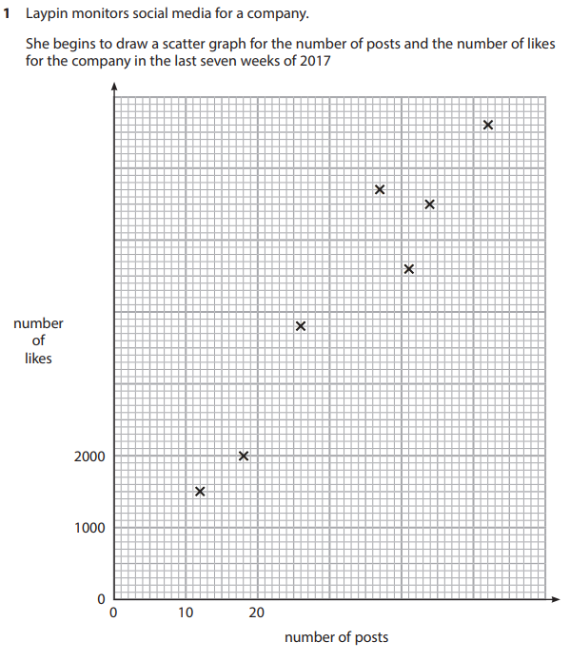
Exam Question
Question continues on next page…

Slide 13
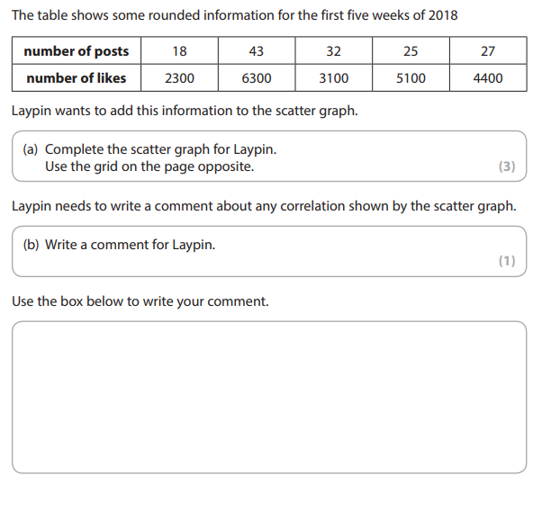
Exam Question

Slide 14
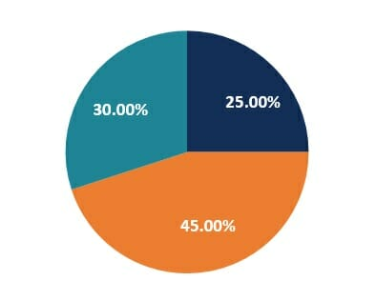
Types of Graph
Pie Charts
Pie charts are a good way to visualise how we have broken up something into smaller sub-sections. This is using the degrees of a circle again (Remember our angles!)

Slide 15
Probability
The probability of an event can be described as likely, unlikely, impossible or certain.
Some probabilities can be given a value and are expressed as a fraction, decimal or percentage
The total probability of all possible outcomes = 1 or 100 %
Impossible
Unlikely
Evens
Likely
Certain
0%
1-49%
50%
51-99%
100%
0 1-49 50 51-99 100
100 100 100 100 100
You will need to simplify these numbers if you choose to express as a fraction!!

Slide 16
Probability
You may also need to work with probability trees. They look like this:
1
2
1
2
1
2
P(HH) = x =
Heads
1
4
1
2
Heads
1
2
1
2
P(HT) = x =
1
2
Tails
1
4
1
2
1
2
1
2
P(TH) = x =
1
2
Heads
1
4
Tails
1
2
1
2
P(TT) = x =
1
2
Tails
1
4
Probabilities on each branch add up to 1
Multiply along the branches to work out the probabilities
Possible outcomes are shown on the end of the branches

Slide 17
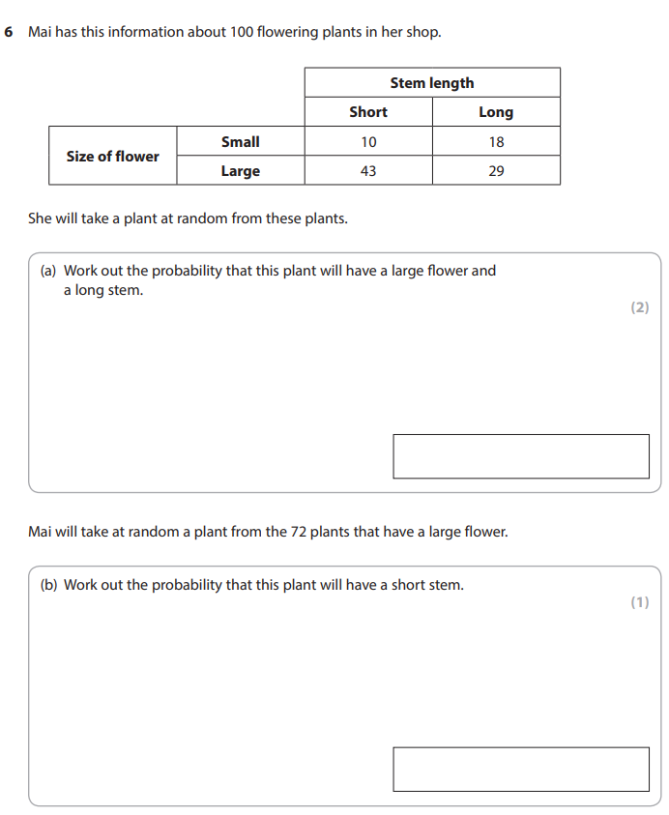
Exam Question

Slide 18
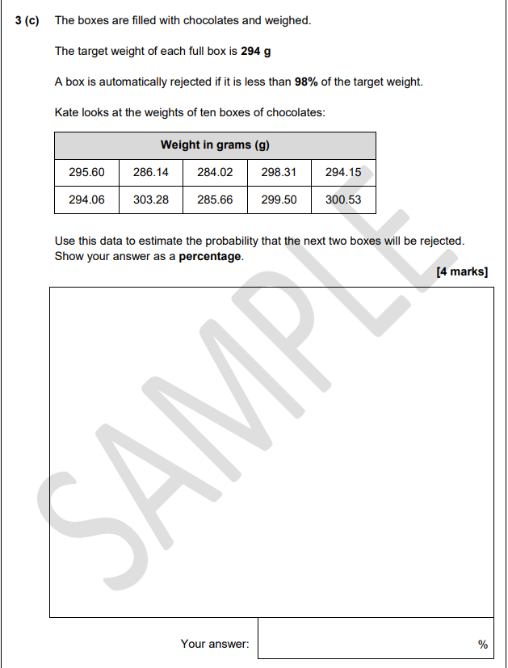
Exam Question

Slide 19
Data Collection
In level 2 Functional Skills Maths, you will need to be able to produce a table that can correlate three pieces of data.
There is a set way of formatting Data collection at this level.
Key:
D = Data
F = Field
Every piece of data will have options. We call these fields.
For example, there could be the following Data to be entered:
Gender – the fields are male or female.
Age – the fields would be the age groups looked at, i.e. 15-18 and 19+.
Time spent at location – the fields would be the time groups looked at, i.e. up to 2 hours, 2-4 hours and 4+ hours
You will also be expected to be able to take information from data and analyse it. This is normally given as an expression or percentage!

Slide 20
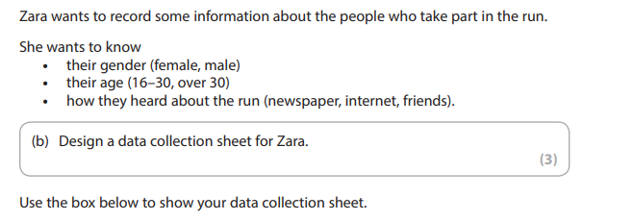
Exam Practice

Slide 21
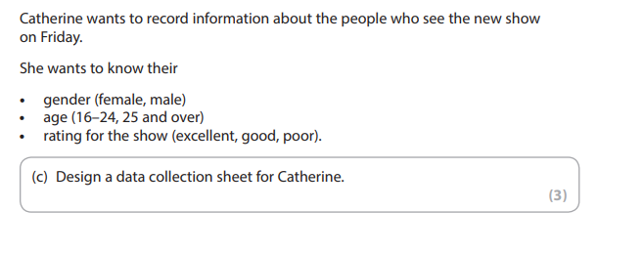
Exam Practice

Slide 22
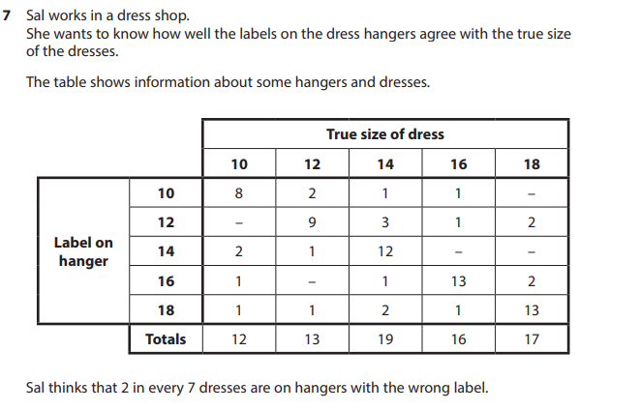
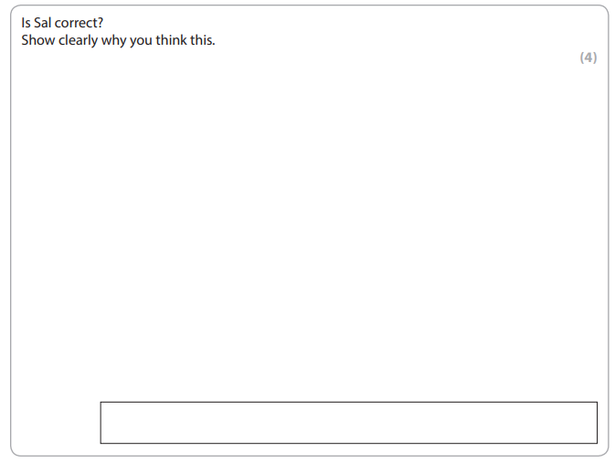
Exam Practice
Here you are using data to confirm if the analysis of probability is correct.
Work out the probability for yourself! THEN compare!

Slide 23
Data: Averages (Mean, Median and Mode), Range, Comparison of Data, Probability, Correlation
How confident do you feel with the following topics now that we have covered them?
TOPIC | Confident | OK | Need More Practice
Averages & Range
Graphs
Correlation
Data Collection
Probability

Slide 24
Last Minute Tips:
Remember:
Percent, Fractions and Ratio’s are all about looking at parts of a whole.
Multiply = groups of
Division = split into groups of
Have a go at all questions – you pick up points all the time, as long as you have a go!
Make notes after each question – remind yourself why you are doing something in the exam! It will help you if you have to go back to a question!
Look at the points being awarder –
1 or 2 points should only take a couple of minutes.
3 or 4 minutes up to ten minutes.
5 or 6 point questions up to 20 minutes (If they are really tricky)!
Don’t spend too long on low mark questions, and double check if you speed through a high point question!
Read the question carefully! Don’t make things too hard for yourself, and don’t assume anything – read the full question. Functional Skills assesses your ability to take in all information as well as your maths.
This qualification is split in how it assesses you – 25% Mathematical, 75% problem solving. Sometimes you’ll need to break maths conventions!

