Slide 1
Functional Skills Maths
Pre-Intensive
Level 1 & 2

Slide 2
General Information
Course Breakdown
Welcome to the Functional Skills Maths Pre-Intensive guide book. This booklet is designed to give you an insight into the intensive course.
The course taught consists of 5 central topics, which each cover a number of maths skills to be applied in real life situations. These topics are:
Number
Formula
Measure
Shape
Data
Each of these is covered in more detail in later sections of the booklet.
Duration
The course is designed to be delivered over two or three days, with the final examinations to take place at the end of the second/third day.
Each day will start at 9.30, end at 16.00, and be broken into one hour sessions, with a number of small breaks and one longer lunch break.
Exams
At 16:00 on the second/third day, you will sit two exams:
A 25 minute non-calculator exam
A 90 minute calculator exam
There is a small break between exams, but you will not be allowed to leave the exam room during this time.

Slide 3
General Information
Equipment
Non-Scientific Calculator
Compass
Protractor
Pencil
If for any reason you cannot bring these items, please inform the Maths & English department at the college, and we will be able to provide you with said equipment.
Unless specified to the college prior, your exams will be sat on computer. Part of the course will include familiarising you with the interface. If you require a paper based exam, and are in any doubt as to what has been booked, please contact the Maths and English department to enquire.
If you have previously had concessions in exams, it is your responsibility to ensure that the college is made aware. If you can evidence previous concessions, this will speed up the process of putting them in place. If you cannot evidence prior exam support, you will need to have an assessment at the college: this process takes time, and if not requested to the college directly, and prior to your invitation to this booking of the course, it will not be able to be put in place before this courses exam.
If you are in any doubt as to any of the above, please get in touch with your contact point at the college (Course Leader, Apprentice Coach, Maths & English Trainer, etc.), or the Maths & English Department on:
Email – MandEQueries@chichester.ac.uk
Exams
Exams Concessions
Contact

Slide 4
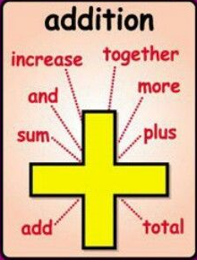
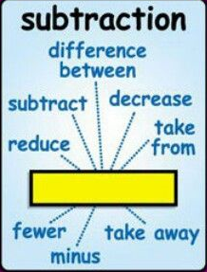
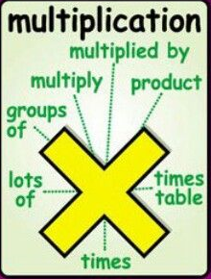
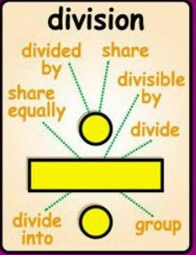
Number
Number is the core topic which will apply to every aspect of your Functional Skills maths in some way.
It consists of:
Mathematical Operations
Addition & Subtraction
You’ll be shown how addition and subtraction can be applied to a number of situations which you may not have considered previously.
Multiplication & Division
You’ll be shown how multiplication and division are central to nearly all aspects of functional skills, as well as manual methods to multiply for the non-calculator exam.
Place Value
You will be shown how place value works for operations, as well as how it affects the other elements of FS maths.

Slide 5
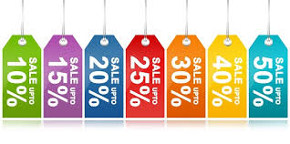
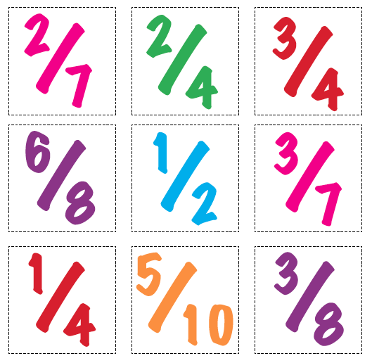
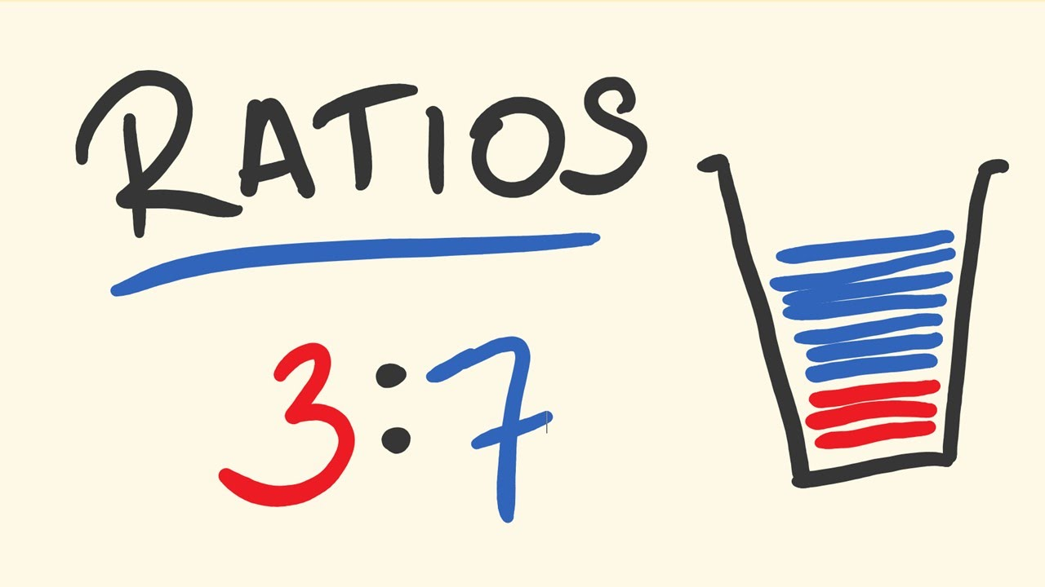
Number
Percentage
You will be shown how to calculate percentage of a total, working out 100% from a part, percentage change (increase and decrease) as well as alternative methods for percentages.
Fractions
You will be shown how to work with fractions of total amounts, operations with variable fractions and simplification of fractions.
Ratio
You will be shown how to use ratios in real life contexts, find the total amount using part of a ratio, as well as

Slide 6
Number
Real World Uses
Working out how much you are saving in sales
How much interest you should be paying on purchases/charges
Comparing value for money on products
How much to tip at restaurants
Which offers are the best
Working out how much of each ingredient to use when adapting recipes

Slide 7
Formula
In the formula section of the course, you will be shown how to interpret formula in questions, use formula in real life situation as well as how to prove your own sums as accurate when asked.
Key Formula
While you will be given formula to use in certain questions, you are still expected to know some from memory. The following are the key formula to remember:
Area (²)
Volume (³)
Length
= Length × Width
= Length × Width × Height
(Area)
Width
Height
Width
Length

Slide 8
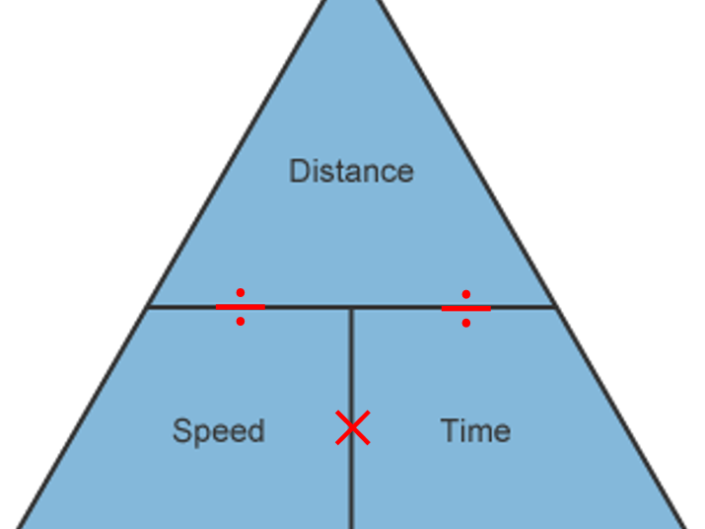
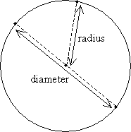
Formula
Key Formula (Cont.)
Distance = Speed × Time
Speed = Distance ÷ Time
Time = Distance ÷ Speed
Circumference & Area of Circles
(Level 2)
Circumference is the outside of a circle.
To work out the Circumference, you need to multiply:
To work out the area of a circle, you need to multiply:
∏ = Pi
Pi is 3.14
∏ × Diameter
∏ × Radius × Radius

Slide 9
Formula
Inverting Operations (to prove your sums)
While not a formula, it’s useful for you to remember the inverse, or opposite operations:
Addition is the inverse of Subtraction
Subtraction is the inverse of Addition
Multiplication is the inverse of Division
Division is the inverse of Multiplication

Slide 10
Formula
Real World Uses
Knowing how much carpet/how many tiles to buy when doing up the house
Checking you’re not being wrongly charged by different businesses/organisations
Make sure you haven’t paid too much/too little for something

Slide 11
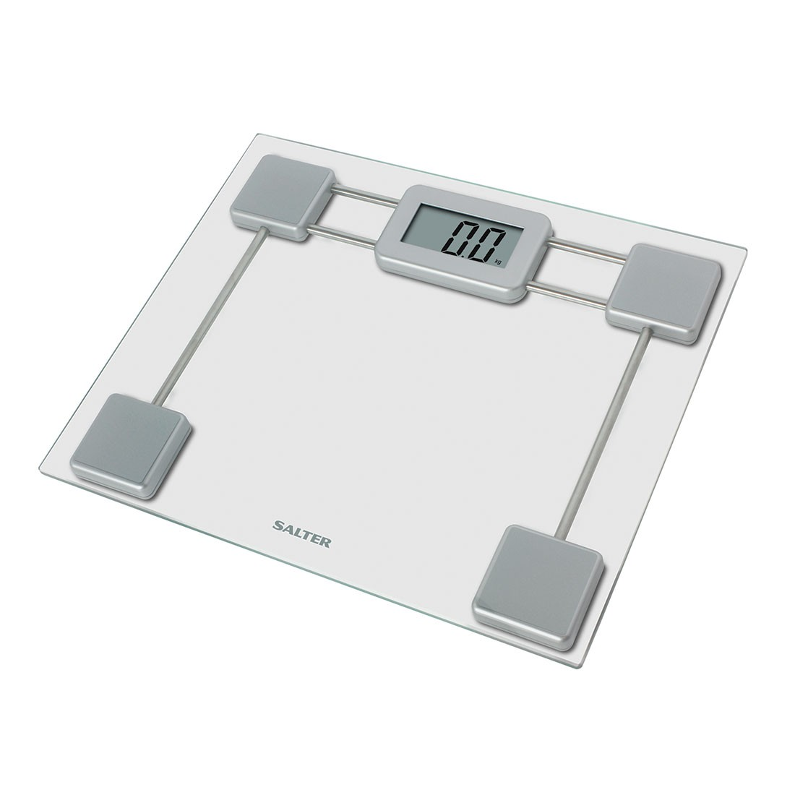
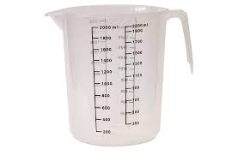
Measure
In the measure section of the course, we will look at how to convert between different units of measurement (including currencies), how to use conversion factors, how to apply the formula for Perimeter, Area and Volume, as well as how to work with time conversion.
Units of Measurement
You are not expected to remember how to convert all the possible units you will have to work with in the exam. Quite often, you will be given the information needed to convert and work with the information you are dealing with.
You ARE expected to remember the Metric Units for the exam.
Distance Metres
Weight Grams
Capacity Litres
10 mm = 1 cm
100 cm = 1 m
1000 m = 1km
10 mg = 1 cg
100 cg = 1 g
1000 g = 1kg
10 ml = 1 cl
100 cl = 1 l

Slide 12
Measure
Correctly weighing up ingredients for meals
Accurately working out how much of each material you may need while working on your house
Working out how much of individual materials you need via conversion
Understanding quantity and dosage strength in relation to medications
Knowing how much to buy of something so you don’t end up with too little or too much
Real World Uses

Slide 13
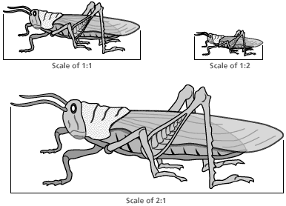
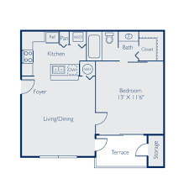
Shape
In the shape section of the course, we will look at how to work with scale, symmetry and angles, as well as looking at different shapes, nets, plans and other scale drawing.
Scale
Scale is how we can represent bigger things from real life into things like floor plans, models, etc.
You will be shown how to use scale factors for drawing and how to interpret scale drawings for construction.
Floor Plans
Floor plans are one of the many ways we use scale. What sort of professions use scale drawings like this? Why might you use scale drawings in your life?

Slide 14
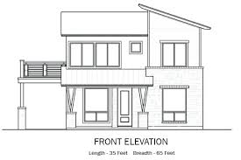
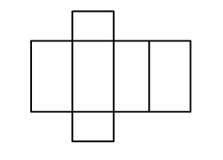
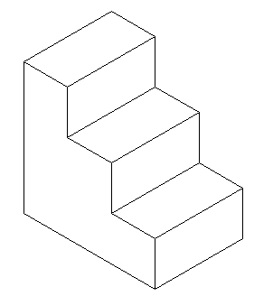
Shape
Elevations
Elevations are drawings taken from one side of a 3D object/area.
You can have front, back and side elevations.
Nets
Nets are 2D drawings of a 3D shape, unfolded. You might be asked to make a scale net of something like a jewellery box in the exam.
3D Shape Net
Isometric Drawing
Isometric drawing is 2.5D; a 3D object represented in 2D. You may be asked to replicate an isometric drawing in your exam.

Slide 15
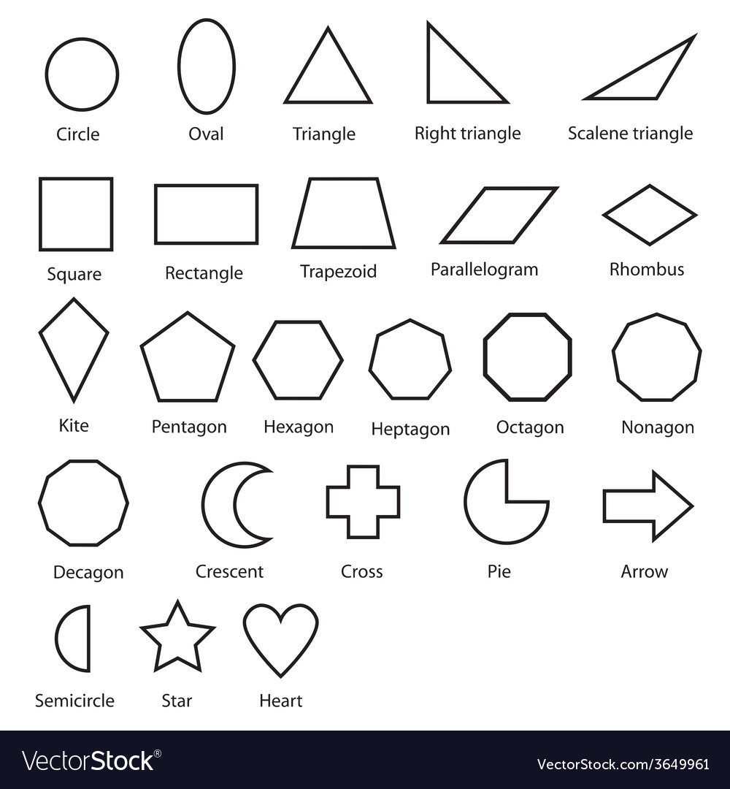
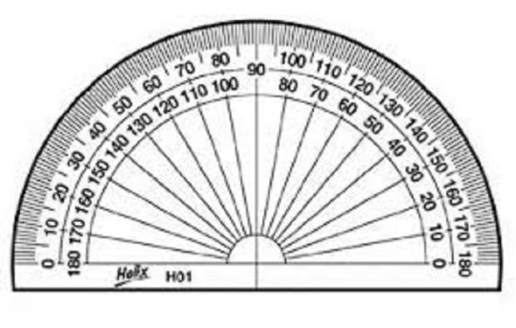
Shape
Symmetry, Shapes & Angles
You may be asked to work with certain shapes in different situations for, so it is important to be able to identify key shapes. Below are the sorts of shape you MAY encounter in the exam.
You Might be asked to identify lines of symmetry (a line that you could place a mirror on and reflect the shape so that it still looks the same)
Working with Angles
You may be asked to work with angles in the exam. This could be measuring them, this could be working out missing angles in a shape, or it could be drawing a shape using them.

Slide 16
Shape
Planning construction in advance
Being able to work out how many materials you may need for a project in advance
Making sure things are symmetrical (so that they match)
Knowing how much carpet you may need (for shapes of rooms not square) to re-carpet a room
Real World Uses

Slide 17
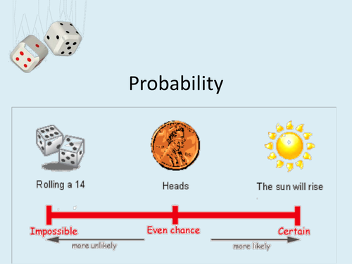
Data
In the Data section of the course, we will look at how to interpret data via averages (mean, median and mode), range, graphs, probability and collection sheets, as well as how to compare said data and how to comment on your use of data.
Averages & Range
You will be shown how to use the three types of average to produce analysis of data, as well as how to find data from an average. You will also learn how to use the range of data – this is not an average, but is linked.
Mean = Add up all data, and ÷ the result by the number of data
Median = the middle value of the data in order or smallest to largest
Mode = the most repeating data value (often there won’t be a mode)
Range = smallest data value subtracted from the largest
Probability
Probability is how likely something is to happen or not. You will be taught how to work out the probability of an event, as well as how to express probability through comments, percentage and fractions.

Slide 18
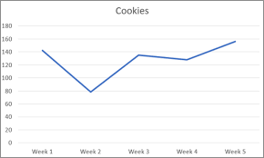
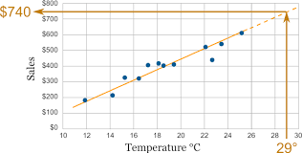
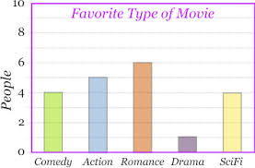
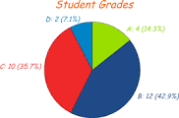
Data
Graphs & Charts
Graphs & Charts are a key tool to displaying data for analysis. You will be shown the use and application of multiple types of graph and chart to draw information, as well as how to generate your own to display data.
Types of Graph
Line Graphs
Scatter Graph/Line of Best Fit
Types of Chart
Bar Chart
Pie Chart
At Level 1 you will be expected to be able to work with all of the above, with the exception of line of best fit/scatter graph!
At Level 2 you will be expected to be able to work with scatter graphs, lines of best fit, and comparative charts and graphs!

Slide 19
Data
Data Collection
Data Collection includes some of the methods above (Tally Charts for example), but also includes specific data collection sheets; forms designed to produce data and correlation (a connection). There is a key difference between Level 1 and Level 2.
Level 1 Data Collection Sheet
At Level 1, you will need to correlate two pieces of data into a form. This could be Gender and Age of customers online.
 | Male | Female
16 – 24 years old
25+ years old
Level 2 Data Collection Sheet
At Level 2, you will need to correlate three pieces of data into a form. This could be Gender, Age and Time Spent by customers online.
 | Male |  | Female
 | 16 – 24 years old | 25+ years old | 16 – 24 years old | 25+ years old
1 – 2 hours
3 – 4 hours

Slide 20
Data
Budgeting for the month/year
Keeping a track of expenses
Keeping a track of trends in business, behaviour, etc
Representing data to others
Making connections between causation and correlation
Being able to work out the probability of something
Real World Uses

Slide 21
How to prepare for this course
It may have been a long time since you last studied maths, and this may look like a lot to go over. You might want to look at some topics in advance; that’s fine! There are many online resources for you to look at on maths, but don’t delve too deep…
The key to maths (and every skill) is repetition; practice makes perfect. Reading something once won’t make you an expert; but reading something 100 times, 1000 times, or more… you’re well on your way to memorising it!
The next page will give you some basic maths ideas to try and apply to every day life in the lead up to this course. The following page will give you some ideas on how to use them, but feel free to come up with your own as well!!

Slide 22
How to prepare for this course
Percentage = Total Number ÷ 100 to find 1%, and then multiply by the percentage you are looking for.
Mean Average = add up all the data you have, and divide by how many pieces of data added (i.e. add up the temperature each day for a week, and divide by the number of days).
Range = subtract the smallest piece of data from the biggest.
Proportion increase = increasing something as a whole, rather than individual measurements. (i.e. taking the amount of sugar consumed in a day and multiplying by 7, rather than measuring all sugar in take for 7 days)

Slide 23
How to prepare for this course
Below are some everyday things you could do to practice maths in a small way. Every little helps!!
Why not total how much money you spend in an entire week, and then work out the average amount you spent each day?
Why not measure some items around the house using a tape measure, and try converting from cm to meters (÷100)?
Why not practice your times tables (again, repetition is the key to memory)?
Why not work out how much it would cost to re-carpet the house? (Area of each room, × by the cost of carpet per m²)
Why not work out how much more you would need of each ingredient in a meal you make for your family if you were making it for 12 people?
Why not work out how much sugar you take in a cup of coffee, and then work out your total sugar for the week (from coffee)?

Slide 24
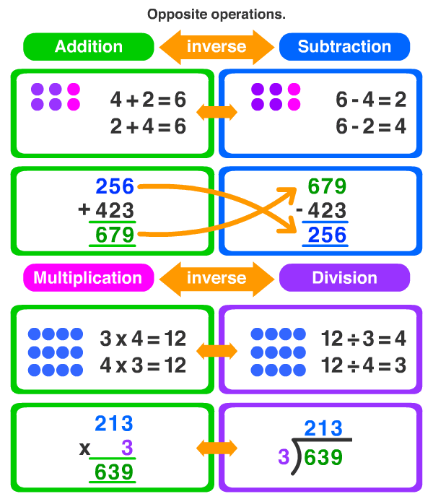
Cheat Sheet
Times Tables
Reverse Methods (Checking sums)

