Slide 1
Functional Skills English Level 2
Intensive Day - Reading Booklet – 2019 Specification

Slide 2
Course Breakdown
Functional Skills English is broken up into several components. They are as follows:
Reading Exam – Level 2 = 75 Minutes
Writing Exam – Level 2 = 60 Minutes
Speaking & Listening Component = 20 Minute Discussion & 10 Minute Presentation
This booklet will guide you through the Reading section of the course.
Course Content:
This course will booster your ability to draw meaning from texts to answer questions, as well as constructing your own pieces of writing using similar techniques.
You actually use all of these skills already, you just may not know the technical language for these skills!

Slide 3
Texts – What is a text?
You will be dealing with texts in all aspects of FS English… but what is a text?
The dictionary definition of the word TEXT
Noun,
1) A BOOK OR OTHER WRITTEN WORK
2) THE MAIN PART OF WRITTEN WORK, NOT INCLUDING PICTURES AND DIAGRAMS ETC.,
3) WRITTEN OR PRINTED WORK FROM A COMPUTER
So basically, any written work is a text! You will be given three texts to look at in the reading exam and expected to produce 2 texts for the writing exam.
All texts have purposes, but what is the purpose of an advert? What is the purpose of a review?

Slide 4
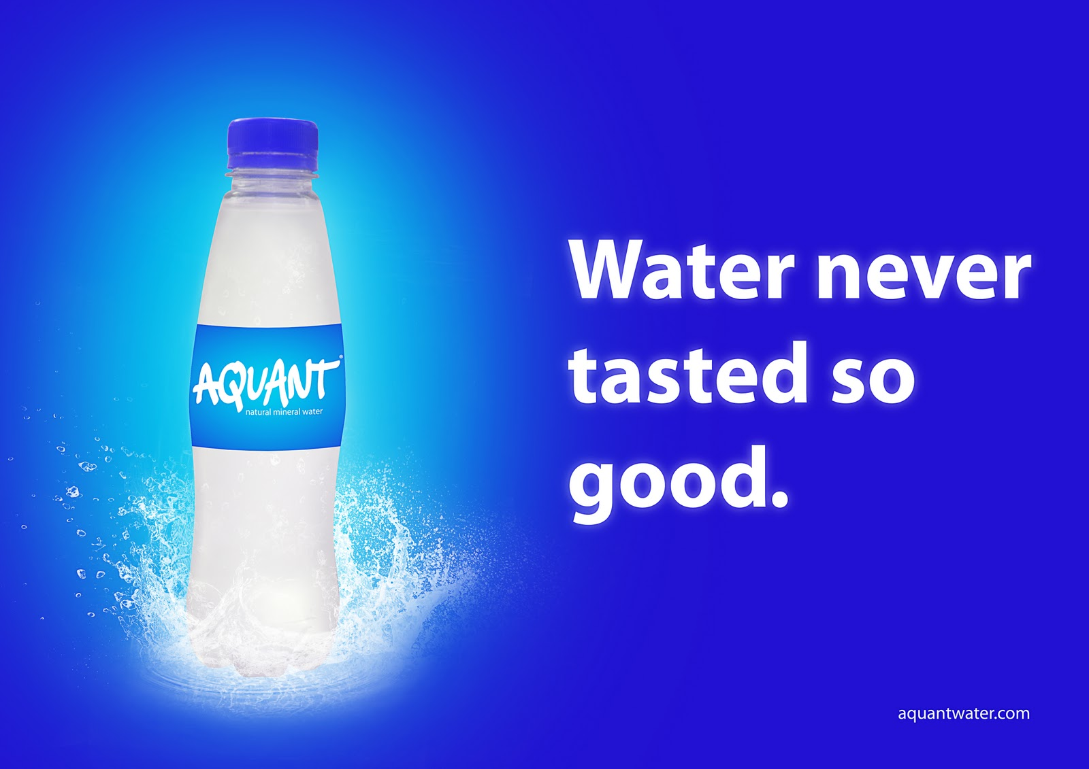
Texts – What is the purpose?
What is the main purpose?
Every text that we come across has a purpose;
The purpose is the reason for the text being composed/written.
For example;
The purpose of an advertisements is to persuade.
The purpose of a stop sign is to warn of impending (or possible) danger.
In each case, the purpose of a visual text will influence the way in which it is composed/written.

Slide 5
Text - Purpose
There are three main types of text that you will encounter.
The Big Three are:
To Instruct
teach, show, coach,
train, educate
To Inform
advise, direct, notify,
explain, tell, enlighten
To Persuade
influence, lead, sway,
encourage, entice

Slide 6
Purpose of Text - Persuasive
The purpose of Persuasive Texts is that these really want you to DO something, or change your mind!
Persuasive Texts include:
Relevant Images
Rhetorical Questions
Emotive Language
Rule of Three
Text in Capitals and Bold
Humour
Price
Exclamation & question marks

Slide 7
Purpose of Text - Informative
The purpose of Informative Texts is that the text wants to ADVISE or TELL you something!
Informative Texts include:
Avoid Repetition
Contains Facts and Statistics
Information is given in a clear and precise way.

Slide 8
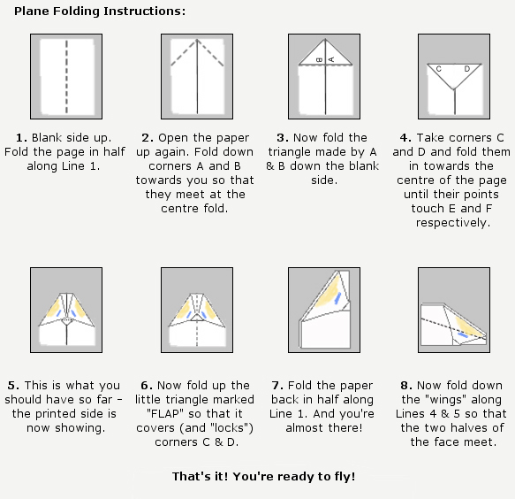
Purpose of Text - Instructive
The purpose of Instructive Texts is to tell you HOW to do something!
Informative Texts include:
Series of steps
Direct language
Often uses ‘must’ and ‘must not’
Uses diagrams, pictures or pictographs to help understanding.
Imperative verbs, i.e. cook, cut, place, etc

Slide 9
Fact
Fact or Opinion
Facts and Opinions can give us a better indication of what type of text we’re looking at.
Fact – Facts can be backed up with evidence that can be checked. Facts are always objective.
The following are typical examples of fact:
Water boils at 100 degrees Celsius (we can perform an experiment to check)
Blue Whales are the largest animal on the planet (we can compare it to other animals)
Avengers: Endgame is the most successful film of all time (we can check box office and compare with other films)

Slide 10
Fact or Opinion
Opinion
Opinion – Opinions are points of view or beliefs. Opinions are not based on evidence that can be checked. They are always subjective.
The following are typical examples of opinion:
Water is delicious (not everyone might agree with this)
Whales should not be hunted (not everyone might agree with this)
Avengers: Endgame is the best film ever (not everyone might agree with this)

Slide 11
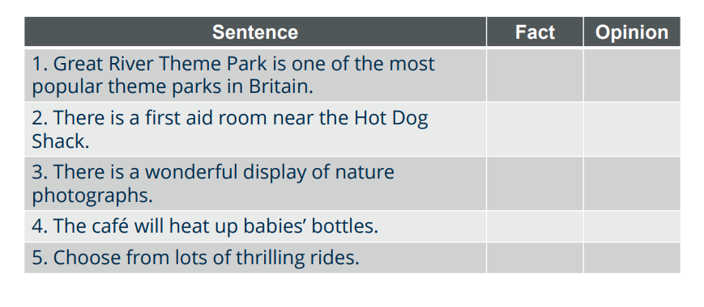
Fact or Opinion - Practice
Read the following text and decide if the sentences beneath are fact or opinion!

Slide 12
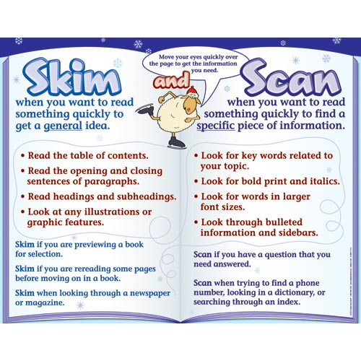
How to Use Texts in the Exam
You’ve now looked at the types of text you’ll have to engage with in the exam, we’re going to look at how we break them apart for points!
Skimming & Scanning
Two of the most valuable skills you will need to use in the FS English Reading exam are Skimming and Scanning.
Summary
Skimming – For getting a general idea of a text
Scanning – For finding specific information quickly

Slide 13
How to find information fast
If a text has subheadings, use these to find the information you need.
If you need numerical information, you can scan a text to find these as they stand out.
Use the text features writers use, e.g. bold font, bullet points, numbered lists, etc.
You will need to be able to find both explicit and implicit meaning from texts:
Explicit information is stated clearly
Implicit information is implied, but not stated openly
Can you think of examples of explicit and implicit information?
Explicit/Implicit Information

Slide 14
Language Features!
Language Features are how writers use language to get specific outcomes from their readers. You actually know these already – you use them everyday, you’ve just not learned what they’re called!
Direct Address – The writer uses the words ‘you’ and ‘your’ to make the reader feel engaged.
Alliteration – When a series of words start with the same letter or sound to make it stay in your head easily!
Facts – something known to exist or have happened, which adds credibility to an argument.
Opinion – A personal response to an idea which may influence the readers own point of view.
Rhetorical Questions – A question which does not expect an answer, but is designed to make you think about the subject.
Emotive Language – Choice of adjectives to influence
Similes – A way to make comparisons for effect, using the words ‘like’ or ‘as’ in the example.
Triplets – Three connected words (i.e. idea, sound, etc)

Slide 15
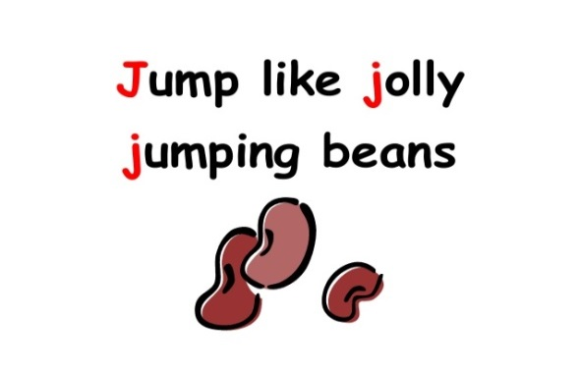
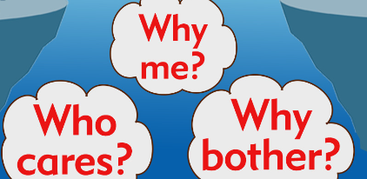
Which Language Feature?
Language Feature:
Language Feature:
Language Feature:
Language Feature:
Language Feature:

Slide 16
Presentation/Organisational Features!
Presentation Features are how we organise our ideas to have the most effect. In this section we will go through the most obvious Presentation Features that you can expect to encounter:
Headline – Lets us know what the overall topic of a text is.
Subheading – Helps us to find specific information or identify where to find specific information.
Bullet Points – Clearly spaces out ideas, and makes them clean for readers.
Italics – Highlights words of importance.
Words in Bold – Highlights words of importance.
Words underlined – Highlights words of importance.
Image – Helps the reader to connect with ideas in text via real world application.
Border – Clearly separates out parts of text.
Text Box – Clearly separates text from main body, sometimes repeating ideas in new ways.

Slide 17
Practice!
Take a look at the exam texts provided on the next three pages. Choose two of them. Can you spot the presentation features and can you spot any language features?
Text 1
Presentation Features:
1.
2.
3.
Language Features:
1.
2.
3.
Text 2
Presentation Features:
1.
2.
3.
Language Features:
1.
2.
3.

Slide 18
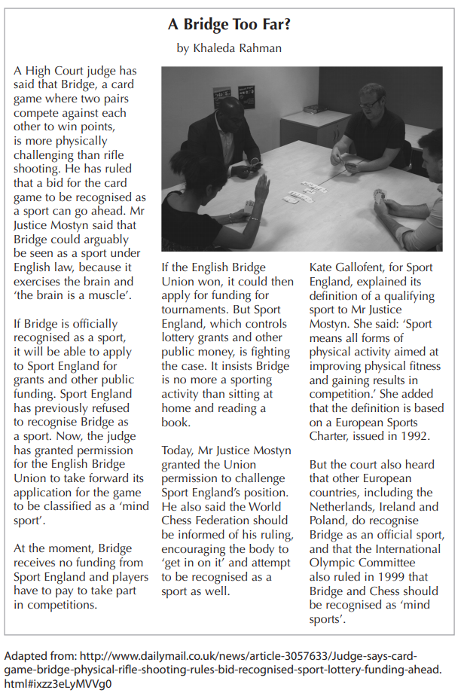
Practice Text
Text A

Slide 19
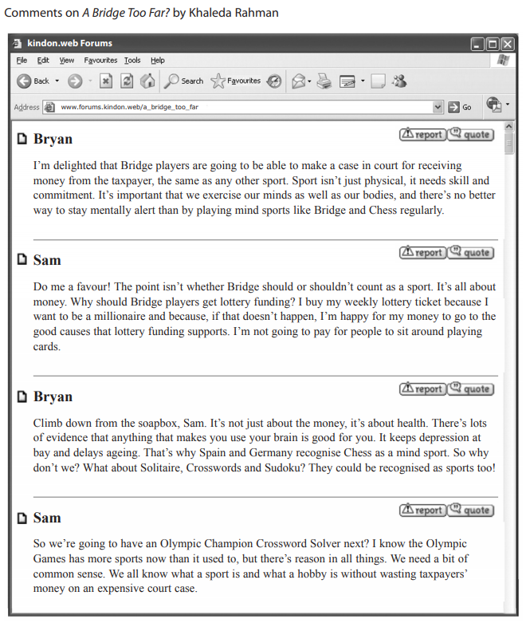
Practice Text
Text B

Slide 20
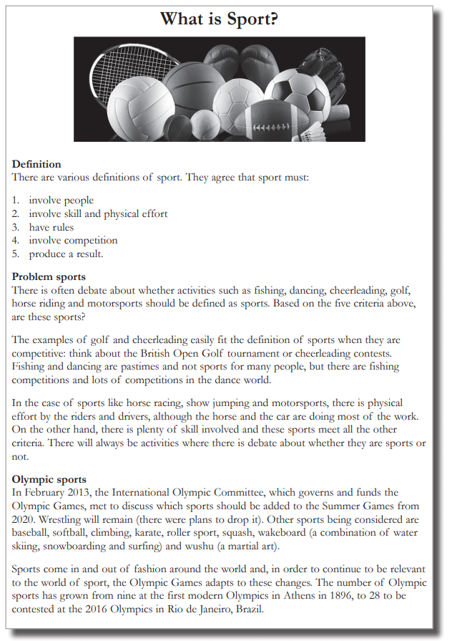
Practice Text
Text C

Slide 21
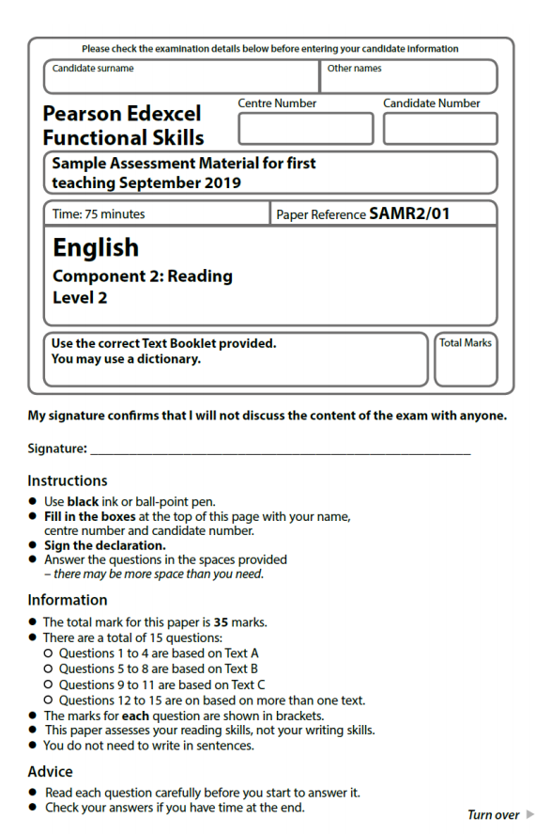
Breaking Apart the Exam!
Over the next few pages we are going to break apart what the exam is looking for when we are asked to answer questions. The exam paper we are looking at will be the one you practice with next (you won’t have the texts until the practice!)

Slide 22
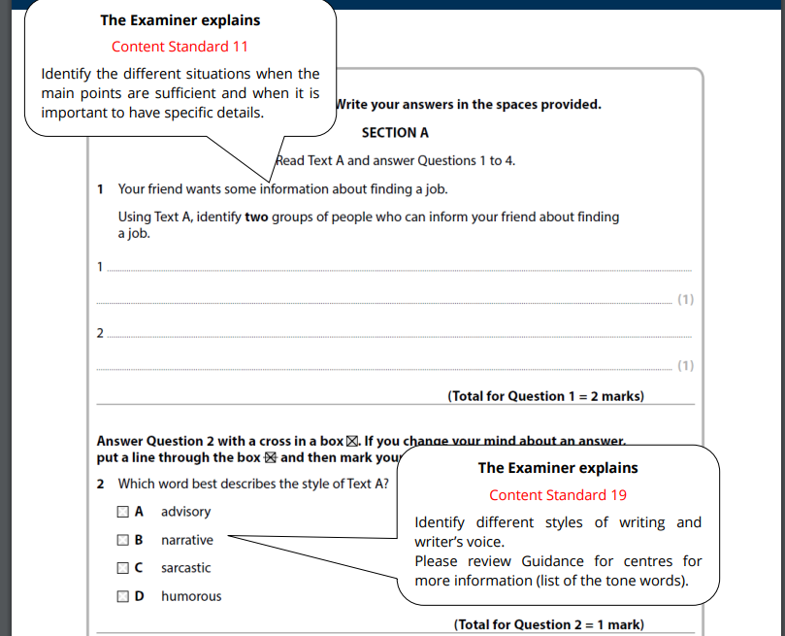
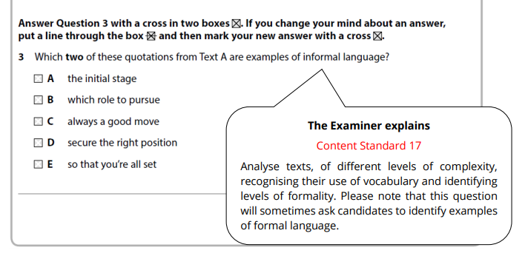
Breaking Down the Exam

Slide 23
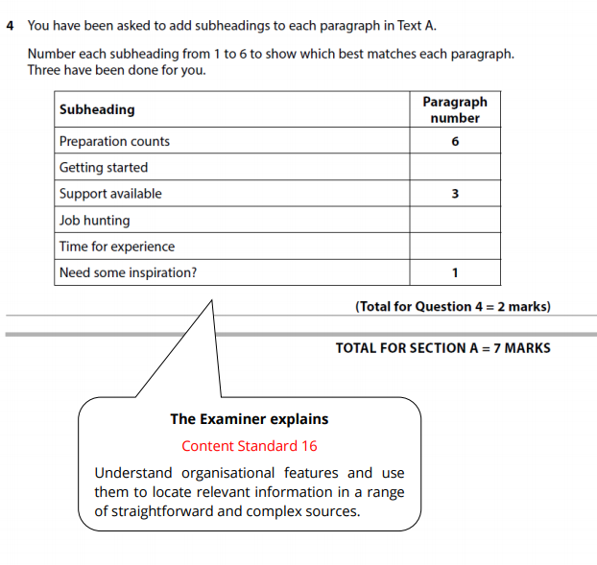
Breaking Down the Exam

Slide 24
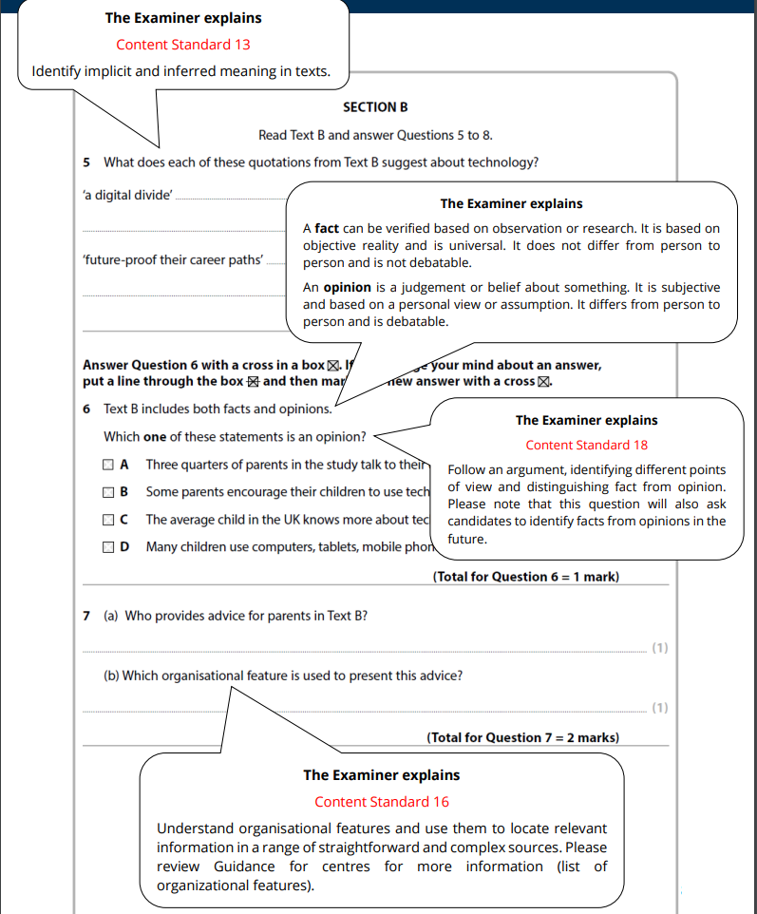
Breaking Down the Exam

Slide 25
Breaking Down the Exam

Slide 26
Breaking Down the Exam

Slide 27
Breaking Down the Exam

Slide 28
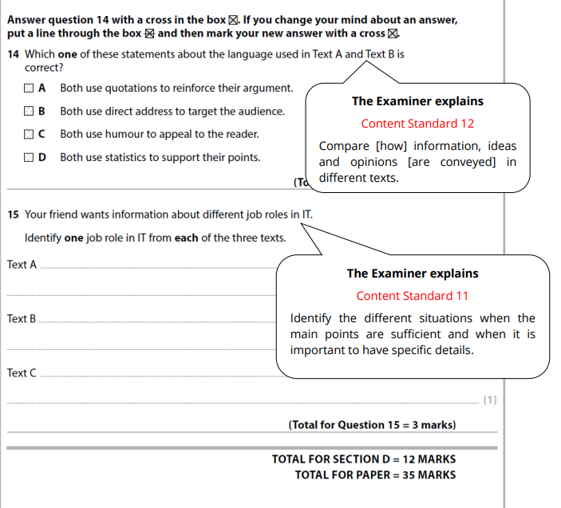
Breaking Down the Exam

Slide 29
Practice Time!
You are now going to have a go at the level 2 practice exam.
You have 75 minutes to answer all the questions.
There will be a 25 minute break after the practice, so if you receive extra time in exams this can be used.

Slide 30
Marking and Exemplars
Question Number & Type | Points Scored/Total Points
1. – Finding information | /2
2. – Multiple choice, single option | /1
3. – Multiple choice, multiple options | /2
4. – Matching subtitles to paragraphs | /2
Section A Total | /7
5. – Explaining quotations from text | /2
6. – Multiple choice, single option | /1
7. - Finding information | /2
8. – Identifying problems and solutions | /4
Section B Total | /9
9. – Finding quotations to back up point of view provided | /2
10. – Identifying language features and providing examples | /4
11. – Multiple choice, single option of quotation to back up provided point | /1
Section C Total | /7
12. – Replacing words with synonyms | /2
13. – Comparing texts for similarities and providing quotes from each text to support | /6
14. – Multiple choice, single option applying to two texts | /1
15. – Identifying information across all texts | /3
Section D Total | /12
Total Points: | /35

Slide 31
Further Practice with Past Papers
You now have time to work with more practice papers before your exam.
If you noticed a specific type of question causing you issues in the previous practice, then focus on those types of questions now.
Work with your trainer for extra help on how to work with the texts and break apart the information required.

Slide 32
Good Luck!
Things to remember in the exam:
Read all three texts in full before you even look at the first question.
Read through the questions, and start using the skills we have talked about.
Skim the texts for general information, Scan the texts for specific information!
You have 75 minutes to read all the texts and answer the questions inside.
Remember to look for both explicit and implicit information in texts.
Check and see if the text is using Facts, Opinions or even a Mixture of both!
Intensive Day - Reading Booklet – 2019 Specification

