Slide 1
Functional Skills English Level 2
Intensive Day - Writing Booklet – 2019 Specification

Slide 2
Course Breakdown
Functional Skills English is broken up into several components. They are as follows:
Reading Exam – Level 1 = 60 Minutes, Level 2 = 75 Minutes
Writing Exam – Level 1 = 60 Minutes, Level 2 = 60 Minutes
Speaking & Listening Component = 20 Minute Discussion & 10 Minute Presentation
This booklet will guide you through the Writing section of the course.
Course Content:
This course will booster your ability to draw meaning from texts to answer questions, as well as constructing your own pieces of writing using similar techniques.
You actually use all of these skills already, you just may not know the technical language for these skills!

Slide 3
FS Writing
So far, you’ve covered techniques and tips for dealing with the reading exam, but now we’re going to focus on writing!
You’ve done a lot of the ground work already! Reading is you using Language and Presentation features to draw meaning from a text, writing is you producing a text using the same techniques!
You already know how to spot them, but now we need to practice using Language Features and Presentation Features in our construction of texts (you most likely already do this, you just don’t know that’s what you’re doing!)

Slide 4
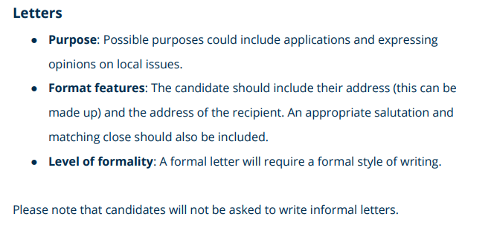
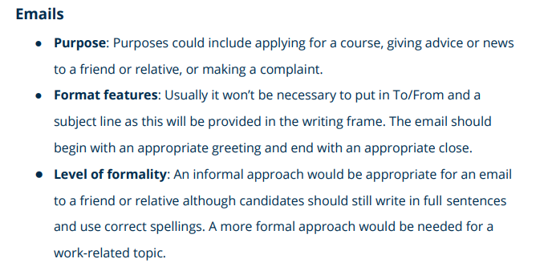
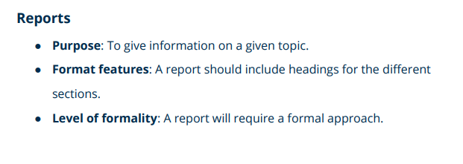
Types of Writing
In the level 2 Functional Skills English exam you will be asked to produce two texts from the following list*.

Slide 5
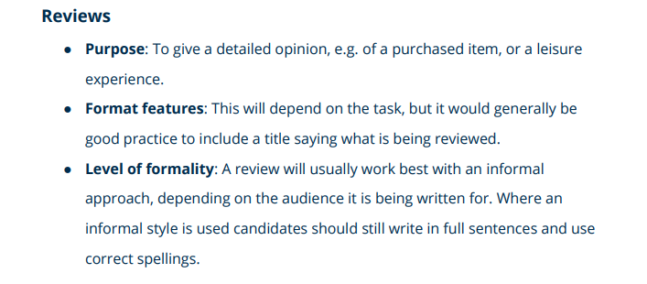
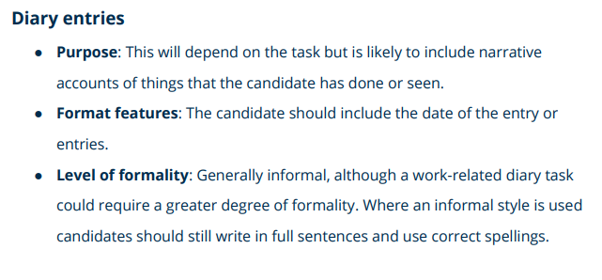
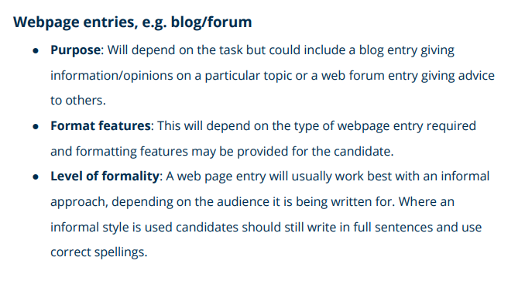
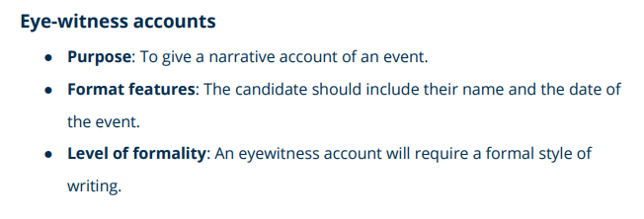
Types of Writing

Slide 6
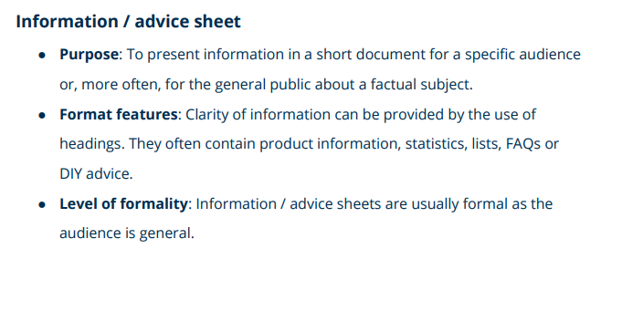
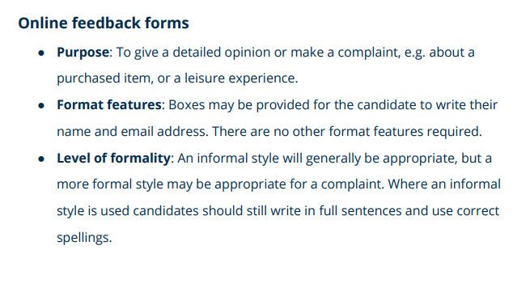
Types of Writing

Slide 7
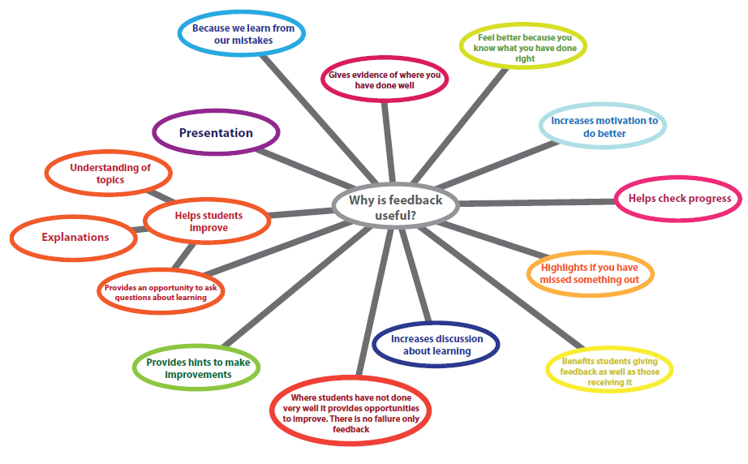
Writing - Planning
Planning is your key to success! If you think about something ahead of time, it’s always going to go smoother than just ‘winging’ it.
Below is the technique we advise using:
Spider Diagrams – Starting with a central idea, and any linked ideas coming off.
This helps to give you points to expand on!
REMEMBER
One thing to remember with your writing questions! You will be given bullet points to guide you – if you can make a paragraph from each bullet point, then you are well on course to pass the exam! Lets look at an example on the next page!

Slide 8
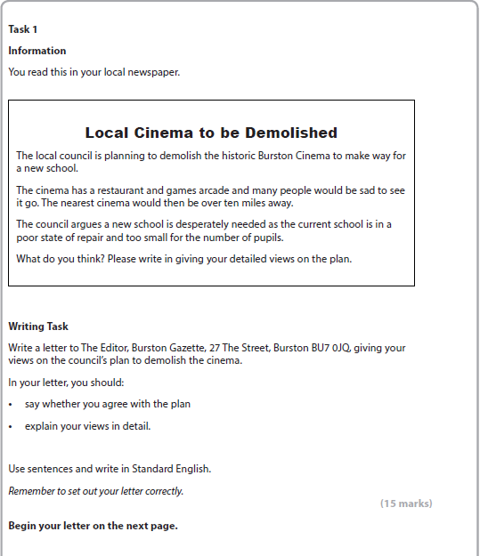
Writing - Planning
REMEMBER
This task is asking you to write a letter. The information you need (i.e. person you are writing to, address) is given to you, as well as two prompts;
Say whether you agree with the plan.
Explain your views in detail.
You should use these prompts to make paragraphs for your writing!

Slide 9
Writing - Planning
Your writing should be broken down into three main areas:
Introductory statement
Main body of text
Summary/sign off
Introductory Statement
No matter the type of writing, you start with an introduction that guides your reader into what type of text they will be reading.
Main Body of Text
The main body of text is your main bulk of writing. It will include paragraphs made from the prompts from the question (last page). This is where you will address and answer the task given to you.
Summary/Sign off
The end of your writing should include a short summary of your main points, as well as

Slide 10
Writing Tips
TAP
When you see a writing task, read it carefully and think about TAP:
Type
Type of text you have to write e.g. letter, email, article, leaflet
Audience
Who will read your writing? Who are you writing to/for?
Purpose
Why are you writing? What are you writing about? What do you want?
Example task:
Below is an example task; Using TAP, we can quickly identify what we are being asked to do!
TYPE- what you have to write?
Audience- who you are writing for
Write a letter to the chairperson of your local council, persuading them to create better leisure facilities for residents of your age
Purpose- why you are writing

Slide 11
Writing Tips
PEE paragraph
What is a PEE paragraph? It’s not as dirty as you think!!
PEE is a technique we can use to help structure our paragraphs. It stands for:
Point- tell the reader your main point
Evidence- give facts/anecdotes to prove your point is sensible
Explain- explain your main point in more depth, add details to it
Try it out! Below is an example question you could be asked for the writing paper. You have also been given a bullet point to guide you. Try to write a PEE paragraph in response to this bullet point.
Could You Live without your favourite gadgets for a fortnight?
Which gadgets would you find most difficult to give up and why?
(There is space on the next page to write your response!)

Slide 12
Writing Practice

Slide 13
Practice Exam – Time: 1 Hour
In the real exam, you will have one hour to produce your two texts. The following two tasks are examples of what you may be asked to write in the exam.
We will be having a go in exam conditions; the practice we work through later will be work shop style, where we can help each other.
After, there will be a short break, and then we will look at example answers from the exam board, as well as the mark scheme!

Slide 14
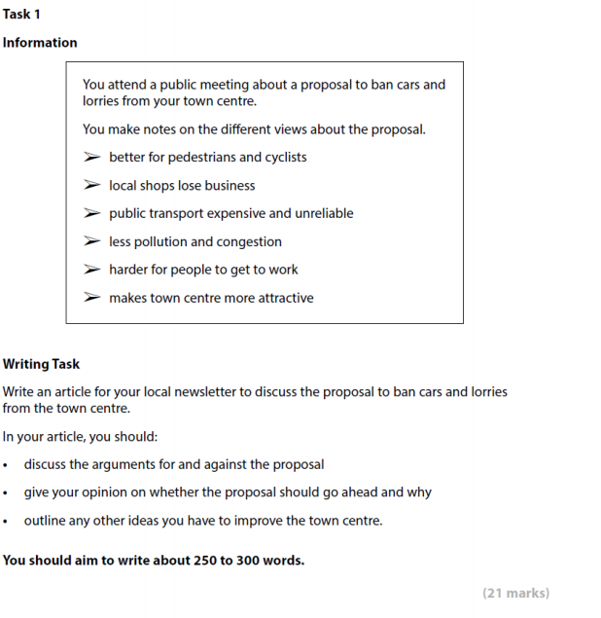
Practice

Slide 15
Practice

Slide 16
Practice

Slide 17
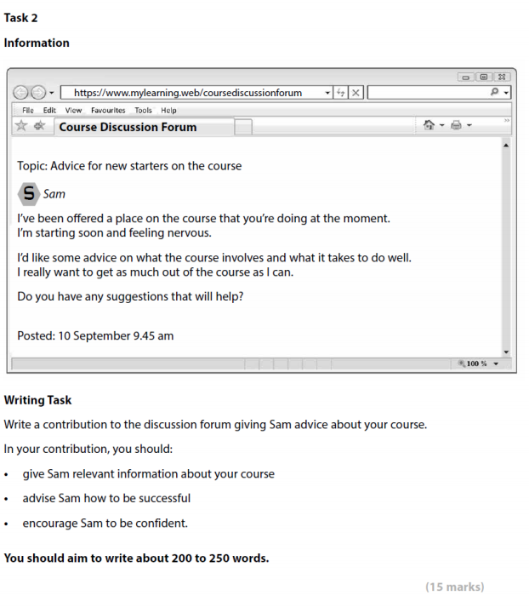
Practice

Slide 18
Practice

Slide 19
Practice

Slide 20
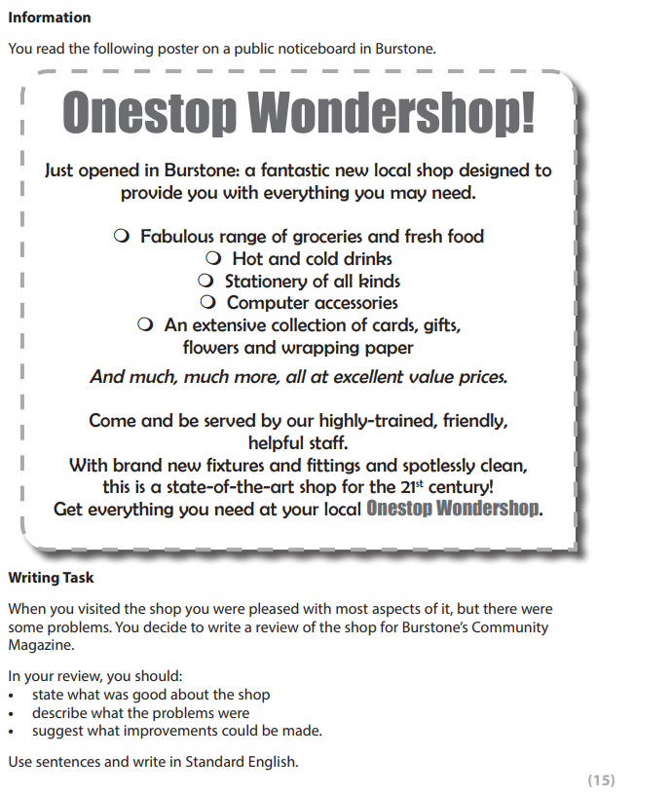
Additional Practice Questions

Slide 21
Additional Practice Questions

Slide 22
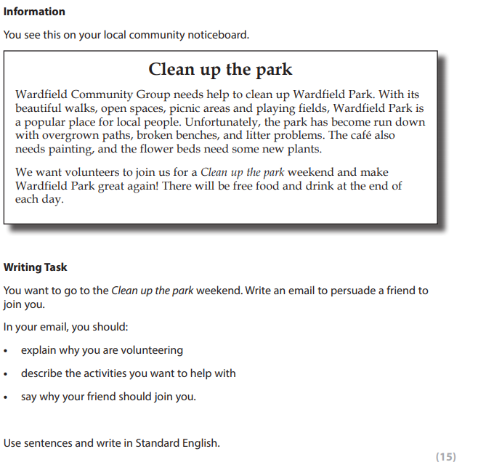
Additional Practice Questions

Slide 23
Additional Practice Questions

Slide 24
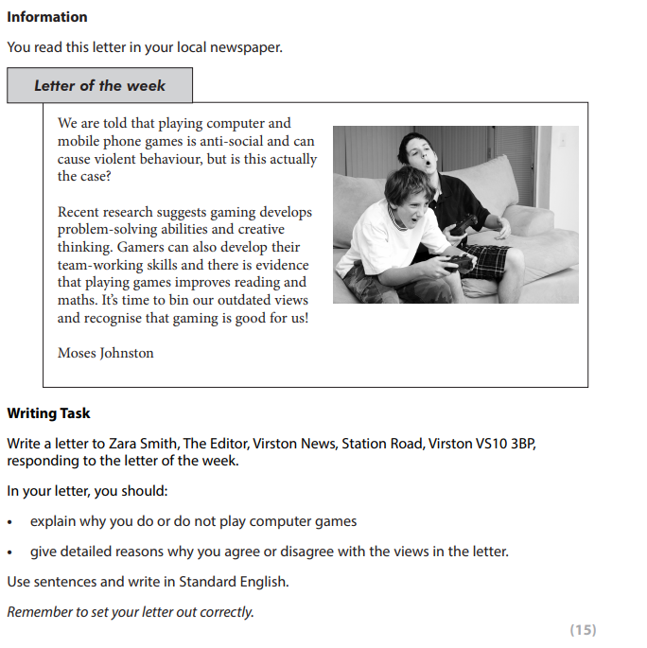
Additional Practice Questions

Slide 25
Additional Practice Questions

Slide 26
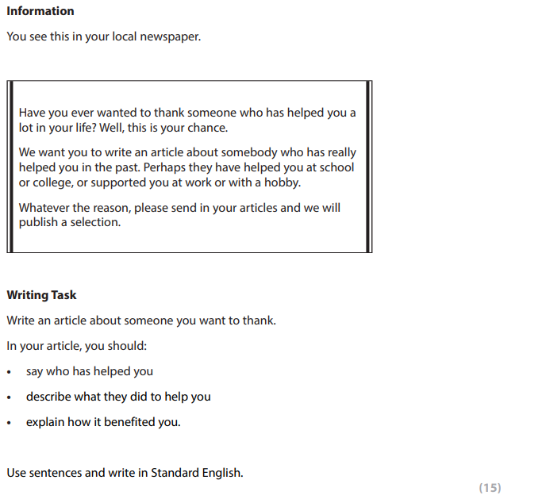
Additional Practice Questions

Slide 27
Additional Practice Questions

Slide 28
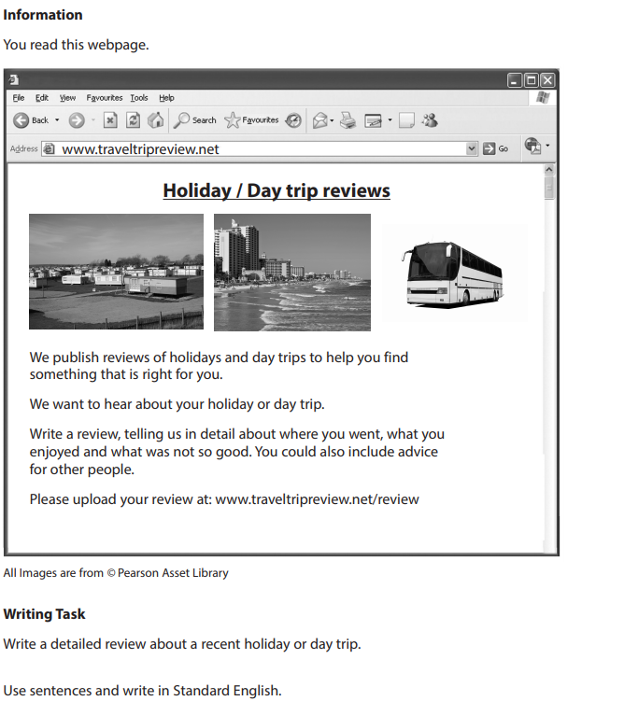
Additional Practice Questions

Slide 29
Additional Practice Questions

Slide 30
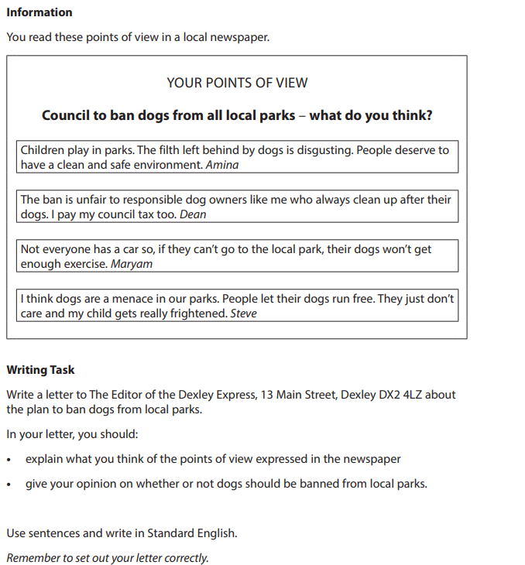
Additional Practice Questions

Slide 31
Additional Practice Questions

Slide 32
Good Luck!
Things to remember in the exam:
Read all the information you are given for the first question.
Use the form given, as well as the bullet pointed information, to plan your writing.
After completing the first question, repeat this for the second question.
You have 60 minutes to answer the questions inside.
Remember to use your language features to effectively connect with the reader.
Be careful to check your tenses, spelling and paragraphing.
Intensive Day - Writing Booklet – 2019 Specification

