Slide 1
Environmental Science A Level
Science for the Planet

Slide 2
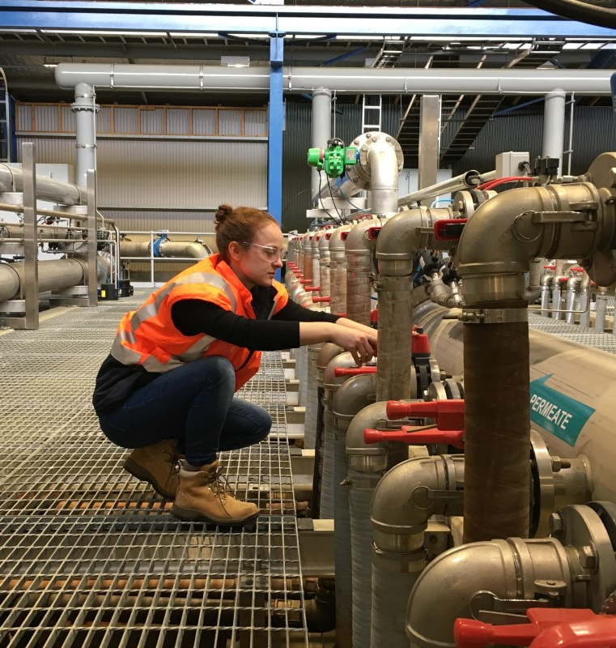
Career - What is an Environmental Scientist?
Environmental Scientists are those who work in a variety of fields related to the Earth and its resources. They may work in a variety of roles from Environmental Lawyer, Coral Reef Sanctuary Manager, Antarctic Researcher, Laboratory Technician, Wastewater Technician, or Solar Panel Engineer. They have gone through school in a variety of ways to obtain their current positions.

Slide 3
Key areas of study of the A- level
Wildlife conservation
Pollution
Energy
Chemical and Nutrient cycles
Preservation of natural life giving systems
Management of our environment
Agriculture, Soil, Mining and Forestry
Global climate change and sustainability.

Slide 4
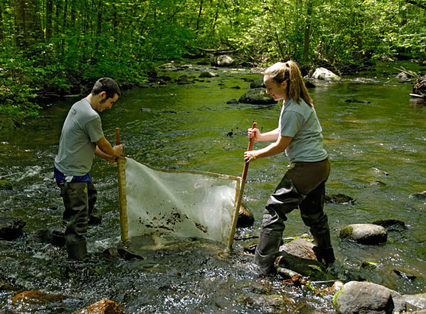
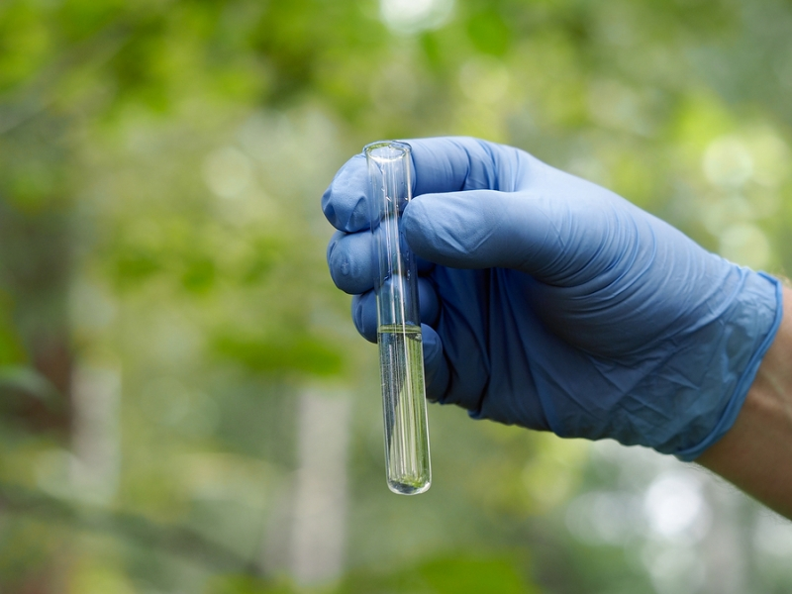
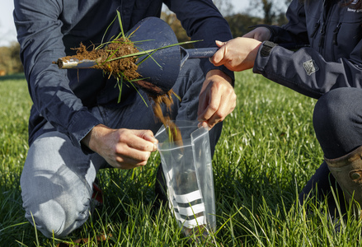
Fieldwork
As part of your course, you will go outside to do fieldwork, collect samples and record data.

Slide 5
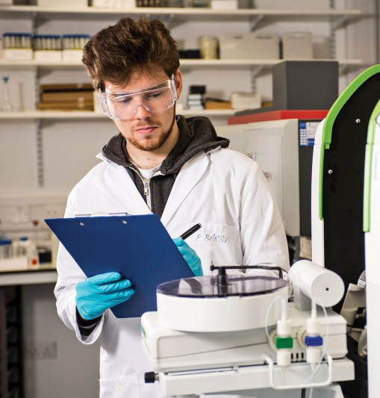
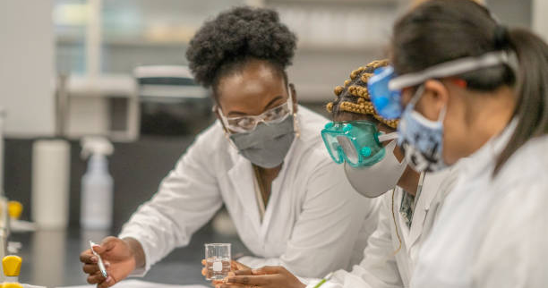
Lab work
You will also do practical experiments in the lab, often with samples or data you may have collected in the field.
A highly sought skill in science, technology, industry and research.
Pictures –Top Left - Life & Environmental Science Bournemouth,
Top Right -University Southampton Geography and Environmental Science,
Bottom – Getty Images (Environmental Science),

Slide 6
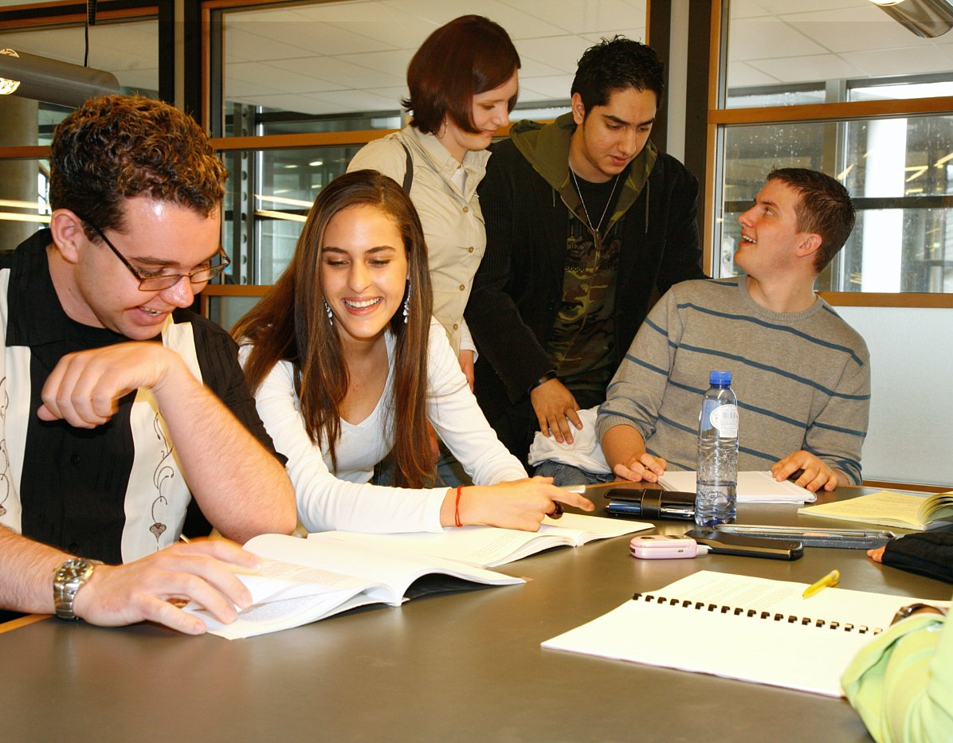
Research and Study
You will need to do a lot of reading and research

Slide 7
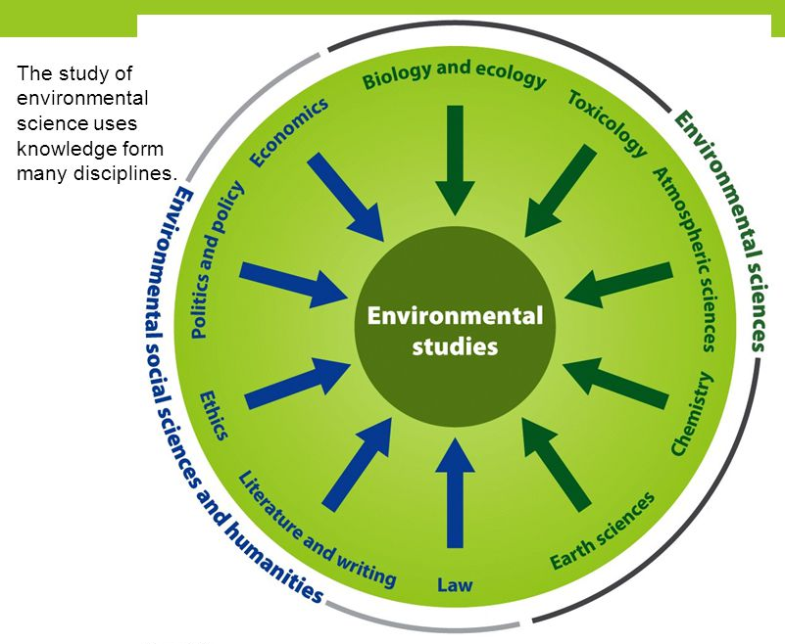
Bridging the Gap between Science and Humanities
Environmental Science includes many disciplines and combines well with many subjects including:
Biology,
Chemistry,
Maths,
Geography
Politics
Law

Slide 8
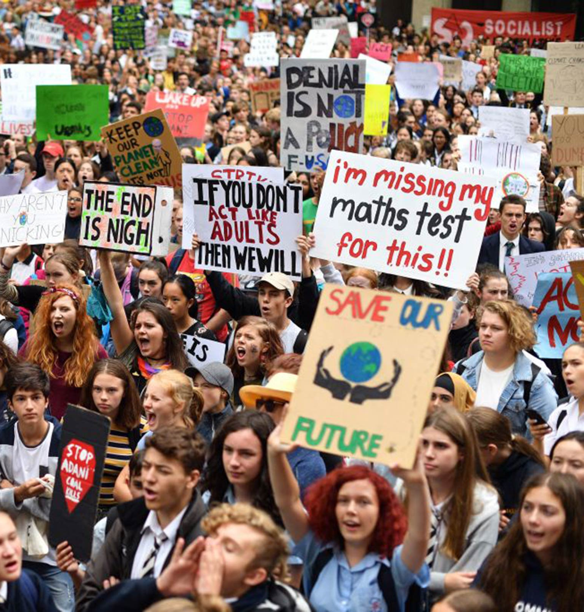
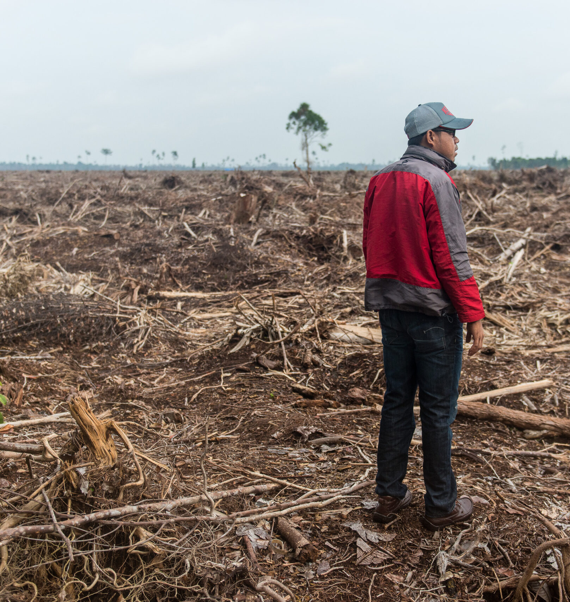
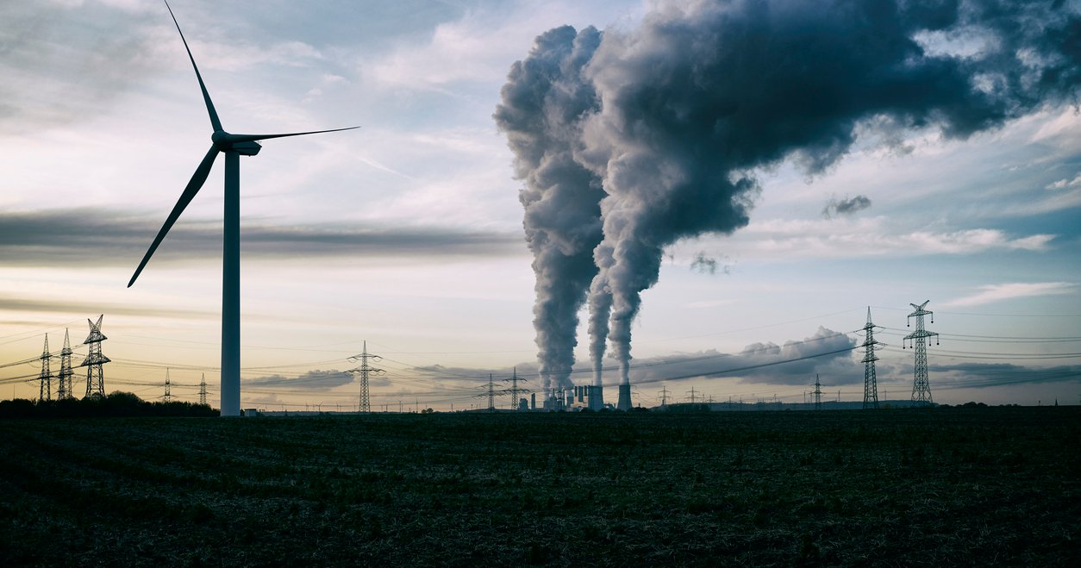
Ethics, Policy, Law and Economics
Along with science, you will also explore the complex relationships human society has with the planet along with some of the conflicts this creates.

Slide 9
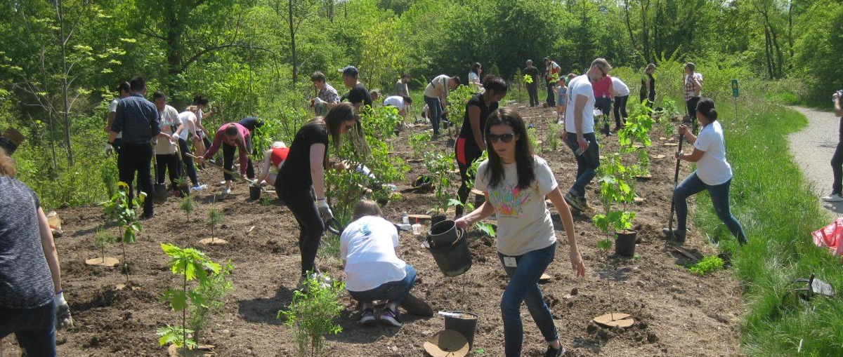
Protect the Planet
You will examine why the conservation of all the life giving systems on Earth is important and explore efforts to preserve coral reefs, Antarctica, areas of natural beauty, wildlife corridors, tropical rainforests and many other unique environments.

Slide 10
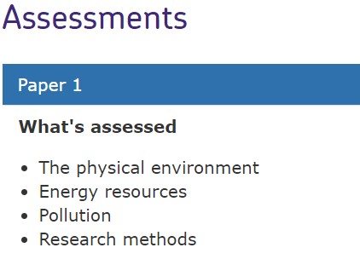
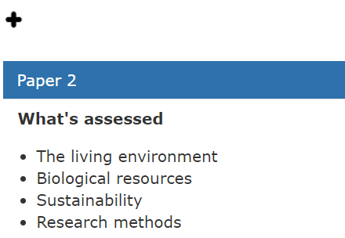
Students will be expected to draw on knowledge and understanding of the entire course of study to show a deeper understanding of the interconnections between topics.
2 Papers, each is:
Written exam: 3 hours
120 marks
50% of A-level

Slide 12
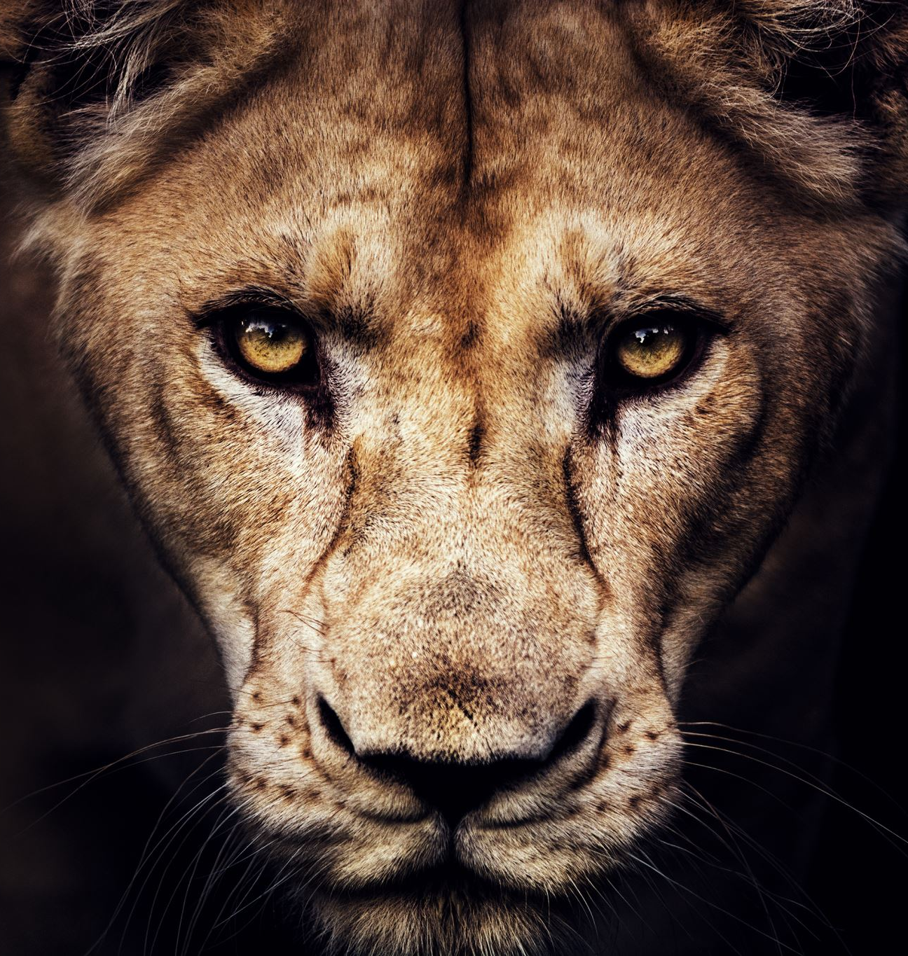
Example Assignment – Living with Lions
Research some of the issues with conservation of lion populations: Living with Lions | Home (lionconservation.org)
- Highlight some of the reasons to preserve lions and the challenges faced.
- What solutions are possible?
- How could current conservation efforts be improved and what stands in the way of doing this?
Notes:
Conservation of endangered species is not easy and not usually a cut and dry decision.
Lions are Key species in that they can indicate the health of an entire ecosystem, like wolves in Yellowstone. Yet they can also eat people.

