Slide 1
Functional skills English
Week 1

Slide 3
R.I.P Queen Elizabeth II (1926-2022)

Slide 4
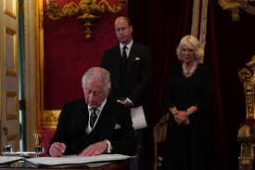
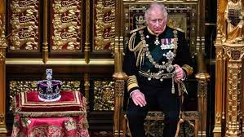
King Charles III (1948)
Coronation is on the 6th of May

Slide 5
The 12-week course - introduction
Welcome to Chichester College Functional Skills English
Over the next twelve weeks you will be working with me (Tom), and I will be supporting you with achieving your Functional Skills English qualification.
Each week there will be a 2-hour long session based around different Reading and Writing topics. There will be classwork and assignments to complete (monitored), and this will help to develop your Reading and Writing skills in preparation for your examination.
The FS English Exam (three parts to this exam):
Part One Reading - 1 hour and 15 minutes
Part Two Writing - 1 hour
Speaking & Listening Assessment (10 Minute Presentation & 20-minute Formal Discussion).

Slide 6
Let’s talk…we are on this journey together!
Who are we?
What do we do?
Why are we doing this course?
Our ambitions?

Slide 7
How do I pass this English course?
Reading - reading texts carefully and understanding the meaning and context.
Writing - being able to write a range of texts correctly.
Speaking and listening - being able to speak persuasively, putting your points clearly, while understanding other points of view.

Slide 8
Reading paper

Slide 9
Reading
For the reading paper you will need to be able to:
Read different texts carefully and understand their meaning.
Separate fact from opinion and identify bias.
Identify what type of text it is, what style it is written in and who it is written for.
Identify language and layout features used.
State what words or phrases mean in a piece of writing.
Compare texts, identifying their similarities and differences.
Let’s look at an example…

Slide 10
Reading
Gav’s basic rules!!
Read the questions carefully.
Understand what is being asked of you.
Think about your answers.
Do not over complicate the questions.
We will work hard on past papers!
Reading paper every two weeks (practise makes perfect 😉).
Pass = 60% (21 marks)

Slide 11
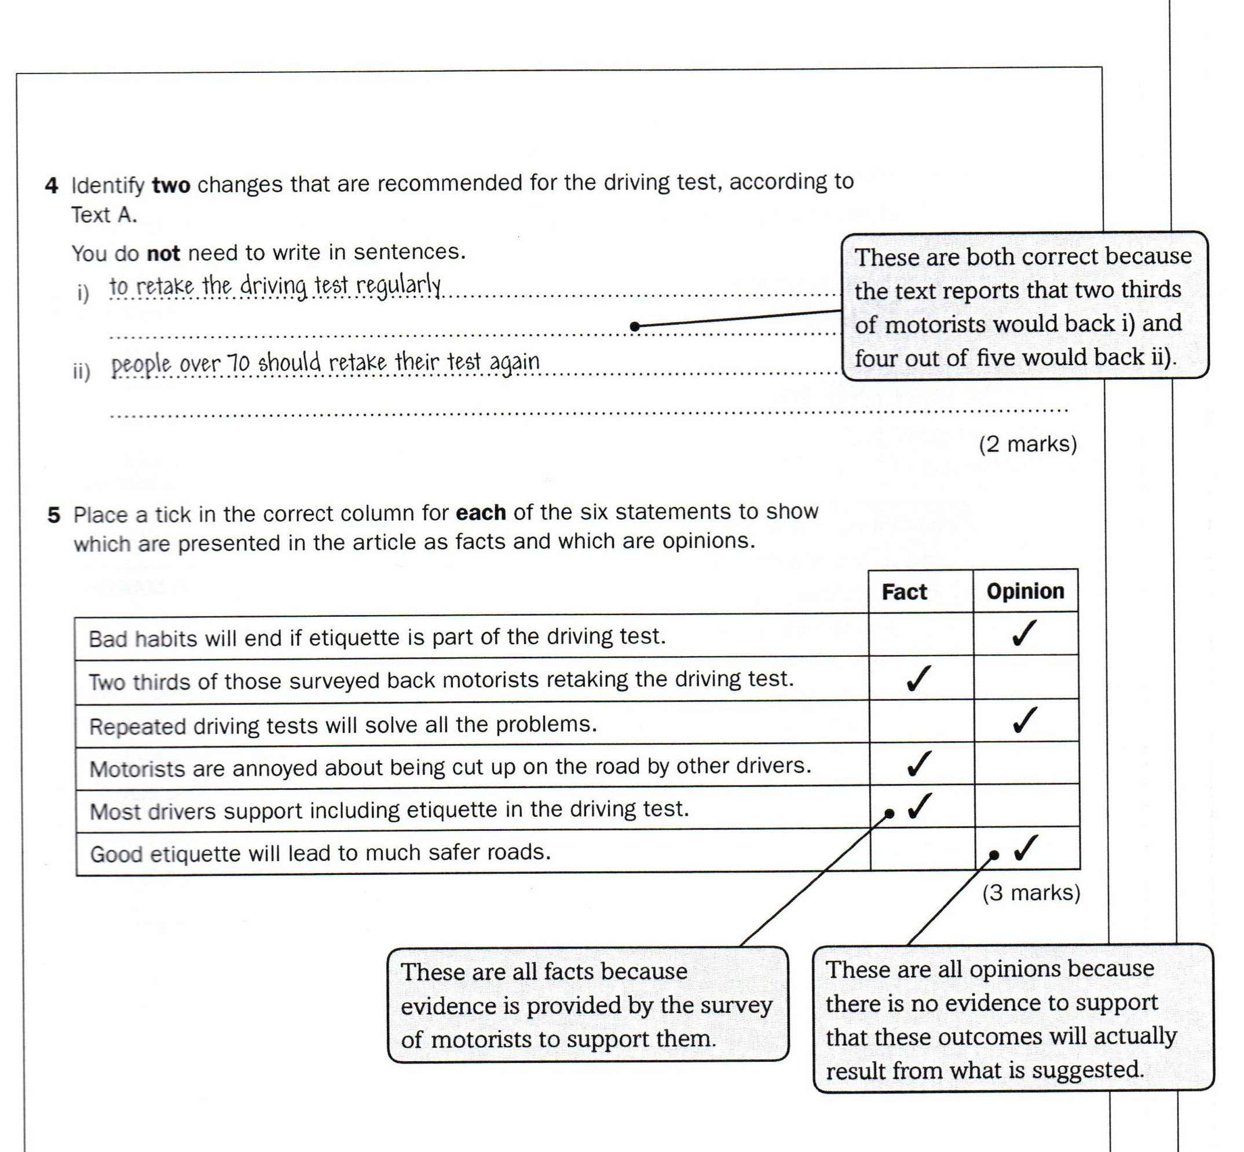
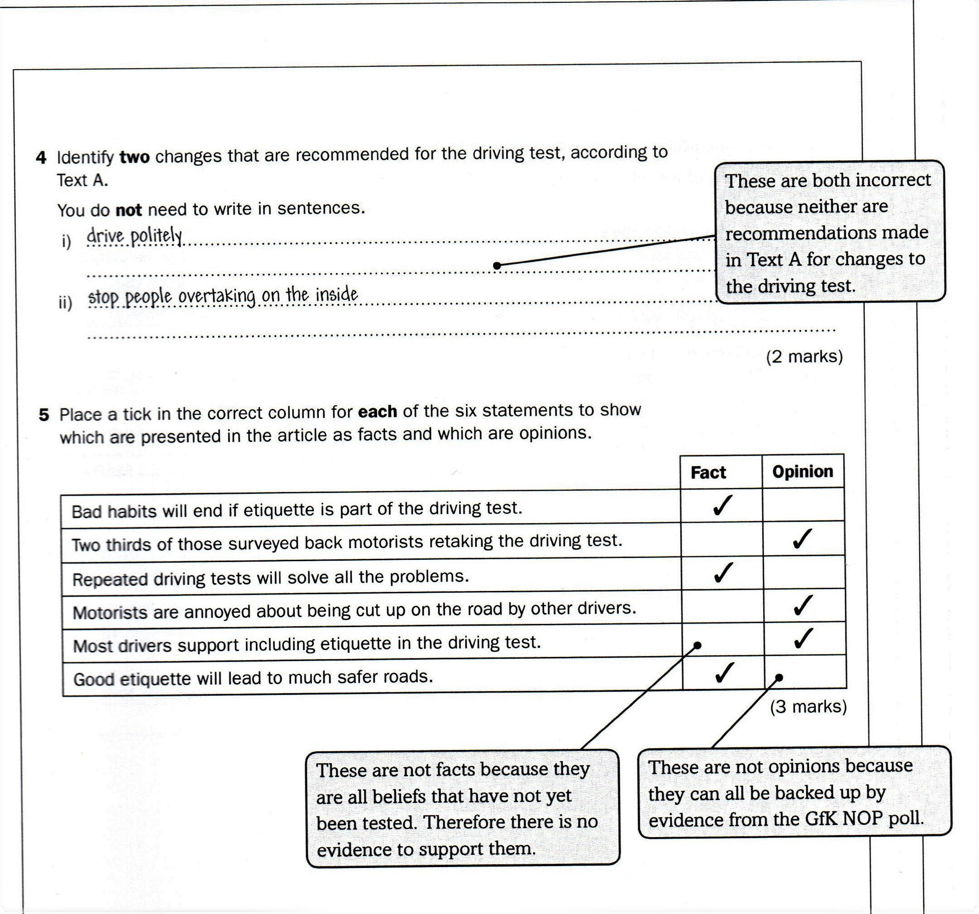
Correct
Incorrect

Slide 12
Writing paper

Slide 13
Writing
For the Writing paper you will need to:
Write clearly and with correct spelling, punctuation and grammar.
Write using the correct layout and style.
Be aware of the audience and purpose of the text you are writing.
Let’s look at an example…

Slide 14
Writing
Gav’s basic rules!!
Read the questions carefully.
Understand what is being asked of you.
Plan your work (use bullet points/memory joggers).
Do not over complicate the question.
We will work hard on past papers!
Writing paper task every two weeks (practise makes perfect 😉).
Pass = 21-23 marks

Slide 15
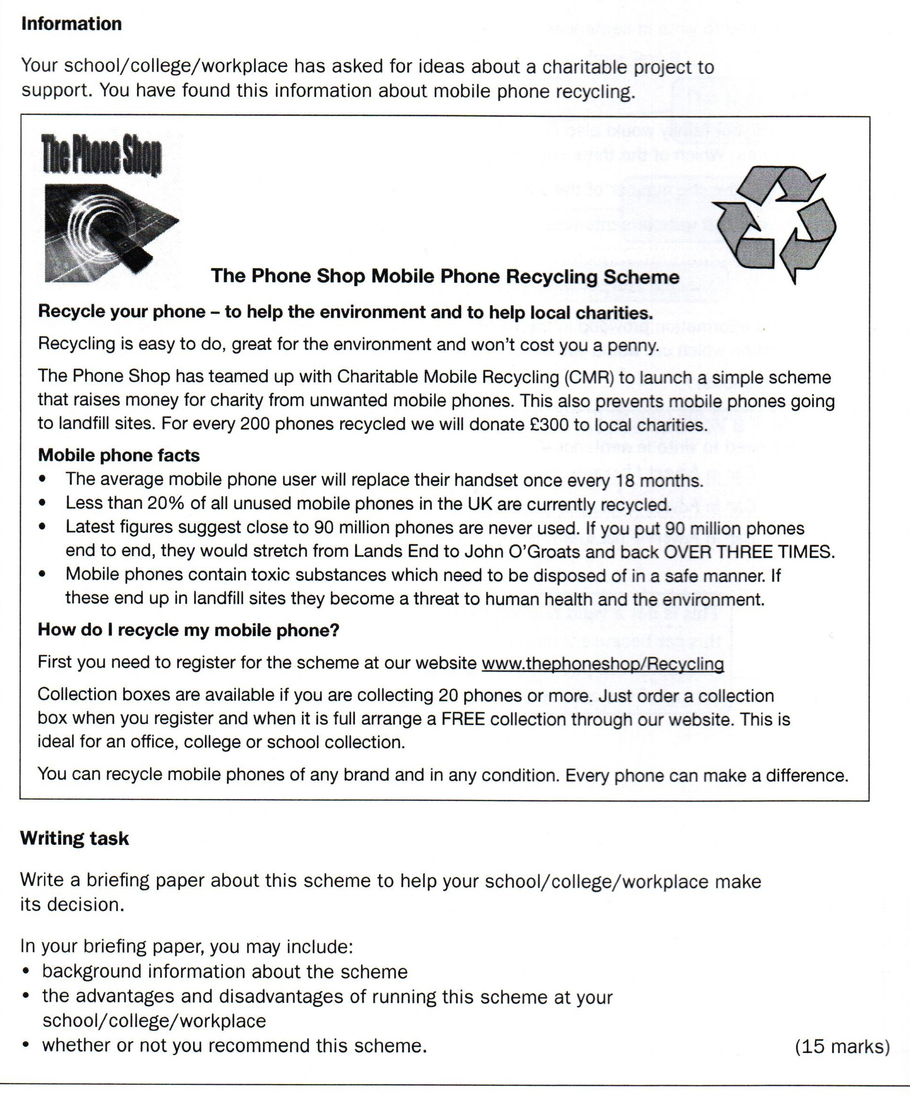
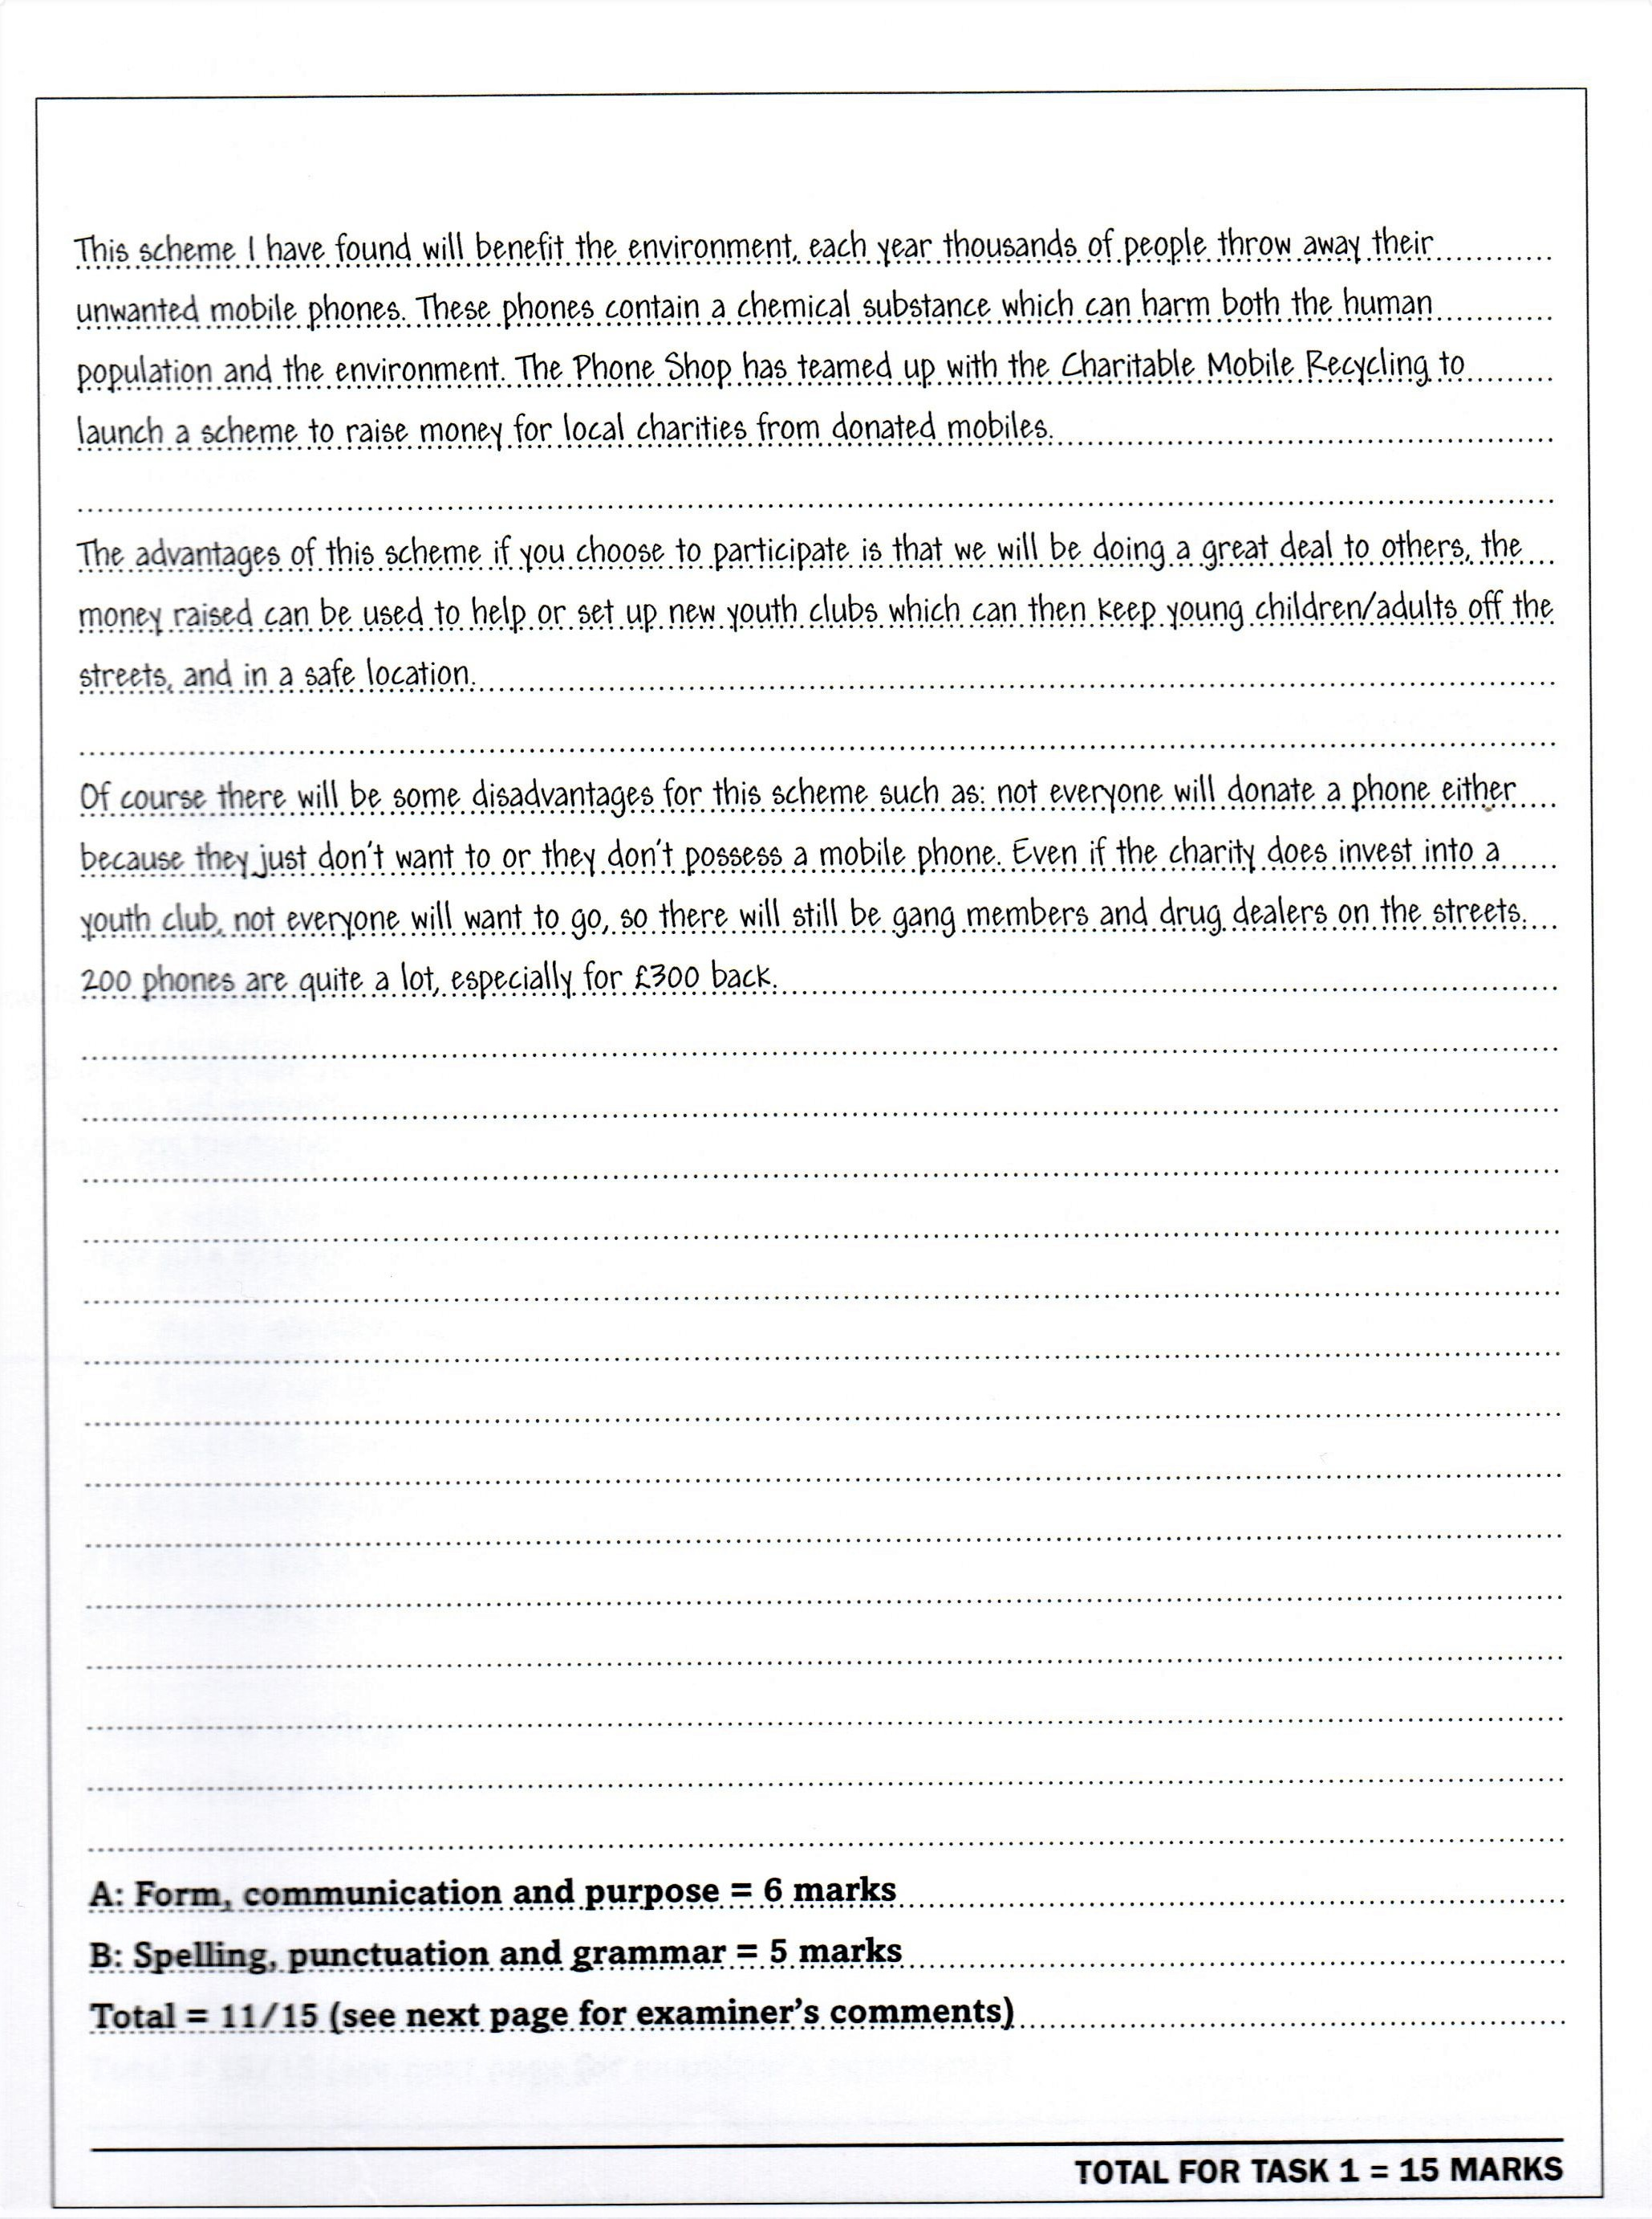
Acceptable (just) ☺

Slide 16
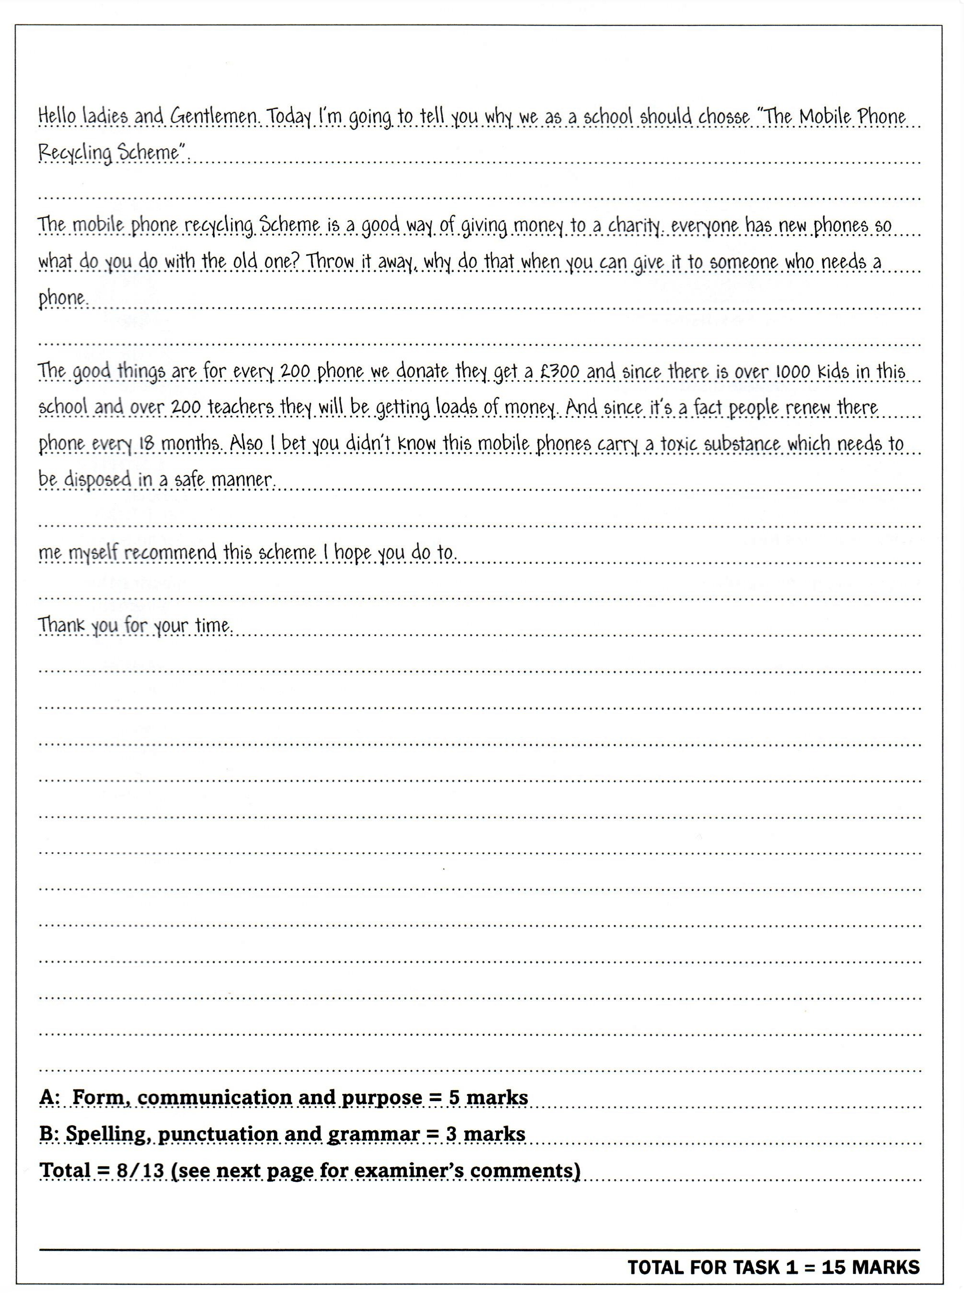
Strong Text
Incorrect

Slide 17
Spelling and Punctuation
You will lose marks if you make a lot of spelling and punctuation mistakes.
Remember that punctuation makes written text easy to read (ensures the meaning is correct).
For example, see how different the meanings are!
Get it right first time!

Slide 18
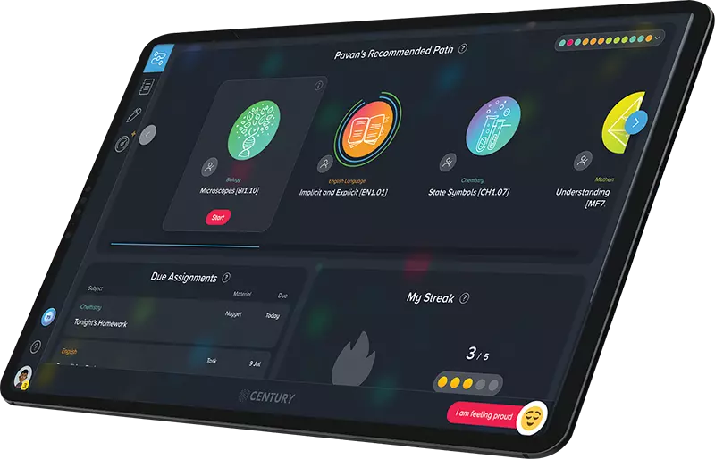
Weekly Assignments & Class Tasks
Independent learning
Exam revision

Slide 19
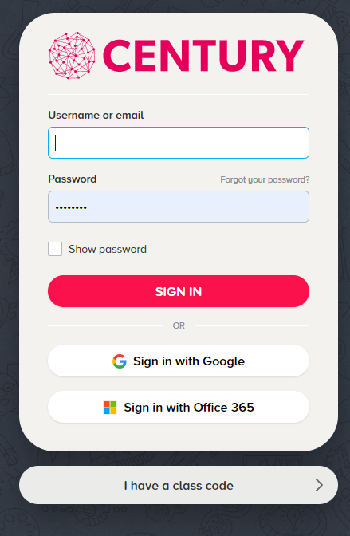
Initial diagnostic assessment on Century tech
This gives me a starting point to see what areas you may need to work on.
It will be testing your Reading and Writing skills.
Log on to https://www.century.tech/

Slide 20
Click on Login
Then click on ‘I have a class code’
And enter this code:
SVNJ3H
(ensure you are using capital letters)
Then click the ‘No, sign me up’ button on the left. It will then ask you to create your Century account.
Then complete the Diagnostic assessments for Reading and Writing.

Slide 21
Next week…
Different texts and styles of writing
Fact, opinion and bias

Slide 22
Write using correct grammar and punctuation
Class Task
Write a piece of text of at least 150 words about your current job.
Use correct spelling, grammar and punctuation throughout.
Remember paragraphs!

Slide 23
Check your Week 1 assignments on Century!
Start your pathway on Century!

Slide 24
Contact: jonesg@chichester.ac.uk

