Slide 1
Functional Skills English
Week 4

Slide 2
Time to think?
Write a sentence containing a:
Simile.
Metaphor.
Rhetorical question?

Slide 3
Learning outcomes this week:
Compare ‘Formal’ & ‘Informal.’
We will look at the correct layout for letters.
Understand the correct layout for an article.
Write an email using the correct layout.

Slide 4
Whatever you are asked to write - always remember TAP (acronym)!
What text is it? A letter, email, article etc.
Who is it for? Target audience?
Why has it been written? There is always a reason!

Slide 5
Key skills for writing texts
When you write anything you need to think about:
What is it I am writing?
Who is the audience I am writing for?
Presentation Features - how will I present my piece of text?
Language Features - what language features will I need to use?

Slide 6
Language features make your writing more persuasive and interesting. So use them!
Remember this from last week!

Slide 7
Formal or Informal?
English has words, phrases and styles that indicate formal or informal language.
Formal language used in serious situations or involve people we do not know.
Informal language used in situations that are more relaxed and with people we know (friends & family).
Formal language used when we write.
Informal commonly used when we speak.
You must identify when & why?

Slide 8
Examples
‘She has decided to accept the job’ (formal).
‘She’s decided to accept the job’ (informal).
‘We went to Cornwall for a holiday. We have so much to tell you’ (formal).
‘Went to Cornwall for a holiday. Got loads to tell you’ (informal).
‘The girl whom I met in the pub is interested in becoming a teacher’ (formal).
‘The girl in the pub was interested in being a teacher’ (informal).
Let’s test your knowledge!

Slide 9
Find formal or informal equivalents:
Formal | Informal
Residence (noun) | House (noun)
Purchase (verb) | (verb)
(verb) | Tell (verb)
Location (noun) | (noun)
(noun) | Ask (verb)
Provide (verb) | (verb)
(verb) | Say sorry (verb)
Receive (verb) | (verb)
(verb) | Need (verb)
Verify (verb) | (verb)
Buy
Inform
Place
Request
Give
Apologise
Get
Require
Confirm

Slide 10
Quiz!

Slide 11
Do not forget Semi-formal
Semi-formal English is neutral language.
This is the language you would use when you talk to people you know, but perhaps not on a personal level (teacher/colleagues).
Semi-formal used in written and spoken communication.
Shorter sentences/less complex than formal language.
One example of Semi-formal: ‘Could you look over this essay.’ Instead of ‘Could you review this essay’…
Still avoid using ‘slang’ & ‘textspeak.’
You will have to decide if a text is informal, formal or semi-formal.

Slide 12
Remember DAFORREST
Time to think!
D
A
F
O
R
R
E
S
T
Direct address
Alliteration
Fact
Opinion
Repetition
Rhetorical question
Emotive language
Statistic
Triplet
Using language features…
Use at least 3 techniques from DAFORREST for any persuasive text - a review, article, letter or email (when trying to persuade someone).

Slide 13
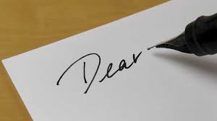
Letters

Slide 14
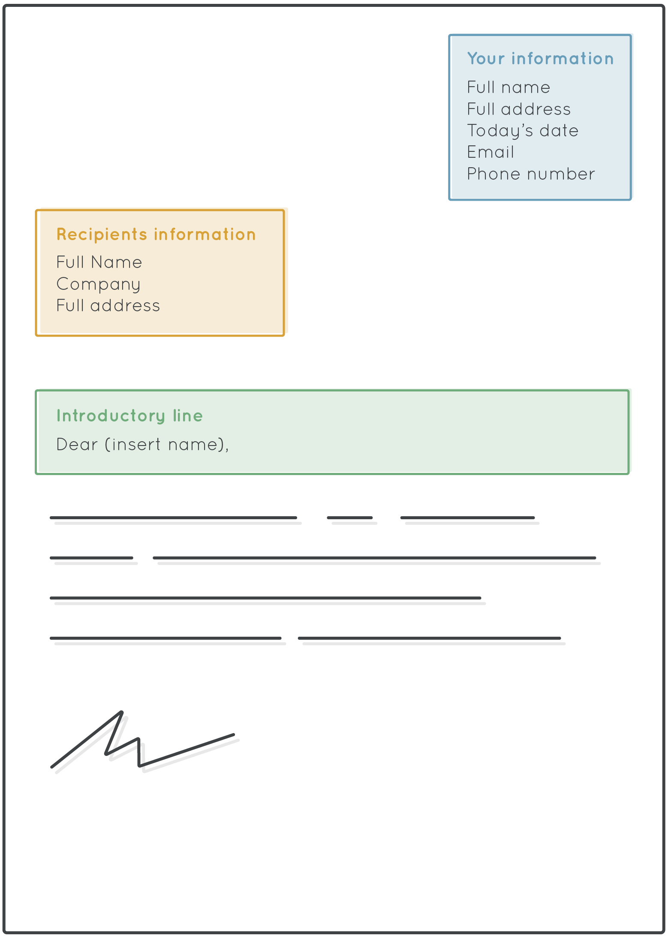
Letters
Layout - their address on the left & yours on the right.
Do not forget the date (3 October 2022).
You must use the correct layout and greeting/closing.
Yours sincerely, - if you know their name.
Yours faithfully, - when you do not know their name.

Slide 15
There are many reasons for writing a formal letter.
To apply for a job vacancy.
Apply for work experience.
To say thank you!
Just to keep in touch.
If you know the person; use their name. For example: Dear Ms. D Jones,
If you do not know the person then use Dear Sir/Madam,
Your address
Full date
Their address
Dear ……,
Introductory paragraph
Main paragraph
Main paragraph
Main paragraph
Concluding paragraph
Yours sincerely/faithfully,
Your name

Slide 16
Possible Introductions for a letter (or an email)
I am writing this letter to let you know that…
I am writing this letter to show my respect for…
I am writing this letter to complain about…
I am writing this letter to inform you that…
I am writing this letter to apply for the job vacancy of…

Slide 17
Your opening sentence should get to the point and clearly state why you are writing.
Avoid using casual or chatty language.
Use paragraphs.
Remember, add a comma after their name (Dear Ms. D Jones,)
Remember, add a comma after Yours sincerely, or Yours faithfully,
Remember, checking your work and redrafting is part of the writing process. Don’t be afraid to make mistakes!

Slide 18
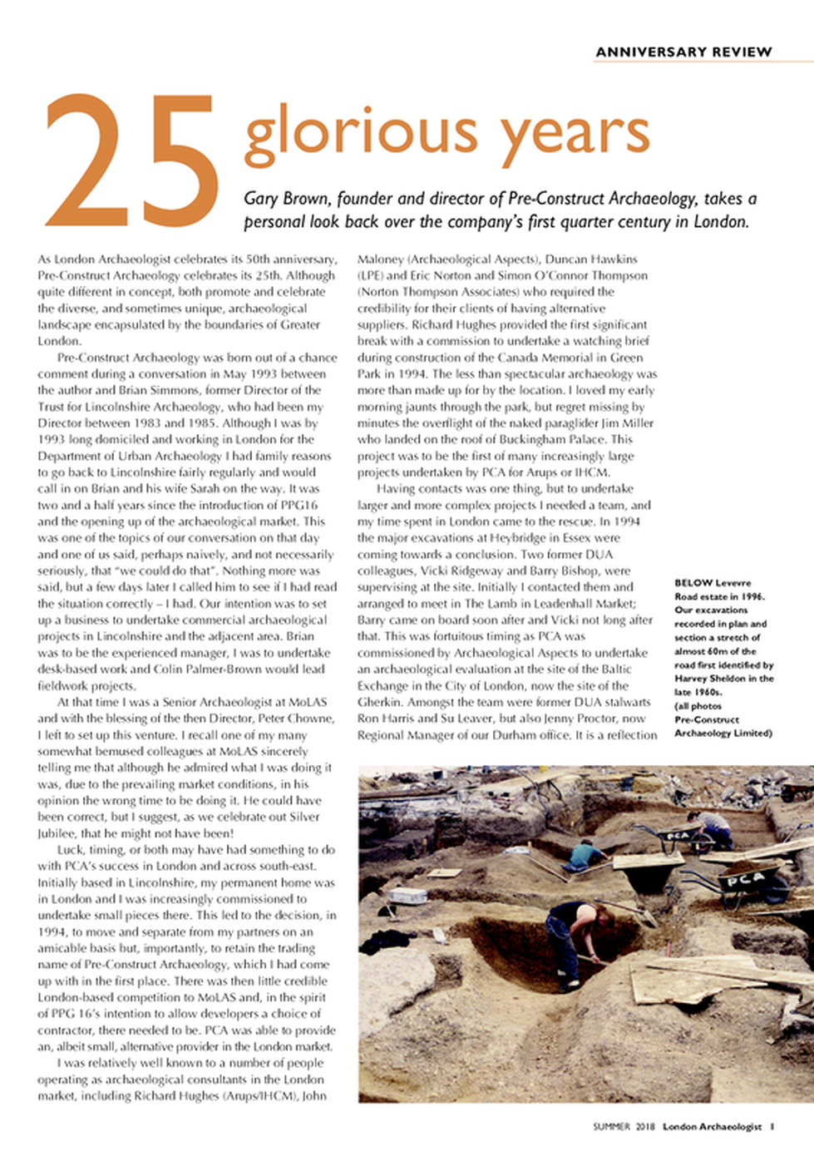
Articles

Slide 19
What should an article look like?
Headline followed by your name
Sub-heading & paragraphs
Introduction and conclusion

Slide 20
Articles inform readers about non-fiction events, facts, opinions and ideas.
Used by websites, newspapers and magazines.
Articles - you need to decide on the level of formality.
Why are you writing it? Who are you writing it for?
The headline has an important purpose - gets the reader to read the article.
Articles should have sub-headings - act as a stepping stone to the text.
Bullet points - used to list/highlight key points or statements.

Slide 21
Your opening paragraph should keep the readers’ attention.
The opening paragraph should also present your reader with your key points.
Opening paragraph should always be short & snappy.
Paragraphs are the main body.
All articles need a strong conclusion.
The conclusion should always sum up your points.
In the exam - try to use as many organisation features as possible.
Let us look at a good example of an article (created by a past student).

Slide 22
Follow this plan for letters, emails or articles
Every task MUST have an introduction and a strong conclusion.
Every bullet point in the task should be a paragraph.
Use at least 4-5 paragraphs (each making clear/flowing points).
Follow any word count - to quickly check how many words, count the words in your first sentence and then times this by how many sentences.

Slide 23
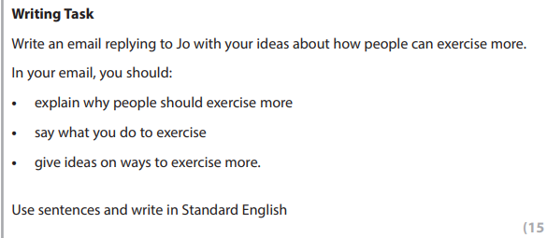
Class Task
Word count: 200 words.

Slide 24
Always make a plan!
Paragraph 1
Introduction – why are you writing?
Ideas on how to exercise more
Paragraph 5
Conclusion – what do you want to happen?
Paragraph 2
Explain why people should exercise more
Paragraph 3
Say what you do to exercise
Paragraph 4
Give ideas on ways to exercise more

Slide 25
Class Task
Word count: 200 words.

Slide 26
Stay on track!
Week 4 assignments on Century.

Slide 27
Next week…
Punctuation
Speaking & Listening Assessment
Writing a complaint
Writing an article

