Slide 1
Functional Skills English
Week 5

Slide 2
Class tasks (writing) - these are set to fine tune your writing skills.
Reading papers are set to assess your ability to pass the reading paper!
These exams are not easy!
Work with me!

Slide 3
What did we do Last time?
Formal & Informal
Letters
Article
DAFORREST
Email
TAP

Slide 4
Learning outcomes this week:
Punctuation - comma splicing.
Write an article using the correct layout and persuasive techniques.
Understand what is required to pass the Speaking and Listening Assessment.

Slide 5
Punctuation

Slide 6
There are rules for using commas. Watch the video to learn them!
A comma splice is a common mistake!
What is a coma splice? When you join two independent clauses with a comma and no conjunction.
What is a conjunction? These are words used to connect words, phrases, and clauses (a clause is a group of words that contain a verb). For example:
There are three ways to fix a comma splice… Let’s look at them!
and
or
but
because
for
so
when
although
Watch this video!

Slide 7
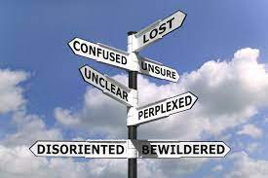
You can use a conjunction such as and, but or as
I am not angry with you, I am not happy with you, either.
Fix a comma splice by adding a conjunction immediately after the comma.
With most comma splices, the conjunctions you will want to add is probably and but so or…
I am not angry with you, but I am not happy with you, either.
Don’t be!

Slide 8
You can use a Semi-colon (;)
If adding a conjunction does not work, you can change the comma to a semi-colon.
Unlike commas, semi-colons are strong enough to glue two independent clauses together.
I am not angry with you, I am not happy with you, either.
I am not angry with you; I am not happy with you, either.
If you use a semi-colon, make sure there is a close/logical connection between the two independent clauses.

Slide 9
You can add a full stop and make two sentences
You can fix a comma splice by simply making each independent clause a separate sentence.
I am not angry with you, I am not happy with you, either.
I am not angry with you. I am not happy with you, either.
Are you getting the hang of it?

Slide 10
Fix these comma splice mistakes…
Remember you can:
Use a conjunction after the comma
If they are a connected topic use a semi-colon
Make two sentences
I went to the shop, Jane was there.
I am thinking of skipping English class, it is so boring.
The teacher was angry, the students were too loud.
I think he is in love, He acts so weird now.
I went to the shop, and Jane was there.
I am thinking of skipping English class; it is so boring.
The teacher was angry because the students were too loud.
I think he's in love. He acts so weird now.

Slide 11
Remember - Whatever you are asked to write - always remember TAP!
What text is it? A letter, email, article etc.
Who is it for? Target audience?
Why has it been written? There is always a reason!

Slide 12
Key Skills for writing Texts
When you write anything you need to think about:
What it is I am writing?
Presentation Features - how will I present my piece of text?
Language Features - what language features will I need to use?
Who is the audience I am writing for?

Slide 13
DAFORREST
Language features make your writing more persuasive and interesting. So use them!
I did tell you all that I would keep repeating it!

Slide 14
Today we will look at what is needed to…
Complete the Speaking and Listening assessment

Slide 15
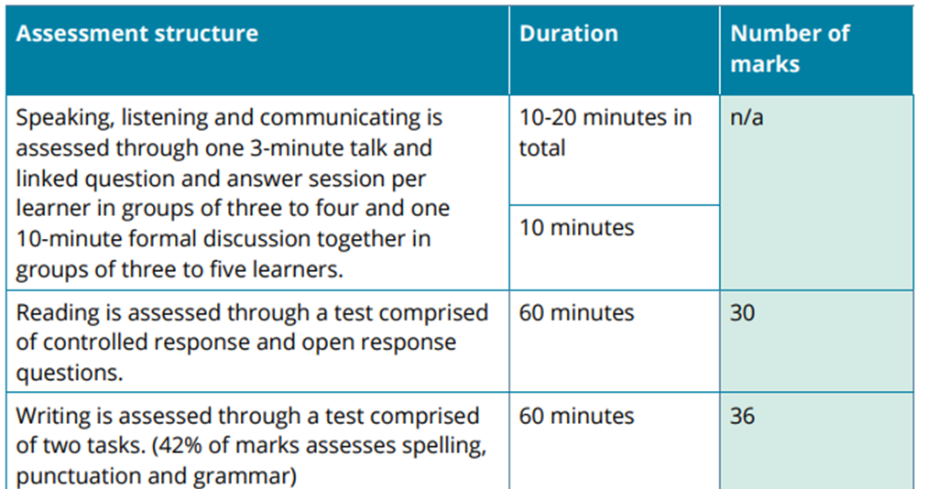
The tests required

Slide 16
Group Discussion
Your topic for your group discussion is: Dream Holidays
Presentation topic:
Work life
Family life
Social life
Anything else

Slide 17
Talk about possible presentations you could do.
Think of what you will write on your slides (if doing a PowerPoint).
When preparing your 3-5 slides try not to have a lot of text on the slides.
Aim to talk through the presentation and not read off a slide!
Help each other! Ask each other questions if a presentation is too short.

Slide 18
Let’s take a look…
Take notes
What would you do differently?
Did Lumbe present himself well?

Slide 19
Writing Tasks

Slide 20
Follow this plan for letters, emails, reviews or articles
Every task MUST have an introduction and a conclusion.
Use at least 4-5 paragraphs (each making clear/flowing points).
Try to use bullet points!
Follow the word count - to quickly count the words, count how many in your first sentence and then times this by how many sentences.

Slide 21
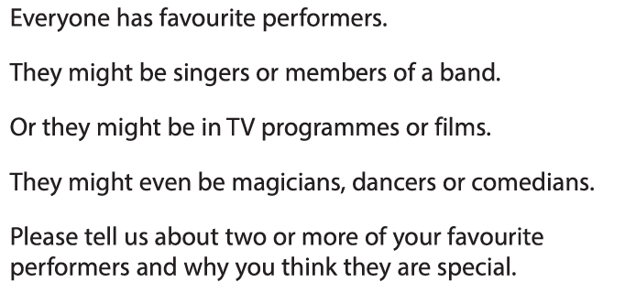
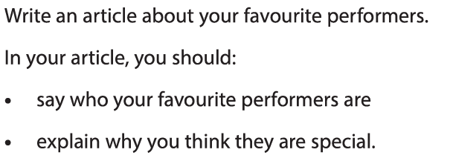
Class Task
Discuss the impact they have had on you
Write at least 200-250 words

Slide 22
Always make a plan!
Paragraph 1
Introduction – What are you writing about? How are you engaging the reader?
Article of Favourite performers
Paragraph 5
Conclusion – what overall impression do you want to leave? What do you want the reader to do next?
Paragraph 2 Who are your favourite performers?
Paragraph 3 Why are they special?
Paragraph 4
What impact have they had on you?

Slide 24
Always make a plan!
Paragraph 1
Introduction – Why are you writing?
Complaint
Paragraph 4
Conclusion – what do you want to happen?
Paragraph 2 Why are you unhappy with your purchase (three things)
Paragraph 3 – what impact did it have on you?

Slide 25
Century… check your pathway
Week 5 assignments on Century:
Complete Reading paper.
Choose Task 1 or Task 2 (Class tasks).

Slide 26
jonesg@chichester.ac.uk
Next week…
Punctuation (continued) & Grammar.
Word Classes.

