Slide 1
Functional Skills English
Week 6

Slide 2
What did we do Last time?
Coma splicing
Article
Speaking & Listening
Web forum - complaint

Slide 3
Learning outcomes this week:
Punctuation & Grammar.
Punctuation & Grammar tasks.
Word Classes.
Word Class Tasks.

Slide 4
Punctuation & Grammar…
The most common punctuation marks in English are:
Capital letters
Full stops
Question marks
Commas
Colons
Semi-colons
Exclamation marks
Quotation marks
When we speak, we use pauses and different pitches of the voice to make what we say clear.
Punctuation does the same thing in writing (makes it easier to read).
Capital letters are used to mark the beginning of a sentence.
Full stops are used to mark the end of a sentence.

Slide 5
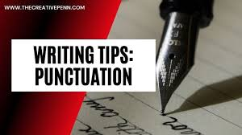
We went to Cornwall last summer. We were really surprised that it was so easy to travel on the A303.
Capital letters - used at the beginning of proper nouns. For example:
Personal names
Personal titles
Days of week
Places
Months of the year
Nationalities
Books
Magazines
Dr Cindy Wood is a lecturer at Winchester University.
Can you speak French?
We are planning a long holiday in Australia.

Slide 6
Full stops
Full stops (.) are used to show that you have reached the end of the sentence.
Unless something is a question or showing excitement or pain, then the sentence will end with a full stop.
A sentence is a set of words which are a complete idea.
Sentences start with a capital letter and end with a full stop, question mark or exclamation mark.

Slide 7
Task
10 mins
Circle letters which should be capitals and place a full stop at the end of a sentence. Count how many you have.
my name is daisy and every thursday i go to chichester college to do my level 2 engineering course it is brilliant because one day i’m going to own my own garage chain and call it daisy’s engines which i think this is a brilliant name i hope that my first garage will be based in bognor where i live and then the second one will be in worthing my teacher joe tells me i’ve got to work hard on my course to get what i want

Slide 8
26
Task
My name is Daisy and every Thursday I go to Chichester College to do my level 2 engineering course. It is brilliant because one day I am going to own my own garage chain and call it Daisy’s Engines which I think is a brilliant name. I hope that my first garage will be based in Bognor where I live, and then the second one will be in Worthing. My teacher Joe tells me I have got to work hard on my course to get what I want.

Slide 9
Punctuation: question marks (?) & exclamation marks (!)
We use question marks to make clear that what is said is a question.
When we use a question mark, we do not use a full stop.
For example:
A: So, are you all enjoying this course?
B: Why does watching Spurs play make me so nervous?

Slide 10
We use exclamation marks to indicate a statement overlaid by an emotive element or expression in informal writing.
When we want to emphasise something in informal writing.
We sometimes use more than one exclamation mark:
Oh no!!! I am so late for college!!!
Listen!

Slide 11
Punctuation: commas (,)
We use commas to separate a list of similar words or phrases:
It is so important to write in clear, simple, accurate words.
We do not normally use a comma before and at the end of a list of single words:
We cycled through Kent, Sussex, Hampshire and Dorset.

Slide 12
Separating clauses with commas
When main clauses are separated by and, or, but, so, etc.…we do not normally use a comma if the clauses have the same subject.
Do you remember from last week…a clause is a group of words that contain a verb.
However, we sometimes use commas if the clauses have different subjects: For example:
A: They were very friendly and invited us to their house for lunch. (same subject)
B: It was so expensive to eat in central London, but we decided it was worth the money. (different subjects)

Slide 13
Punctuation: colons (:)
Colons are used to introduce lists:
There are three main reasons for success on this course: hard work, commitment and dedication.
Colons to indicate a subtitle or to indicate a subdivision of a topic:
We often use colons to introduce direct speech:
Then she said: ‘I really cannot help you in any way.’
Commonly, a colon is used between sentences when the second sentence explains or justifies the first sentence:
Try to keep your house clean and tidy: it will sell more easily.
Life in Brighton: A Personal View

Slide 14
Punctuation: semi-colons (;)
Semi-colons used instead of full stops to separate two main clauses.
In such cases, the clauses are related in meaning but are separated grammatically. For example:
‘Spanish is spoken throughout South America; in Brazil, the main language is Portuguese.’
Semi-colons are not commonly used in contemporary English. Full stops and commas are more common.

Slide 15
Punctuation: quotation marks (‘…’ or “…”)
Quotation marks in English are ‘…’ or “…”.
In direct speech, we enclose what is said within a pair of single or double quotation marks.
Single quotation marks are the most common.

Slide 16
Direct speech begins with a capital letter and can be preceded by a comma or a colon:
‘Are you with me?’
He said, “Where can we find a nice Indian restaurant?” or He said: ‘Where can we find a nice Indian restaurant?’

Slide 17
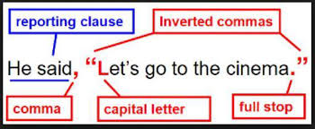
We can put the reporting clause in three different positions. Note the position of commas and full stops in these examples:
The teacher said, ‘Don’t forget to do your English homework.’
‘Don’t forget to do your English homework,’ the teacher said.
‘Don’t forget,’ the teacher said, ‘to do your English homework.’
(quotation mark after comma introducing speech and after full stop)
(comma before closing quotation mark)
(commas separating the reporting clause)

Slide 18
Brackets
Brackets are punctuation marks that we use to include additional information to a sentence.
In many cases, this information is not essential to the main point that the sentence is making.
Brackets are a good way of including extra information (without making a sentence too long).
Try to use them in your writing.

Slide 19
‘We provide outdoor activities, the chance to meet new people and the opportunity to create lasting memories.’
Why is the comma used in this quotation?
A to show the two parts of a sentence.
B to explain the meaning of a word.
C to indicate the end of a sentence.
D to separate the contents of a list.
2. 'Other popular rides include the Great River Splash (don't forget your waterproof coat).’
Why is '(don't forget your waterproof coat)' in brackets?
A to show that it is an exclamation.
B to join different parts of the sentence.
C to show it is additional information.
D to mark the beginning and end of speech.
Time to think?

Slide 20
Word classes?
Noun
Adjective
Verb
Adverb

Slide 21
Word classes task: Identify the correct word class for each word.
London
Slowly
Heavy
Fast
Noun
Adverb
Adjective
Adjective
Table
Fork
Cheerfully
Great
Noun
Noun
Adverb
Adjective
Jacket
Dancing
Run
Write
Noun
Verb
Verb
Verb

Slide 22
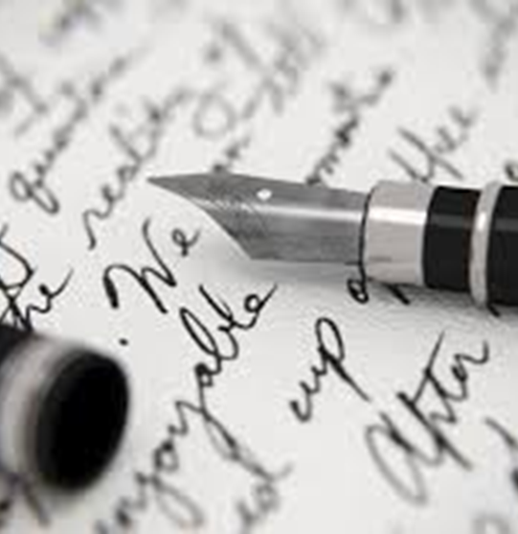
Practicing Standard English
Standard English has a higher status than non-Standard English (informal).
Taught in school so people can use it later in life (e.g., at a formal interview).
Let’s try these examples below:
A: They’ve taken me lunchbox.
B: I was there, but I never saw nothing.
C: I ain’t done my homework.
D: We was waiting for ages.

Slide 23
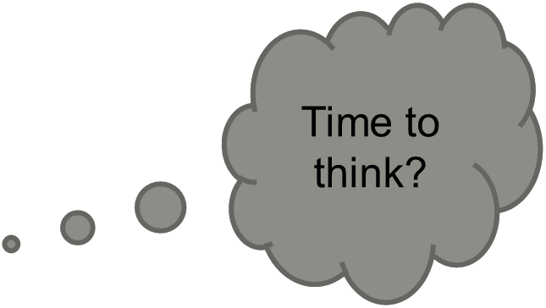
Practicing Standard English
(correct form)
All of us ….. going to the circus. I ….. excited (was/were).
The clowns ….. much more fun than the lions (was/were).
The clown I ….. watching ….. very funny indeed (was/were).
Rachael and ….. both bought candy floss (I/me).
John invited Kasey and ….. to share an ice-cream with him (I/me).
The loudest of the group ….. Kasey (is/are).
Just between you and me, I love all ….. Friends (me/my).

Slide 24
Find the missing articles (a, an or the)…?
10 mins
Dear Gavin,
Thank you for supporting UCLH Charity during most difficult and challenging time. Your donation has made big difference to UCLH frontline staff. Each pound has been spent to support staff well being beyond ways in which NHS can realistically fund. Thanks to you, UCLH staff have been looked after and they are extremely grateful for your support.
As winter approaches our hospitals are busier than ever. Clinical teams are working hard to meet current emails whilst also trying to treat large number of patients waiting for treatment as a result of delays caused by CovId-19.
a
a
the
the
the

Slide 25
Planning your writing.
Proofreading.
Reports.
Contributing to a web forum.
Next week…

Slide 26
Century…
Week 6 assignments on Century:
Continue with pathway.

