Slide 1
Functional Skills English
Week 7

Slide 2
What did we do Last time?
Punctuation & grammar.
Word classes.

Slide 3
Learning outcomes this week:
Planning your writing.
Proofreading.
Writing a report correctly.
Contribute to a web forum.

Slide 4
Planning your writing

Slide 5
Planning your writing
What is the correct method to use when planning a text?
In time, find a method that suits you!
Always begin by considering the purpose of your writing.
Who is the audience?
Is it an important text?

Slide 6
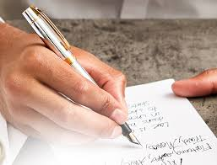
Planning your writing
Write a list of ideas or points.
Draw a picture, such as a mind map or spider diagram.
Write ideas on sticky notes.
Organising your ideas is important.
You can also plan your paragraphs.
Here are some examples of ways to plan your writing!

Slide 7
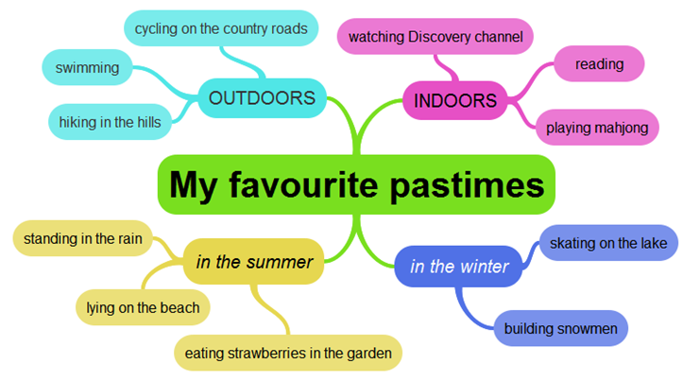
Mind maps

Slide 8
Why think about your audience and purpose?
The purpose of your writing affects:
content - the ideas and information you include.
format - the layout of your writing.
style - the language you use (formal or informal).
Formal language - used when writing an official document.
Informal language - used when writing to family/friends.

Slide 9
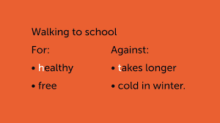
Planning your writing
Bulleted lists are useful for planning your writing (remember to use them in the exam).
Look at these examples
Use either bullets or numbers.
Multiple ways to use these.
Bulleted points help to inform the reader.
Wealth of information in small space.

Slide 10
Planning - using paragraphs
A paragraph is a group of sentences that share the same idea.
Paragraphs are used to structure our writing and to make it easier for the reader to follow.
Look at different texts - such as newspapers, magazines and books - see how different writers divide texts into separate paragraphs.
Lots of different ways of developing your writing in a paragraph.
Comparison of ideas/arguments
statistics
linking words or phrases
subheadings
Bullet points

Slide 11
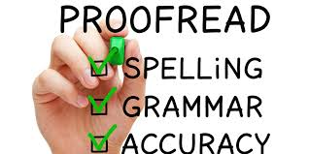
PROOFREADING

Slide 12
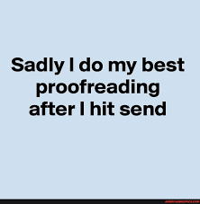
Proofreading
Proofreading is an important stage in the writing process.
Proofreading - checking for errors in punctuation, spelling or grammar.
Proofreading can feel difficult.
It is sometimes difficult to find errors in your own writing.
There are good methods that you can use whenever you are proofreading.

Slide 13
Proofreading tips…
Read aloud!
Find a quiet room!
Read your writing aloud.
You will notice when a word or sentence is not right.
Get a friend/family member to read your writing aloud.
Does your work make sense?
You will ‘hear’ any punctuation/grammar mistakes.

Slide 14
Proofreading tips…
Useful strategy for ‘seeing’ mistakes.
Use a ruler to read each sentence.
Check paragraphs.
Spelling.
Punctuation.
Word choice?
Everyone is different.
Find a method that works for you.
Proofreading is essential - make it a habit.
Do not rely on spellcheck software!

Slide 15
Letter of Complaint
Dea r Sir
I am ritin to complain to yuse about the meal that I one as a price first in a competision at your restaurant. Immediately ater the meal too of my friends were violuntly sick in the taxi They visited the doctor next day how treated them four food poisoning.
I honustely believe it must be somethin they eat has I and my friend Jaya was not ill. I believe it must ave been the sea food salad as neither Jaya and I had any.
I am askin you to investigate this matter and ascertain why the salad caused the food poisonin I hope you stop such a matter happening again in the futere. I wood appreciate a reply regarding these situation what you intend to do two compensate us for this unfortunate incident
Yours Sincerley
Joe Bloggs
10 minutes

Slide 16
39
Letter of Complaint
Dear Sir/Madam,
I am writing to complain to you about the meal that I won as a first prize in a competition at your restaurant. Immediately after the meal, two of my friends were violently sick in the taxi. They visited the doctor the next day, who treated them for food poisoning.
I honestly believe it must be something that they ate because my friend Jaya and I were not ill. I believe it must have been the sea food salad as neither Jaya nor I had any.
I am asking you to investigate this matter and ascertain why the salad caused the food poisoning. I hope you stop such a matter happening again in the future. I would appreciate a reply regarding this situation. What do you intend to do to compensate us for this unfortunate incident?
Yours faithfully,
Joe Bloggs

Slide 17
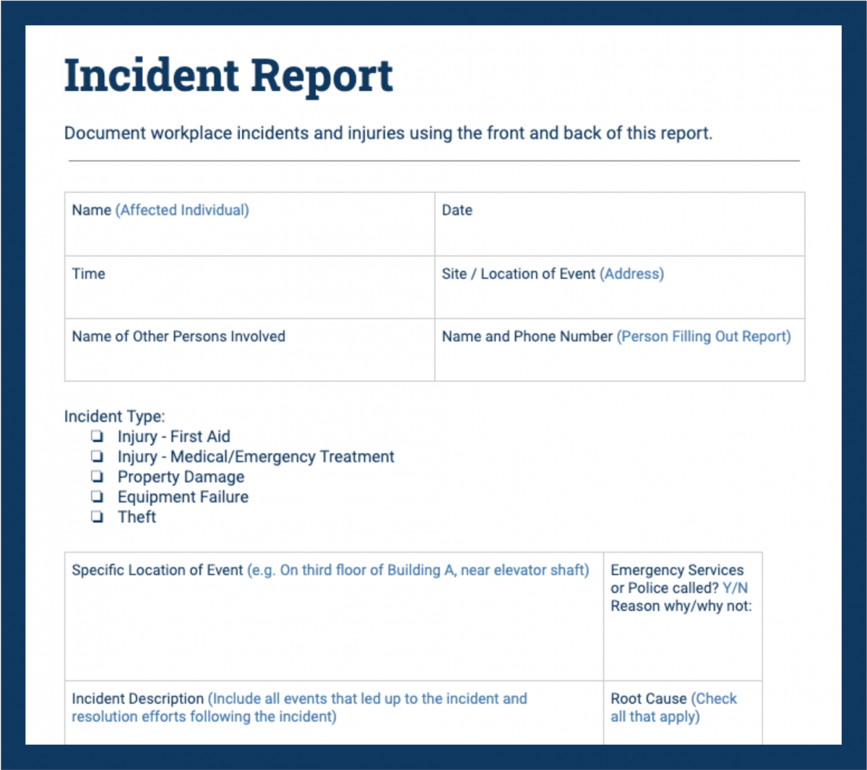
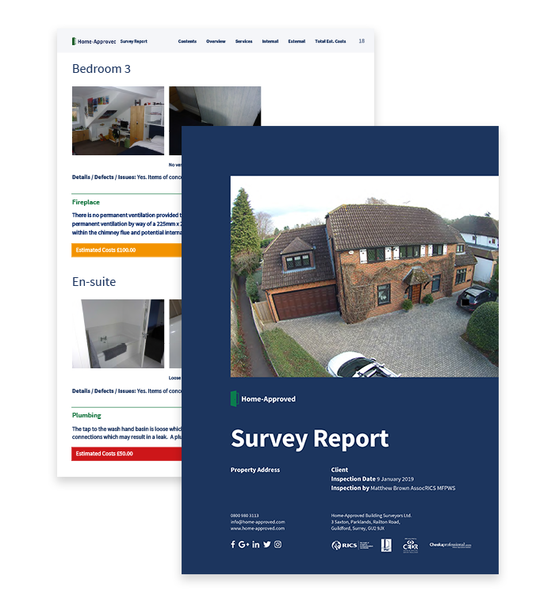
Reports

Slide 18
What is a report?
Reports tend to feature these types of content:
Details of an event or situation.
The consequences or ongoing effect of an event or situation.
Evaluation of statistical data.
Predictions or recommendations based on the information in the report.
How the information relates to other events or reports.

Slide 19
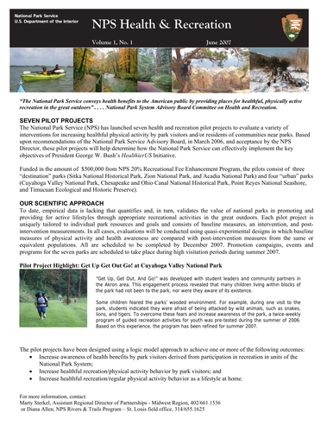
Reports:
An example: The secret life of urban foxes | Natural History Museum (nhm.ac.uk)

Slide 20
Remember a report must have:
Formal writing so no slang or contractions.
Information must be organised and easy to see.
Subheadings.
Bullet points.
Numbered lists.
Conclusion.

Slide 21
Key Skills for writing Texts
Remember when you write anything you need to think about:
What it is I am writing?
Presentation Features - how will I present my piece of text?
Language Features - what language features will I need to use?
Who is the audience I am writing for?

Slide 22
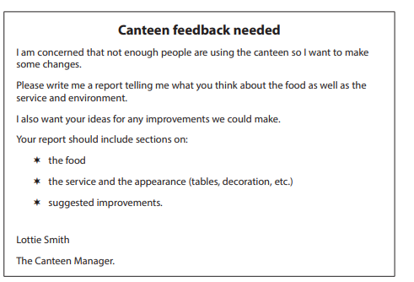
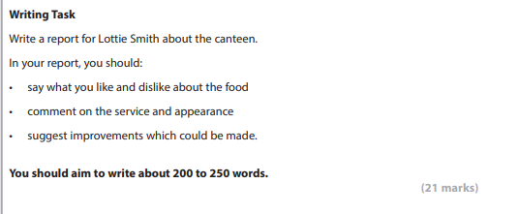
Writing a Report
Class Task
This is a clue!

Slide 23
Always make a plan!
Paragraph 1
Introduction – What are you writing about?
Report about the canteen
Paragraph 5 – conclusion what do you want to happen?
Paragraph 2 – what do you like and dislike about the food?
Paragraph 3 – comment on the service and appearance
Paragraph 4 – what improvements could be made?

Slide 24
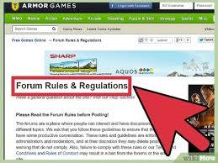
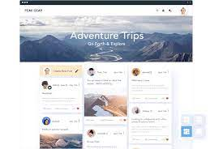
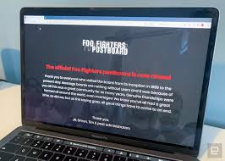
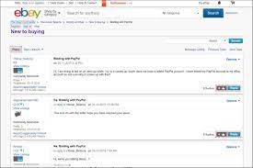
Web forums

Slide 25
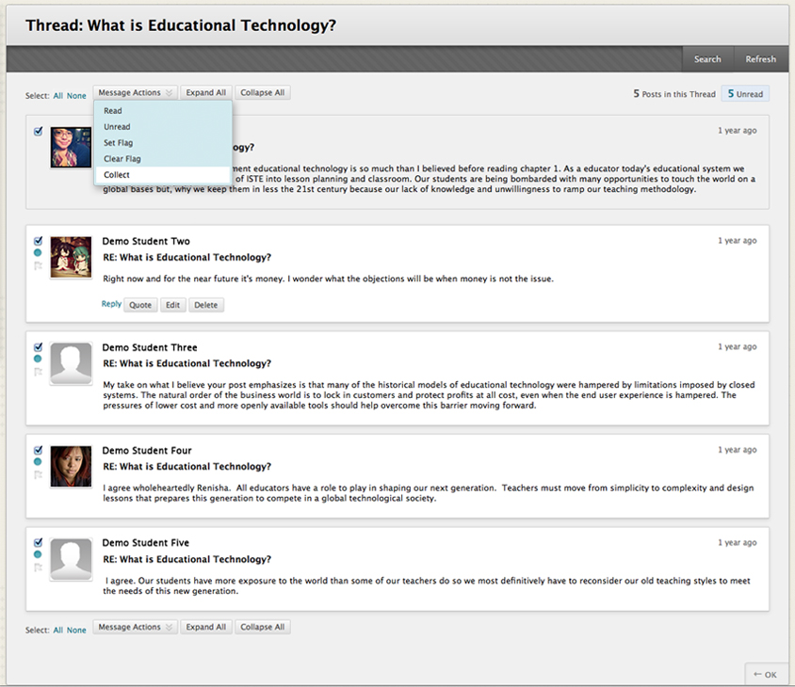
Web forums
What is a forum?
Group discussion published on a website.
Has a particular topic or subject.
Formal or informal language?
Usually relaxed/chatty - no slang!
First person (I, me, my and mine).
Tip - use the title & date of posting (if given in the exam).

Slide 26
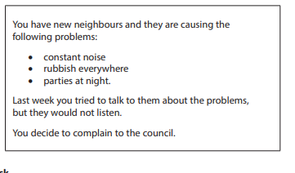
Contributing to a web forum
Class Task
This is a clue!

Slide 27
Language features
Make your writing more persuasive and interesting!
DAFORREST
DAFORREST
DAFORREST

Slide 28
Assignments...
Week 7 assignments on Century.
Option of Task 1 or Task 2.
Follow your pathway.

Slide 29
Next time…
Similarities/Comparison
Extending vocabulary
Witness statements

Slide 30
Advice on what to do in the event of an accident
You may not want to think about the worst when driving but how meny of us actualy no what to do if we are involved in a acident
Hopfuly well never need to find out but just in case the worst does happen carrentals.co.uk offers sum tips on wot to do after an accident
Cheque four injurees After an accident your first priority should be to check yourself any passengers and any other drivers for sines of injury – your health is mutch more important than any damage to vehicules
Call for help If anyone is injured cheque the ABC of first ade – airway breathing and circulasion Make shore someone calls for a ambalanse and keep any casualtees warm and imobalised
Report the accident No matter how miner you may think the accident is always report it to the police strate away so that you have an offishal record of the incident
Move cars Drivers involved in minor accidents with no serious injuries should move cars to the side of the rode and out of the way of the oncoming trafic
If they cannot be moved drivers and passengers should remane in the cars with seatbelts fastened untill help arrives Turn on hazard warning lites and put out cones or warning trianges Make a note of any pacific damage to all cars

Slide 31
You may not want to think about the worst when driving, but how many of us actually know what to do if we are involved in an accident?
Hopefully, we’ll never need to find out but just in case the worst does happen, carrentals.co.uk offers some tips on what to do after an accident.
Check for injuries: After an accident, your first priority should be to check yourself, any passengers and any other drivers for signs of injury – your health is much more important than any damage to vehicles.
Call for help: If anyone is injured check the ABC of first aid – airway, breathing, and circulation. Make sure someone calls for an ambulance and keep any casualties warm and immobilised.
Report the accident: No matter how minor you may think the accident is, always report it to the police straight away so that you have an official record of the incident.
Move cars: Drivers involved in minor accidents with no serious injuries should move cars to the side of the road and out of the way of the oncoming traffic.
If they cannot be moved, drivers and passengers should remain in the cars with seatbelts fastened until help arrives. Turn on hazard warning lights and put out cones or warning triangles. Make a note of any specific damage to all cars.

