Slide 1
Functional Skills English
Week 8

Slide 2
What did we do last time?
Planning
Proofreading
Reports
Web forums

Slide 3
Learning outcomes this week…
Identify similarities
Comparing texts
Extending vocabulary
Witness statements

Slide 4
Identifying similarities…
Look at this image.
What stands out?
Pick out 4 things about this image.
Make a note of the 4 things.

Slide 5
Look at this image.
What stands out?
Pick out 4 things about this image.
Make a note of the 4 things.
The same picture when it was a working mill…

Slide 6
Same image…different times! How would we compare them?
Class discussion
Present
Are there any similarities?

Slide 7
Comparing texts…how can we identify similarities?
Read the text carefully!
Think about the main points in each text. Find those finer details!
What opinions do the writers have? How are they similar/different?
We can compare main points, information, formality, Presentation or facts.
We can compare language features (the way texts are written).
Persuasive language Emotive language Alliteration Direct address

Slide 8
Comparing texts…
We can also compare ideas & points of view.
How ideas/views are presented.
Are there similes, quotes or metaphors?
The method the writer uses will influence the reader’s response.
You are the reader, so think about how the text is makes you feel and respond.

Slide 9
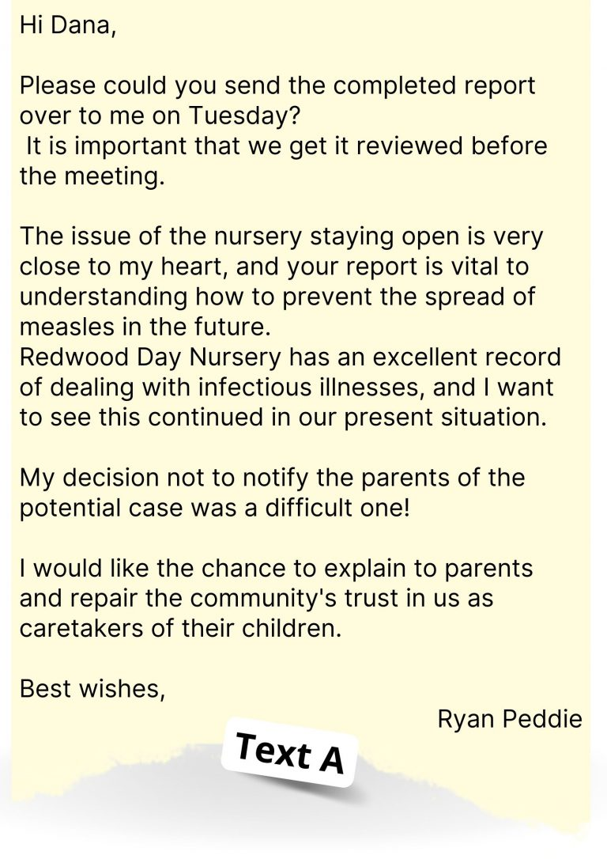
Vs

Slide 10
Text A
Text B
Both texts are about a measles outbreak in a day nursery
Letter/email
Newspaper article
Both texts say there has been a positive response to outbreaks in the past
Direct address
No direct address
Both texts written from a personal/insider point of view
Facts
Opinion
Layout features:
Columns
Image
Heading
subheading
Paragraphs
Both texts use emotive language

Slide 11
Plan your ideas
Jot down your ideas/points.
Spider diagrams/bullet points - ideal for recording your thoughts.
Find the links between three texts (e.g. their ‘purpose’).
Important to discuss texts (e.g. ‘Text A, Text B and Text C’).

Slide 12
Key phrases help to compare texts…
Similarities | Differences
Similarly, | In contrast,
Equally, | However,
In the same way as… | On the other hand,
Just as... so does.... | Alternatively,
Both Text A and Text B… | In a different way…

Slide 13
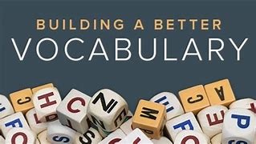
Extending vocabulary
“Words are, in my-not-so-humble opinion, our most inexhaustible source of magic”.
(J.K. Rowling's character Dumbledore in Harry Potter and the Deathly Hollows).

Slide 14
Ways to improve vocabulary
Expose yourself to new words.
Read as much as you can.
Books, articles, magazines and newspapers.
Watch TV with subtitles or listen to the radio.
Use the dictionary & thesaurus (plenty online).
Practice new words by playing word games with family/friends.

Slide 15
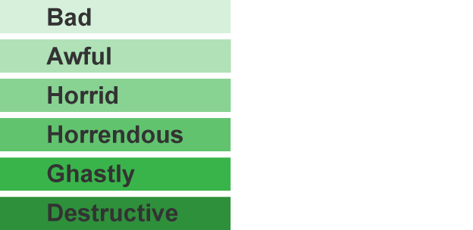
Think of an alternative and more interesting word for:
Nice
Happy
Cold
Hot
Unhappy
Keep
Beautiful
Safe
Awesome
Euphoric
Freezing
Scorching
Sorrowful
Retain
Gorgeous
Protected

Slide 16
Vocabulary Builder Tasks
Ad hoc
For a particular purpose?
Very occasionally?
A last minute event?
Alfresco
A famous New York salad?
A refreshing wine-based drink?
In the open air?
Blasé
A glaze on porcelain?
Indifferent or bored?
A large bonfire?
Correct
Words used in our language are sometimes borrowed from foreign countries (France, Italy and Greece).
Look at the words opposite & choose the correct meaning.
We will go through the answers together.
Correct
Correct

Slide 17
1. What word could be used to replace “endeavours” in the following sentence?
George has made great endeavours to pass his driving test first time.
economies b. efforts c. experiments d. enterprises
√
2. Which word can replace ’concluded’ in the following sentence?
The report concluded that there was no case to answer.
a. consummated b. pre-empted c. determined d. foresaw
√
3. Which word would you use to complete this sentence?
On my day off I like to sleep in late because I am
exhausted.

Slide 18
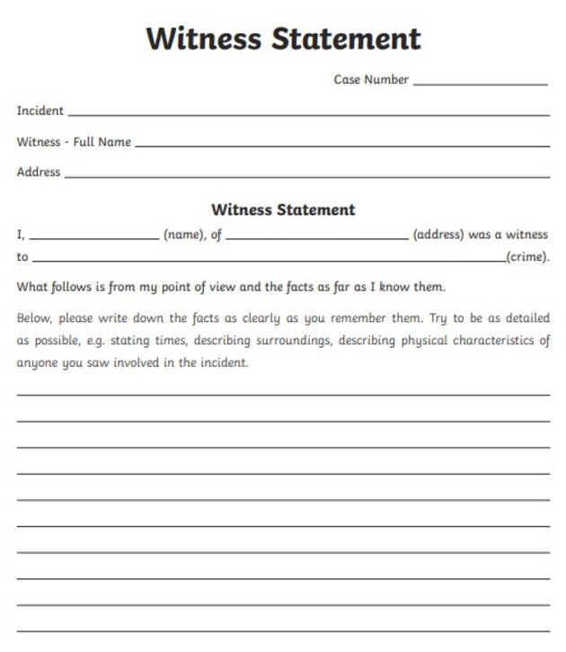
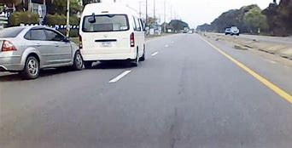
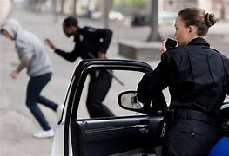
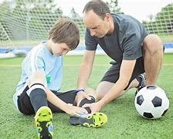
Witness Statements

Slide 19
Writing a witness statement
Important information that must be in a statement for an accident in the workplace:
The name of person hurt.
The date and time of the incident.
State the exact details of what happened.
Your name and job role.
What did you ‘see’, ‘hear’ or ‘smell.’
What action did you take?

Slide 20
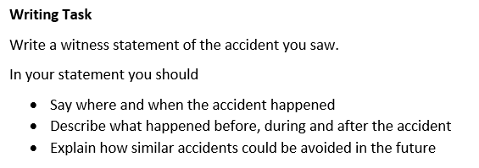
Writing a witness statement
Class Task 1
Word count: 250

Slide 21
Always make a plan!
Paragraph 4
Conclusion - Explain how similar accidents can be avoided in future
Paragraph 1
Introduction - Why are you writing?
Write a Witness Statement
Paragraph 2 - Say where and when the incident happened
Paragraph 3 - Describe what happened before, during and after the accident

Slide 22
Compare the writers’ ideas and perspectives about their lives with wild animals.
Class Task 2
What is similar in the language and structure used?
What is different?
4 clear points and comparison paragraphs.

Slide 23
Assignments
Check your Century.
Choice of class task 1 or 2.
Nuggets (comparing/understanding texts).
Practise your planning!
Practise proofreading!

Slide 24
Next week…
Explicit vs Implicit
Writing in the present tense
Tone
Reviews

