Slide 1
Functional Skills English
Week 9

Slide 2
What did we do Last time?
Similarities
Comparing texts
Extending vocabulary
Witness statements

Slide 3
Learning outcomes this week:
Explicit vs Implicit
Writing in the present tense
Tone
Reviews

Slide 4
Explicit
Explicit (adjective) - meaning something that is clear cut and without question!
We give explicit instructions which leave us in no doubt.
Something described as explicit - leaves nothing open to interpretation.
Writers use explicit information in texts to directly express something.

Slide 5
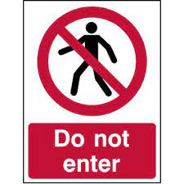
Explicit examples…
This sign is directly telling us not to enter.
The sign is giving us explicit instructions.
This direct instruction is not open to interpretation.
The information on this sign is precisely and clearly expressed.
If I said to my boss: ‘If you do not give me a pay rise, I will leave.’ - this would be very explicit (my statement would be quite clear).

Slide 6
Extract from The Boy in the Striped Pyjamas by John Boyne.
The Fury was far shorter than Father and not, Bruno supposed, quite as strong. He had dark hair, which was cut quite short, and a tiny moustache – so tiny in fact that Bruno wondered why he bothered with it at all or whether he had simply forgotten a piece when he was shaving. The woman beside him, however, was quite the most beautiful woman he had ever seen in his life. She had blonde hair and very red lips, and while the Fury spoke to Mother she turned and looked at Bruno and smiled, making him go red with embarrassment.
1. Write down at least two explicit details you learn about the appearance of ‘the Fury’ and his female companion.
2. Write down two of the things that Bruno is explicitly thinking.

Slide 7
IMPLICIT
Implicit (adjective) - to imply or suggest something.
We give implicit instructions which suggest or hint at something (but are not directly stated or expressed).
Implicit information is not immediately obvious.
Writers use implicit information in texts - leaving it open for the reader to interpret.

Slide 8
Implicit examples…
This sign is implicitly suggesting that we do not go in.
The sign does not directly say ‘do not go in.’
Going in or not is something that we need to think about!
The danger is only implied.
If something is implicit - we need to read between the lines.
Implicit - we need to think about what is being suggested.
If I said to my boss: ‘If you do not show more appreciation, I will have to review my options.’ - this would be implicit (my statement would be implying something).

Slide 9
What can we infer about these two people based on the image?
To investigate some of the implicit ways writers reveal information
Anger?
Frustration?
Concern?
Persuasion?
Jessica looked at her daughter, exasperated. She brought her hands slowly up to her temple, her brow furrowing with frustration. She gently massaged her temples, slowing her breathing down while she did so.

Slide 10
Before he pushed the loaded supply boat out into the sound, he turned his back to the wind, reached into his waistcoat pocket and delicately drew out a folded square of paper. He re-read the copper-plate writing that was so familiar. "Thy way is in the sea, and my path in the great waters." He read the words slowly and deliberately and, although he was not religious, the message carried some deeper significance which was not clear to him. He returned the paper back into his pocket, repeated the words in his mind, and pushed the bow of the boat seaward.
List two pieces of explicit information about the sailor in this extract.
He turned his back to the wind.
He was wearing a waistcoat.
He isn’t religious.
He read the words slowly and
deliberately.
List two pieces of implicit information about the sailor in this extract.
It was cold/windy.
The sailor was journeying alone.
He felt comforted by the words on
the piece of paper.

Slide 11
How do I remember the difference?
Explicit information: Information which is obvious, clearly stated or openly said by the writer of a text.
Implicit information: Information which is not immediately obvious, suggested by the author, based on what has been written.
Explicit - refers to something that is explained thoroughly.
Implicit - is implied.

Slide 12
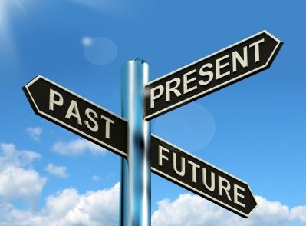
Writing in the present tense

Slide 13
Writing in the present tense - it is harder than you think!
Present tense - used to describe something in the current moment.
Present tense - is a verb tense (doing) used to describe actions happening right now.
We use present tense to distinguish from events happening in the past and in the future.
The present tense makes your writing simpler and more direct.
Present tense - effective with a first person narrator (writing using ‘I’).

Slide 14
Writing in the present tense saves your audience work and helps make your points clearer.
Writing in the present tense (if used correctly) evokes a sense of urgency, immediacy and air of suspense in the reader. For example:
“I am standing on the shoreline and the waves are so big! I want to jump in and swim for it, but it is far too dangerous.”

Slide 15
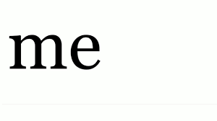
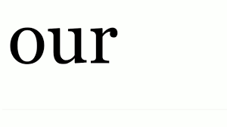
One basic rule of writing in the present tense:

Slide 16
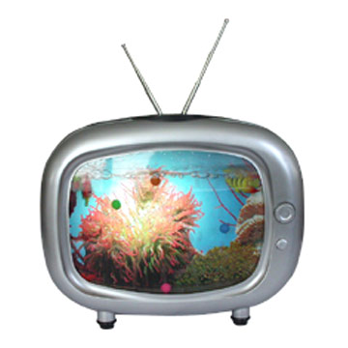
Which tense is this sentence written in?
Last night I watched Coronation Street on TV.
Past tense!

Slide 17
Which tense is this sentence written in?
I am going to the cinema at the weekend with my friends to watch a film.
Future tense!

Slide 18
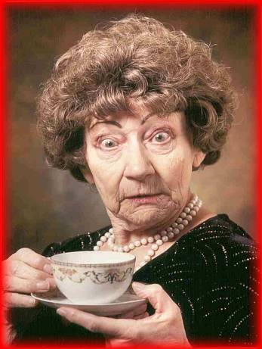
Which tense is this sentence written in?
On a Sunday, I get up at 10.30 am and make myself a cup of coffee in my favourite cup.
Present tense!
Me first thing in the morning!!

Slide 19
Writing a diary entry…
10 mins
Imagine you are the woman in this family who has sought asylum in a new country.
Write a diary entry about the first morning in their new country from her point of view.
You might write about:
What might she miss?
What doesn’t she miss?
What she likes about her new home?
What is very different?

Slide 20
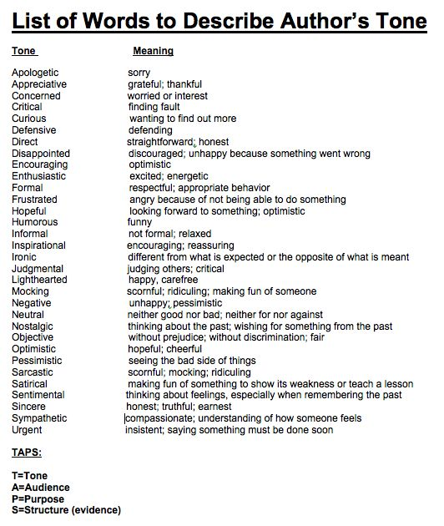
TONE

Slide 21
There are various different ways to create tone in a text:
Tone can express emotions: worried, excited, upset, affectionate.
Tone can change depending on the situation.
Tone is used in formal and informal writing.
Tone can be a powerful writing tool.
How do you identify tone?
Tone is identified by the way a writer makes you feel or think!
similes
sentence structure & powerful words
metaphors

Slide 24
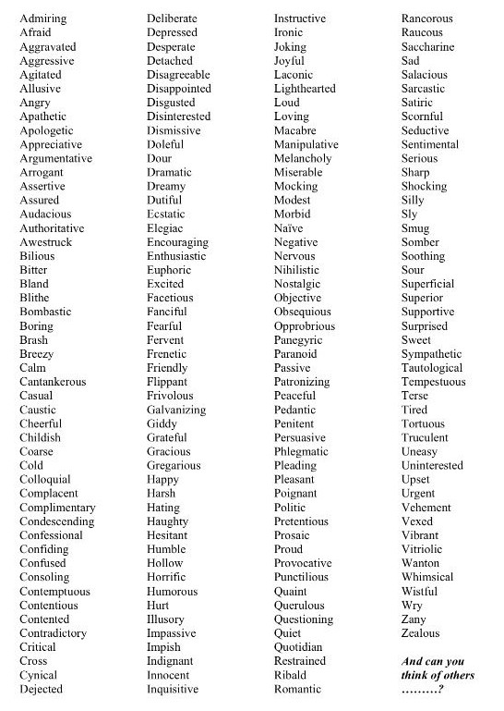
Let’s discuss ‘In Flanders Fields.’
What words from this list could be used to describe the poem?
Pick two words to describe this war poem by John McCrae.
What other words could you use?

Slide 25
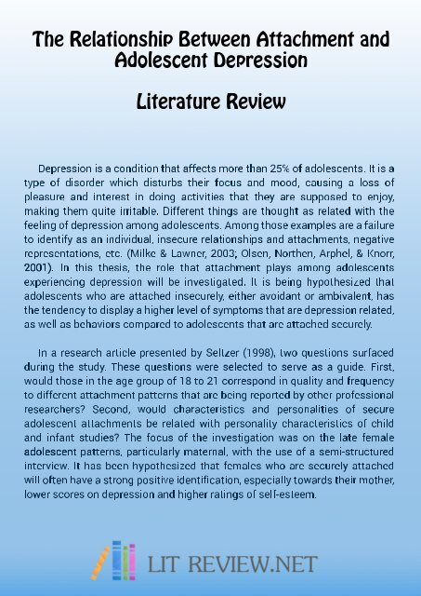
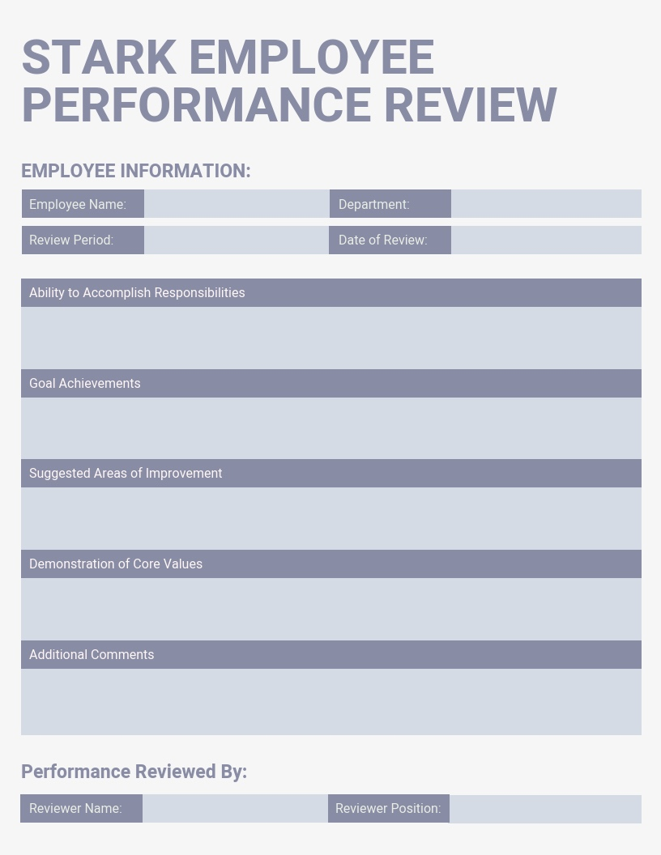
Writing a review

Slide 26
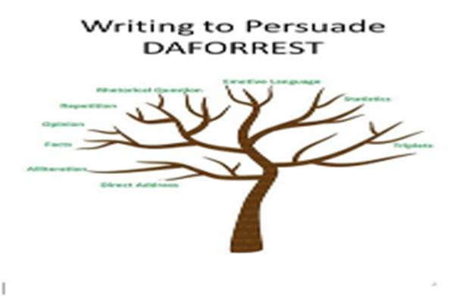
A review is a detailed written opinion on a topic (often in first person).
There are many different types of reviews:
A review needs to be laid out like an article.
Use a short heading to quickly inform your reader.
A review should include your opinion.
Book reviews
Music reviews
Film reviews
Art reviews
Restaurant reviews

Slide 27
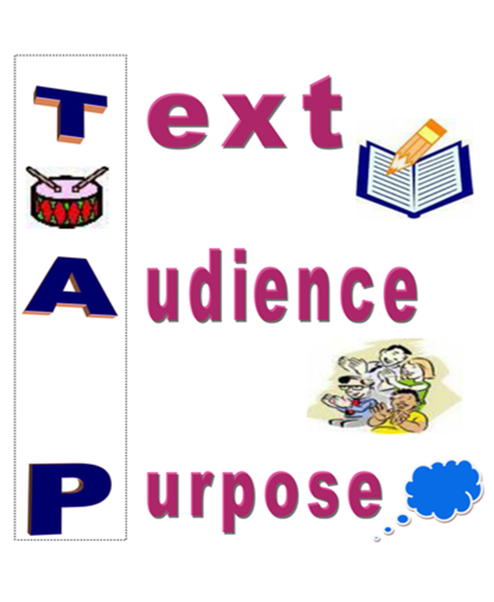
Subheadings.
Use persuasive language.
What other language features you could use?
A review should inform, persuade & entertain.
A review usually works best with an informal approach.
Always be aware of the audience.
Remember…Text…Audience…Purpose!

Slide 28
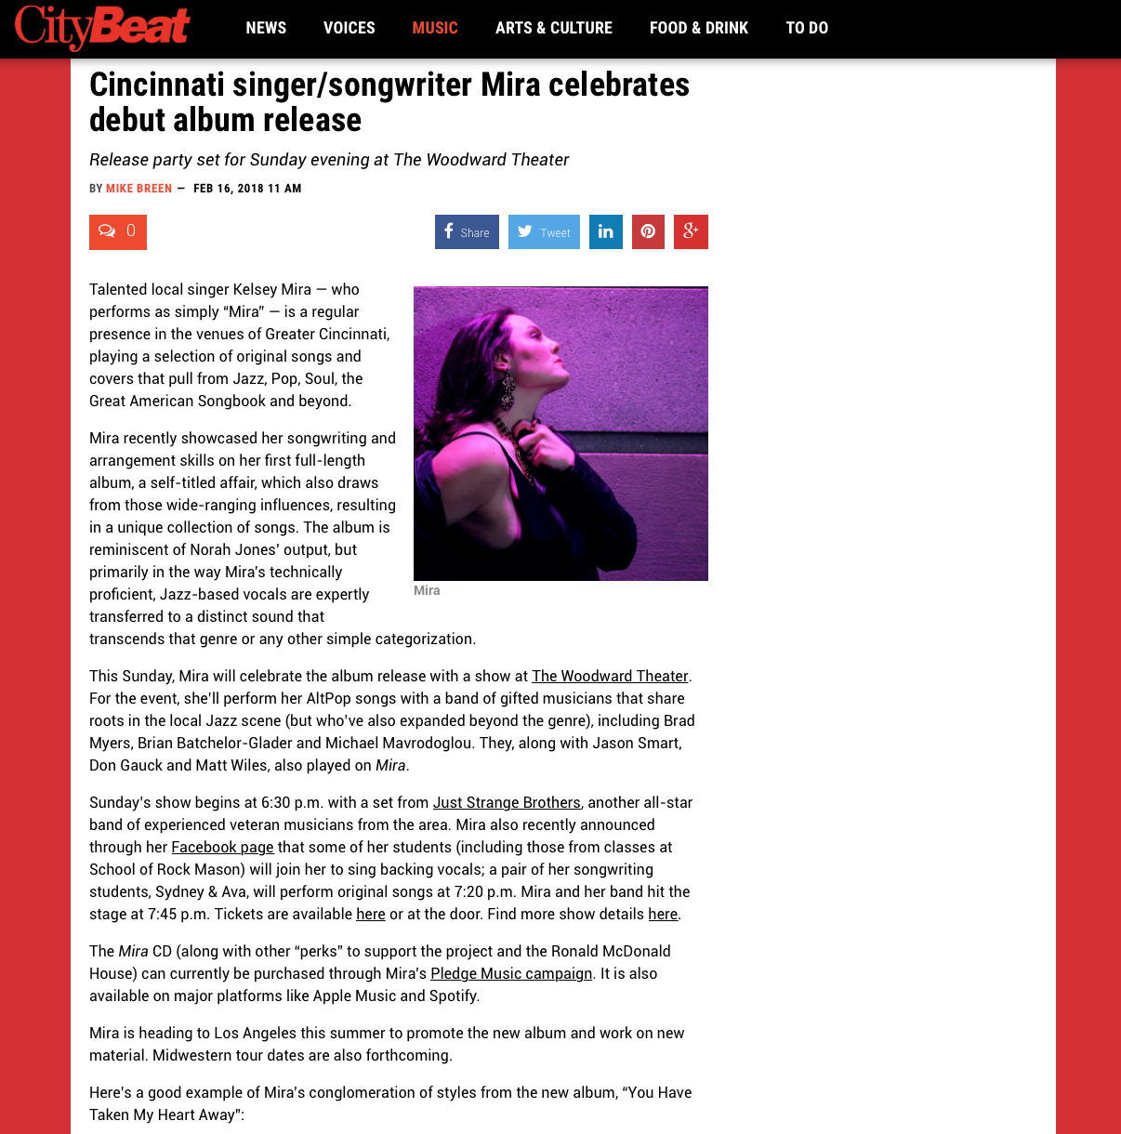
Review layout EXAMPLES

Slide 29
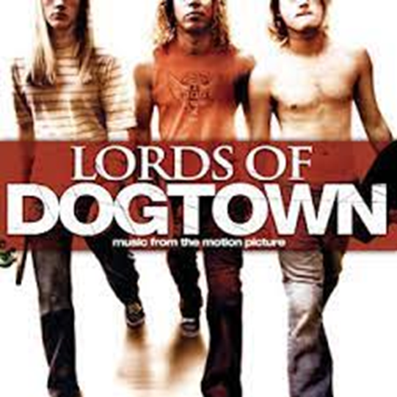
Class Task
Review
You have been asked to write a review of your favourite film for the college web site. You must include:
What film you are reviewing?
What made you choose it?
What you like about the film?
What don’t you like about the film?
Word count: 200-250

Slide 30
Always make a plan!
Paragraph 1
Introduction – Why are you writing?
Write a review
Paragraph 5
Conclusion – what do you want to happen?
More people seeing the film or not seeing it
Paragraph 2 – what film are you reviewing?
Why have you chosen that film?
Paragraph 3 – What are the good aspects of the film
Paragraph 4
What about the film don’t you like?

Slide 31
Week 9 assignments on Century.
DAFORREST

Slide 32
Next time…
Reading Paper Breakdown.
Reading exam video.

