Slide 1
Functional Skills L2 Maths
Session 1

Slide 2
Introduction
Welcome to Functional Skills Maths!
Over the next few weeks, I will be supporting you with achieving your Functional Skills Maths Level 2 qualification.
Each week will be based around a different topic and will help to develop and/or consolidate your maths skills in preparation for your examination.
The FS Maths Exam – There are two parts to this exam:
Section A – Non Calculator
Section B – Calculator
Each week we will look at examples of exam questions to help prepare you.

Slide 3
Timetable

Slide 4
Functional Skills – Course Structure
Functional Skills Maths as a course is designed to support your maths skills, but it is also heavily focused on developing your problem solving ability.
Problem Solving Skills
25%
Mathematical Ability
75%

Slide 5
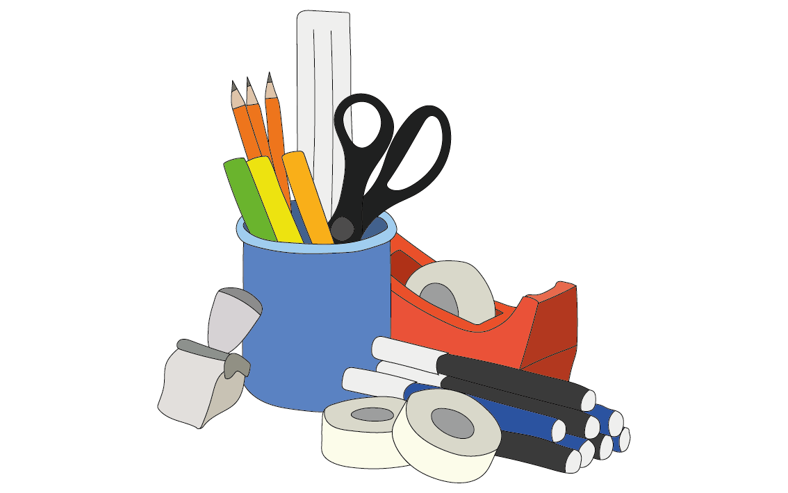
What will you need?
Pen
Pencil
Paper
Calculator
Ruler
Protractor
Compass

Slide 6
Revision Guide

Slide 7
What are we doing today?
Non-Calculator Methods
General Number Skills

Slide 8
What do we need to know?
Understand place value
How to add, subtract, multiply and divide without a calculator
Positive/Negative numbers

Slide 9
Place Value

Slide 10
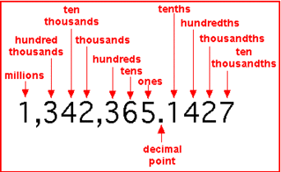
Place Value
The value of a digit depends on its place in the number.
As you move to the left, the place value is 10x bigger.
As you move to the right, the place value is 10x smaller.

Slide 11
Place Value
Remembering place value is key when it comes to decimals!
Which is the bigger number?
0. 325 or 0.6
Units | . | Tenths | Hundredths | Thousandths
0 | . | 3 | 2 | 5
0 | . | 6 | 0 | 0

Slide 12
Non-Calculator Methods

Slide 13
Operations
We are going to look at the four ‘operations’. These are the building blocks for Functional Skills Maths.
They are:
Addition: Combining numbers into a greater amount
10 + 12 = 22
Subtraction: Taking apart numbers from the greater amount
22 – 12 = 10
Multiplication: How many groups of a number we have
3 groups of 5 equal 15 (3 x 5 = 15)
Division: How many times a number fits into another number
5 fits into 15 3 times (15 ÷ 5 = 3)

Slide 14
Functional Skills - Addition
Addition is when we add two or more numbers together to make a greater part.
This is relatively straight forward, as long as we remember our place value!
Firstly, we need to write out our sum. We will be looking at 1129 + 1736.
1129
Now we need to work from the right side towards the left (as this is the units, the smallest type of number). 9 + 6 =
+1736
15! However, remember that the 1 in 15 represents 10, so we move it below the sum into that column, and continue as normal. 2+3+1 (we still need to use that 1) =
2
8
6
5
1
What is the final answer?

Slide 15
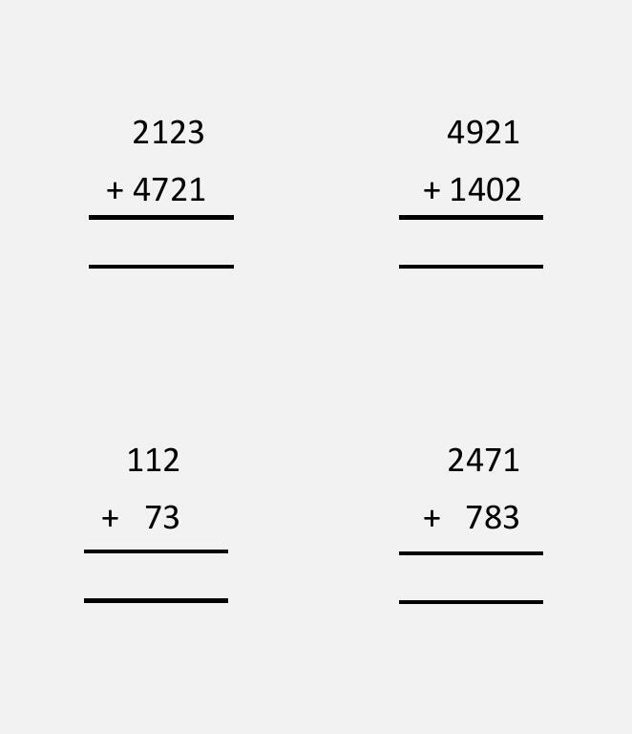
Functional Skills - Addition

Slide 16
Functional Skills - Addition
0.9 + 3.05 = | 3.41 + 5.94 =
0.004 + 1004 = | 83.006 + 150.205 =
With decimals

Slide 17
Functional Skills - Subtraction
Subtraction is when we take two or more numbers and separate them to make a smaller part.
This is relatively straight forward, as long as we remember our place value (just like addition!)
First, we will write out our sum like the addition example.
3
1
3645
Now, working from the right we go through each type of unit in order. So 5 – 6 = -1… but we can’t have a negative number mixed with positive numbers!
-1436
2
2
0
9
So we need to borrow a tenner from the column next door! Now, 15 – 6 =
Because we borrowed a ten, the 4 becomes a 3, so now we look at 3 – 3 =

Slide 18
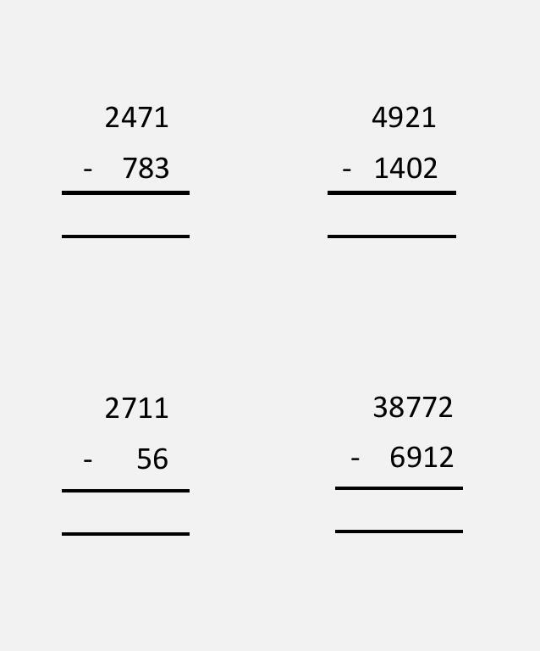
Functional Skills - Subtraction

Slide 19
Functional Skills - Subtraction
51.12 – 6.03 = | 4.07 – 2.5 =
18.99 – 0.4 = | 652 – 26.9 =
With decimals

Slide 20
Functional Skills - Multiplication
There are three main methods for multiplication that we use:
The column method
The lattice method
The grid method
Let’s move to the whiteboard to see how these work…

Slide 21
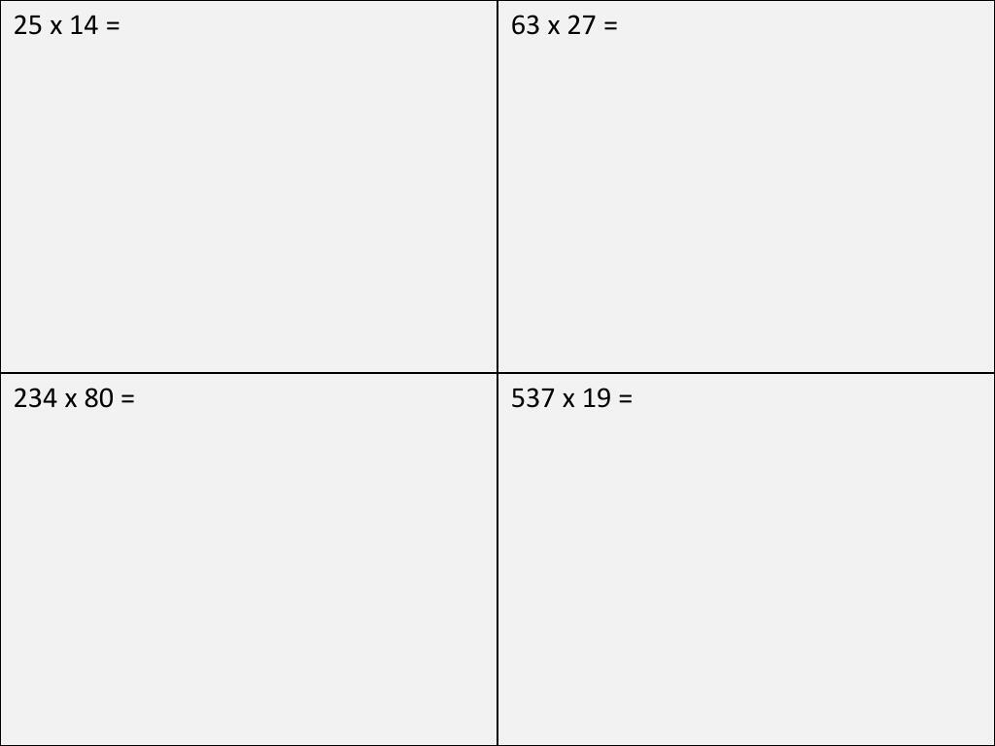
Functional Skills - Multiplication

Slide 22
Functional Skills - Multiplication
1.3 x 7.2 = | 23.5 x 6.4 =
35.3 x 12 = | 102.7 x 33.4 =
With decimals

Slide 23
Functional Skills - Division (Bus Stop Method)
We are now going to look at the bus stop method; you may remember this from school. We will look at 426 ÷ 3. First, we need to draw a ‘bus stop’.
Now fill in the number you want to divide underneath, and the number you are dividing by to the left of the bus stop.
1
4
2
Next, we need to work from left to write and try dividing each number. So first, how many 3’s are in 4?
3
4 2 6
Well, there is only 1, but we will have a unit left over. So we need to move that unit.
1
Now we move the ‘1’ leftover to be with the ‘2’, but remember it is from a column 10x bigger, so it goes in front of the 2 to make 12. How many 3’s in 12?
Finally, how many 3’s go into 6?
So, 426 ÷ 3 = 142

Slide 24
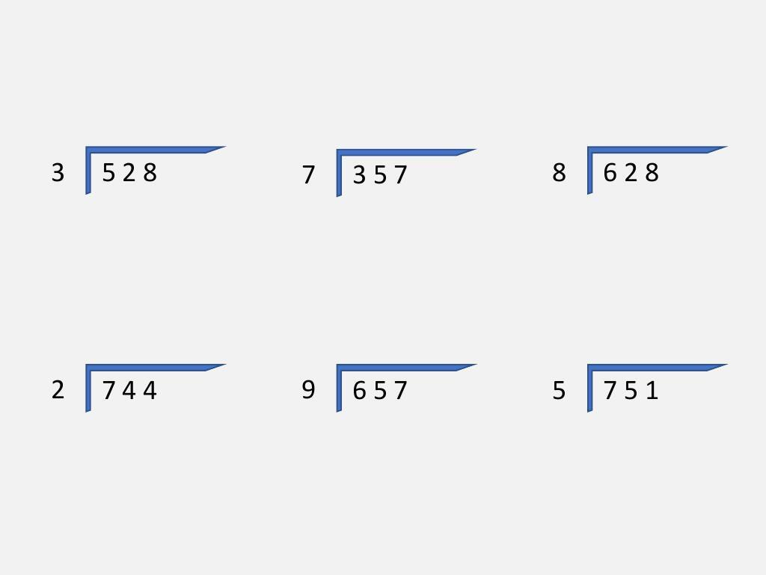
Functional Skills - Division (Bus Stop Method)

Slide 25
Functional Skills - Division (Bus Stop Method)
19.98 ÷ 3 = | 205.6 ÷ 4 =
73.2 ÷ 5 = | 0.917 ÷ 7 =
With decimals

Slide 26
Exam Question
How should we approach this question?

Slide 27
Positive & Negative Numbers

Slide 28
Positive & Negative Numbers
Negative numbers can be misleading
It can be helpful to think of them in terms of temperature or money!
Which is bigger?
-10 or -5

Slide 29
Positive & Negative Numbers
You may be asked to add or subtract with negative numbers
Drawing or visualising a number line can help make sure you are moving in the right direction!
When adding we move to the right
When subtracting we move to the left
What is -3 + 4?

Slide 30
Positive & Negative Numbers
You may be asked to add or subtract with negative numbers
Drawing or visualising a number line can help make sure you are moving in the right direction!
When adding we move to the right
When subtracting we move to the left
What is -5 - 2?

Slide 31
Positive & Negative Numbers
Have a go at these questions:
3 – 8 = | -1 – 9 =
-2 + 7 = | -6 + 4 =

Slide 32
Estimation

Slide 33
Estimation
It is really important when a question says to estimate, that you are rounding your numbers!
Every number in the question should be rounded to end in a 0
How do we know whether to round up or down?
Round Down
Round Up

Slide 34
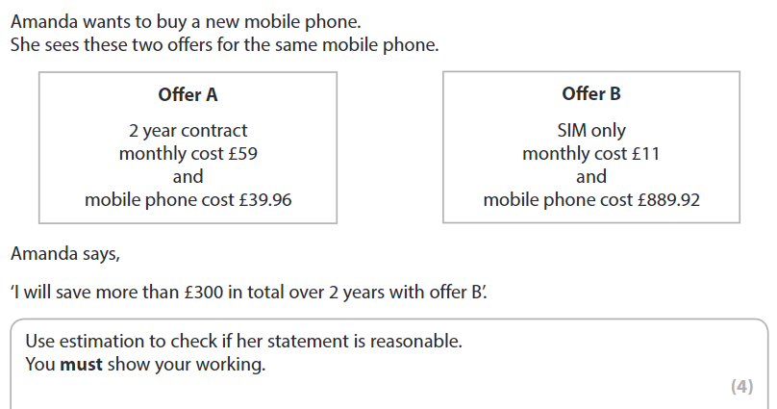
Exam Question

Slide 35
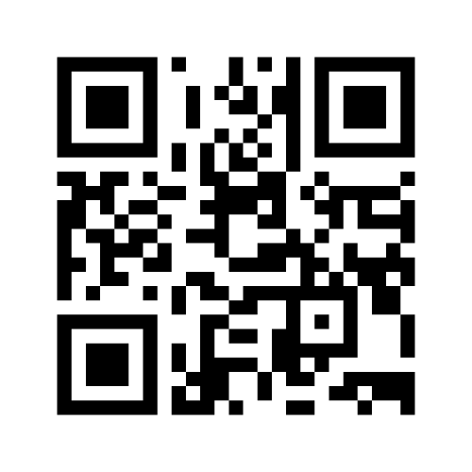
What have we learnt today?
Mentimeter Code:
1918 8154
www.menti.com

Slide 36
What Have We Learnt today?
Type your answers in the chat:
Identify one thing you did well at
Identify one thing you will need to practice
Rate your confidence level
1 – Good, I've got this!
2 – Ok, but I may need to revise before the exam
3 – Not confident but will be ok with practice
4 – Help! I'm completely lost

Slide 37
Century
Link:
https://app.century.tech
Class Code:
66XPK7
You can then create an account (or log in with your existing one if you have used Century before!)

Slide 38
Century
Any tasks set as homework will appear in the Due Assignments box on your home page. These will reinforce the learning from that week’s lesson.
You should aim to complete any assignments by your next lesson.
You are free to explore your learning path at your own pace for extra revision!

Slide 39
All done!
Next week’s topic is:
Fractions

