Slide 1
Functional Skills L1 Maths
Session 10

Slide 2
Starter Activity 5 in 5
7 + 5 x 3 = ? | Share £30 in the ratio 1:4 | 30% of 950 | Use estimation to solve: 4.72 x 63 | Draw a net of a cube

Slide 3
Recap
What did we do last lesson?

Slide 4
Practice Question

Slide 5
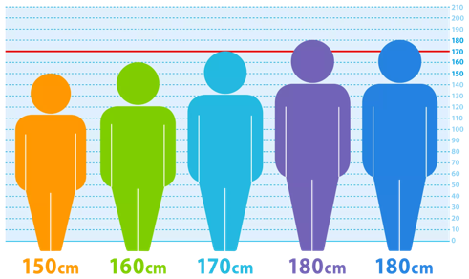
What are we doing today?
Probability
Mean, Median, Mode & Range

Slide 6
What do we need to know?
How to use the probability scale
How to work out the probability of a given scenario
Know the difference between mean, median, mode and range
Be able to find the mean, median, mode and range from a set of numbers

Slide 7
Probability

Slide 8
Probability Scale

Slide 9
Practice question

Slide 10
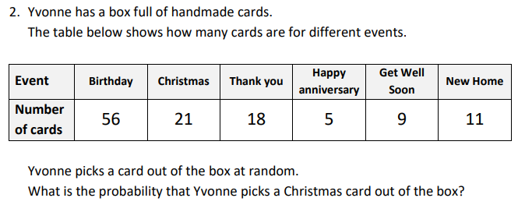
Practice question

Slide 11
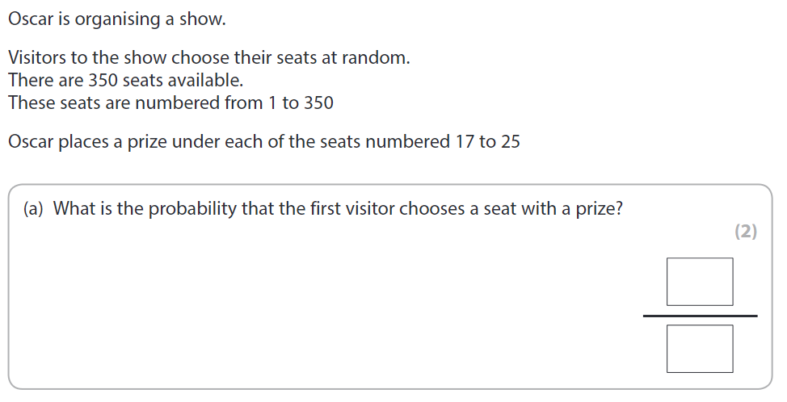
Exam Question

Slide 12
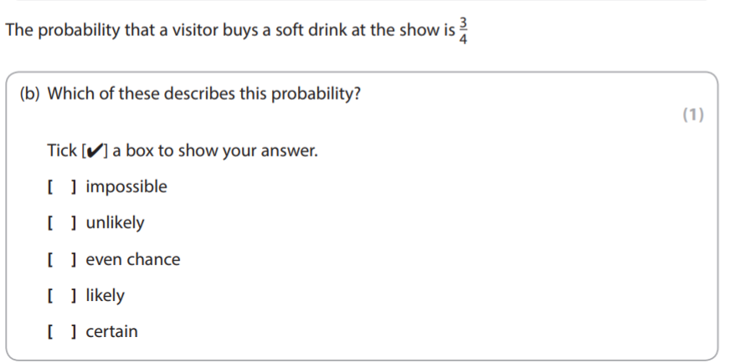
Exam Question

Slide 13
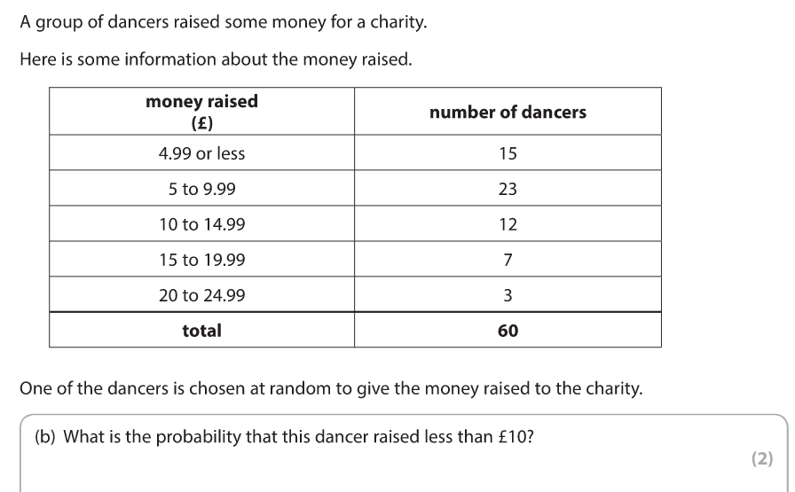
Exam Question

Slide 14
Mean, Median, Mode & Range

Slide 15
What are they?
Mean
Median
The ‘average’.
Add the numbers together and divide by how many there are.
The middle one.
Put the numbers in ascending order first.
Mode
Range
The most common value.
Could be more than one answer.
The span of the data.
Difference between the highest and lowest value.

Slide 16
Find the Mean, Median, Mode and Range from this set of numbers
3 4 5 3 2 1

Slide 17
Find the Mean, Median, Mode and Range from these sets of numbers
11, 5, 19, 11, 5, 7, 12
120, 135, 115, 120, 130, 145
70, 77, 73, 77, 81, 78, 76

Slide 18
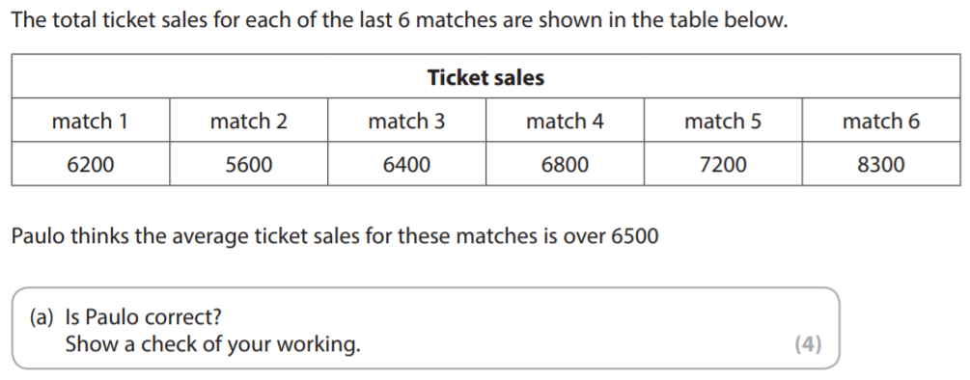
Exam Question

Slide 19
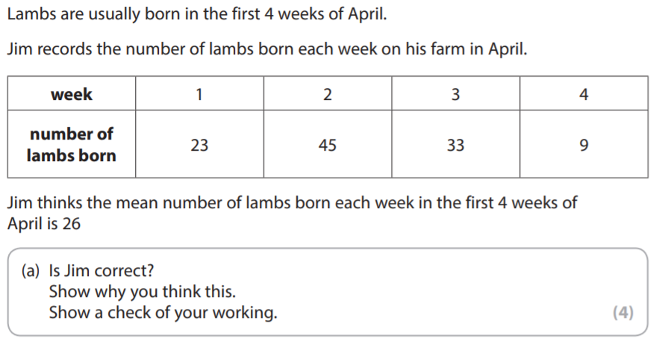
Exam Question

Slide 20
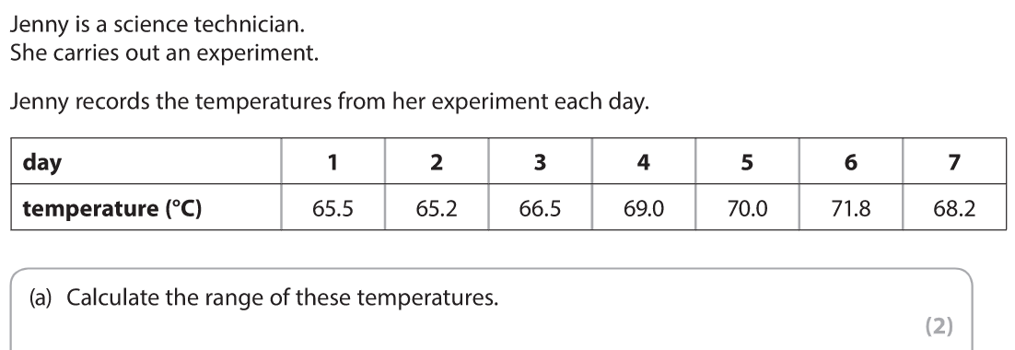
Exam Question

Slide 21
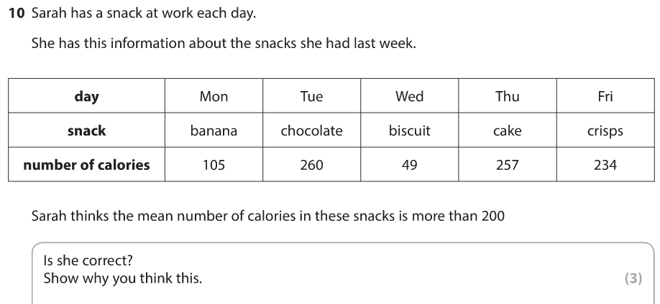
Exam Question

Slide 22
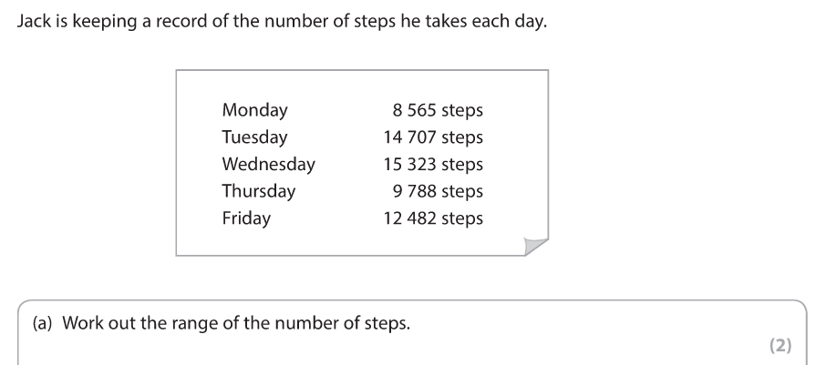
Exam Question

Slide 23
All done!
Next week’s topics are:
Charts & Graphs

