Slide 1
Functional Skills L2 Maths
Session 10

Slide 2
Starter Activity 5 in 5
7 + 5 x 3 = ? | Share £25 in the ratio 2:3 | 34% of 950 | Use estimation to solve: 4.72 x 63 | How many degrees in a rectangle?

Slide 3
Recap
What did we do last lesson?

Slide 4
Exam Question

Slide 5
What are we doing today?
Probability
Averages

Slide 6
What do we need to know?
Writing Probability
Probability Trees
How to calculate the different types of average
Calculating mean from a table

Slide 7
Probability

Slide 8
What is probability?
Probability is the likelihood of something happening
For example:
When flipping a coin what is the chance of it landing on heads?
There are two possible options: Heads or Tails
So, what’s the probability?

Slide 9
Exam Question

Slide 10
Practice question

Slide 11
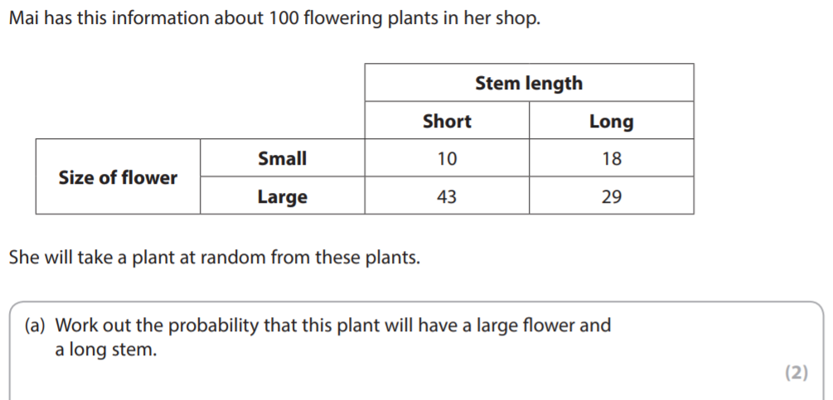
Exam question

Slide 12
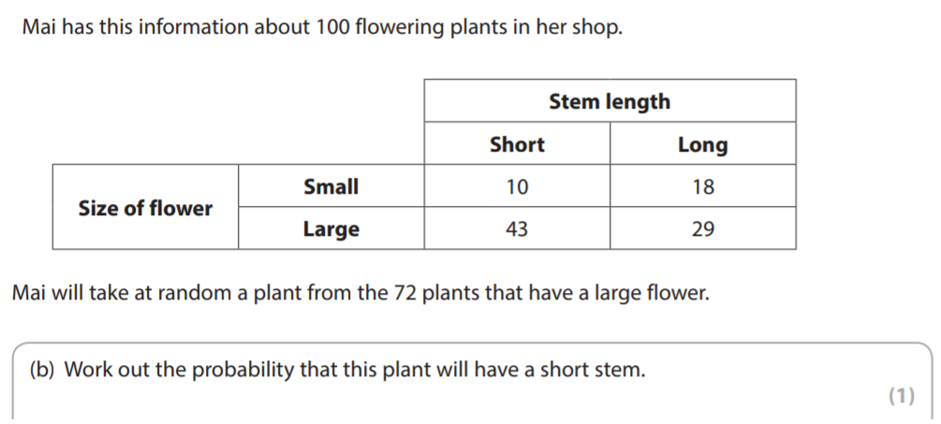
Exam question

Slide 13
Probability Trees

Slide 14
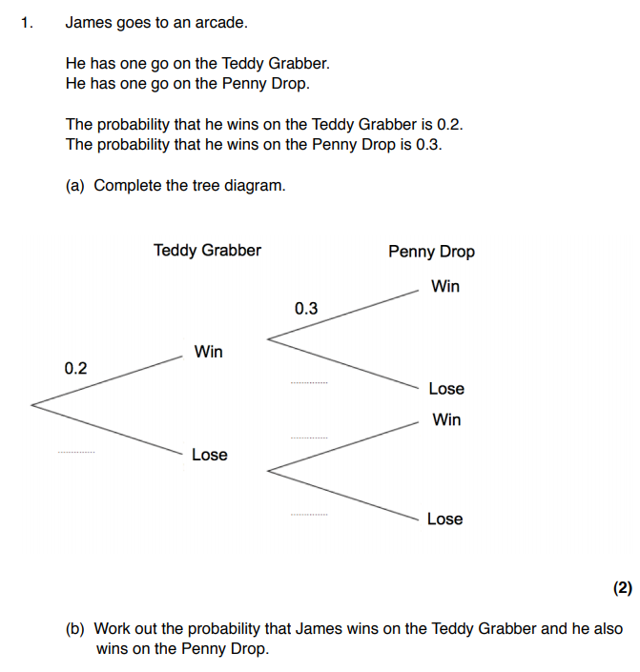
Let’s work through this one together

Slide 15
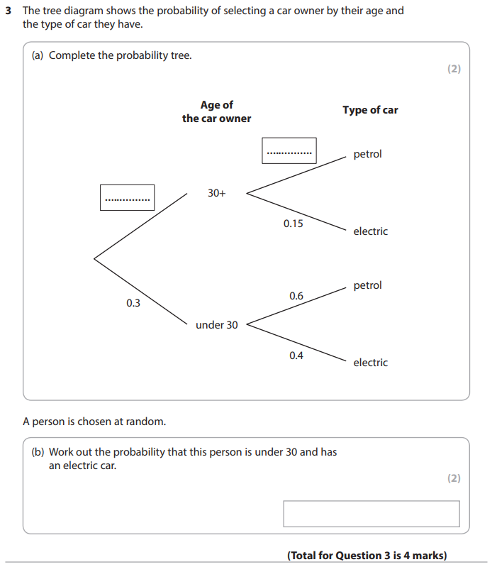
Have a go at this one yourselves

Slide 16
Averages

Slide 17
What are they?
Mean
Median
The ‘average’.
Add the numbers together and divide by how many there are.
The middle one.
Put the numbers in ascending order first.
Mode
Range
The most common value.
Could be more than one answer.
The span of the data.
Difference between the highest and lowest value.

Slide 18
Find the Mean, Median, Mode and Range from this set of numbers
3 4 5 3 2 1

Slide 19
Find the Mean, Median, Mode and Range from these sets of numbers
11, 5, 19, 11, 5, 7, 12
120, 135, 115, 120, 130, 145
70, 77, 73, 77, 81, 78, 76

Slide 20
Exam Question

Slide 21
Exam Question

Slide 22
Exam Question

Slide 23
Exam Question

Slide 24
Finding Mean from a table
Notes:
https://youtu.be/7QReTFK2hD4

Slide 25
Exam Question

Slide 26
Mean from a Table – Exam Question

Slide 27
All done!
Next week’s topic is:
Graphs

