Slide 1
Functional Skills L1 Maths
Session 11

Slide 2
Starter Activity 5 in 5
What is $\frac{7}{20}$ as a percentage? | How many cm in 1m? | 162 ÷ 3 = ? | How do you find the mode? | Find 15% of 180

Slide 3
Recap
What did we do last lesson?

Slide 4
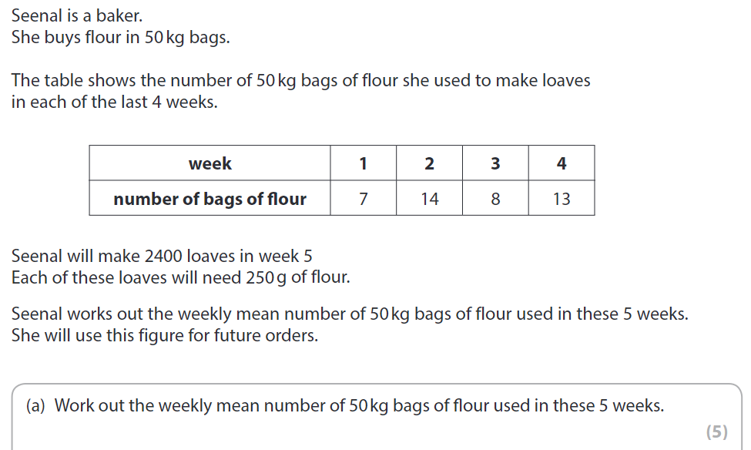
Practice Question

Slide 5
What are we doing today?
Charts & Graphs

Slide 6
What do we need to know?
Understand the properties of different graph and chart types
How to read and interpret information from different graphs and charts
How to represent data in different graph and chart types

Slide 7
Frequency Tables

Slide 8
Frequency Tables
You may have to use a frequency table for grouped data
It may include a tally column
To get full marks, you need to:
Have clear labels
Use regular intervals that don’t overlap
Complete the tally/frequency accurately

Slide 9
Practice Question

Slide 10
Practice Question

Slide 11
Bar Charts

Slide 12
Bar Charts
If you are asked to draw a graph to represent data in the exam, it will be a bar chart!
You will get marks for:
Labels!!
Linear Scale
Accurate plotting
Helpful Hint:
Use the headings from the table to label your axes

Slide 13
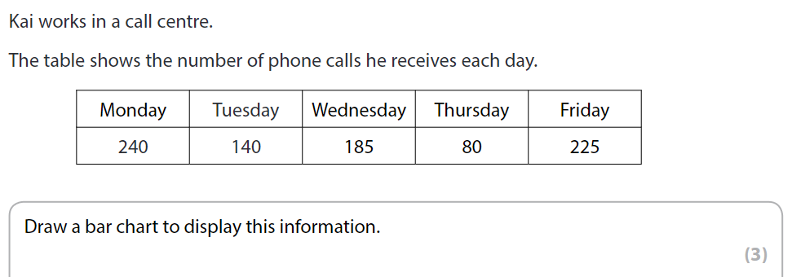
Practice Question

Slide 14
Have a go at the worksheet

Slide 15
Pie Charts

Slide 16
Pie Charts
You may need to draw or complete a pie chart
For this, you will need a ruler, protractor and possibly a pair of compasses (if you have to draw the circle!)
To draw a pie chart you need to know the number of degrees in a circle...
360°

Slide 17
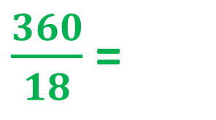
My Results
Pie Charts
“What is your favourite Quality Street?”
Sweet | Results
Strawberry Cream | 5
Orange Cream | 3
Purple Hazelnut | 6
Green Triangle | 2
Other | 2
TOTAL
Degrees
100°
60°
120°
40°
40°
Degrees
X 20
$\frac{360}{18}$ =
20°
360°
X 20
18

Slide 18
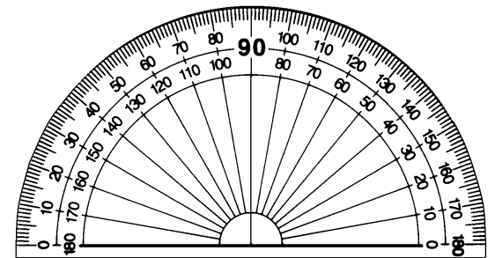
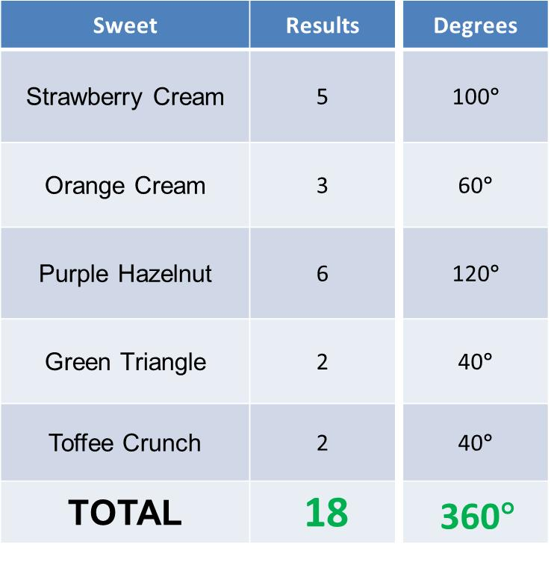
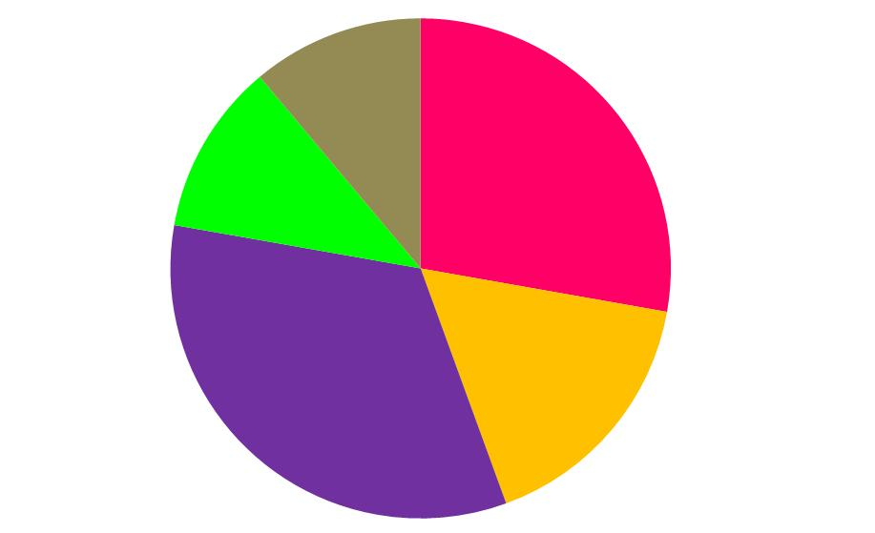
Pie Charts

Slide 19
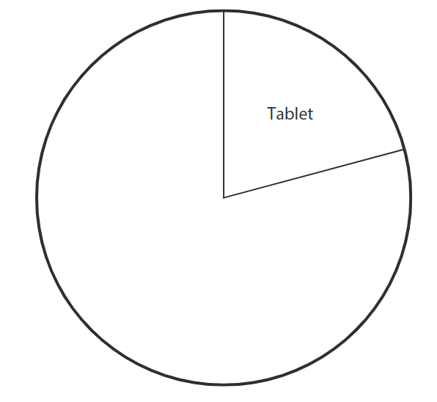
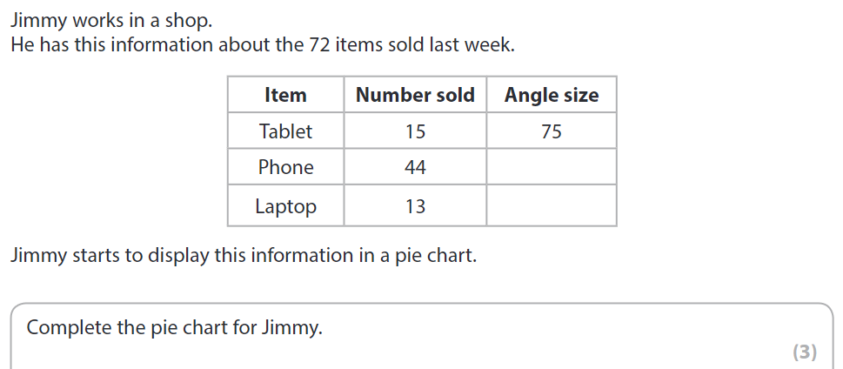
Practice Question

Slide 20
Have a go at the worksheet

Slide 21
All done!
Next week’s topic is:
Revision Week

