Slide 1
Functional Skills L2 Maths
Session 11

Slide 2
Starter Activity 5 in 5
$\frac{7}{8}$ of 456 | If $x$ = 2, what is $$3x^{2}$$ | 162 ÷ 3 = ? | How do you find the range? | How many cm in 3.5m?

Slide 3
Recap
What did we do last lesson?

Slide 4
Practice Question

Slide 5
What are we doing today?
Graphs

Slide 6
What do we need to know?
How to read, write and plot co-ordinates
How to draw and interpret scatter graphs
How to draw and interpret pie charts

Slide 7
Graph Co-ordinates

Slide 8
Graph Co-ordinates
Co-ordinates are used to identify the position of a point on a graph
Graphs have two axes:
The X axis is horizontal
The Y axis is vertical
When plotting or reading co-ordinates, the X value is given first, then the Y (x, y)

Slide 9
Exam Question

Slide 10
Have a go at the worksheet

Slide 11
Scatter Graphs

Slide 12
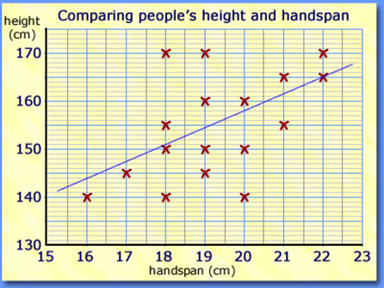
Scatter Graphs
Used to compare two variables to see if there is a link or trend
The line of best fit should not go through (0,0)
There should be roughly the same number of points above and below the line.
It should be long enough to pass all data points, but not too long.

Slide 13
Scatter Graphs

Slide 14
Exam Question

Slide 15
Exam Question

Slide 16
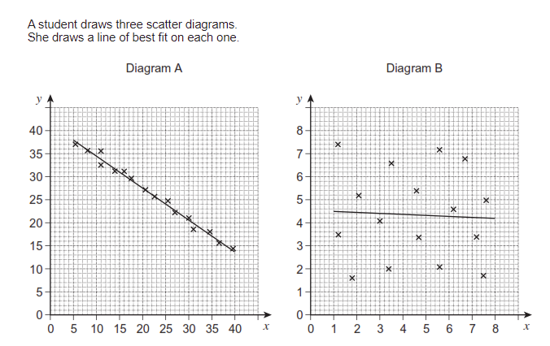
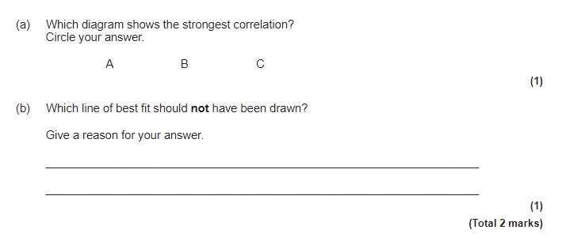
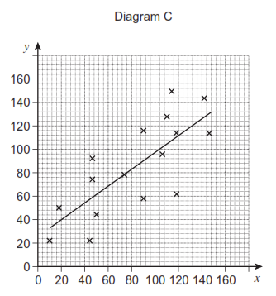
Exam Question

Slide 17
Have a go at the worksheet

Slide 18
Pie Charts

Slide 19
Pie Charts
You may need to draw or complete a pie chart
For this, you will need a ruler, protractor and possibly a pair of compasses (if you have to draw the circle!)
To draw a pie chart you need to know the number of degrees in a circle...
360°

Slide 20
My Results
Pie Charts
“What is your favourite Quality Street?”
Sweet | Results
Strawberry Cream | 5
Orange Cream | 3
Purple Hazelnut | 6
Green Triangle | 2
Other | 2
TOTAL
Degrees
100°
60°
120°
40°
40°
Degrees
X 20
$\frac{360}{18}$ =
20°
360°
X 20
18

Slide 21
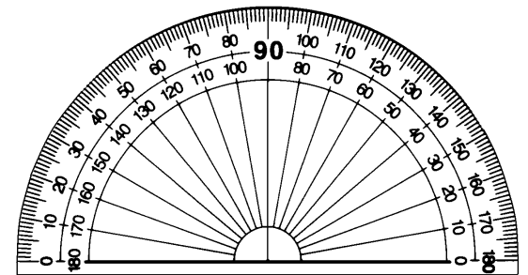
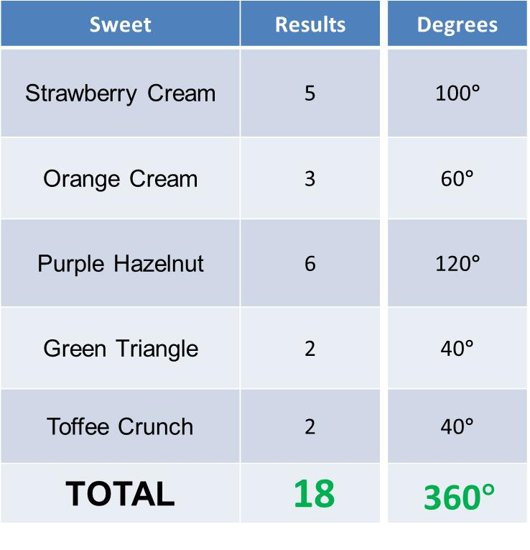
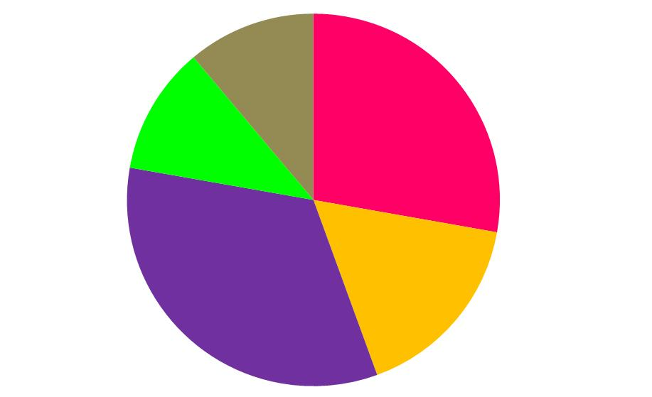
Pie Charts

Slide 22
Practice Question

Slide 23
Have a go at the worksheet

Slide 24
All done!
Next week’s topic is:
Revision Week!

