Slide 1
Functional Skills L1 Maths
Session 12

Slide 2
What are we doing today?
Revision

Slide 3
Topics covered
Non calculator and problem solving
Number – fractions, decimals, percentages and ratio
Formula – BIDMAS, solving written formula problems,
Measure – conversion of units, plan and scale, angles and bearings
Shape – 2D and 3D shapes, perimeter, area and volume
Data – Drawing and interpreting graphs and charts, median, mean, mode and range, probability

Slide 4
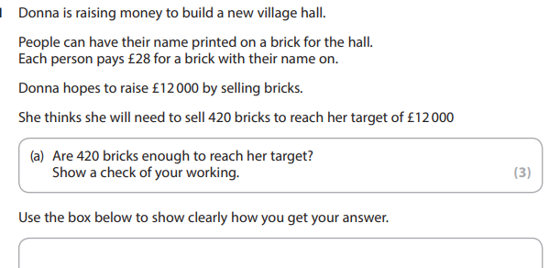
Non-Calculator Methods

Slide 5
Fractions

Slide 6
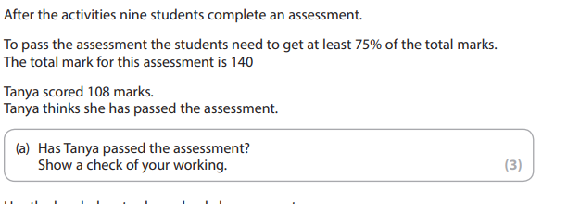
Percentages

Slide 7
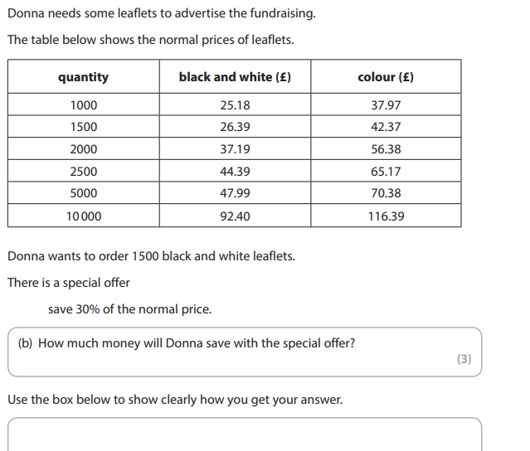
Percentages

Slide 8
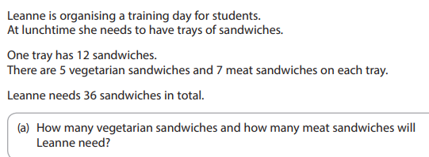
Ratio & Proportion

Slide 9
Ratio & Proportion

Slide 10
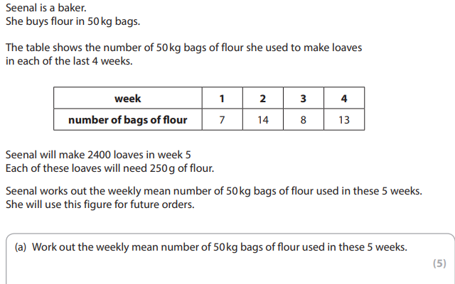
Averages

Slide 11
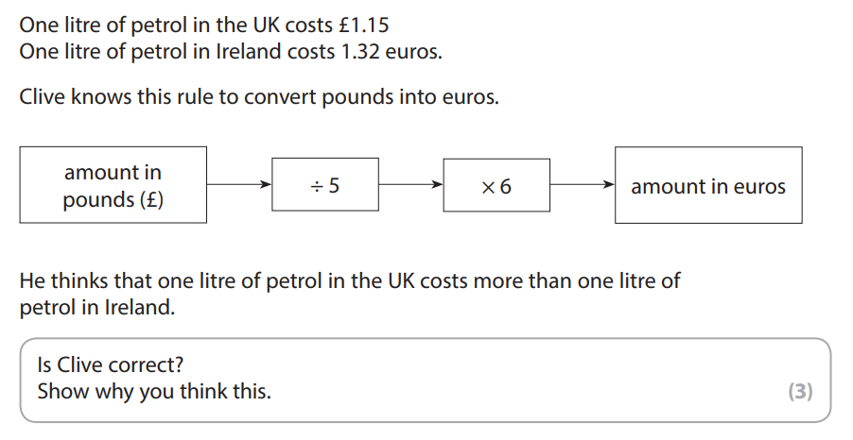
formula

Slide 12
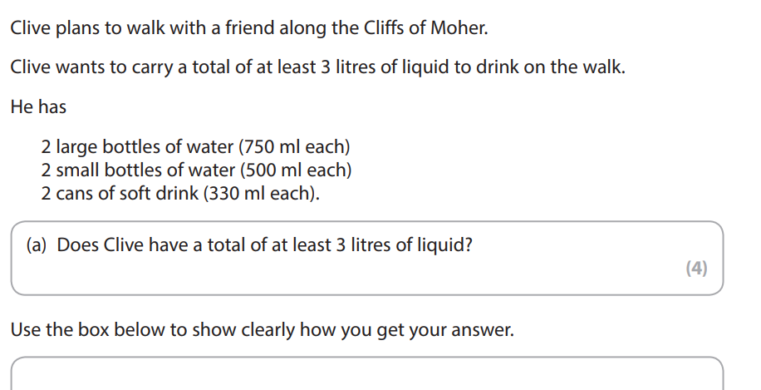
Measure and conversion

Slide 13
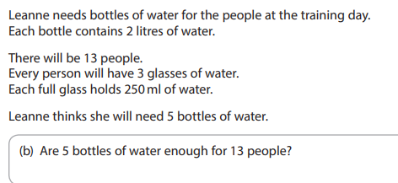
Measure and Conversion

Slide 14
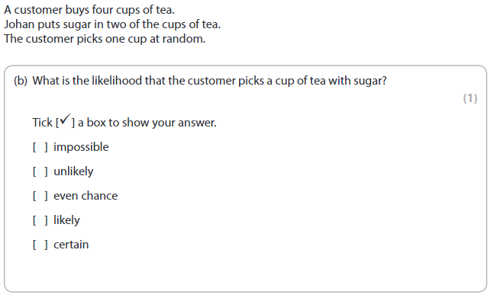
Probability

Slide 15
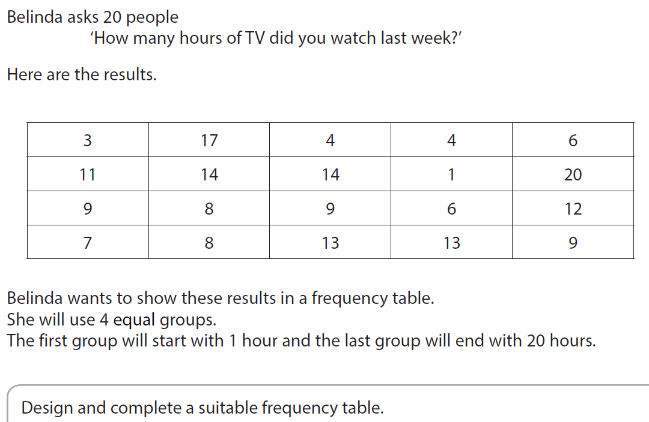
Graphs & Charts

Slide 16
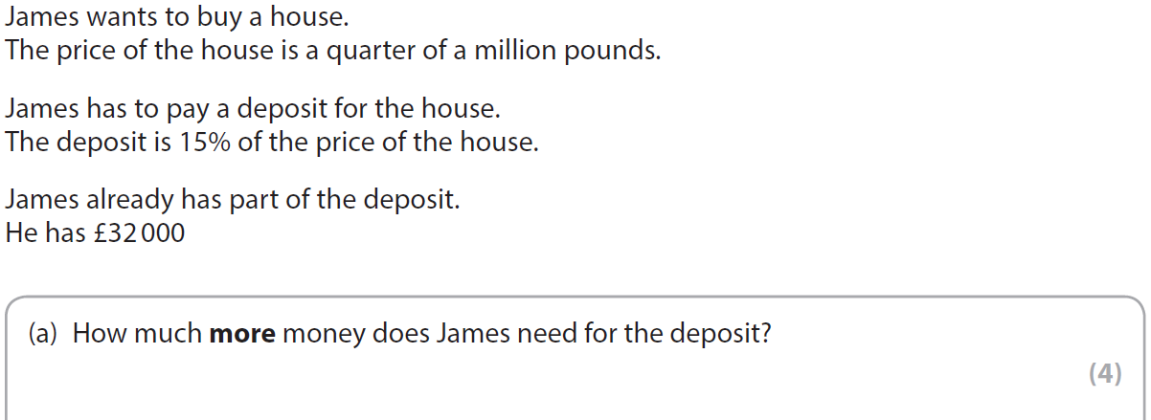
Percentages

Slide 17
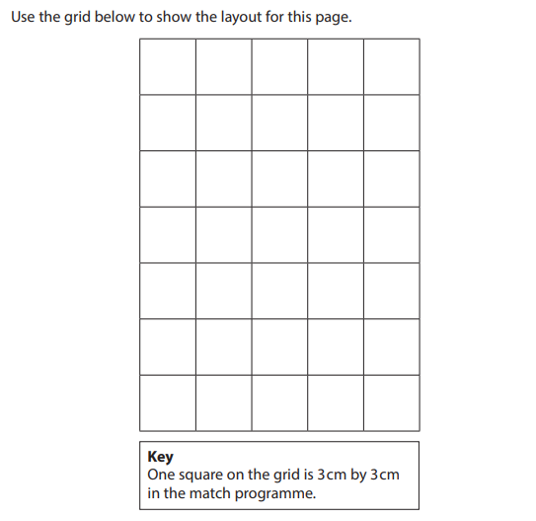
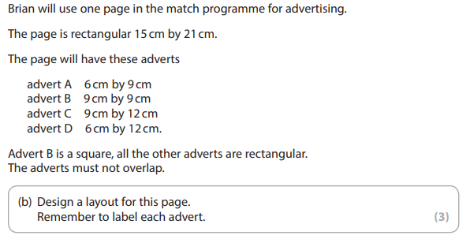
Plan and scale

Slide 18
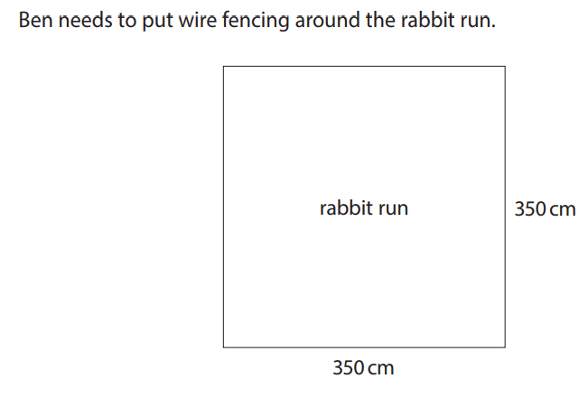
perimeter

Slide 19
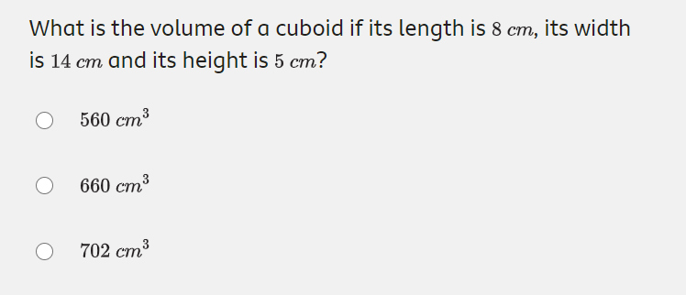
Volume

Slide 20
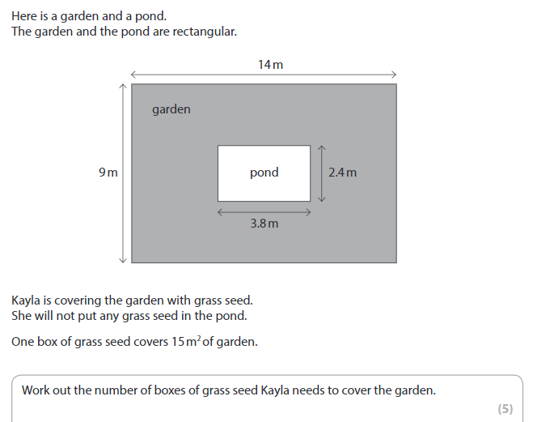
Area

Slide 21
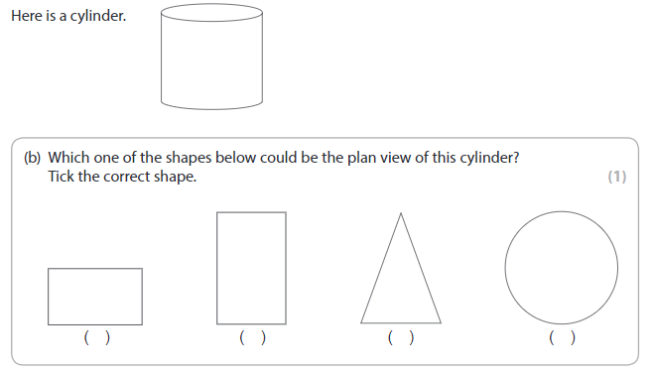
Plan & scale

Slide 22
Exam Tips
You can find copies of all the PowerPoints on Teams
Use the Topic Checklist to target your revision
In the exam room:
Make notes of methods and formulae on scrap paper before you start the test to use as a mini cheat sheet.
Attempt every question! Even if you don’t finish the question or get it 100%, you can still get method marks!
Keep track of the time. Don’t spend too long on one question; you can always come back to it.

Slide 23
All done!
Next week’s is:
The exam!

