Slide 1
Functional Skills L2 Maths
Session 12

Slide 2
What are we doing today?
Revision

Slide 3
Topics covered
Non calculator and problem solving
Number – fractions, decimals, percentages and ratio
Formula – BIDMAS, solving written formula problems,
Measure – conversion of units, plan and scale, angles and bearings
Shape – 2D and 3D shapes, perimeter, area and volume
Data – Drawing and interpreting graphs and charts, median, mean, mode and range, probability

Slide 4
Non-Calculator Methods

Slide 5
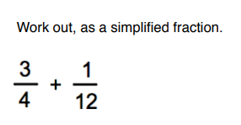
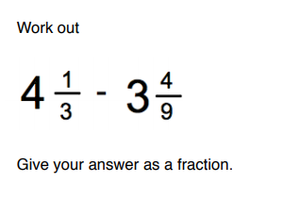
fractions

Slide 6
fractions

Slide 7
Percentages

Slide 8
percentages

Slide 9
ratio

Slide 10
Formula

Slide 11
formula

Slide 12
formula

Slide 13
conversion

Slide 14
Conversion

Slide 15
Plan & Scale

Slide 16
angles

Slide 17
Perimeter/Area/Volume

Slide 18
Perimeter/Area/Volume

Slide 19
Perimeter/Area/Volume

Slide 20
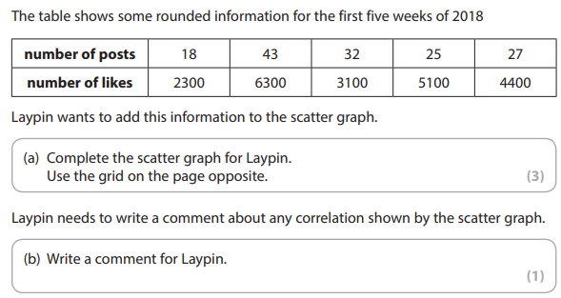
Scatter graphs

Slide 21
Averages

Slide 22
Averages

Slide 23
Averages

Slide 24
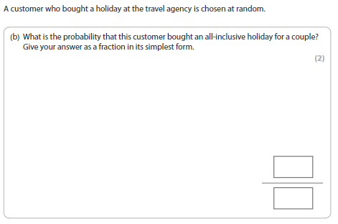
Probability

Slide 25
Exam Tips
You can find copies of all the PowerPoints on Teams
Use the Topic Checklist to target your revision
In the exam room:
Make notes of methods and formulae on scrap paper before you start the test to use as a mini cheat sheet.
Attempt every question! Even if you don’t finish the question or get it 100%, you can still get method marks!
Keep track of the time. Don’t spend too long on one question; you can always come back to it.

Slide 26
All done!
Next week is:
The exam!

