Slide 1
Functional Skills L1 Maths
Session 2

Slide 2
Starter Activity 5 in 5
728 + 133 | -3 + 9 | 72 x 15 | 328 ÷ 4 | Which is bigger? -7 or -17

Slide 3
Recap
What did we do last lesson?

Slide 4
Exam Question

Slide 5
What are we doing today?
Fractions

Slide 6
What do we need to know?
Equivalent Fractions
Simplifying Fractions
How to find a fraction of a number
Converting between Fractions, Decimals and Percentages

Slide 7
Equivalent Fractions

Slide 8
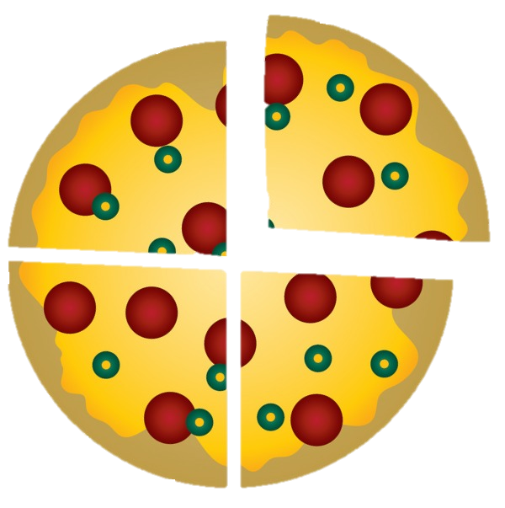
What are Fractions?
Fractions show a part of a whole
E.g. a pizza shared between four people means:
The pizza is split into 4 parts
Each person gets 1 part
We write this as ¼

Slide 9
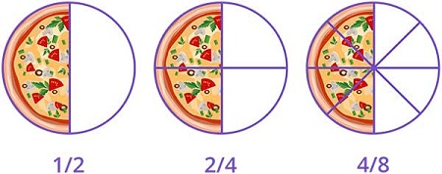
What Are Fractions?
Remembering what the top and bottom values represent can help us to understand equivalent fractions…
Look at the fractions below the pizzas
Can you see any connection between these values?

Slide 10

Equivalent Fractions
The key rule for equivalent fractions:
What you do to the top, you must do to the bottom!
Let’s look at an example:
$$\frac{1}{3}$$
Knowing your times tables will be a great help!
What equivalent fractions
can we make?

Slide 11
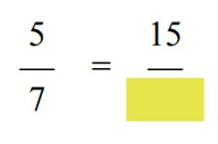
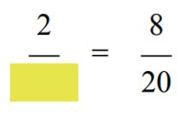
Equivalent Fractions

Slide 12
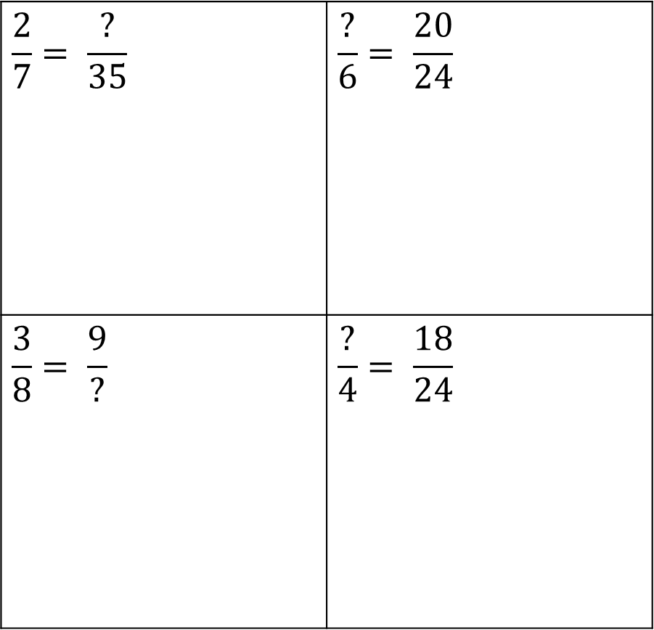
Equivalent Fractions
$$\frac{2}{7}= \frac{?}{35}$$ | $$\frac{?}{6}= \frac{20}{24}$$
$$\frac{3}{8}= \frac{9}{?}$$ | $$\frac{?}{4}= \frac{18}{24}$$
Find the missing values in the following equivalent factions

Slide 13
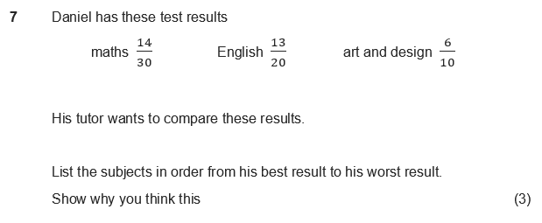
Practice Question
How can we use equivalent fractions to help us solve this question?

Slide 14
Simplifying Fractions

Slide 15
Simplifying Fractions
We are going to use the exact same skills that we just used for equivalent fractions but this time we are only making the numbers smaller!
That means we should only be dividing.
The same rule applies:
What we do to the top, we must do to the bottom!
Let’s look at an example…

Slide 16
Simplifying Fractions
Let’s simplify $\frac{24}{108}$

Slide 17
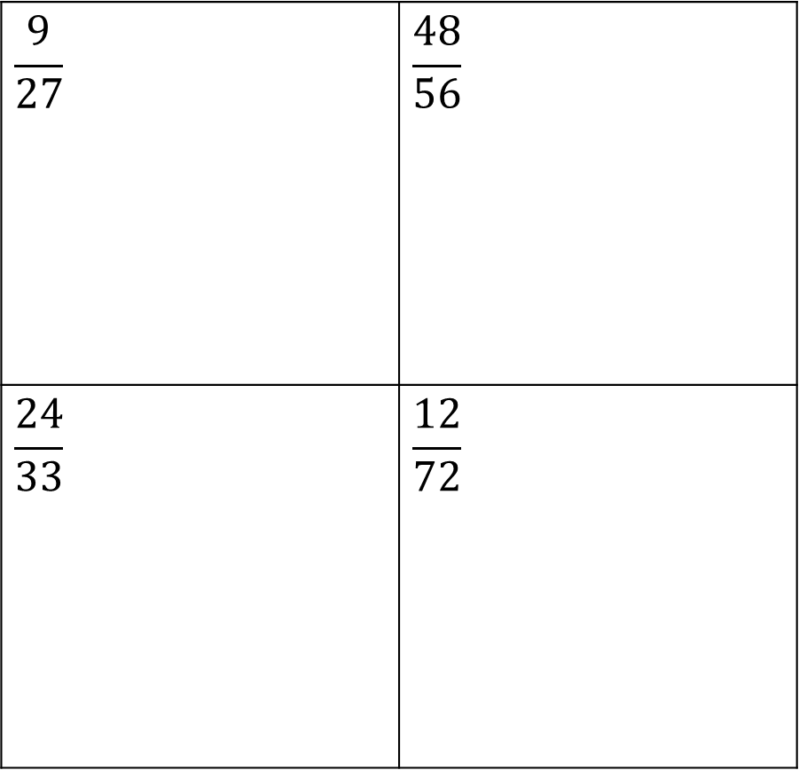
Simplifying Fractions
$$\frac{9}{27}$$ | $$\frac{48}{56}$$
$$\frac{24}{33}$$ | $$\frac{12}{72}$$
Simplify these fractions

Slide 18
Fractions of a number

Slide 19
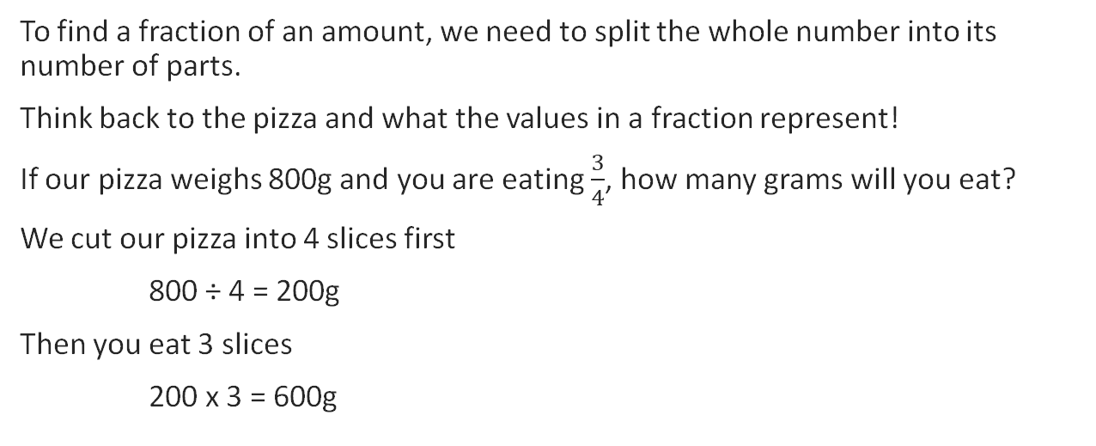
Finding Fractions of a number
To find a fraction of an amount, we need to split the whole number into its number of parts.
Think back to the pizza and what the values in a fraction represent!
If our pizza weighs 800g and you are eating $\frac{3}{4}$, how many grams will you eat?
We cut our pizza into 4 slices first
800 ÷ 4 = 200g
Then you eat 3 slices
200 x 3 = 600g
Golden Rule for Finding Fractions:
Divide by the bottom
Times by the top

Slide 20
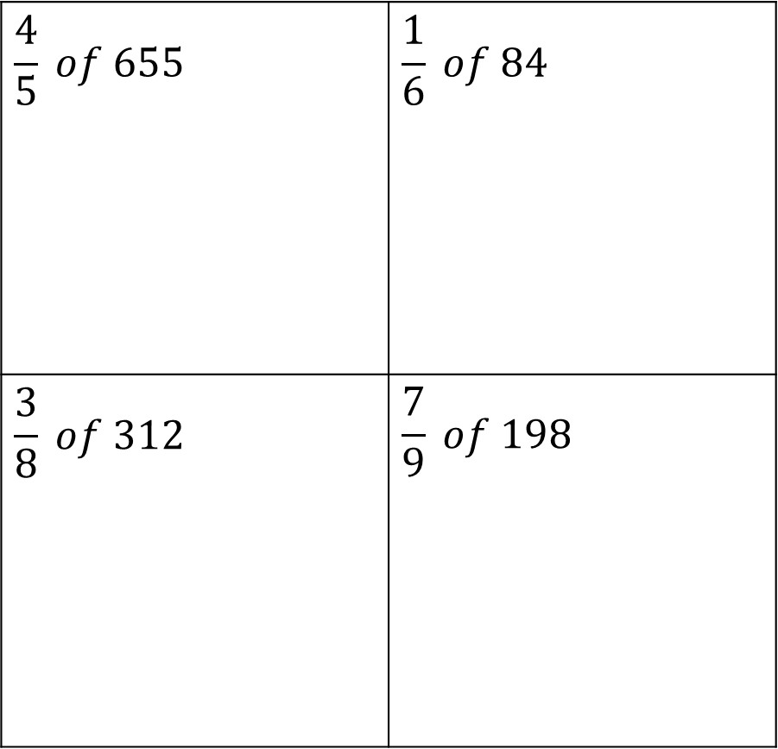
Finding Fractions
$$\frac{4}{5} of 655$$ | $$\frac{1}{6} of 84$$
$$\frac{3}{8} of 312$$ | $$\frac{7}{9} of 198$$

Slide 21
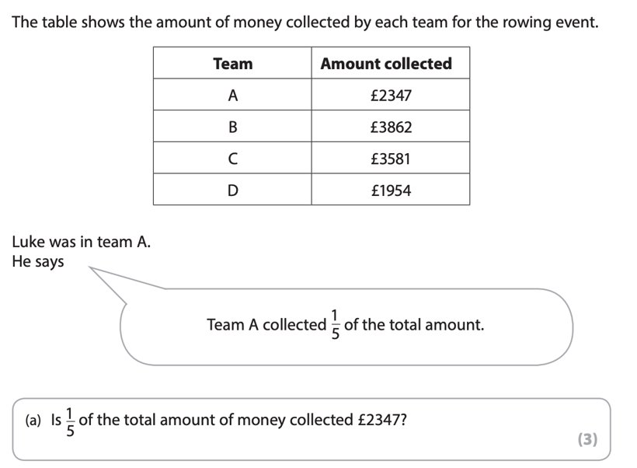
Exam Question

Slide 22
Converting between Fractions, Decimals & Percentages
Let's move to the whiteboard!

Slide 23
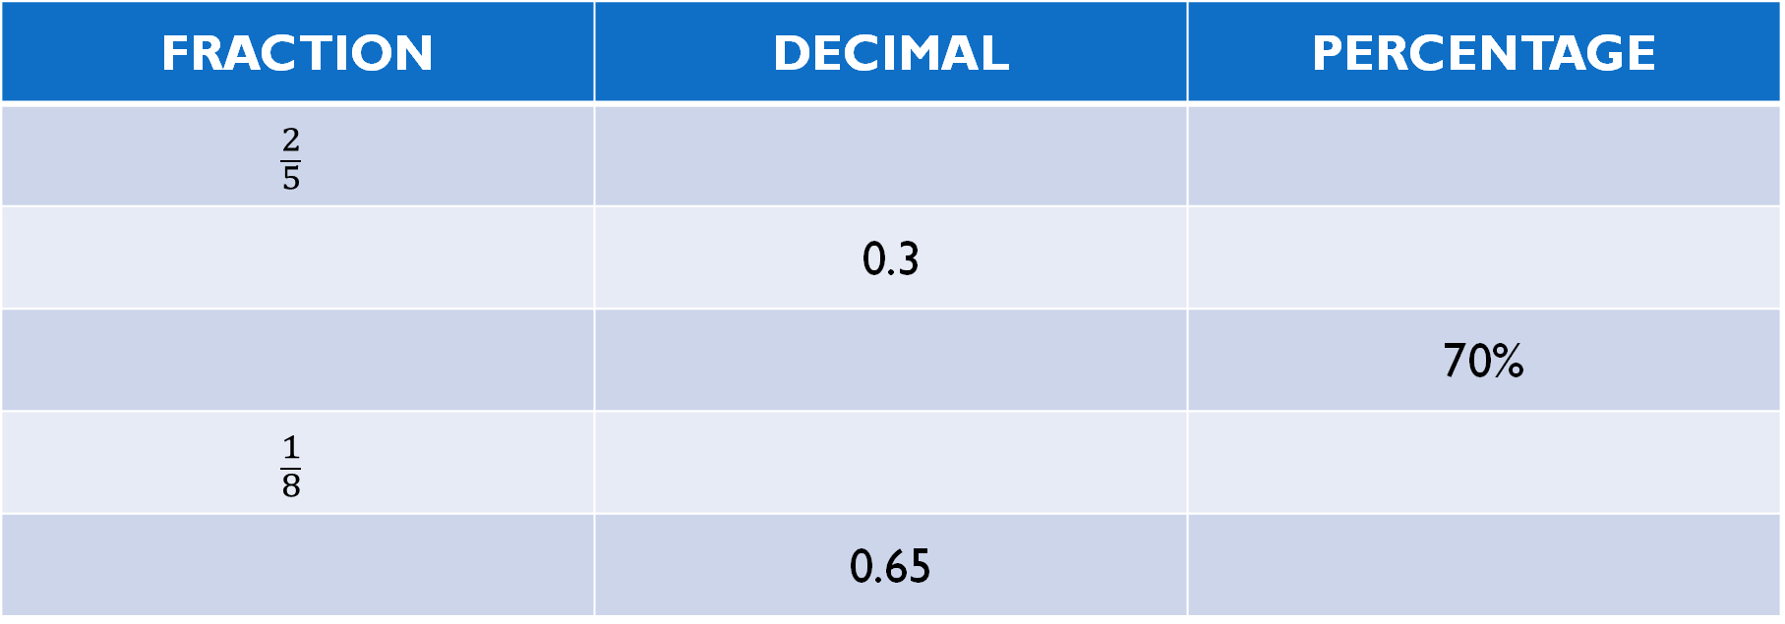
Converting Between Fraction, Decimals & Percentages
FRACTION | DECIMAL | PERCENTAGE
$$\frac{2}{5}$$
 | 0.3
 |  | 70%
$$\frac{1}{8}$$
 | 0.65

Slide 24
What have we learnt today?
Mentimeter Code:
5690 3703
www.menti.com

Slide 25
All done!
Next week’s topics are:
Percentages
Ratio

