Slide 1
Functional Skills L1 Maths
Session 3

Slide 2
Starter Activity 5 in 5
Simplify $\frac{18}{24}$ | 285 ÷ 3 | $$\frac{2}{9}= \frac{?}{27}$$ | Find $\frac{7}{8}$of 64 | -8 + 4

Slide 3
Recap
What did we do last lesson?

Slide 4
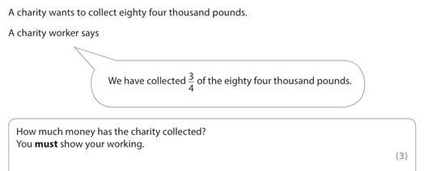
Exam Question

Slide 5
What are we doing today?
Percentages
Ratio

Slide 6
What do we need to know?
Convert between Fractions, Decimals & Percentages
How to find a percentage of a number
Three ways of working with ratio

Slide 7
Converting between Fractions, Decimals & Percentages
Let's move to the whiteboard!

Slide 9
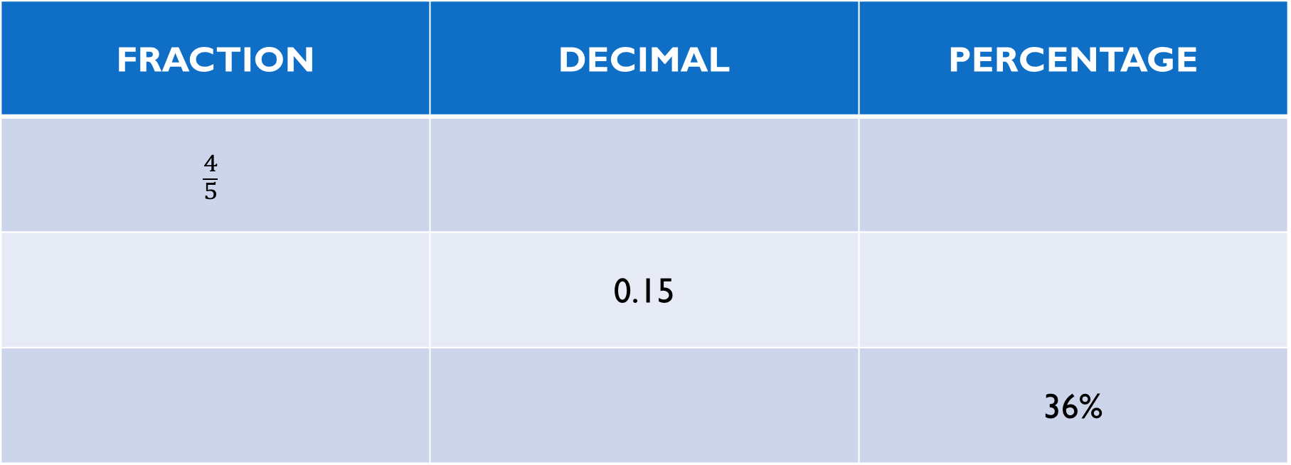
Converting Between Fraction, Decimals & Percentages
FRACTION | DECIMAL | PERCENTAGE
$$\frac{4}{5}$$
 | 0.15
 |  | 36%

Slide 10
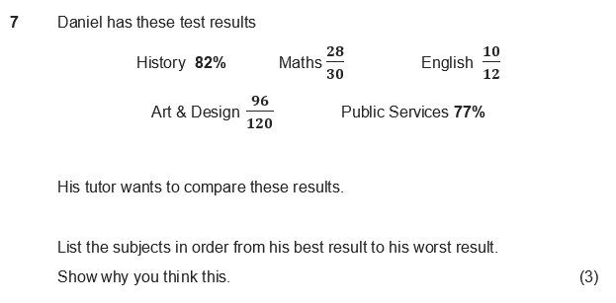
Exam Question
Now let’s use our converting skills to solve this question

Slide 11
Percentages

Slide 12
Finding Percentages
Percent (per cent) means out of 100
It’s just like a fraction except the bottom number is always 100
So, we can use the same method!
Divide by the bottom
Times by the top

Slide 13
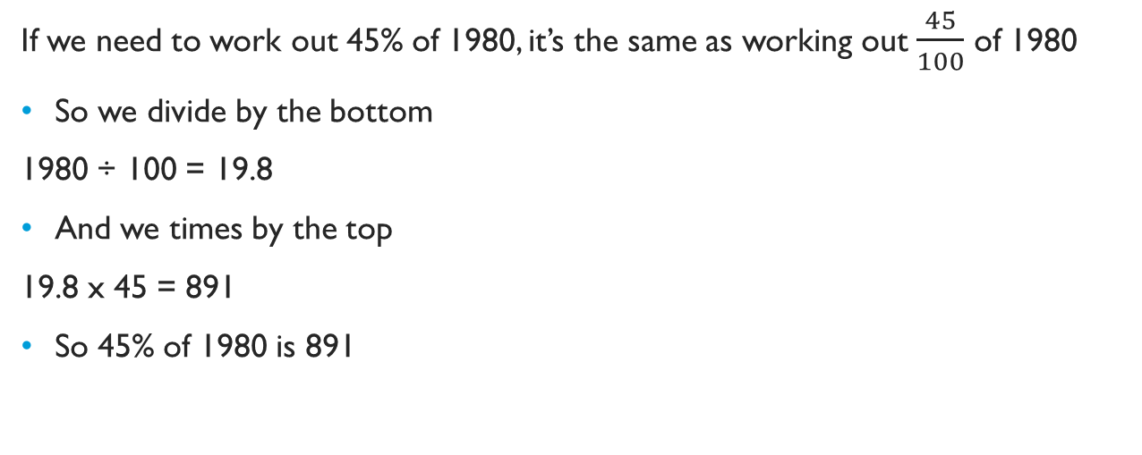
Finding Percentages
If we need to work out 45% of 1980, it’s the same as working out $\frac{45}{100}$ of 1980
So we divide by the bottom
1980 ÷ 100 = 19.8
And we times by the top
19.8 x 45 = 891
So 45% of 1980 is 891
Divide by the bottom
Times by the top

Slide 14
Finding Percentages
70% of 340​ ​ | 15% of 84​
45% of 1350​ | 85% of 975​

Slide 15
Exam Question

Slide 16
Ratio

Slide 17
Three ways of using ratio
Ratio
How to write and simplify a ratio from given quantities
How to share a quantity into a given ratio
How to work out the total amount from a given quantity

Slide 18
What are Ratios?
Ratio is a way of comparing one part to another part
The ratio 2:5 means for every 2 of one thing, there are 5 of the other

Slide 19
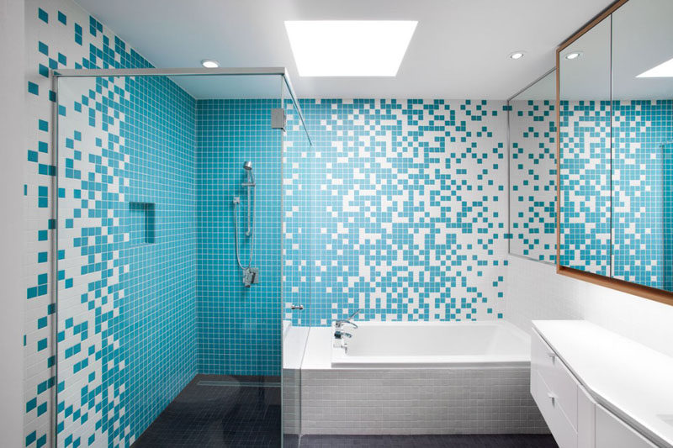
Ratio – Option 1
A bathroom is decorated with 150 blue tiles and 180 white tiles.
What is the ratio of blue tiles to white tiles?
150:180
Now we can simplify
As both end in 0 we can divide by 10
15:18
We can divide both by 3
5:6
So, the ratio of blue tiles to white tiles is 5:6

Slide 20
Ratio - Practice
Ana has a fish tank. The tank contains 21 tetra fish and 12 angel fish. Write this as a ratio and simplify
Rees is having a BBQ. He has invited 4 vegetarians and 12 meat eaters. What is the ratio of vegetarian to non-vegetarian guests? Simplify your answer.
An English class contains 28 students. 12 are female, the rest are male. Write the ratio of female to male students in its simplest form.

Slide 21
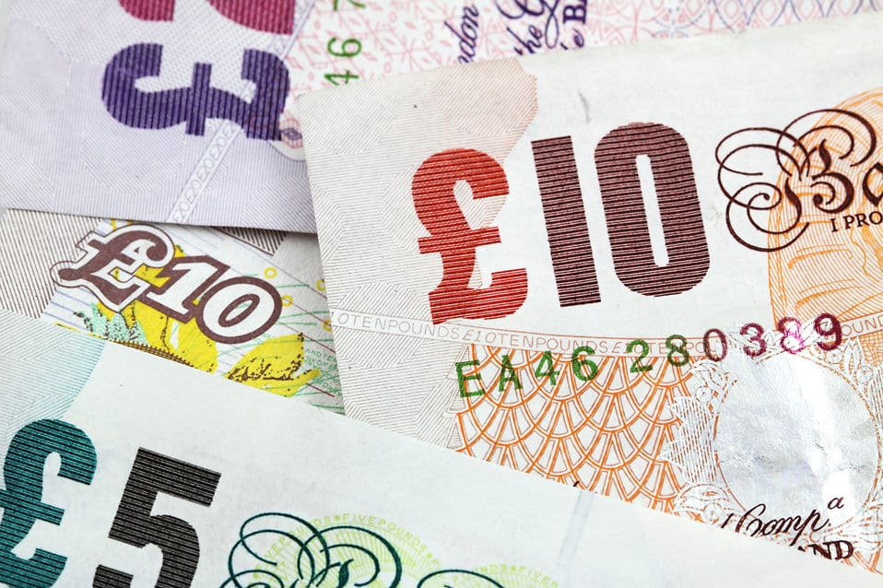
Ratio – Option 2
Split £300 between Kasey and Sophie using the ratio 1:3
First, we need to calculate the total number of parts
1+3 = 4
We divide the £300 by 4 to find 1 part
300 ÷ 4 = 75
Now times by the ratios to find your amounts
75 x 1= £75 (Kasey’s part)
75 x 3 = £225 (Sophie’s part)
To check your work, you can add the amounts.
They should always total your original number! (75 + 225 = 300)

Slide 22
Ratio - Practice
Split £150 into the ratio 1:2
Split 360g into the following ratio 1:5
Split 225m into the following ratio 2:3

Slide 23
Ratio – Option 3
Rafael makes a cocktail using the following ratio of juice to alcohol: 5:2
He uses 60ml of alcohol. How many ml of juice did he use?
60ml is 2 parts
To find 1 part we divide by 2
(60 ÷ 2 = 30ml)
We can now times this by 5 to find how much juice was used
(30 x 5 = 150ml)

Slide 24
Ratio - Practice
Karen and Priti are sharing a packet of sweets in the ratio 1:2.
Karen gets 10 sweets. How many sweets does Priti get?
Magnus and Alec share some money in the ratio 1:4.
If Magnus gets £100, what is Alec’s share?
A car factory produces red and blue cars in the ratio 3:5.
If it produces 150 red cars each week, how many blue cars does it make?

Slide 25
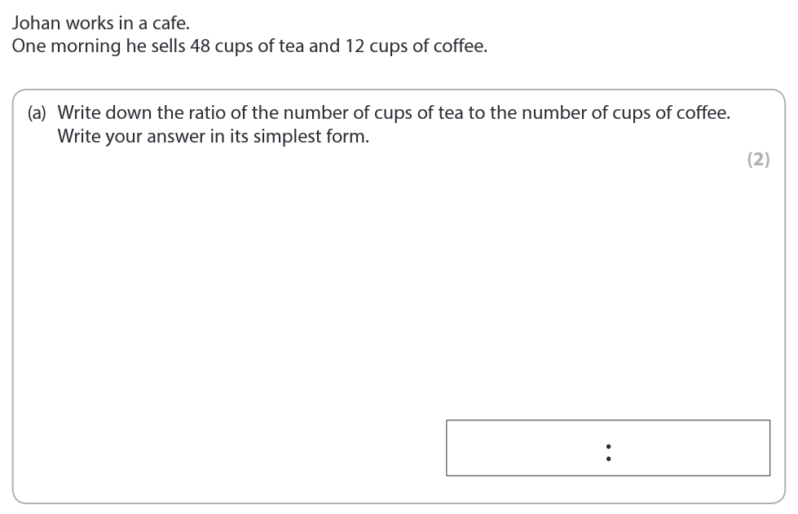
Exam Question

Slide 26
Exam Question

Slide 27
What have we learnt today?
Mentimeter Code:
5561 1042
www.menti.com

Slide 28
All done!
Next week’s topic is:
Conversions
Revision Time

