Slide 1
Functional Skills L1 Maths
Session 4

Slide 2
Starter Activity 5 in 5
Convert into $\frac{7}{20}$ a decimal | 984 - 192 | Simplify 16:44 | What is 32% of 650 | $\frac{3}{8}$ = $\frac{?}{48}$

Slide 3
Recap
What did we do last lesson?

Slide 4
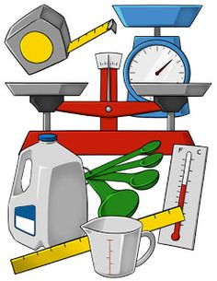
What are we doing today?
Conversion

Slide 5
What do we need to know?
How to convert between metric units
Conversion Factors
Converting Time

Slide 6
Metric Units

Slide 7
Converting between Metric units
It’s important to know how to convert between metric units as sometimes we are given mixed units in an exam question
We can use the prefixes of the words to give us a clue:
Milli = Means “a thousandth of” or “$\frac{1}{1000}$”
Centi = Means “a hundredth of” or “$\frac{1}{100}$”
Kilo = Means “a thousand of” or “x1000”

Slide 8
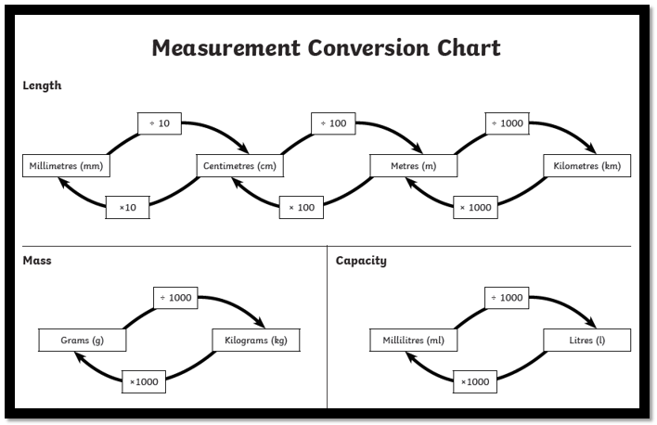

Slide 9
Convert the following
130cm to m
1.3kg to g
825ml to l
375g to kg
65mm to cm
0.95l to ml

Slide 10
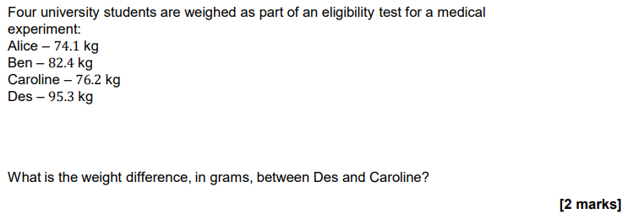
Practice Question

Slide 11
Conversion Factors

Slide 12
Conversion factors
You may be asked to convert between metric and imperial amounts or to exchange money between currencies.
For these types of questions you will be given the conversion factor.
This is value you will need to multiply or divide by.
E.g. £1 = $1.38
If I wanted to exchange £400, how much would I have in dollars?

Slide 13
Convert the following
1kg = 2.2lb
How many lbs are in 15kg?
1km = 0.62 miles
How far is 12km in miles?
1litre = 1.76 pints
How many litres in 11 pints?
£1 = €1.19
What is £350 in €?
1km = 0.62 miles
What is 26 miles in km?
1 foot = 12 inches 1 inch = 2.54cm
What is 5 foot 11 inches in cm?

Slide 14
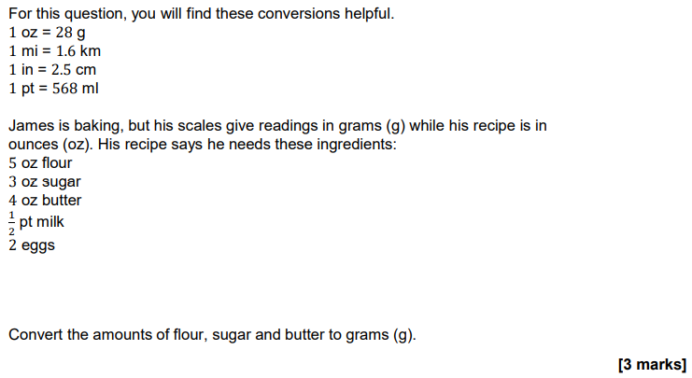
Practice Question

Slide 15
Converting Time

Slide 16
Converting time
Although we are all familiar with time, it is easy to get confused when converting between seconds, hours and minutes.
For example:
1.25 minutes is not 1 minute and 25 seconds though at a quick glance that might be your first guess!
Think about how many seconds there are in a minute and think about 0.25 as a decimal value…

Slide 17
Convert the following
72 minutes into hours
Give your answer as a decimal
105 seconds into minutes
Give your answer as a decimal
4.25 minutes into seconds
3.5 hours into minutes

Slide 18
What have we learnt today?

Slide 19
All done!
Next week’s topics are:
Perimeter
Area

