Slide 1
Functional Skills L2 Maths
Session 5

Slide 2
Starter Activity 5 in 5
Find $\frac{4}{5}$ of 1095 | Which is greater, 0.8 or 74%? | What is 3.2m in cm? | 24 x 16 = ? | Share £450 in the ratio 2:3

Slide 3
Recap
What did we do last lesson?

Slide 4
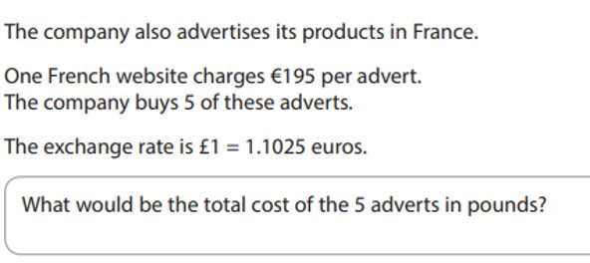
Exam Question

Slide 5
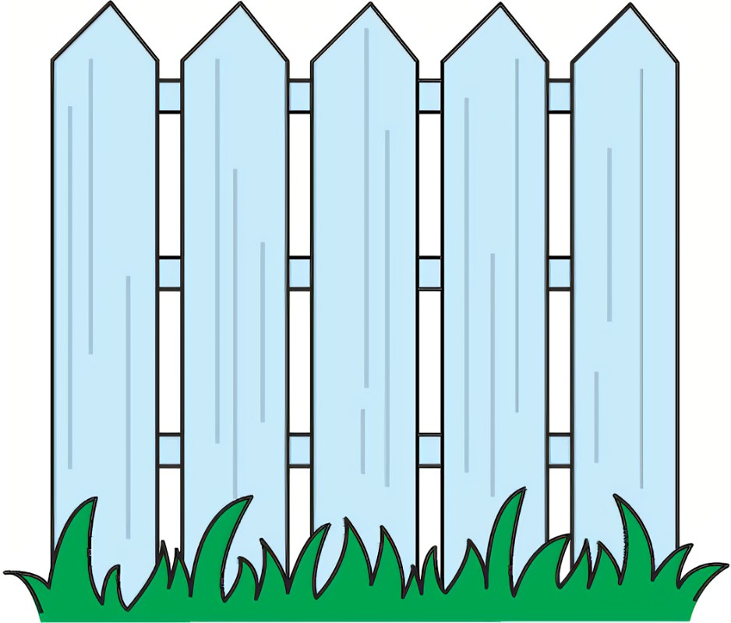
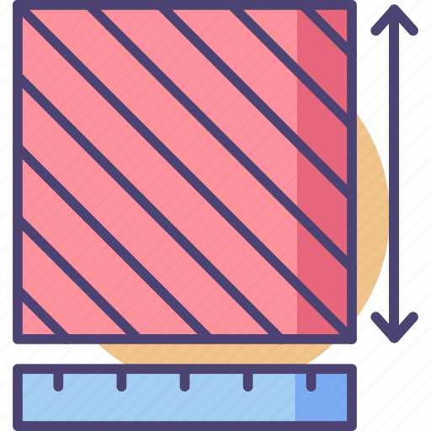
What are we doing today?
Perimeter
Area

Slide 6
What do we need to know?
How to find the perimeter of simple and compound shapes
How to find the area of simple and compound shapes

Slide 7
Perimeter

Slide 8
What is it?
What is the perimeter?
The distance around the outside of a shape
How do I work it out?
Add up the lengths of all the sides
4 cm
12 cm

Slide 9
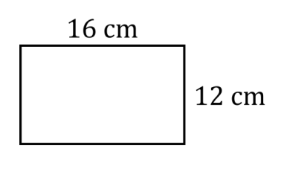
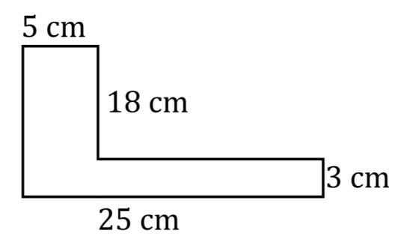
Find the Perimeter

Slide 10
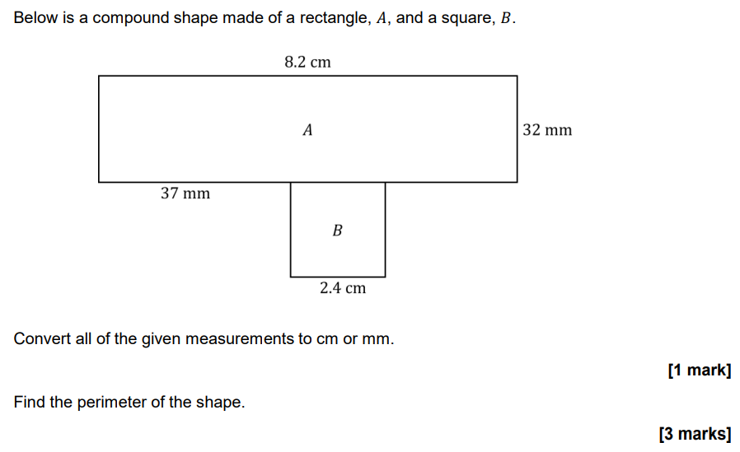
Practice Question

Slide 11
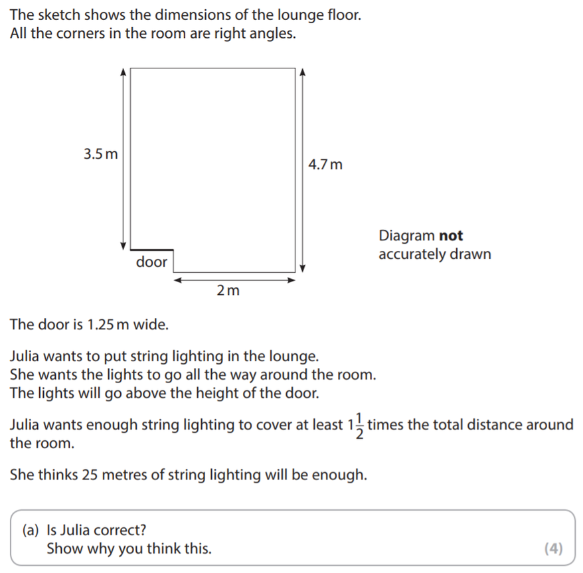
Exam Question

Slide 12
Area

Slide 13
What is it?
What is the area?
The space inside a 2D shape
How do I work it out?
For a 4-sided shape:
Length x Width
4 cm
12 cm

Slide 14
Compound Shapes
8 cm
7 cm
3 cm
12 cm

Slide 15
Compound Shapes
8 cm
7 cm
3 cm
12 cm

Slide 16
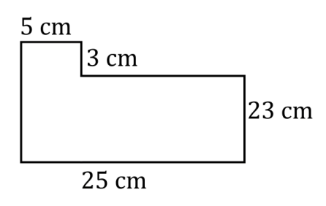
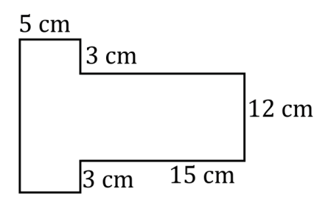
Compound Shapes

Slide 17
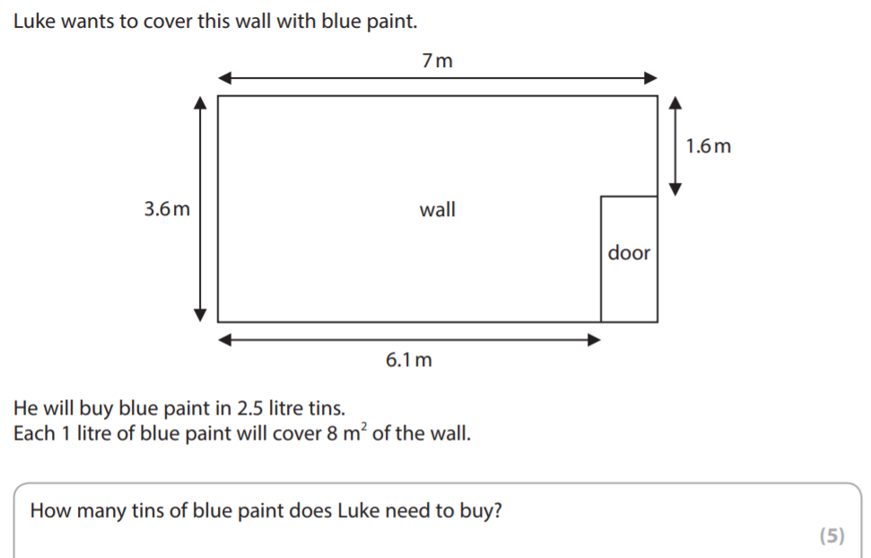
Exam Question

Slide 18
Area of a Triangle
Think of triangles as half a 4-sided shape
To find the area:
Base x Height
2
11 cm
8 cm

Slide 19
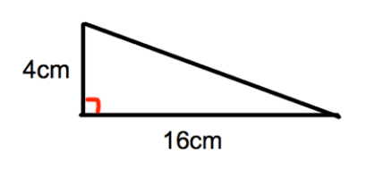
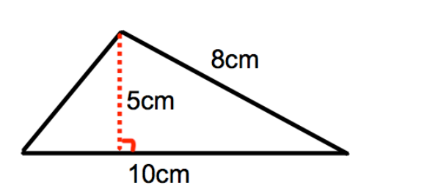
Area of a Triangle

Slide 20
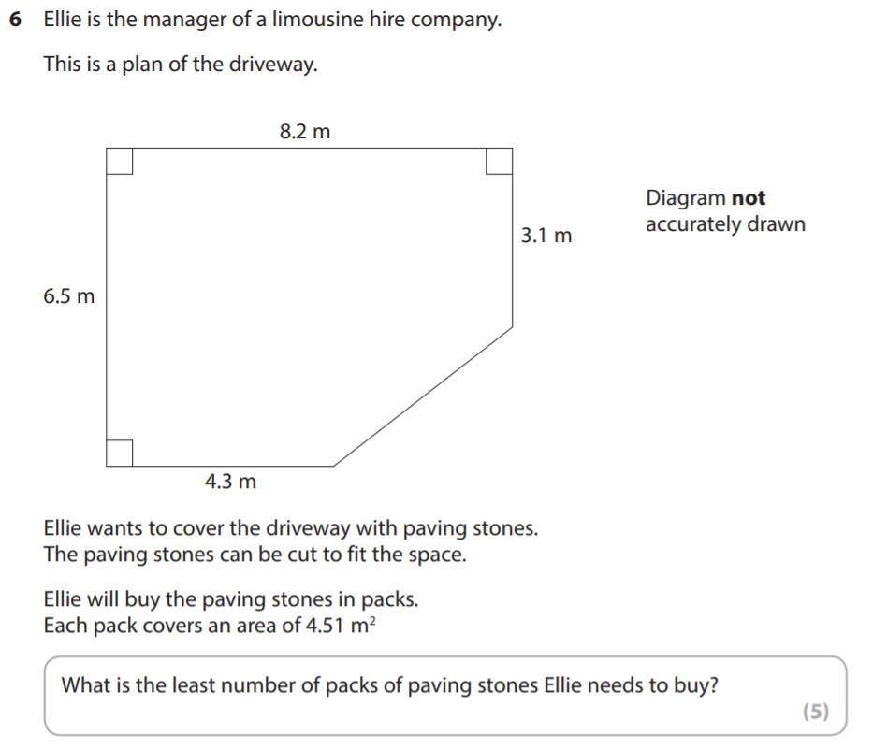
Exam Question

Slide 21
What have we learnt today?

Slide 22
All done!
Next week’s topics are:
Circles
Volume

