Slide 1
Functional Skills L1 Maths
Session 6

Slide 2
Starter Activity 5 in 5
How do you find the perimeter of a shape? | 372 ÷ 3 = ? | Find 85% of 670 | Simplify $\frac{18}{48}$ | 452 – 118 = ?

Slide 3
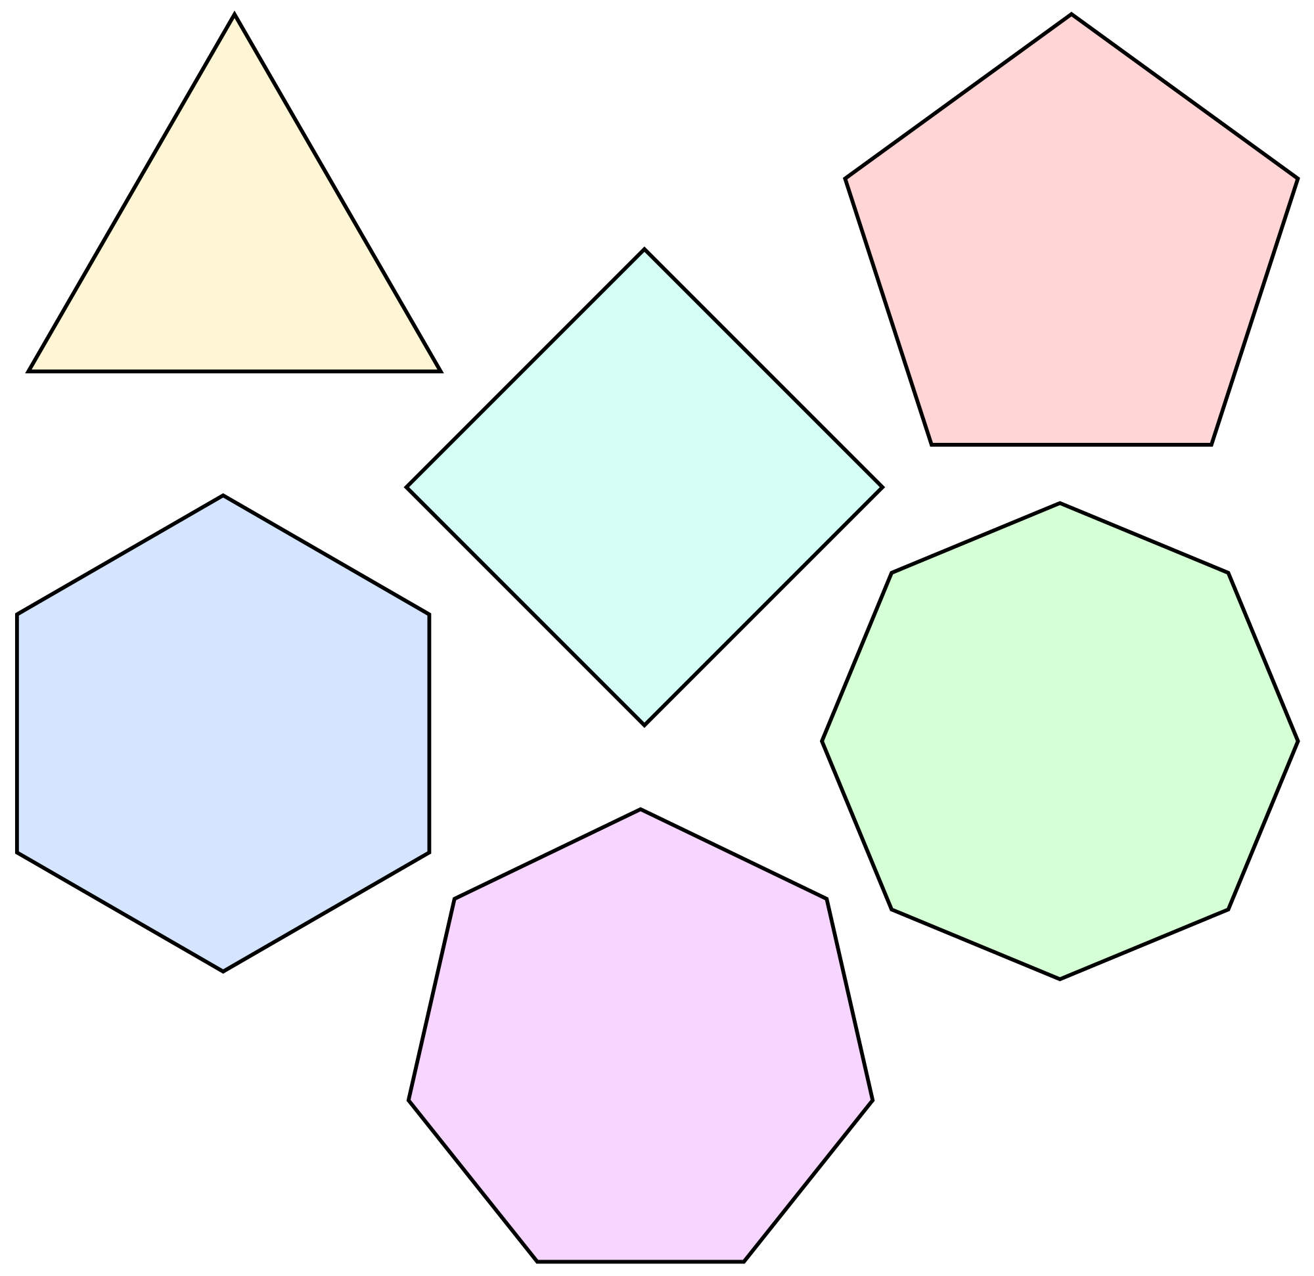
What are we doing today?
Volume
2D & 3D Shapes

Slide 4
What do we need to know?
How to find the volume of simple 3D shapes
Identifying Edges, Vertices and Faces in 2D & 3D shapes
Identifying lines of symmetry in 2D shapes

Slide 5
Volume

Slide 6
Area
Finding the area is the starting point to be able to find the volume of a shape
Let’s recap how to do that first!

Slide 7
Find the Area of these shapes
11m
3cm
7m
7cm
6cm
2cm

Slide 8
Find the Area of these shapes
3m
3m
10m
9cm
4m
16cm

Slide 9
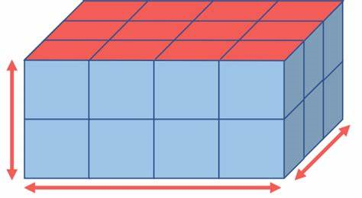
Finding the volume
Where area is for 2D shapes, volume is for 3D shapes
Find the area of the 2D shape on one side, then multiply by the depth of the shape to give you the volume

Slide 10
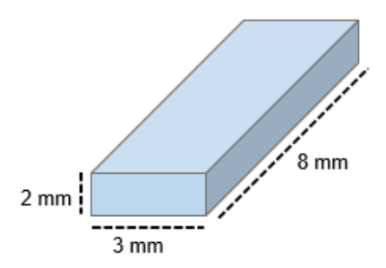
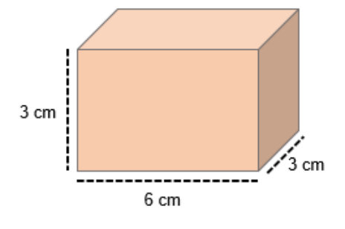
Find the volume of these shapes

Slide 11
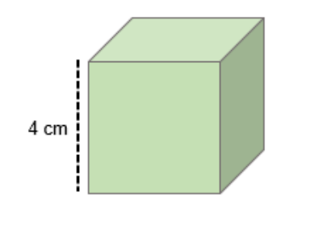
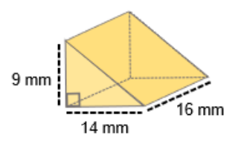
Find the volume of these shapes

Slide 12
Practice Question

Slide 13
Exam Question

Slide 14
2D & 3D Shapes
Complete the worksheets
This link may help:
Vertices, Edges and Faces (mathsisfun.com)

Slide 15
All done!
Next week’s topics are:
Angles
Scale & Bearings

