Slide 1
Functional Skills L2 Maths
Session 6

Slide 2
Starter Activity 5 in 5
How do you find the perimeter of a shape? | 372 ÷ 3 = ? | Find 85% of 670 | Simplify $\frac{18}{48}$ | 452 – 118 = ?

Slide 3
What are we doing today?
Circles
Volume

Slide 4
What do we need to know?
Key parts of a circle
How to find the circumference of a circle
How to find the area of a circle
How to find the volume of simple shapes

Slide 5
Circles

Slide 6
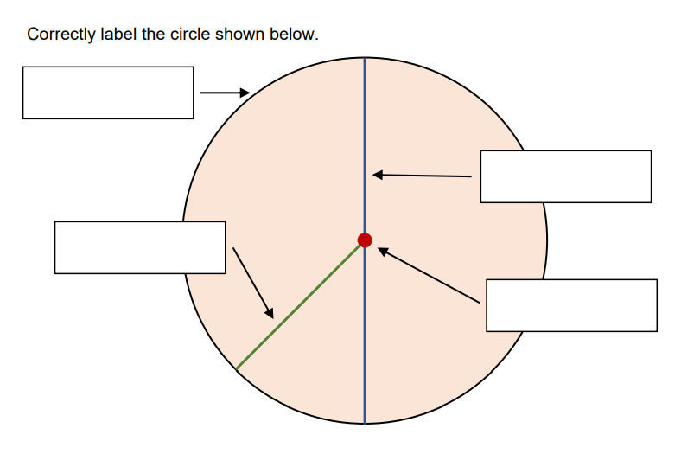
Circles
Radius
Circumference
Centre
Diameter

Slide 7
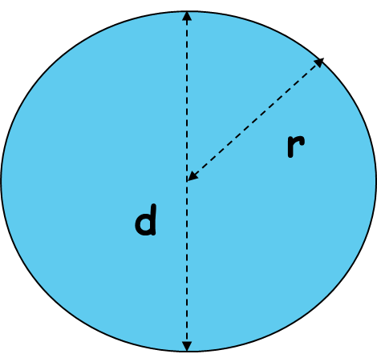
Circles
The radius is half the diameter
The diameter is double the radius
To work out the Circumference:
π x d
π = 3.14

Slide 8
Circles
The radius is half the diameter
The diameter is double the radius
So if the diameter of the circle is 12cm, what is the circumference?
π = 3.14

Slide 9
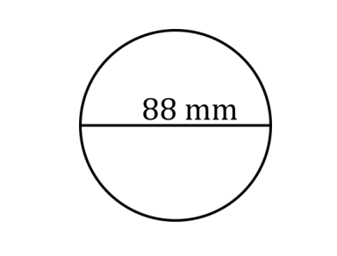
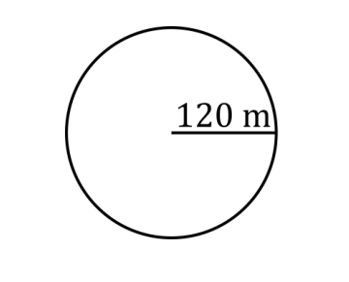
Find the circumference of these Circles

Slide 10
Practice Question

Slide 11
Circles
The radius is half the diameter
The diameter is double the radius
To work out the Area:
π x r²
π = 3.14

Slide 12
Circles
The radius is half the diameter
The diameter is double the radius
So if the radius of the circle is 6cm, what is the area?
π = 3.14

Slide 13
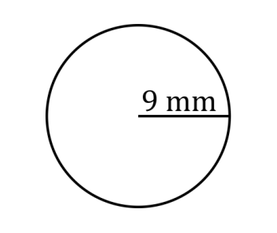
Find the area of these Circles

Slide 14
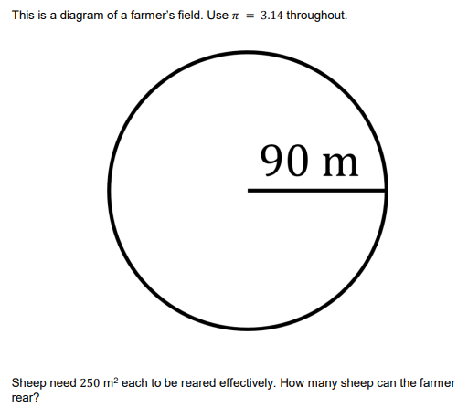
Practice Question

Slide 15
Volume

Slide 16
Area
Finding the area is the starting point to be able to find the volume of a shape
Let’s recap how to do that first!

Slide 17
Find the Area of these shapes
11m
3cm
7m
7cm
6cm
2cm

Slide 18
Find the Area of these shapes
3m
3m
10m
9cm
4m
16cm

Slide 19
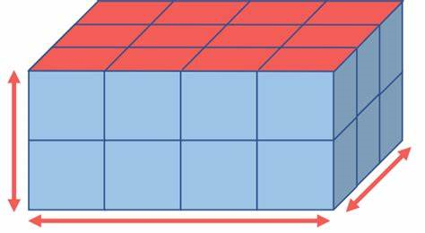
Finding the volume
Where area is for 2D shapes, volume is for 3D shapes
Find the area of the 2D shape on one side, then multiply by the depth of the shape to give you the volume

Slide 20
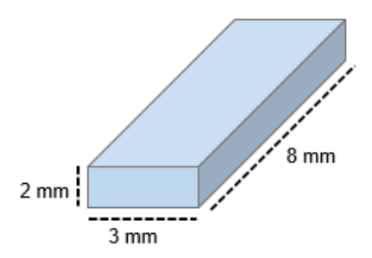
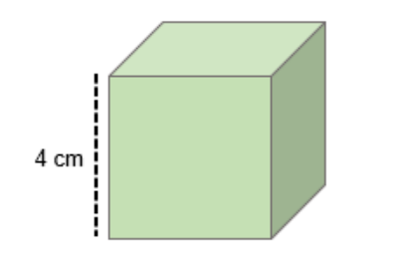
Find the volume of these shapes
Cube
Cuboid

Slide 21
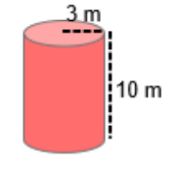
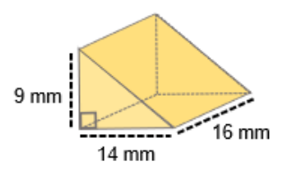
Find the volume of these shapes
Triangular Prism
Cylinder

Slide 22
Practice Question

Slide 23
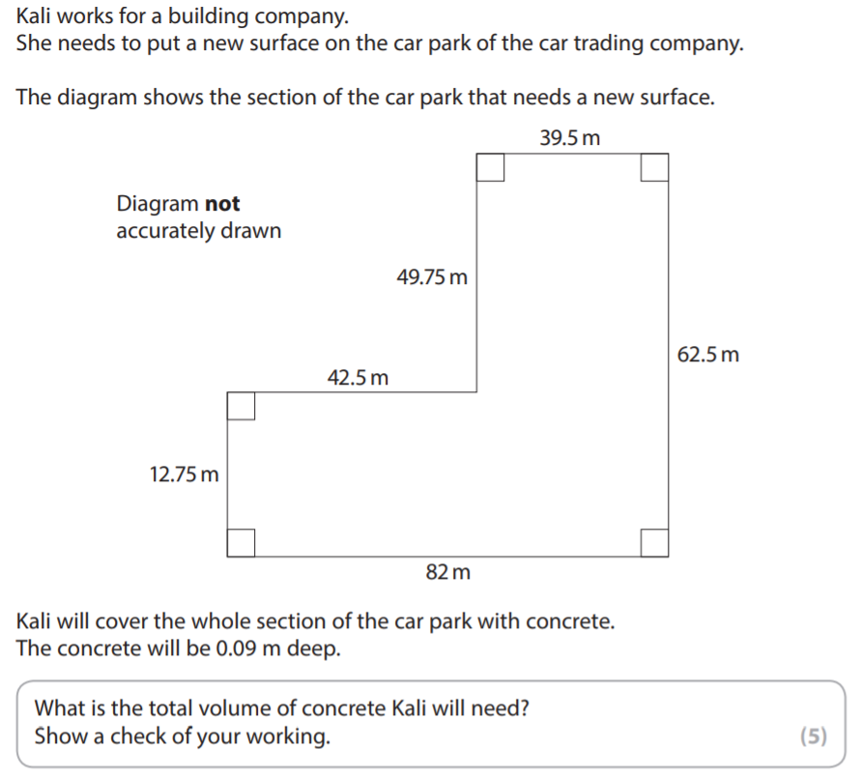
Exam Question

Slide 24
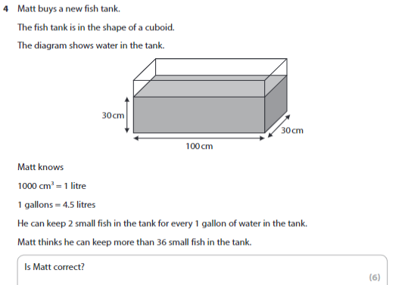
Exam Question

Slide 25
What have we learnt today?

Slide 26
All done!
Next week’s topics are:
Angles
Scale & Bearings

