Slide 1
Functional Skills L1 Maths
Session 7

Slide 2
Starter Activity 5 in 5
Find 40% of 950 | Share £350 in the ratio 1:4 | What are vertices? | Convert $\frac{3}{10}$ into a decimal | How do you find the area of a triangle?

Slide 3
Recap
What did we do last lesson?

Slide 4
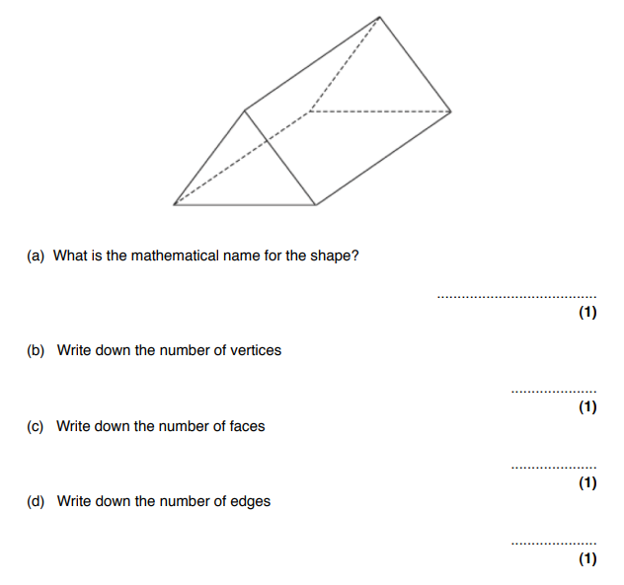
Exam Question

Slide 5
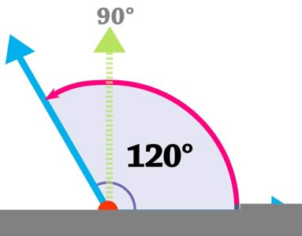
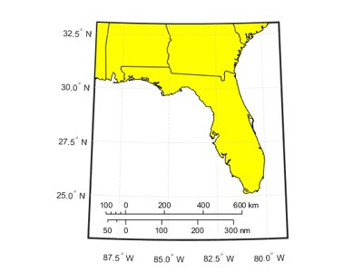
What are we doing today?
Angles
Scale & Bearings

Slide 6
What do we need to know?
Types of angle​
How to measure angles​
Angles in simple shapes​
How to use scale​
How to measure bearings

Slide 7
Angles

Slide 8
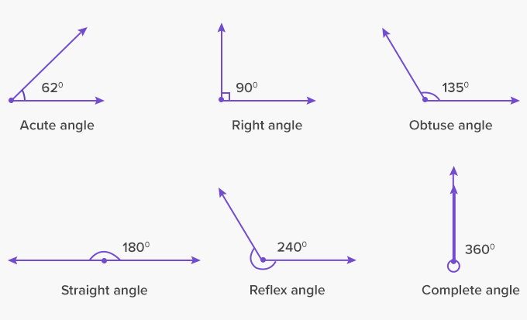
Types of Angle

Slide 9
Types of angle

Slide 10
Angles in a triangle
Angles in a triangle always add up to 180˚
There are four types of triangle to be aware of:
Equilateral
Isosceles
Right-Angled
Scalene

Slide 11
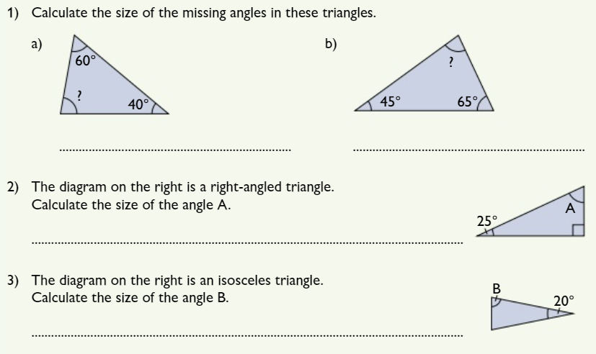
Practice questions

Slide 12
Angles in a Quadrilateral
A quadrilateral is any 4-sided shape
Angles in a quadrilateral always add up to 360˚
Think about possible lines of symmetry!

Slide 13
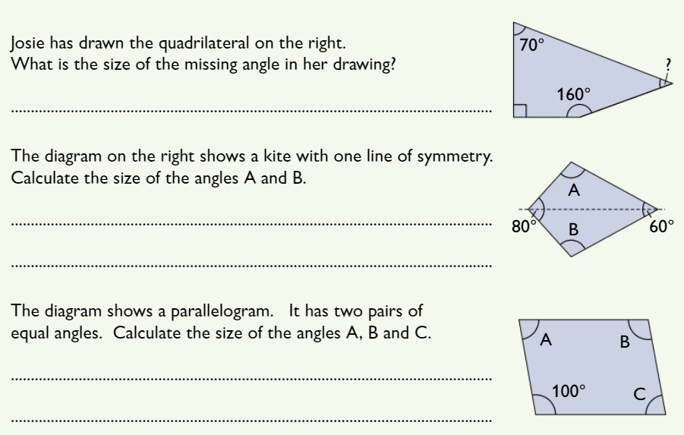
Practice questions

Slide 14
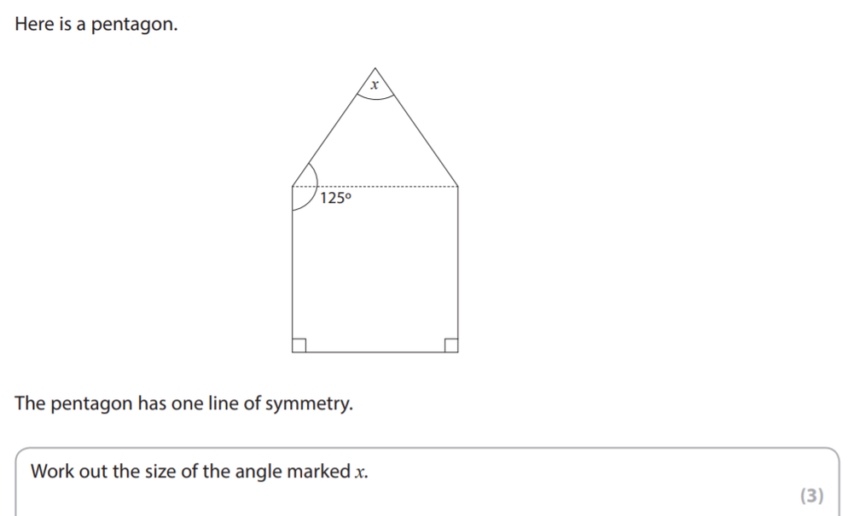
Exam Question

Slide 15
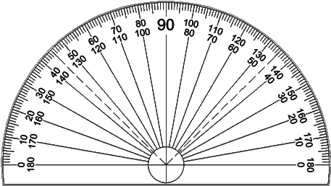
Measuring Angles
To measure angles you will need a protractor
Lining up your protractor is the first step!
The crosshairs should be on the vertex of the angle
The 0° should be along one line of the angle
Then you just need to read the number where the second line intersects

Slide 16
Measuring Angles
To measure angles you will need a protractor
Lining up your protractor is the first step!
The crosshairs should be on the vertex of the angle
The 0° should be along one line of the angle
Then you just need to read the number where the second line intersects

Slide 17
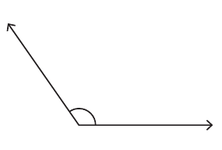
Measure this angle

Slide 18
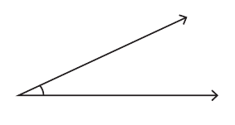
Measure this angle

Slide 19
Scale

Slide 20
What is Scale?
It is a way of creating an accurate drawing of something either very large or very small.
E.g. A Map
You will be given a scale to use that looks like a ratio or conversion.
E.g. 1:10 or 1cm = 1m

Slide 21
Practice Questions

Slide 22
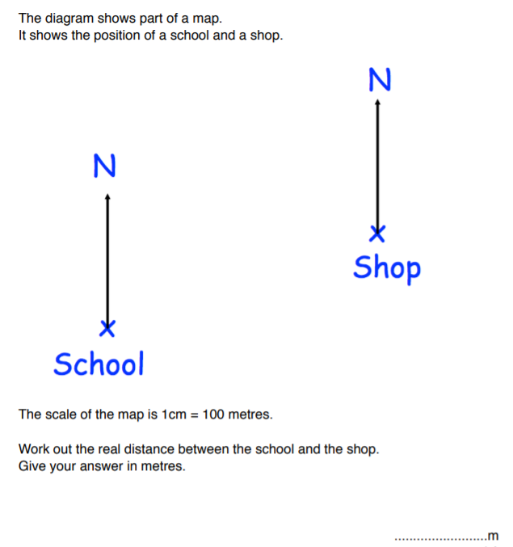
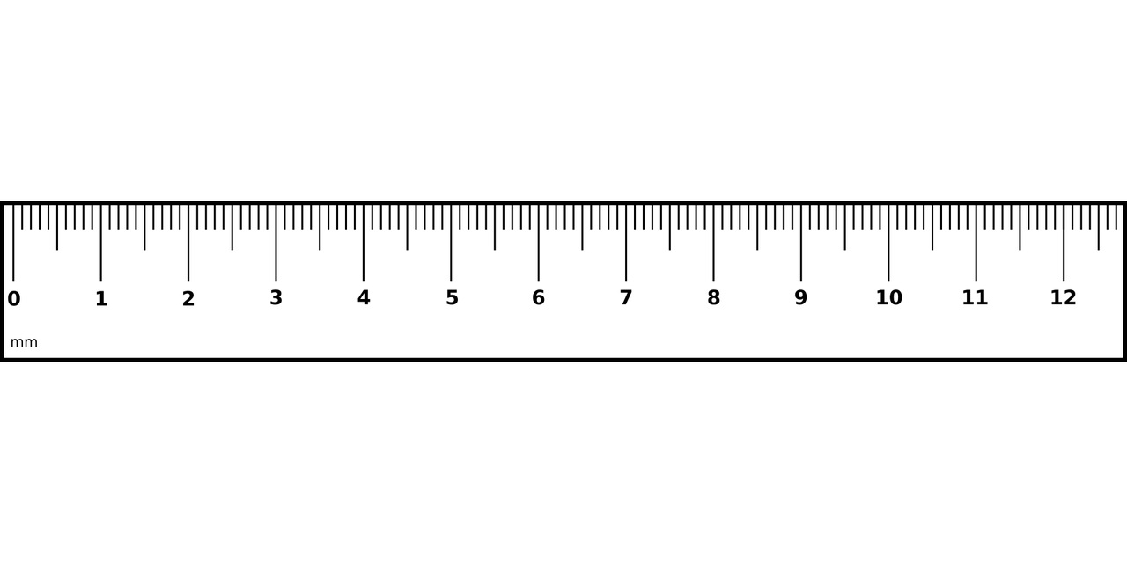
Practice Question

Slide 23
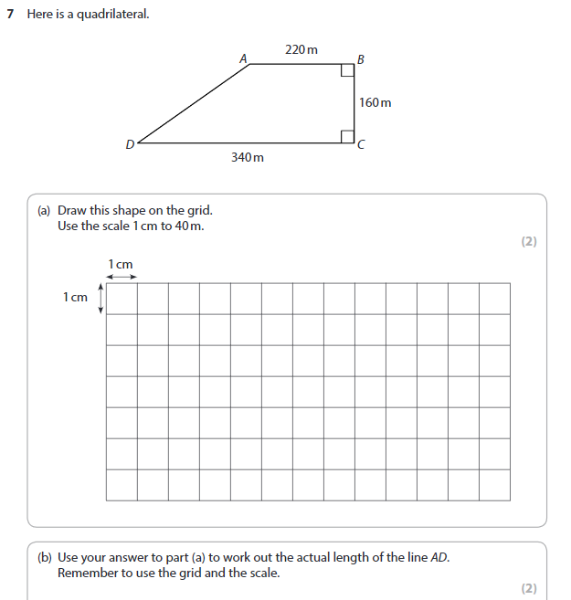
Exam Question

Slide 24
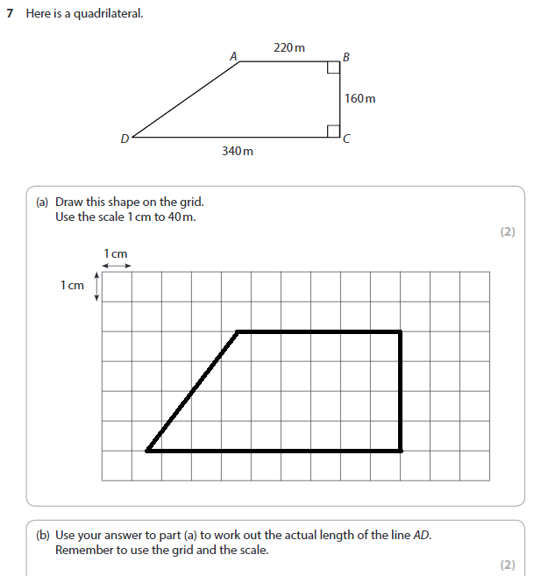
Exam Question

Slide 25
Bearings

Slide 26
Bearings – What Are they?
A bearing is a way of measuring direction, it is often used by ships and the military.
It is measured in degrees.
It is measured from north.
It is measured clockwise.
It is always given in three figures.
It is measured using a protractor.

Slide 27
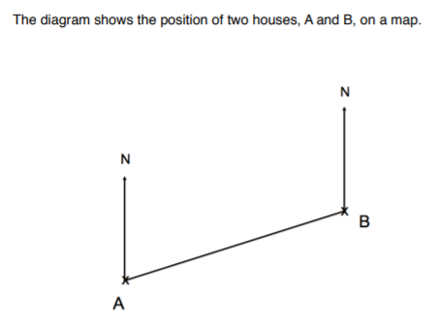
Practice Question

Slide 28
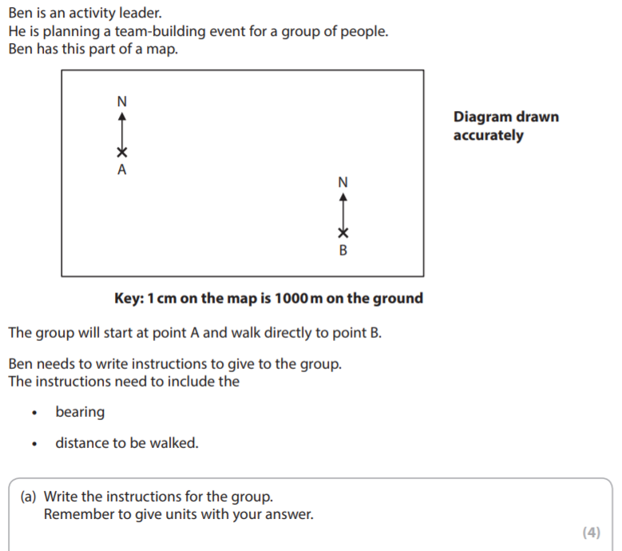
Exam question

Slide 29
Exam question

Slide 30
Exam question

Slide 31
Have a go at the worksheet

Slide 32
All done!
Next week’s topics are:
Nets, Plans & Elevations

