Slide 1
Functional Skills L2 Maths
Session 7

Slide 2
Starter Activity 5 in 5
Find 48% of 950 | Share £350 in the ratio 1:6 | What are vertices? | Convert $\frac{3}{5}$ into a decimal | How do you find the area of a triangle?

Slide 3
Recap
What did we do last lesson?

Slide 4
Exam Question

Slide 5
What are we doing today?
Angles
Scale & Bearings

Slide 6
What do we need to know?
Types of angle
How to measure angles
Angles in simple shapes
How to use scale
How to measure bearings

Slide 7
Angles

Slide 8
Types of Angle

Slide 9
Types of angle

Slide 10
Angles in a triangle
Angles in a triangle always add up to 180˚
There are four types of triangle to be aware of:
Equilateral
Isosceles
Right-Angled
Scalene

Slide 11
Practice questions

Slide 12
Angles in a Quadrilateral
A quadrilateral is any 4-sided shape
Angles in a quadrilateral always add up to 360˚
Think about possible lines of symmetry!

Slide 13
Practice questions

Slide 14
Exam Question

Slide 15
Exam Question

Slide 16
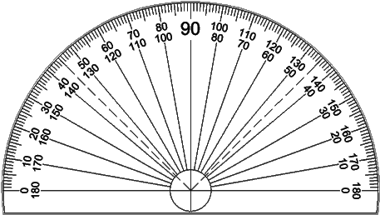
Measuring Angles
To measure angles you will need a protractor
Lining up your protractor is the first step!
The crosshairs should be on the vertex of the angle
The 0° should be along one line of the angle
Then you just need to read the number where the second line intersects

Slide 17
Measuring Angles
To measure angles you will need a protractor
Lining up your protractor is the first step!
The crosshairs should be on the vertex of the angle
The 0° should be along one line of the angle
Then you just need to read the number where the second line intersects

Slide 18
Measure this angle

Slide 19
Measure this angle

Slide 20
Measure this angle

Slide 21
Measure this angle

Slide 22
Scale

Slide 23
What is Scale?
It is a way of creating an accurate drawing of something either very large or very small.
E.g. A Map
You will be given a scale to use that looks like a ratio or conversion.
E.g. 1:10 or 1cm = 1m

Slide 24
Practice Questions

Slide 25
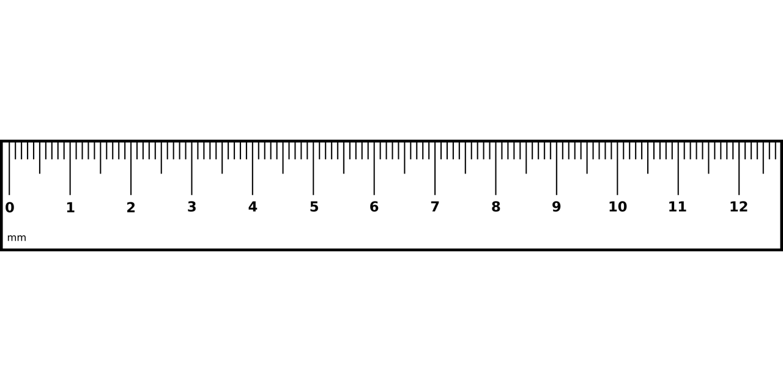
Practice Question

Slide 26
Exam Question

Slide 27
Exam Question

Slide 28
Bearings

Slide 29
Bearings – What Are they?
A bearing is a way of measuring direction, it is often used by ships and the military.
It is measured in degrees.
It is measured from north.
It is measured clockwise.
It is always given in three figures.
It is measured using a protractor.

Slide 30
Practice Question

Slide 31
Exam question

Slide 32
Exam question

Slide 33
Exam question

Slide 34
Have a go at the worksheet

Slide 35
All done!
Next week’s topics are:
Nets, Plans & Elevations

