Slide 1
Functional Skills L2 Maths
Session 8

Slide 2
Starter Activity 5 in 5
74 x 32 | How many degrees in a straight line? | £1 = $1.15 Convert $345 into £ | -4 – 8 = ? | $\frac{3}{8}$ of 152

Slide 3
Recap
What did we do last lesson?

Slide 4
Exam Question

Slide 5
What are we doing today?
Nets, Plans & Elevations

Slide 6
What do we need to know?
Identifying and drawing nets of 3D shapes
Identifying and drawing plans of 3D shapes
Identifying and drawing elevations of 3D shapes

Slide 7
What are Nets, Plans & Elevations?
Nets
A net is what a 3D shape looks like when it is folded out flat
Plans
A plan is what a 3D shape looks like from above
Elevations
An elevation is what a 3D shape looks like from either the front or side view
It will then be called either a front elevation or a side elevation

Slide 8
Nets
When drawing a net, you should have a section for each face
You will usually need to draw it to a given measurement or scale
There may be more than one way of drawing a net for a shape
As long as it can fold into the correct 3D shape, it is right!

Slide 9
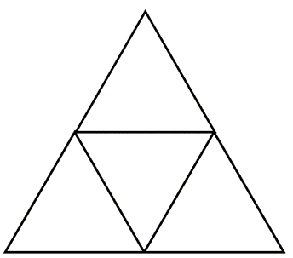
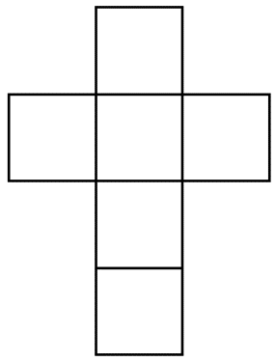
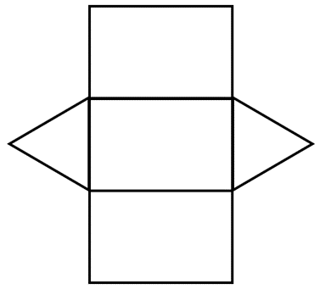
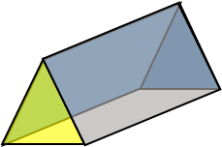
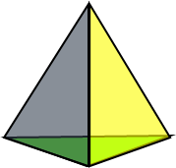
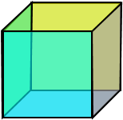
Match the Net to the correct shape

Slide 10
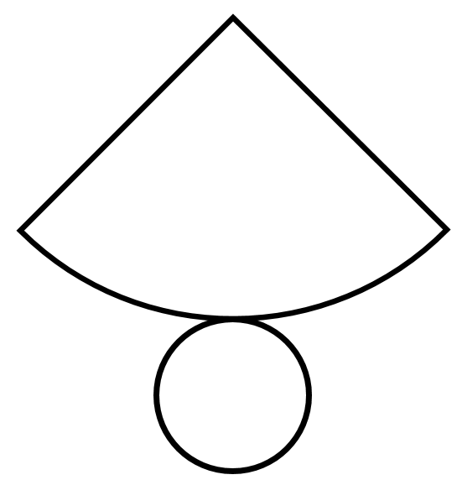
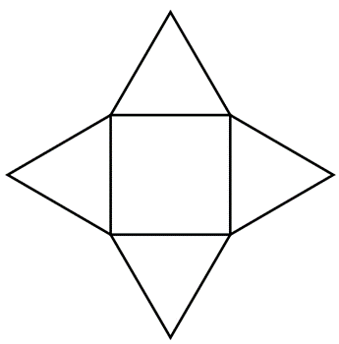
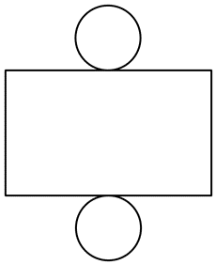
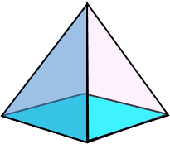
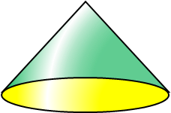
Match the net to the correct shape

Slide 11
Exam Question

Slide 12
Plan & Elevation
Notes:
Video Link: https://www.youtube.com/watch?v=BnwoipoGWJ8&t=5s

Slide 13
Practice question

Slide 14
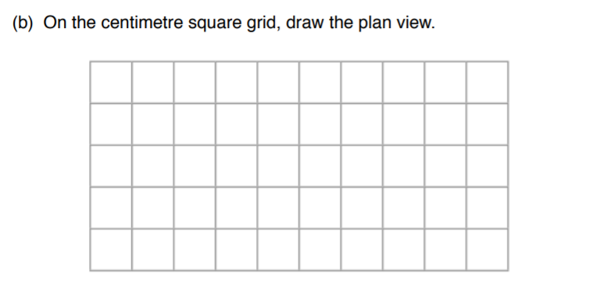
Practice question

Slide 15
Practice question

Slide 16
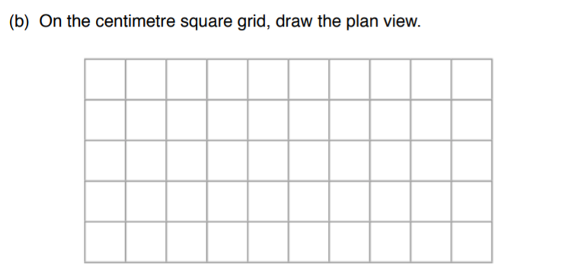
Practice question

Slide 17
Exam Question

Slide 18
Exam Question

Slide 19
Revision Time
Area, Perimeter & Volume

Slide 20
Quick Recap
How do you work out the perimeter of a shape?
How do you find the area of a rectangle?
How do you find the volume of a prism?
How can I find the radius if I know the diameter?
How do I find the area of a circle?
How do I find the circumference of a circle?
What is the value of pi?

Slide 21
Exam Question

Slide 22
Exam Question

Slide 23
Exam Question

Slide 24
Exam Question

Slide 25
All done!
Next week’s topic is:
Formula

