Slide 1
Functional Skills L1 Maths
Session 9

Slide 2
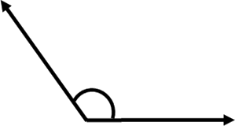
Starter Activity 5 in 5
A square has a side length 4cm. What is the perimeter? | 1182 – 764 = ? | $\frac{7}{10}$ of 520 | How many vertices in a triangular prism? | What type of angle is this?

Slide 3
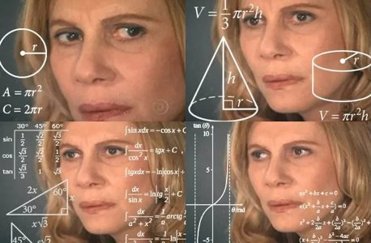
What are we doing today?
Formula

Slide 4
What do we need to know?
How to use function machines to solve multi-step formula
Be able to define BIDMAS
Use BIDMAS to solve calculations

Slide 5
Function Machines

Slide 6
Function Machines
Input
Output
6
+ 3
x 8
?

Slide 7
Function Machines
Inputs
Outputs
7
x 5
- 10
?
3
x 7
+ 5
?
24
÷ 4
x 12
?
16
x 3
÷ 12
?

Slide 8
Function Machines
Input
Output
?
÷ 4
+ 17
22
12
- 2
x ?
30

Slide 9
Function Machines
Inputs
Outputs
?
+ 15
÷ 6
4
8
x ?
- 7
17
?
÷ 4
- 1
3
2
+ 10
x ?
60

Slide 10
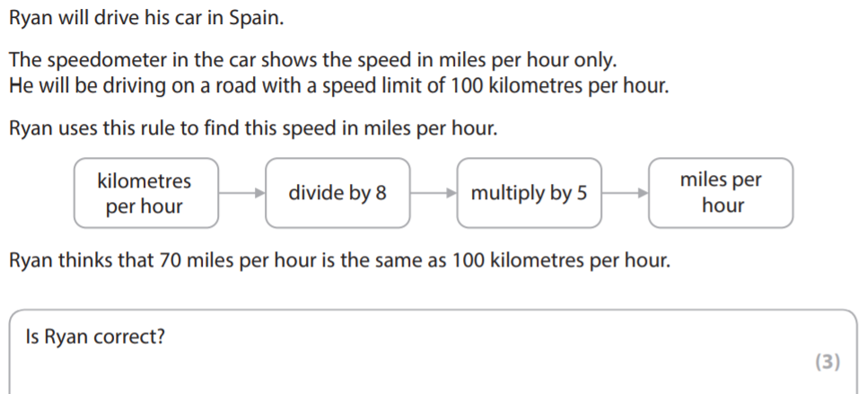
Exam Question

Slide 11
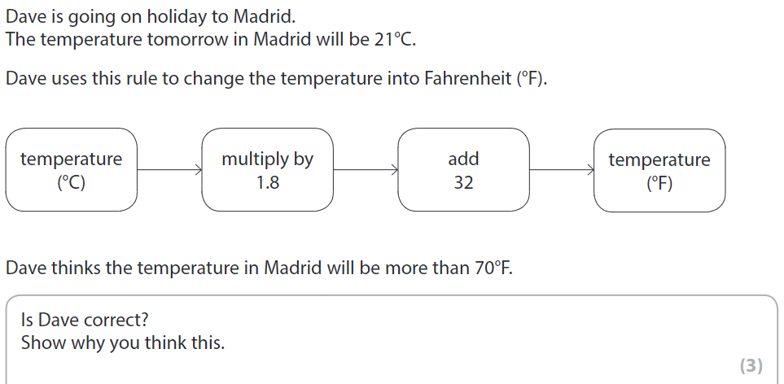
Exam Question

Slide 12
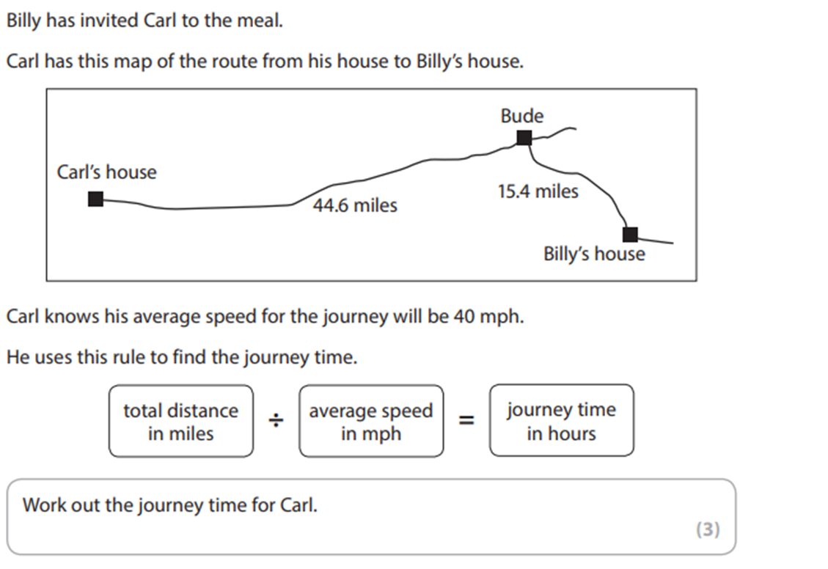
Exam Question

Slide 13
BIDMAS

Slide 14
bidmas
When solving a calculation, we should always follow BIDMAS:
Brackets
Indices
Division
Multiplication
Addition
Subtraction

Slide 15
BIDMAS
16 – 5 x 2
10 – 3²
5 x (2 + 3)
6 + 6 ÷ 3
8 + 3 x (5 – 1)
9 x 2 + 20 ÷ 2

Slide 16
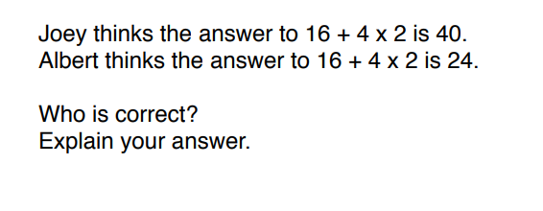
Practice Question

Slide 17
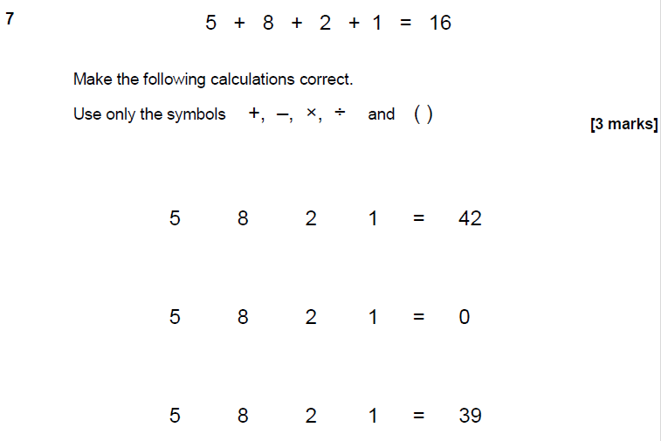
Practice Question

Slide 18
All done!
Next week’s topics are:
Probability
Mean, Median, Mode and Range

