Slide 1
Functional Skills L2 Maths
Session 9

Slide 2
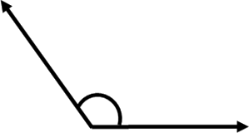
Starter Activity 5 in 5
A cube has a side length 4cm. What is the volume? | 1182 – 784 = ? | $\frac{7}{12}$ of 540 | How many vertices in a cylinder? | What type of angle is this?

Slide 3
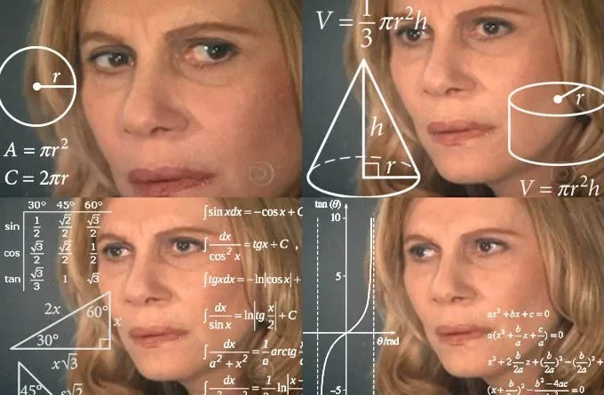
What are we doing today?
Formula

Slide 4
What do we need to know?
BIDMAS
How to read formula
How to solve formula
Distance/Speed/Time

Slide 5
BIDMAS

Slide 6
bidmas
When solving a calculation, we should always follow BIDMAS:
Brackets
Indices
Division
Multiplication
Addition
Subtraction

Slide 7
BIDMAS
10 ÷ 2 − 3 × 1
55 − (1 + 4) × 4
7 × (8 ÷ 4)²
(2 × 7) + 1 × 3
6 + 5 × 8
8 + 3 × 4
2

Slide 8
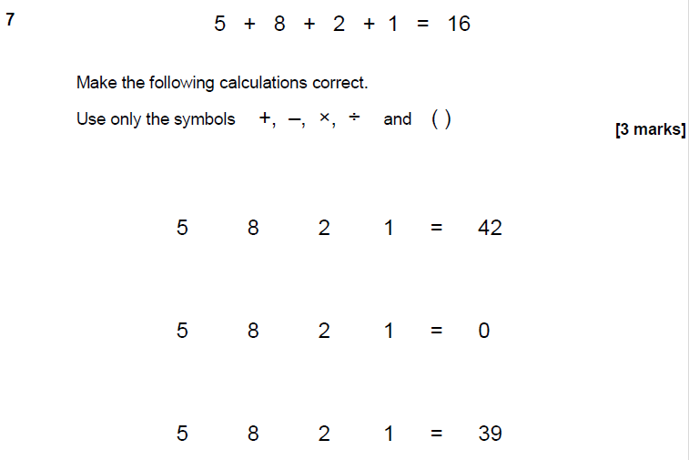
Practice Question

Slide 9
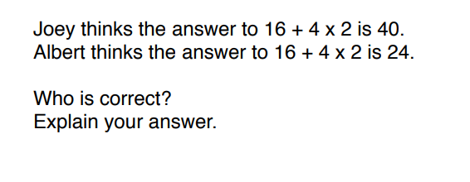
Practice Question

Slide 10
Reading & Solving Formula

Slide 11
Function Machines
Input
Output
6
+ 3
x 8
?

Slide 12
Function Machines
Inputs
Outputs
7
x 5
- 10
?
24
÷ 4
x 12
?
16
x 3
÷ 12
?

Slide 13
Function Machines
Input
Output
?
÷ 4
+ 17
22
12
- 2
x ?
30

Slide 14
Function Machines
Inputs
Outputs
?
+ 15
÷ 6
4
8
x ?
- 7
17
?
÷ 4
- 1
3
2
+ 10
x ?
60

Slide 15
Formula
Substitutes of Value = when a letter represents a named value. The number may change, which is why formulas are written in this way; the formula will always work as long as the correct numbers are entered into it!
REMEMBER
3a = 3 x a
ab = a x b
a² = a x a
$\frac{a}{b}$ = a ÷ b
Two values next to each other, multiply!
A value with an indice, multiply by itself the number of times the indices shows!
One value over another, divide the top by the bottom!

Slide 16
Function Machines to Formula
Input
Output
$$5x+10$$
$$\frac{x+6}{4}$$

Slide 17


Substitution
What would the answer to these sums be if:
$x$ = 10 $x$ = 6 $x$ = 5
$$5x+10$$
$$\frac{x+6}{4}$$

Slide 18
Exam Question

Slide 19
Exam Question

Slide 20
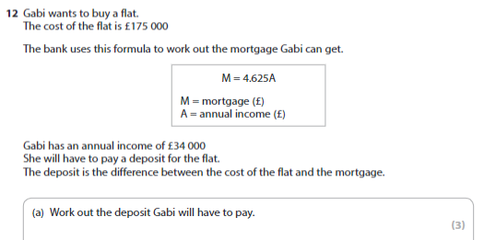
Exam Question

Slide 21
Distance/Speed/Time

Slide 22
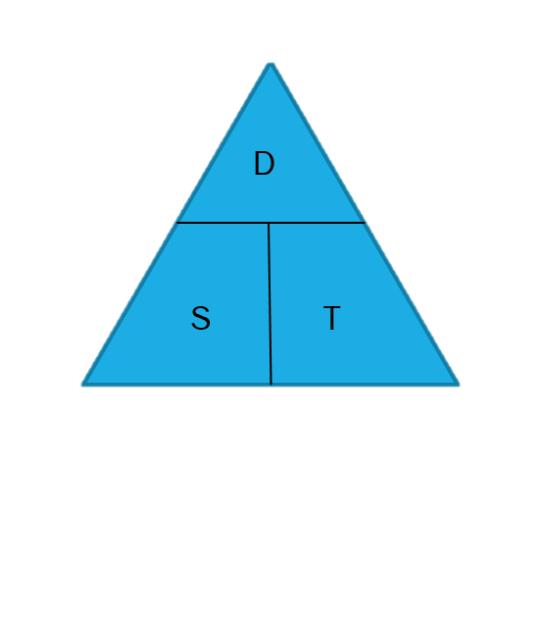
Speed/Distance/time
One of the formulas you need to remember is for Speed, Distance and Time
This is best done by picturing the equation as a triangle. Whichever you are trying to find, place your hand over that letter.
The way the remaining letters are placed with each other tells you what to do (think about how we read formula!)
D=
S=
T=

Slide 23
Speed/Distance/time
If a train travels 300 miles over 2 hours, how fast was it going?
If a bus travels for 2 hours at a speed of 50 mph, how far did it go?
A cyclist rides 5 miles at a speed of 2 miles an hour. How long did it take?
D= Speed x Time
S= Distance ÷ Time
T= Distance ÷ Speed

Slide 24
Practice Questions
A vehicle leaves Leeds at 8.00am and arrives in Newcastle at 10.30am. If the distance is 140 km, what was the average speed of the vehicle?
Pierre cycles at 4 miles per hour and travels a distance of 12 miles. How long does his journey take?
A whale swims at a speed of 13 metres per second for half a minute. How far does the whale swim in this time?
An Audi travels at 88mph over a distance of 22m. Calculate in minutes the time taken for the Audi to travel this distance.

Slide 25
Exam Question

Slide 26
More Practice

Slide 27
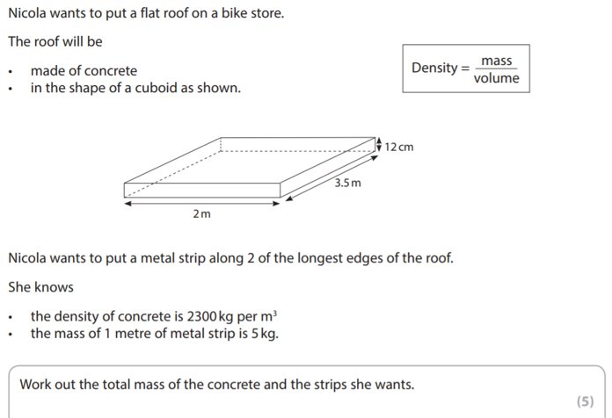
Exam Question

Slide 28
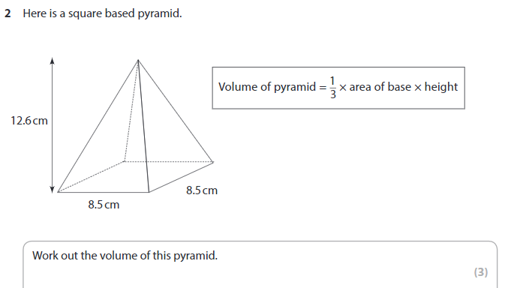
Exam Question

Slide 29
All done!
Next week’s topics are:
Probability
Averages

