Slide 1




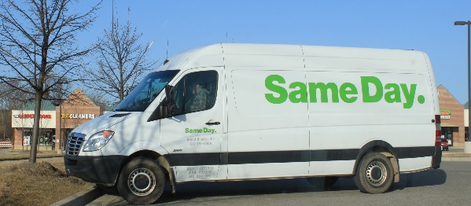
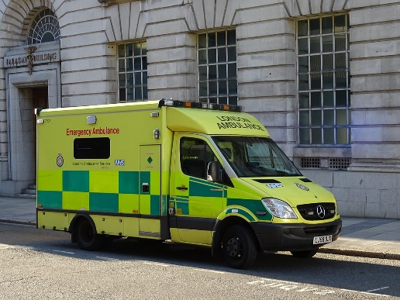

IDENTIFYING
CAREERS
Notes:
WORKSHOP INFORMATION:
TITLE: Identifying Careers
DURATION: 45 mins
RESOURCES REQUIRED: SWOT handout per person

Slide 2
OBJECTIVES
Today we will understand;
  Self-awareness
  How self-awareness can help with career ideas
  Tool for self awareness (SWOT analysis)
  Resources to help identify and explore different careers
Notes:
TOTAL SLIDE TIME: 2 minutes
RESOURCES: n/a
CONTENT AND/OR ACTIVITY(S):
Introduce self and outline the objectives for the session;
Self-awareness
How self-awareness can help with career ideas
Tool for self awareness (SWOT analysis)
Resources to help identify and explore different careers

Slide 3
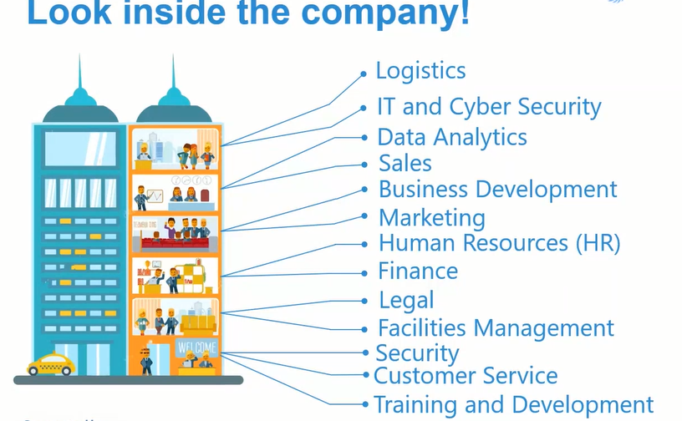
QUESTION !
?
How many different job roles are there
across the college group?
699
Notes:
TOTAL SLIDE TIME: 2 minutes
RESOURCES: n/a
CONTENT AND/OR ACTIVITIES:
Explain that there are 699

Slide 4
SELF AWARENESS
Self awareness is your ability to observe personal;
feelings
values
strengths/weaknesses
reactions
habits
behaviours
thoughts
Notes:
TOTAL SLIDE TIME: 2 minutes
RESOURCES: n/a
CONTENT AND/OR ACTIVITY(S):
Facilitate discussion around self awareness explaining this is found in observing feelings, values, strengths, reactions, habits, behaviours, thoughts.

Slide 5
SELF-AWARENESS AND CAREERS
Strengths
Your main selling points
Weaknesses
Areas to develop
Opportunities
People/extra courses/work experience/contacts to help you.
Threats
Anything that really worries you or could cause difficulties.
Notes:
TOTAL SLIDE TIME: 10 Minutes
RESOURCES: Handout personal SWOT analysis
CONTENT AND/OR ACTIVITY(S): Complete the Personal SWOT analysis by reviewing and identifying;
Your best qualities/strengths
Areas for development
Opportunities of interest
Opportunities to avoid

Slide 6
EXPLORING CAREERS
What do we need to know when considering career options?
What does the job involve
How do you become a…
What qualifications would you need
What skills would you need
What would the environment be like
Any restrictions (e.g. health/visa)
What are the progression options
How much can I earn
Notes:
TOTAL SLIDE TIME: 5 Minutes
RESOURCES: n/a
CONTENT AND/OR ACTIVITY(S):
Ask the group what do we need to know when considering career options;
What does the job involve
How do you become a…
What qualifications would you need
What skills would you need
What would the environment be like
Any restrictions (e.g. health/visa)
What are the progression options
How much can I earn

Slide 7
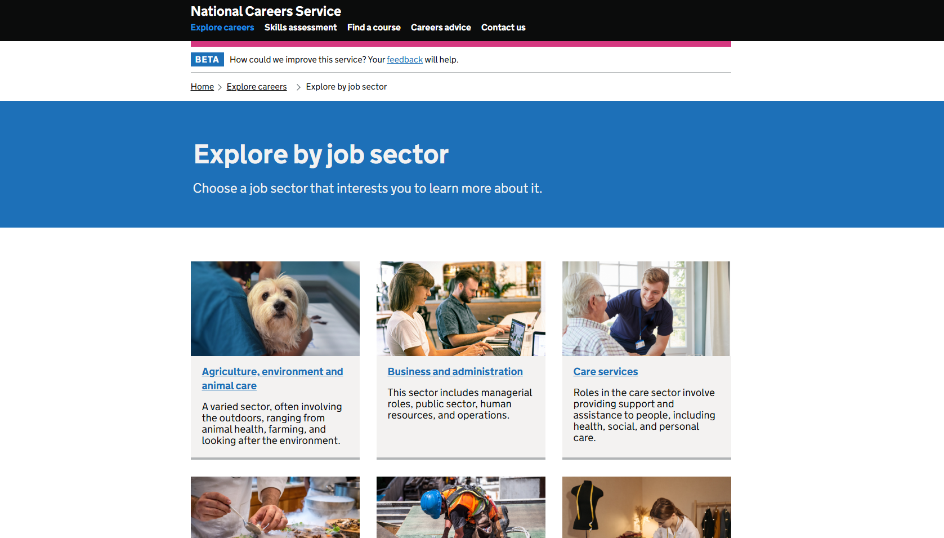
EXPLORING CAREERS

Slide 8
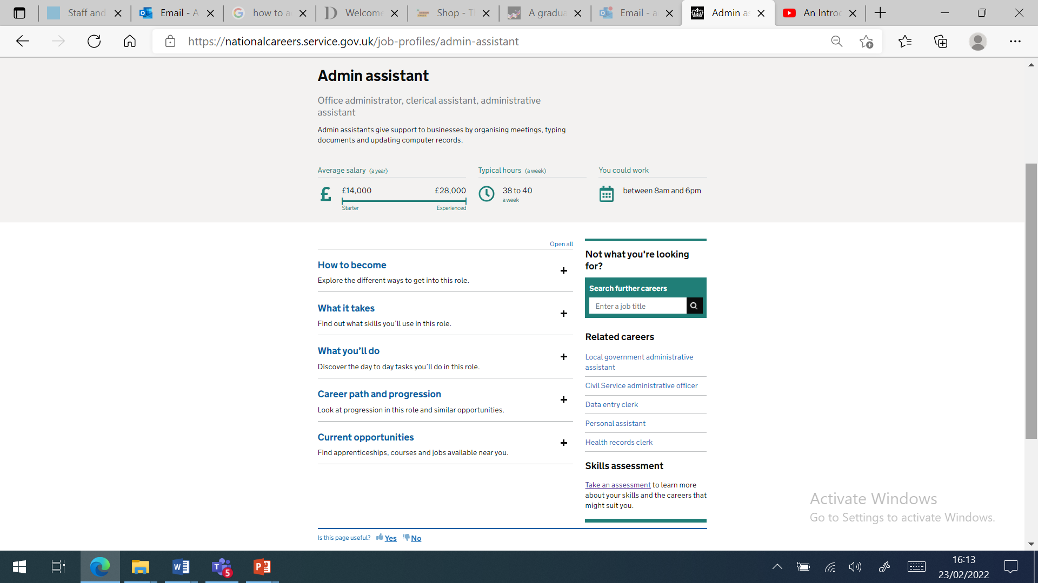
EXPLORING CAREERS

Slide 9
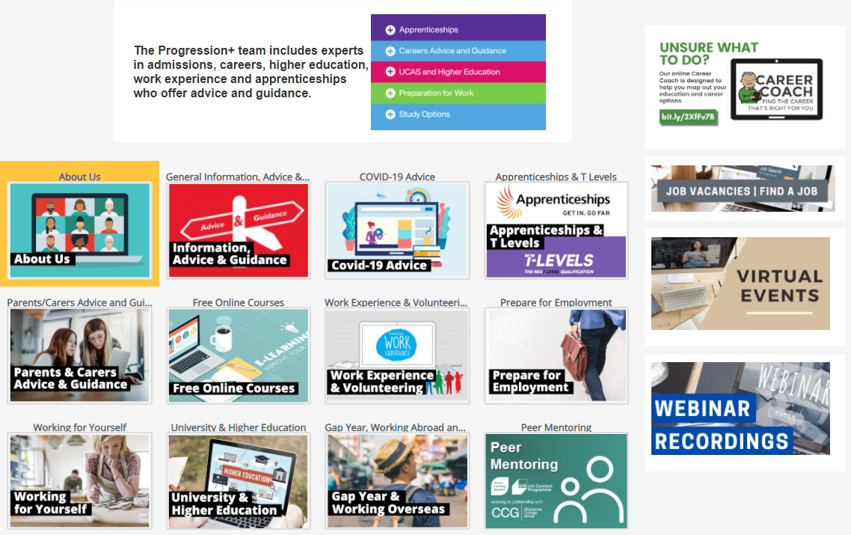
ONLINE RESOURCES:
CCG ONLINE
Notes:
TOTAL SLIDE TIME: 5 minutes
RESOURCES: none
CONTENT AND/OR ACTIVITY(S):
[5] Outline the nature of careers and progression resources held on CCG Online. Demonstrate the job vacancy board, virtual events and webinar recordings in particular

Slide 10
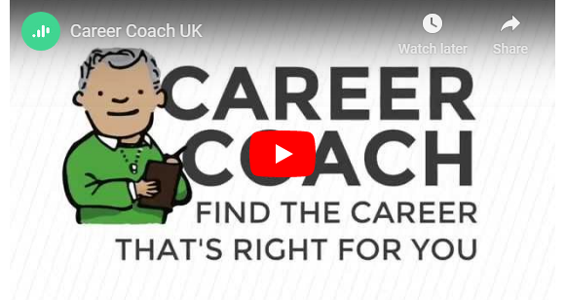
ONLINE RESOURCES:
CAREER COACH
Notes:
TOTAL SLIDE TIME: 4 minutes
RESOURCES: play video
CONTENT AND/OR ACTIVITY(S):
[4] Play career coach promotional video

Slide 11
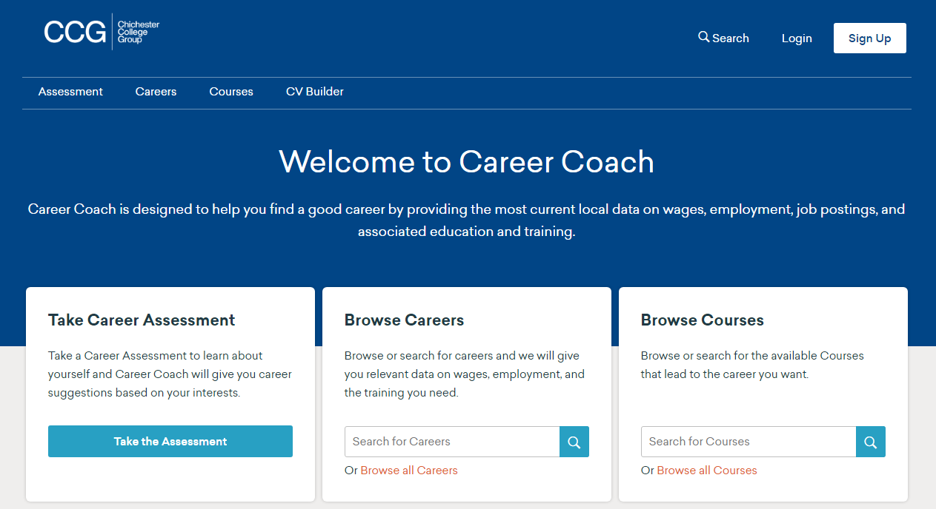
ONLINE RESOURCES:
CAREER COACH
https://bit.ly/2XfFv7B
Notes:
TOTAL SLIDE TIME: 5 minutes
RESOURCES: none
CONTENT AND/OR ACTIVITY(S):
Demonstrate career coach and its uses for the group. Target to curriculum area. Highlight the range of assessments on offer which can support them exploring and identifying career options

Slide 12

ONLINE RESOURCES:
CAREERS ASSESSMENTS
Notes:
TOTAL SLIDE TIME: 4 minute
RESOURCES: none
CONTENT AND/OR ACTIVITY(S):
[4] Outline that our CCG Online there are a number of careers assessment options for students to try out to support exploring key interests, motivations for work and career paths that they might be suited to. These can be completed independently online or with an advisor for support. Outline the benefits of completing career assessments and how they can help.

Slide 13
OBJECTIVES
Today we have explored;
  Self-awareness
  How self-awareness can help with career ideas
  Tool for self awareness (SWOT analysis)
  Resources to help identify and explore different careers
Notes:
TOTAL SLIDE TIME: 2 minutes
RESOURCES: n/a
CONTENT AND/OR ACTIVITY(S):
Outline the learning objectives for today; Self awareness, how self awareness can help with careers ideas, Tool for self awareness (SWOT) and resources to help identify and explore different careers

Slide 14


ANY QUESTIONS?
Notes:
TOTAL SLIDE TIME: 2 minutes
RESOURCES: none
CONTENT AND/OR ACTIVITY(S):
[2] Answer any questions that students have

