Slide 1

Catering
and Hospitality
Information Morning

Slide 2
Why Choose Hospitality?
The hospitality is central to the UK economy contributing around £93 billion annually to this country’s GDP
2.8 Million people work within the hospitality industry that’s 7.5% of UK employment
Latest statistics state there are174,000 unfilled job vacancies
This is causing 61% of UK businesses to suffer with staff shortages
So, you will always find a job!
Wide variety of jobs available and you will learn lots of transferable skills
Study in a College with the best facilities and course range on the
south coast

Slide 3
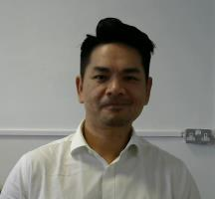
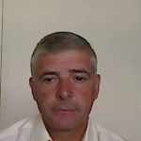
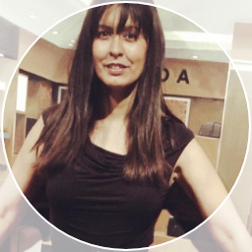


Meet the team Study Program Leaders
Level 1 Diploma Matthew Reed
Level 2 Professional Cookery Francis Hele
Level 3 Hospitality Alison Girdlestone
Level 3 Professional Cookery Sean Denny
Level 2 & 3 Patisserie Travor Tan

Slide 4
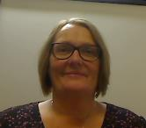
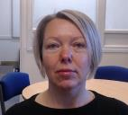

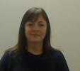
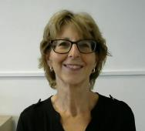

Meet the team Management
Course Teachers and Assessors
Diane Jackson Head of Learning
Julie Davis Teaching and Learning Manager
Hayley Keates Specialist Practitioner Hospitality
Sam Luff Specialist Practitioner Kitchen
Liza Lawrence Assessor Café 19
Paul Downing Chef Lecturer Apprentices

Slide 5

Finance
Pauline Baldwin and
Alison Gilbert

Slide 6


Chichester College Group
Student Finance
Apply Online!
Speak to us for more information!

Slide 7

Admissions

Slide 8
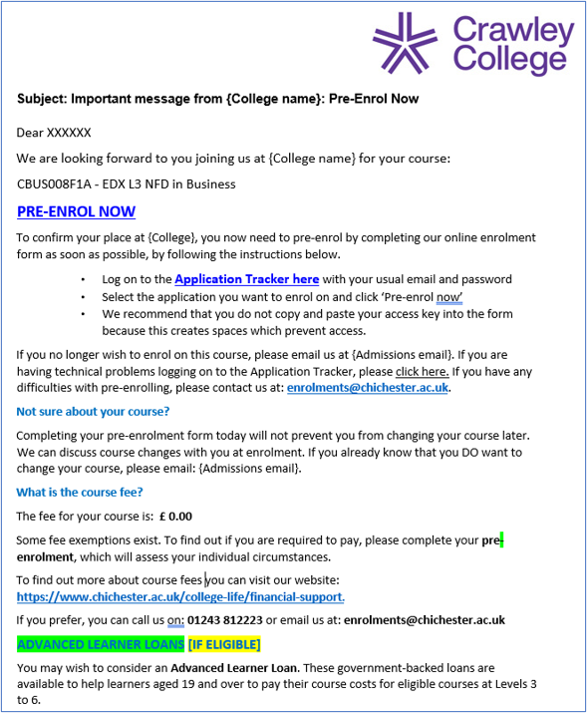
18th June – Invitation to complete your pre-enrolment
Admissions – Key dates for your diary

Slide 9
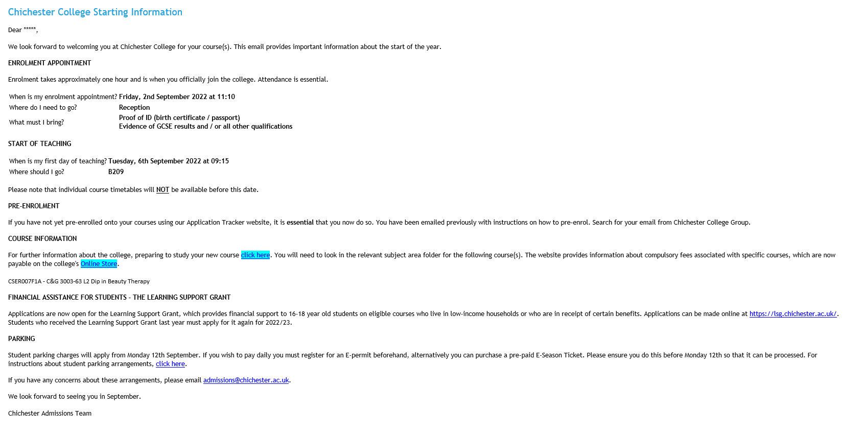
Admissions – Key dates for your diary
18th June – Invitation to complete your pre-enrolment
1st August – ‘Chichester College Starting Information’

Slide 10
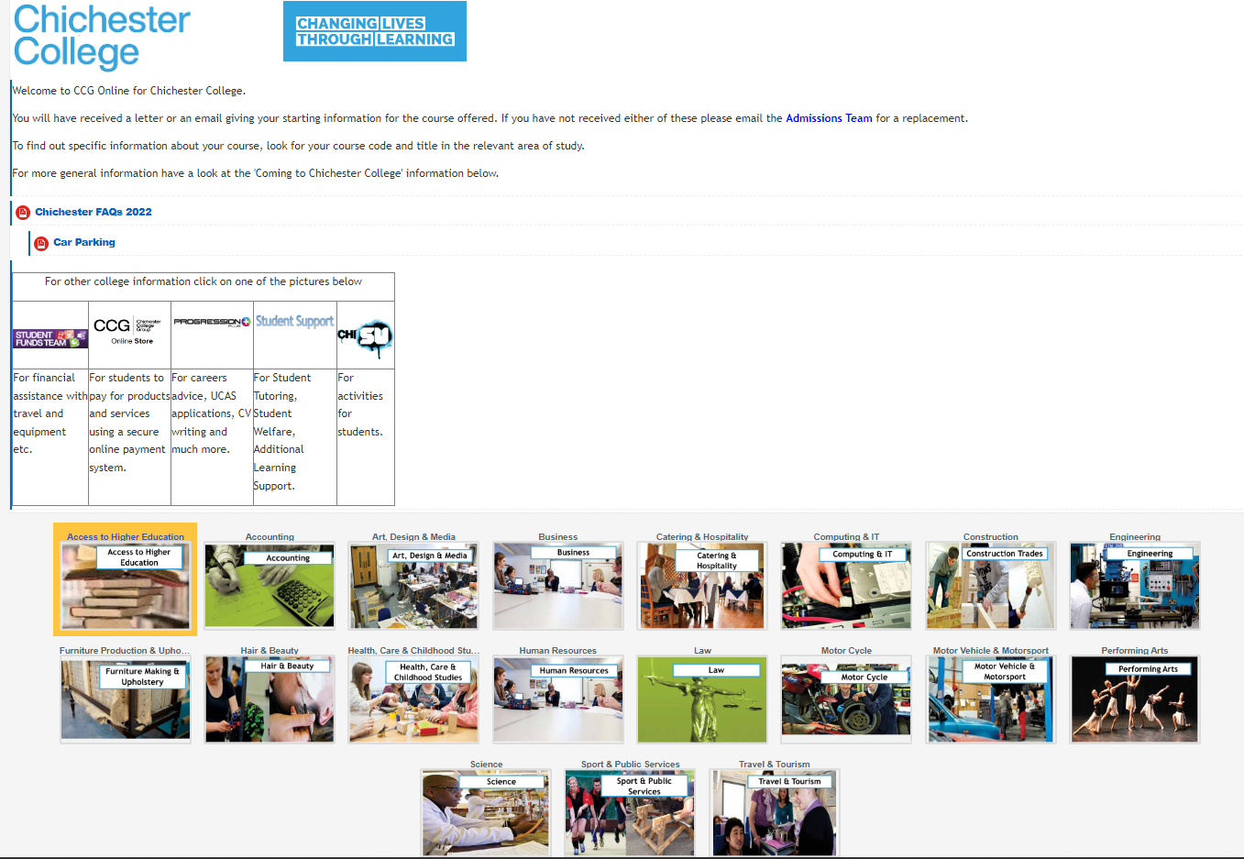
Admissions – Key dates for your diary
1st August – ‘Chichester College Starting Information’

Slide 11
Admissions – Key dates for your diary
18 June
Invitation to complete your pre-enrolment
1 Aug.
‘Chichester College Starting Information’
21 Aug.
GCSE Results Day
27 Aug.
‘YES!’ Day 2-7pm
27 Aug.
Enrolment day
Please remember your GCSE results, a form of ID i.e., passport and proof of payment
1 Sep.
Induction Week
Week commencing 2nd September – Induction
5 Sep.
Late enrolment day

Slide 12


Slide 13


Slide 14
Attendance Parents are able to track their child’s attendance via College Connect
Positive register marks
Present /
Distance Learning D
Late L Left Early X
Negative Marks
Absent 0
Authorised Absence A
Sickness S
Neutral Marks
Exam E
Medical M
Work Experience/Placement

Slide 15

Additional Support
Kerry Poat/ Zane Alecio

Slide 16

Course Minimum Entry Requirements
Level 1 Gateway Diploma in Hospitality Services
3 GCSEs at 2 or above including M of E at a 3 or above
Level 2 Professional Cookery
4 GCSEs at 4 or above including M or E and Food Tec or relevant experience
Level 2 Patisserie
4 GCSEs at 4 or above including M or E and Food Tec or relevant experience
Level 3 Diploma in Hospitality Supervision
5 GCSEs at 4 or above including Math and English

Slide 17
Timetables
Full induction timetables for weeks 1 and 2 can be found on the Starting In September information from the beginning of August
Permanent timetables will not be available until the end of induction week All timetables are subject to change throughout the year.
The hospitality day begins at 8.30am and can finish at 9pm if there is evening service. Your lessons will be held within this time and will include practical and theory lessons and math and English if you do not already have a grade 4 or above

Slide 18
Induction Week
Wed. 27 Aug.
Enrolment for all students will be on Wednesday 27th August.
September
Induction timetables will be available to view from the 1st August on the Chichester College Starting in September Hospitality Page
Tue. 2 and Wed. 3 Sep.
For all level 1 and 2 programs and level 3 hospitality your induction days will be Tuesday 2nd and Wednesday 3rd September
Thu. 4 Sep.
For returning level 3 students there will be a 1-day induction on Thursday 4th September.

Slide 19
Course Structure
Main Qualification
Food Safety/BII Qualification
Math and English
Work Experience

Slide 20
The Assessment Process
All learners will build a portfolio throughout the year
The portfolio is made up from practical assessments, knowledge exams, work products and assignments
This is assessed by the lecturer and some units from every learner will be submitted for internal quality assurance. Units are not signed off until this process has been completed
Once a year, we have an external quality assurance visit from the exam board. This is to ensure that the college is following all protocols and is not to assess the students individually although she will look at portfolios and speak to students

Slide 21

Math and English
Ruth Hill

Slide 22
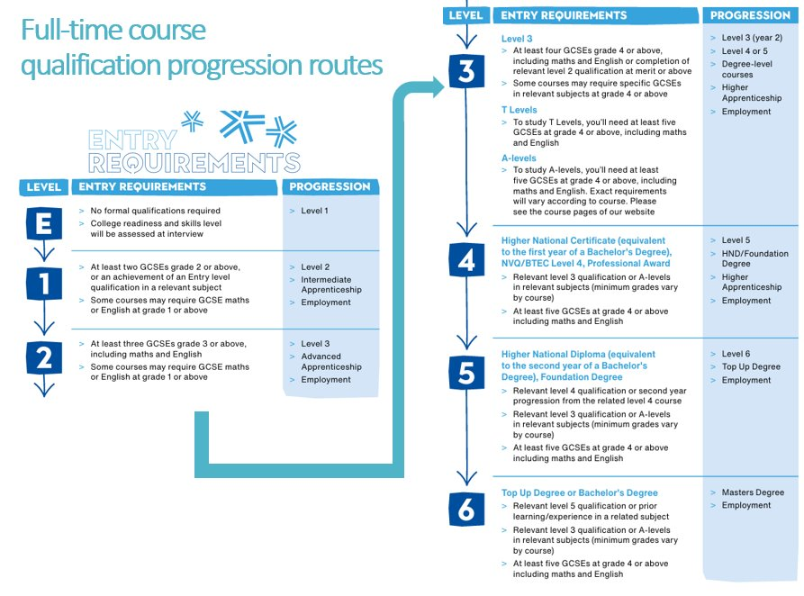

Slide 23


Slide 24


Slide 25
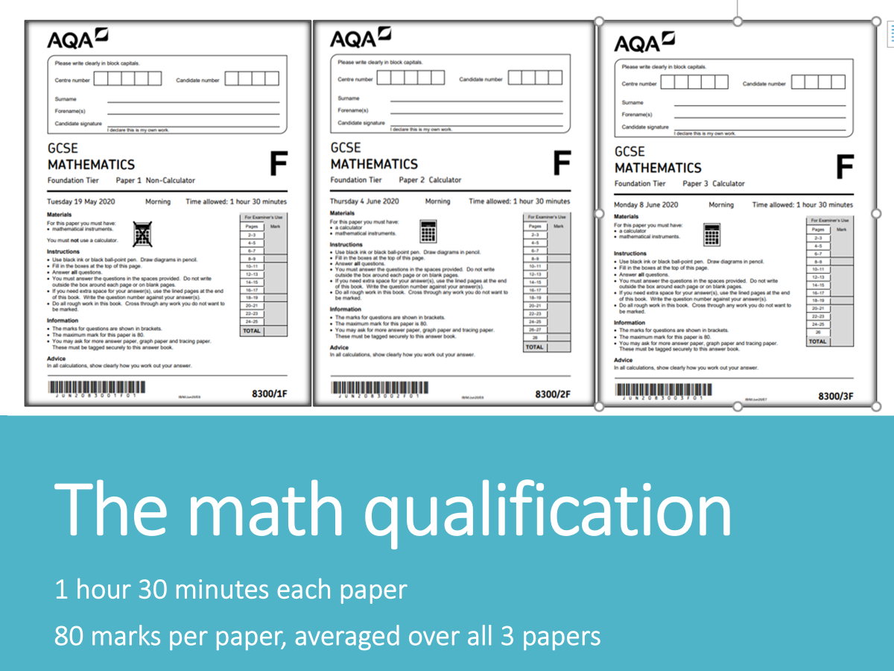
About the maths and English courses

Slide 26
The maths qualification
1 hour 30 minutes each paper
80 marks per paper, averaged over all 3 papers

Slide 27
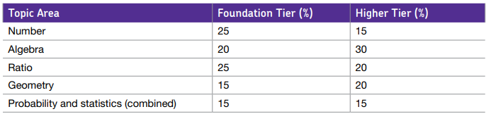

Distribution of math marks

Slide 28
Work Experience
We encourage all students to gain employment within the hospitality industry. We have a dedicated TEAMS page where job adverts are posted
All students will be required to find a minimum of 1 day a week work experience throughout the year
Additional experiences will take place throughout the year where we take the students off site, please ensure that you fill in the required consent forms and return them during induction week

Slide 29










Employers include:

Slide 30
Chef and Front of House Uniforms
Uniforms will be available to purchase from 1st August you will find the order forms with the Starting in September information
Go bigger not smaller (except for shoes)
Uniform must be taken home and washed after use and brought back clean and ironed.
Students are unable to be assessed if they do not have the correct uniform and may not be able to access classes
Students claiming the LSG will have their uniform covered by their grant
Please make sure your name is clearly marked in all uniform

Slide 31

Jewellery, Nails, Personal Hygiene and Phones
Department policy is that we work to best practice as directed by Environmental Health
During induction you will be given a document to sign and return for personal hygiene rules
Nails-clean short, no nail varnish or fake nails
Jewellery-only permissible jewellery is a plain wedding band everything else must be removed before class
Phones to be kept in lockers and not in the kitchen
48-hour rule for V&D and infectious illness

Slide 32
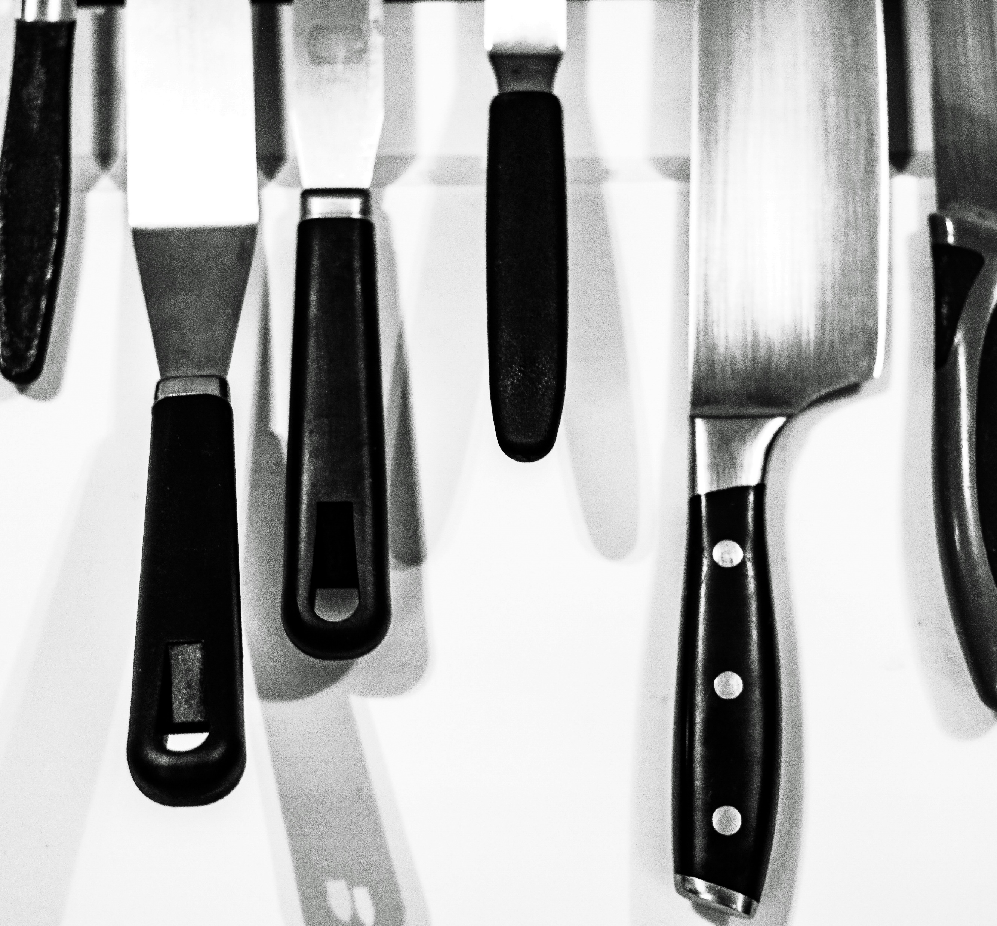
Knives
All learners studying a professional kitchen qualification will have their own set of knives included in their kit.
These knives will be engraved with the student’s initials
Knives are to stay on site in the student’s locker during term time and taken home during college breaks.
It is illegal to carry a knife in a public place without a good reason.
Maximum penalty for carrying a knife in public is 4 years in prison

Slide 33

Progression
For automatic progression you will need
Completion of all elements of your study program
Attendance across all classes of a minimum of 90%
An improvement of at least 1 grade in any GCSE Math or English taken
A planned work experience placement of at least 1 day per week

Slide 34



Planned Residentials
We are currently planning the following residentials for next year
This year's trips included
New York
Sorrento
St Lucia
Disneyland Paris

Slide 35

Thank you for listening
Any Questions
You now have the opportunity to speak to your study program leader, have a look at the kitchens if you have not had a chance to already, and chat to some of your new classmates.

Slide 36


Thank you for listening
Any questions?
You will now speak to one of our team members about your personal application
If you have not already had an opportunity to have a look around our kitchens, please let us know.

