Slide 1
Chichester College Photography Transition Task
Name:_____________________

Slide 2
Overview
To get you thinking about how you can use your camera to document the world around you, we have devised four photographic tasks for you to complete. The aim of these tasks is to show us how you see the world, and how imaginative you can be when image making.
For each section we have supplied you with artists to give you some potential influences of how to approach the task, however, feel free to interpret the brief in your own creative way.
Please Complete:
Define a person without showing their face
Present order amongst chaos
Create a photo of a thing that makes me question what it is
Take me on a journey
Feel free to insert additional slides to show additional images taken or any editing process.

Slide 3
Define a person without showing their face
Insert Image
Why have you chosen to photograph this part of the person?
How does this say something about them?

Slide 4
Present order amongst chaos
Insert Image
Have you chosen order or chaos?
Why have you chosen this?
How does your photograph show order/chaos?

Slide 5
Create a photograph of an object that makes me question what it is
Insert Image
What made you select this object?
How have you photographed it to alter the perspective of it/way it looks?
Why is it successful?

Slide 6
Take me on a journey
Insert Image
Insert Image
Insert Image
Where have you decided to photograph? Why?
Why have you chosen these places/people/objects to photograph?
How do the images present a story/narrative of the journey?
Insert Image
Insert Image
Insert Image

Slide 7
Things you will need to start the A-Level:
General pencil case containing standard classroom equipment
Pens/Pencil/Ruler/Glue/Highlighters/etc
DSLR (Digital SLR camera) / Mirrorless camera
Camera needs to be able to be manually controlled.
Preferably have an 18-55mm (or similar) lens.
We use Nikon DSLR’s Cameras mostly but do have some lenses available for Canon Cameras. This means that when buying a camera, we advise that you stick to these two main brands.
If wishing to purchase a camera good second-hand sellers include:
WEX
MPB
SD Card / Card Reader / Cable to transfer images
Access to a Cloud storage device / 16GB+ USB memory stick or portable hard drive
35mm film SLR camera
This will not be needed before January 2025
If you possess a 35mm SLR Camera and would like us to check it, we can look over the camera to ensure it functions correctly.
Having your own SD Card, SD card reader and case for your SD card is essential.

Slide 8
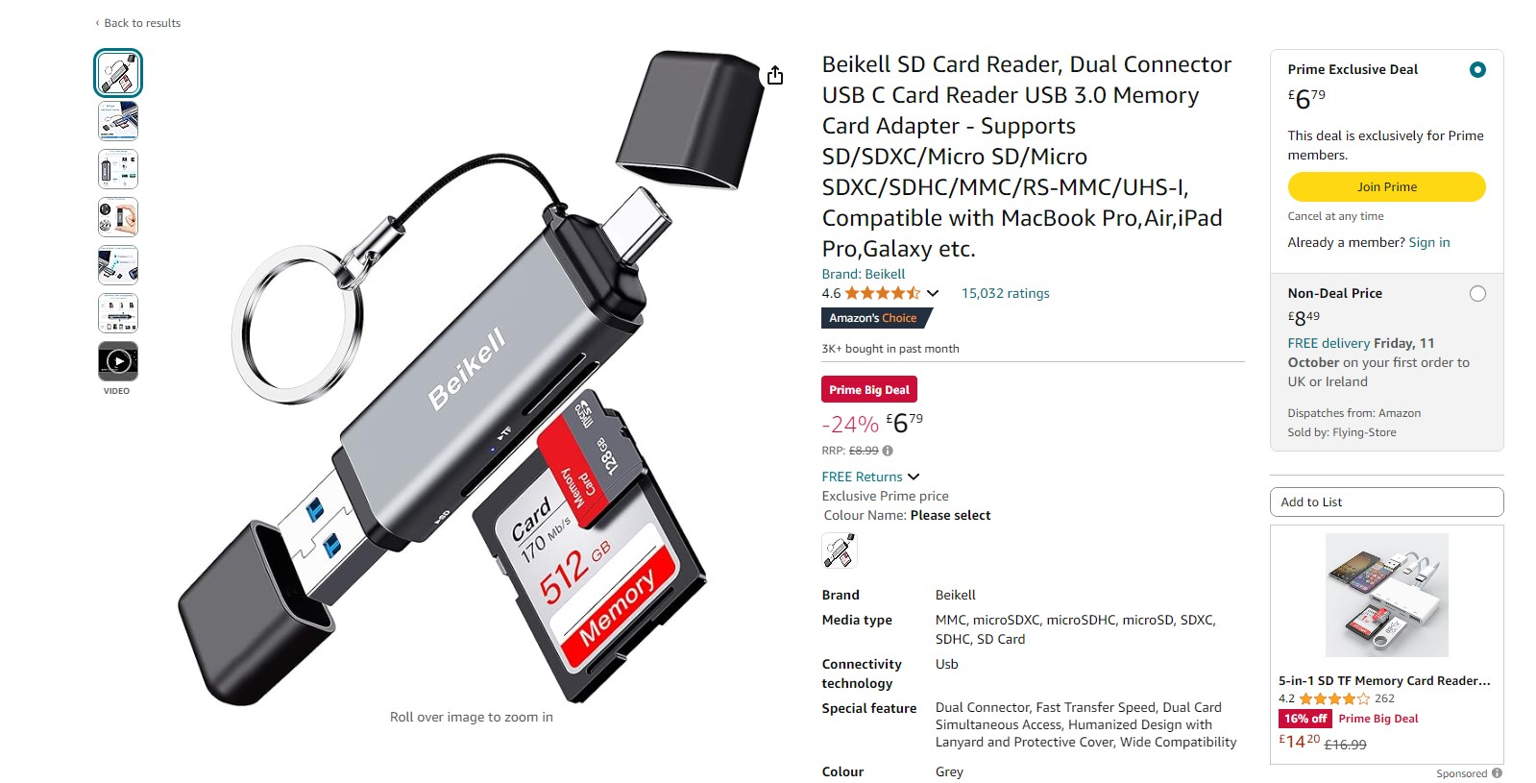
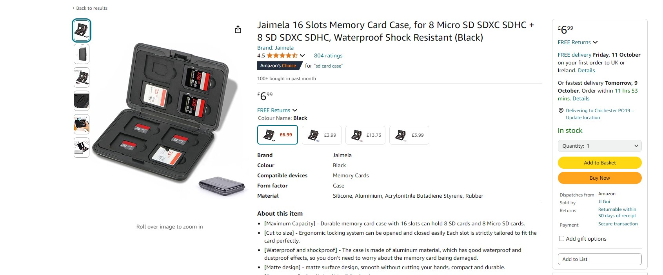
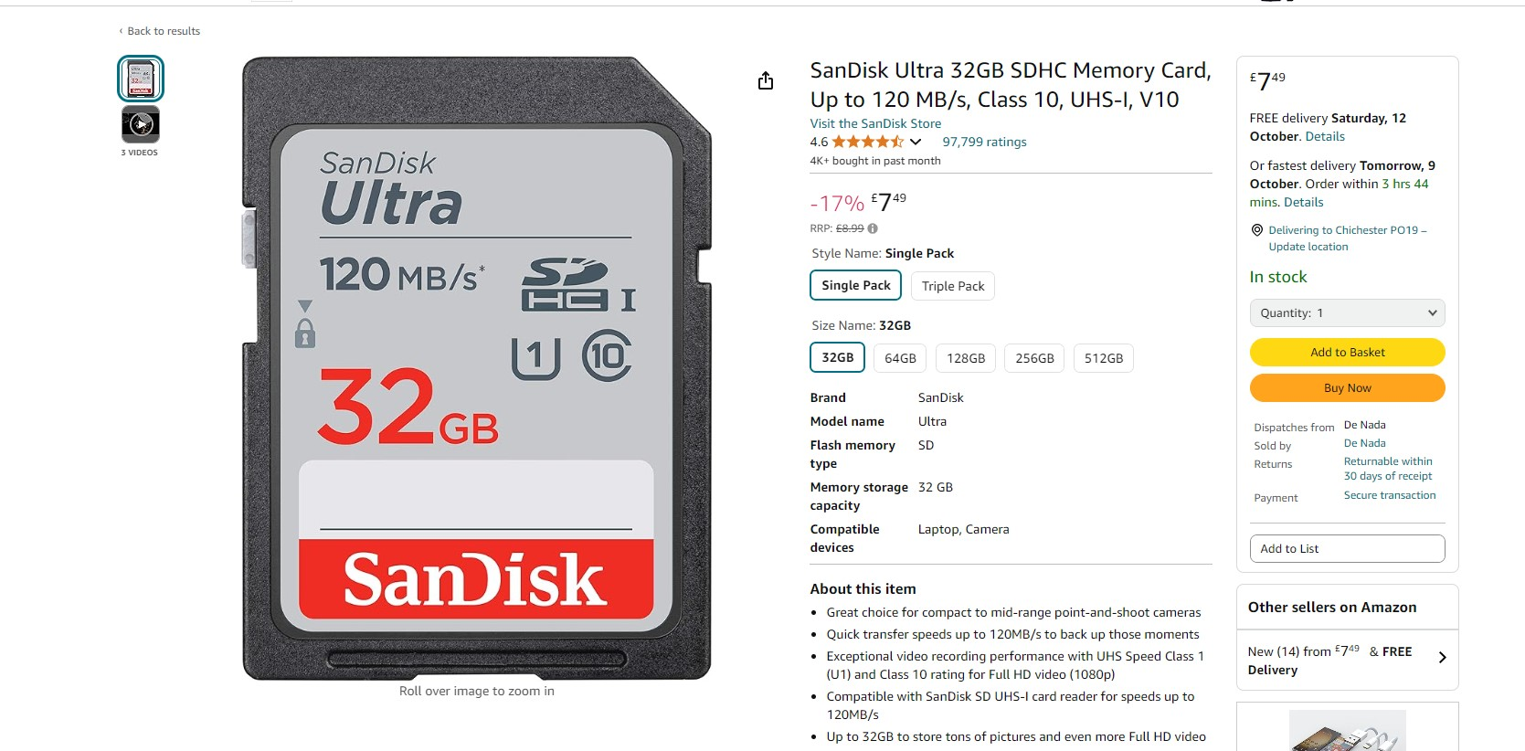
Three items you will need for this course
An SD Card (Maximum 32gb card)
An SD card reader
An SD card case to protect your SD cards when not in camera
(If you need any help or advice on these purchases then we can assist in Induction week)
se

Slide 9
Other things to think about
ADOBE SOFTWARE
Students can access all the Adobe Creative Cloud packages whilst on the college site, both in the classrooms and in the library and open access (college computer suite).
If you wish to purchase your own version of Adobe CC (Photoshop/Etc), then you purchase this via Adobe, please ensure that you use the student discount. This brings the price the £16.24 per month and is a 12-month contract.
PHOTOGRAPHIC KIT:
We will also inform you at the start of the year of the price of the Photography Kit, this is calculated yearly but will most likely cost between £25-£40. This covers some basic art materials, Photographic 35mm Film, Photographic Darkroom Paper and Chemistry needed for the darkroom.

